Slide 1
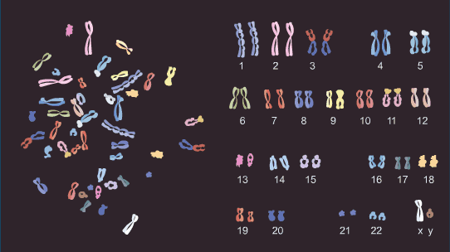
Karyotype And Its Evolutionary Changes

Slide 2
Why do scientists look at chromosomes?
Scientists can diagnose or predict genetic disorders by looking at chromosomes.
This kind of analysis is used in prenatal testing and in diagnosing certain disorders, such as
  Down syndrome,
  or in diagnosing a specific types of leukemia.

Slide 3
What is a Karyotype?
A display / photomicrograph of an individual’s somatic-cell metaphase chrs are arranged in a standard sequence (based on number, size, type)
To analyze chromosomes, cell biologists photograph cells in mitosis =fully condensed and easy to see (usually in metaphase).
Chromosomes are then arranged in homolog pairs.
The homologous pairs are then placed in order of descending size. sex chrs are placed at the end.
They are numbered according to size
A picture of chromosomes arranged in this way is known as a karyotype.
The karyotype is a result of a haploid sperm (23 chrs) fertilizing a haploid egg (23 chromosomes).

Slide 4
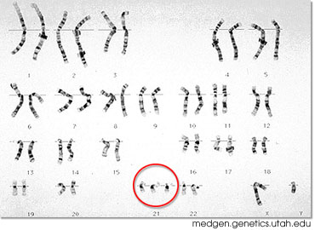
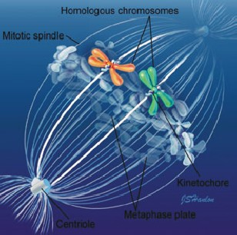
Preparing a karyotype
harvest cells
culture cells 1-2 days
arrest cells in metaphase with colchicine
“spread” cells on slide and stain
count chrs in 20 representative cells
capture image of 5 “best” cells
photograph is taken or the analysis is done by a computer.
construct karyotypes for each
Chromosomes are arranged in a standard presentation format of longest to shortest.
metaphase

Slide 5
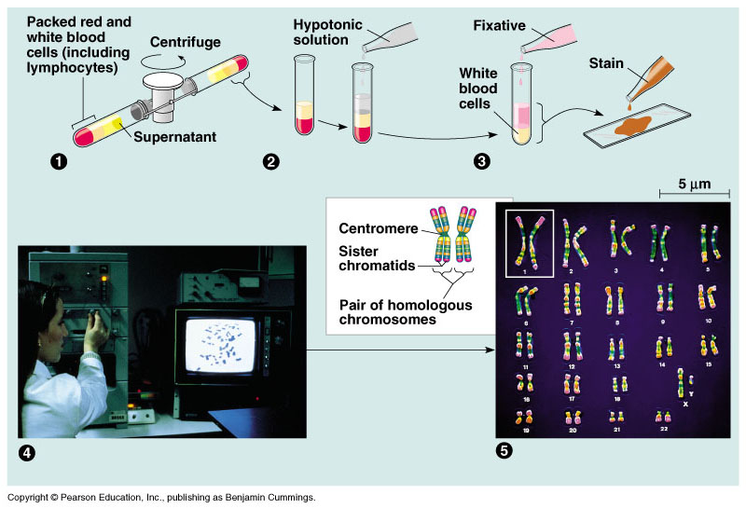
How are DNA samples obtained for karyotypes?

Slide 6
Labeling a Karyotype
To label a karyotype correctly, first list the number of chromosomes found in the karyotype. Ex. 46
Secondly, list the type of sex chromosomes found in the karyotype. Ex. XX
Lastly, list the any abnormalities at the appropriate chromosome number.
Arm
Region
Band
Subband
3
2
2
2
1
p
1
2
1
1
5
1
4
3
2
1
1
17
q
1
1
.
2
1
2
1
3
2
1
2
q
3
3
1
2, 3
4
2
1
4
2
3
Chromosome 17

Slide 7
The Karyotype: an international description
total number of chromosomes,
sex chromosome constitution,
anomalies/variants.
46,XY
47,XX,+21 Trisomy 21 (Down syndrome)
47,XXX Triple X syndrome
69,XXY Triploidy
45,XX,der(13;14)(p11;q11) Robertsonian translocation
46,XY,t(2;4)(p12;q12) Reciprocal translocation
46,XX,del(5)(p25) Deletion tip of chromosome 5
46,XX,dup(2)(p13p22) Duplication of part of short arm Chr 2
46,XY,inv(11)(p15q14) Pericentric inversion chromosome 11
46,XY,fra(X)(q27.3) Fragile X syndrome
46,XY/47,XXY Mosaicism normal/Klinefelter syndrome

Slide 8
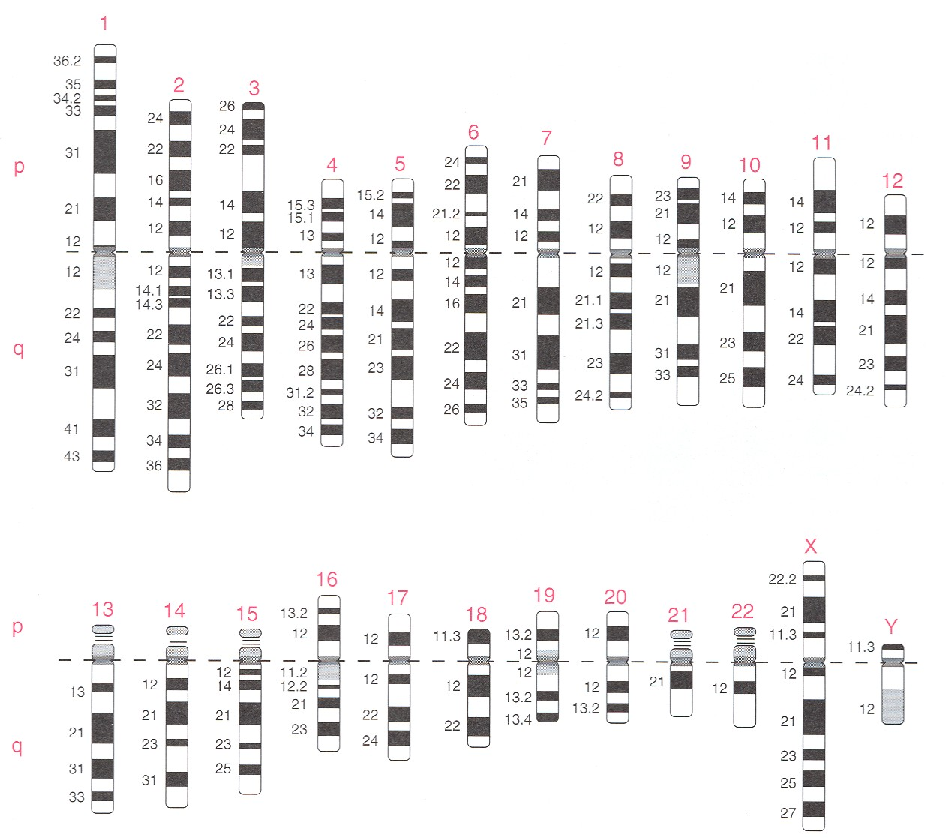
Nomenclature of cytogenetic bands.
The ideograms show ideal G-banding patterns at 550 band resolution. Major bands are labelled 1,2,3, etc., going from centromere to telomere.
Major band 11q1 (11q means the long arm of chromosome 11, 11p the short arm) is divided into sub-bands 11q11 – 11q14, and at the highest resolution 11q14 splits into 11q14.1 – 11q14.3.

Slide 9
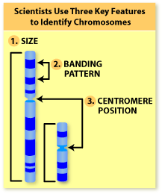
How Do Scientists Identify Chromosomes?
Three key features to identify their similarities and differences:
  Size. This is the easiest way to tell two different chromosomes apart.
  Banding pattern. The size and location of Giemsa bands on chromosomes make each chromosome pair unique.
  Centromere position. Centromeres are regions in chromosomes that appear as a constriction.
Using these key features, scientists match up the 23 pairs

Slide 10
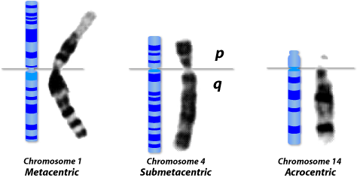
In metacentric chromosomes, the centromere lies near the center of the chromosome.
Submetacentric & very Submetacentric chromosomes, have a centromere that is off-center, so that one chromosome arm is longer than the other.
In acrocentric chromosomes, the centromere resides very near one end.

Slide 11
Chromosome Groups
Group | Chromosomes | Description
A | 1–3 | Largest; 1 and 3 are metacentric but 2 is submetacentric
B | 4,5 | Large; submetacentric with two arms very different in size
C | 6–12,X | Medium size; submetacentric
D | 13–15 | Medium size; acrocentric with satellites
E | 16–18 | Small; 16 is metacentric but 17 and 18 are submetacentric
F | 19,20 | Small; metacentric
G | 21,22,Y | Small; acrocentric, with satellites on 21 and 22 but not on the Y
Autosomes are numbered from largest to smallest, except that chromosome 21 is smaller than chromosome 22.

Slide 12
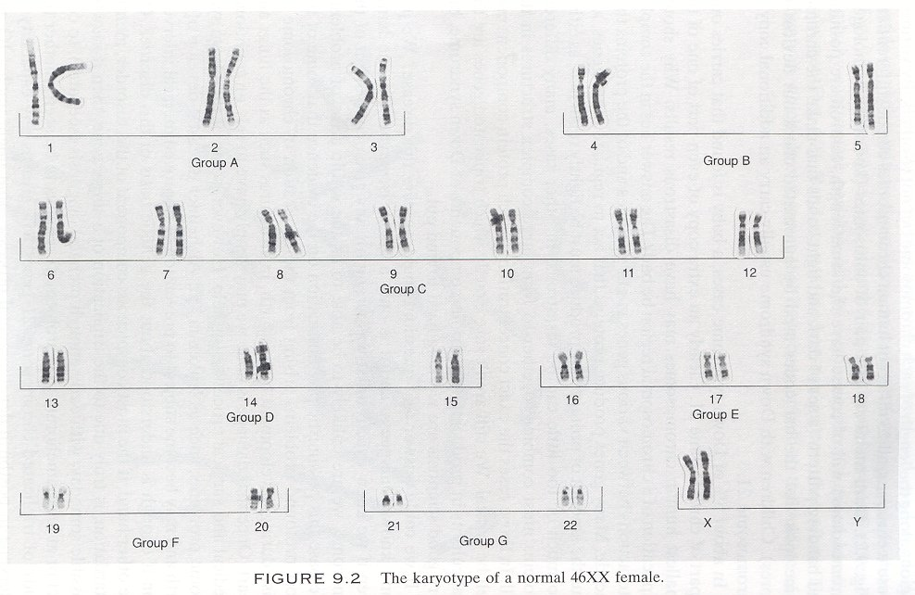

Slide 13
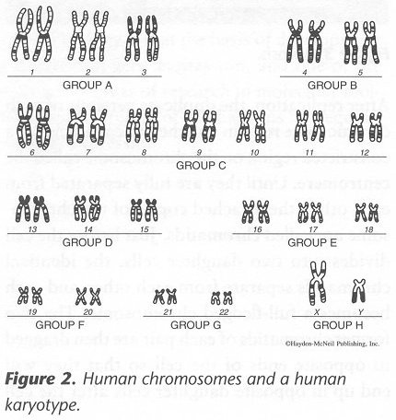
Patau
Edwards
Turner, Klinefelter
Down

Slide 14
Applications of karyotypes
To identify genes that contribute to the chromosome-related syndromes
In systematic and phylogenetic studies
For example,
humans 2n = 46, chimps 2n = 48
9 pericentric inversions + 1 centric fusion
Humans differ from closest relatives by 9 pericentric inversions and 1 centric fusion

Slide 15
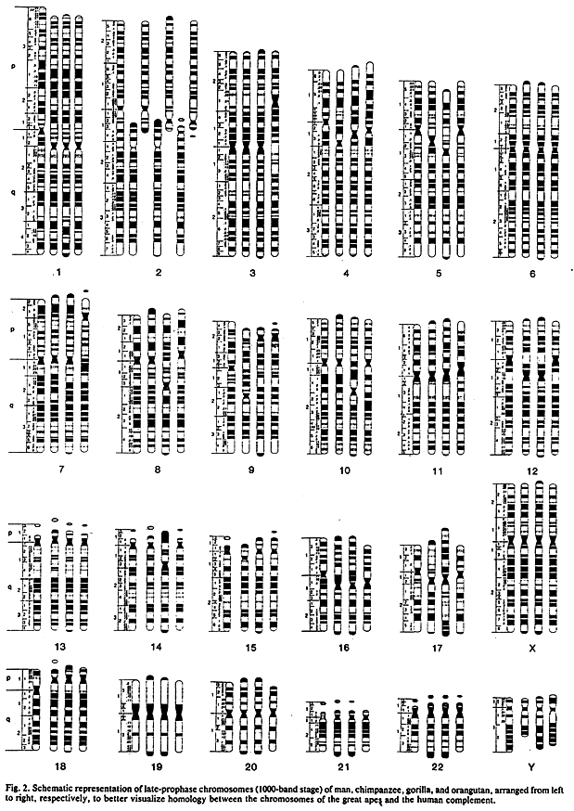
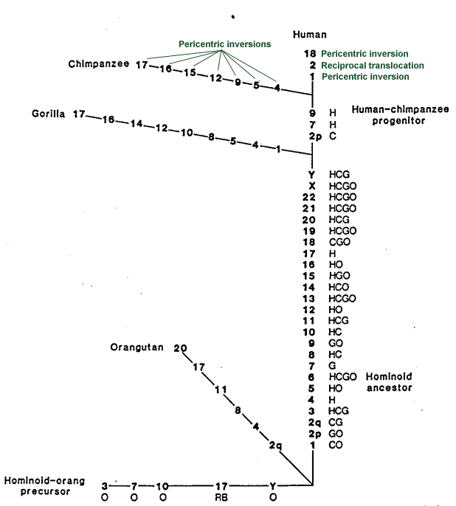
Humans and great apes
9 pericentric inversions, and one reciprocal translocaton
from Yunis & Prakash (1982)
Science 215, 1525-1530.

