Slide 1
Maintenance and Installation of Machinery
Debre markos University Institute of Technology
School of Mechanical and Industrial Engineering

Slide 2
Chapter two 2. Fundamentals Theory of Damages
Damages are causes for the loss of function ability or workability of a means of production, if proper action is not taken against them.
Even with optimum design and operation conditions damages are unavoidable.
Thus damages are the reasons for the existence of a maintenance organization.

Slide 3
2.1. Classification of Damages:
The value of equipment or a means of production is affected by two processes. These are technological processes and technical and economical processes.
Processes reducing
Use - value
Technological process
(change of state)
Technical -economical
processes
Damage
Obstacles
Wear
Overload
Others
-fire, pests
Wear
Wear
Wear
Wear

Slide 4
2.2. Reasons of damage
Damage is influenced by environmental conditions and conditions of use of equipment.
For proper maintenance work, it is necessary to make systematic analysis of damages which includes discussions on reasons for damages and their consequences.
The conclusions obtained are feedback to designers, manufactures and operational maintenance personnel.

Slide 5
.....cont’d
Reasons for damages can basically be classified as follow:-
Objective: Those are damages caused by operational processes and environmental causes. These damages are unavoidable.
Subjective: These are caused by failure in design, manufacturing, and maintenance.
If an equipment or a means of production is handled appropriately, subjective damages can be avoided.

Slide 6
2.3. Typical Damages of Equipment
The changes of state or damages, as are commonly known, that result from technological processes are basically classified into three. These are; corrosion, wear & tear, and fatigue.
2.3.1 Corrosion
Corrosion is the destruction or deterioration of materials by chemical or electrochemical reaction with the environment. This includes the destruction of metals in all types of atmospheres and liquids, and at any temperature.

Slide 7
....cont’d
Corrosion reduces the useful life of equipment. And about 5% of yearly production of steel is destroyed by corrosion.
Under most ordinary conditions of exposure, corrosion products consist mainly of oxides, carbonates and sulphids.

Slide 8
The processes of corrosion
The process of corrosion takes place due to direct chemical action when the metal enters into a chemical reaction with other elements to form nonmetallic compound or due to electrochemical action.
Metallic elements when placed in contact with water or a solution have definite inherent tendencies to go in to the solution in the form of electrically charged particles.

Slide 9
.....cont’d

Slide 10
.....cont’d

Slide 11
Kinds of corrosion
Corrosion is classified by the forms in which it manifests itself, the basis for this classification being the appearance of the corroded metal, which can be identified by visual observation
i. Surface corrosion
ii. Pitting corrosion
iii. Inter-crystalline corrosion (around the grain)
iv. Trans-crystalline corrosion (across the grain)
v. Galvanic corrosion (two metal corrosion)

Slide 12
Common locations of corrosion
• Common locations where problems of corrosion can be found are the following:-
– Along the water-line in partially filled tanks,
– In and around drops of water on steel surfaces,
– Along crack lines ,
– Along joints, particularly in dissimilar metals, and
– Along cold-worked areas like bending, sharp ends, etc.

Slide 13
Methods of minimizing corrosion
• From the point of view of maintenance, damages caused by corrosion have to be dealt with preventively.
Some of the methods of minimizing of corrosion are the following
– Use of protective metals such as zinc, tin, lead, etc.
– Application of protective paints,
– Rendering the surface of the metal passive (immersing in nitric acid after it has been highly poised immersing in fuming sulfuric acid)

Slide 14
Corrosion problems
Corrosion problems are pronounced, to a varying degree, in:-
– Steam generating plants,
– Equipment in chemical plants ,
– Pipes and piping ,and
– Structures.

Slide 15
2.3.2. Wear
• Wear is an undesired change of surface of machine components by the removal of little particles caused by mechanical reasons and/or tribo-chemical reasons.
(tribology is the science of interacting surfaces in relative motion)
Mostly wear is caused by friction of two mating parts Thus
- There must be a pair of contacting wear partners ( a basic body and a mating body)
- A normal force must act maintaining contact between the two bodies
- There must exist a relative motion b/n the two surfaces

Slide 16
.....cont’d

Slide 17
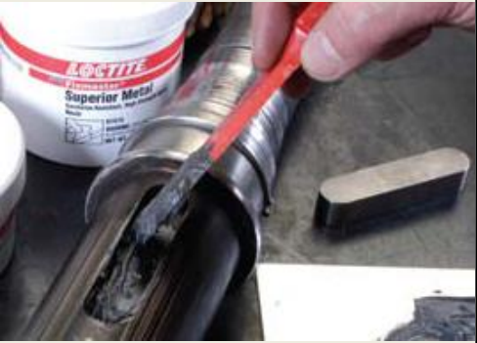
Kinds of wear
The whole field of wear which is diverse is divided in two limited area with similar condition
i. Depending of the relative motion of mating parts
a. Kinematic wear
Sliding
Rolling
Drilling
Mixed
b. Static wear
c. Impact

Slide 18
ii. Depending on the time behavior of wear there are two kinds of wear:-
a. Stationary wear – in which the wear intensity remains constant
b. Non-stationary wear – in which the wear intensity depends on time
Wear processes
The wear process is a complex one being dependent on a number of factors :
load,
velocity,
intermediate materials,
ambient condition, etc.
Wear processes are accompany by heating in the micro-range as well as changes in the physical and chemical material properties of the wear partners.

Slide 19
Wear processes can be differentiated as
i. Shearing process
roughness points will be sheared off if the acting forces are greater than the shear strength. This leads to the reduction of roughness and increased percentage of contact area which reduces energy concentration and wear velocity .
ii. Elastic deformation
big surface roughness results in low percentage of contact area and high energy concentration in contact point. This may result in high local stresses in the elastic range this causes small flattening or bending of roughness points. Repetition of this process will cause local fatigue of material.

Slide 20
....cont’d
iii. Plastic deformation
If local stress produced exceeds the elastic limit, plastic deformation takes place in flattening and bending the material with no loss in mass.

Slide 21
Wear types
Depending on the presence of lubricants and/or lack of it, wear types are classified into the following.
i. Wear by solid friction
Solid friction occurs between the contacting surfaces of two bodies having relative motion where there is no intermediate material.
ii. Wear by liquid friction
In the case of liquid friction the two mating bodies are completely separated from each other by an intermediate material, mostly a lubricant.

Slide 22
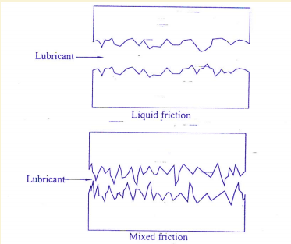
....cont’d
iii. Wear by mixed friction
Simultaneous action of solid and liquid friction, caused by high roughness or high load for the lubricating film causes wear by mixed friction.
Schematically these wear types are shown.

Slide 24
....cont’d

Slide 25
Time- behavior of wear
Amount of wear depends on time according to the equation
ℎ = ℎ𝑜+ ℎ′.$t^{a }$
where
a is exponent of wear behavior ,
ℎ is amount of wear,
ℎ′ is wear velocity, and
ℎ𝑜 is the initial wear.
t is time

Slide 26
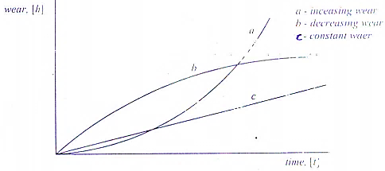
....cont’d
Depending on a, assuming the initial wear ℎ𝑜 = 0, the wear behavior with time can be increasing, decreasing or constant. These three wear behaviors With time are shown in the figure below.

Slide 27
Protection against wear:
The main protection measure against wear is lubricating of the moving parts. A lubricant is the intermediate material between two parts with relative motion for the purpose of reducing friction and/or wear between them. Proper lubrication with timely.
Addition/replacement of lubricant plays a vital role in maintaining machine accuracy and increasing its working life.

Slide 28
Classification of lubricants
Lubricants are in the form of lubricating oils, grease and solid lubricants.
i. Lubricating oils
Lubricating oils are of two types: mineral and synthetic oils.
In addition to preventing or minimizing wear, lubricating oils perform the following duties:
– Cooling by reducing friction and removing excess heat generated
–Protection by inhibiting corrosive processes caused by air and water
– Cleaning by flushing dirt particles away from lubricated surfaces

Slide 29
A, Mineral oil
Minerals oils are basically hydrocarbons often with some additives to introduce specific characteristic features in the oil. Mineral oils are classified as:-
– Paraffinic:- which contain significant amounts of waxy hydrocarbons with little or no asphaltic matter;
– Naphthenic:- which contain asphaltic matter in fraction, with little or no wax;
– Mixed base:- which contain asphaltic materials

Slide 30
.....Cont’d
The most important physical property of mineral oils is viscosity which is a measure of resistance to flow .
Other important lubricant properties are the following
– Anti-wear and EP (extreme pressure) properties
– Oxidation resistance
– Ant-corrosion properties
– Anti-foaming property; and
– Ability to separate from water)

Slide 31
B, Synthetic oils
Synthetic oils are products produced under controlled conditions from chemical base and additives.
Synthetic oils are engineered to perform under rigorous conditions and extreme temperature.
The most important properties of synthetic oils are the following:
– Added lubricity
– Higher film strength
– Good engine start-up properties
– Good resistance to thinning:

Slide 32
.....cont’d
– Improves energy efficiency
– Less sludge or deposit formation
– Good thermal properties:
Because of their properties, synthetic oils are used for high speed lubrication under extreme loading conditions.

Slide 33
...cont’d
Because of their properties, synthetic oils are used for high speed
lubrication under extreme loading conditions.
However, synthetic oils have some disadvantages and these are:
• Compativity problem with paints, elastomers and certain metals;
• Reactive in the presence of water resulting in hydrolysis and
corrosion;
• High potential for toxicity;
• Disposal problem due to un-degradable molecular structure;
• More expensive;

Slide 34
ii. Greases
Grease may be defined as:-
solid to semi-fluid lubricant consisting of a dispersion of a thickening agent in a lubricating fluid.
The consistency of grease depends
Depending on the degree of consistency, greases are classified as:-
• Semi-fluid
• Soft
• Stiff

Slide 35
.....Cont’d
In selecting grease for use, considerations must be given to conditions and nature of use including:-
The first thing to be decided is the consistency range.
Next comes the operating temperature.
Use of greases is limited to very low speeds up to 2m/s.

Slide 36
iii. Solid lubricants:
A solid lubricant is defined as any solid used as powder or a thin film on a surface to provide protection from damage during relative motion so as to reduce friction and wear . Solid lubricants are used when fluid lubricants. i.e. oils and greases, are undesirable or ineffective.
Fluid lubricants are undesirable if they are liable to contaminate product as in food machinery, electrical contacts, etc. fluid lubricants are ineffective in hostile environments, high temperatures and extreme pressures.
A common type of solid lubricant is graphite.

Slide 37
.....Cont’d
The following are some properties of solid lubricants:
– Solid lubricants are incapable of carrying away heat.
– Solid lubricants are immobile and they must somehow be bonded to the surface.
– Solid lubricants are capable of retaining their lubricating effectiveness at high temperatures.

Slide 38
2.3.3. Fatigue
Fatigue is the failure (or reduction in strength) of a material under fluctuating stresses, which are repeated a very large number of times.
Fatigue failure begins with a hair-line crack which develops at a point of discontinuity in the material (notches, groves, fillets,…). Once a small crack develops, it propagates under load to cause failure.
Components subjected to fluctuating forces must be designed for fatigue conditions. Surface conditions, residual stresses due to metal working processes or metal – treating processes, stress concentration affect strength very much. Hence, they should be considered properly at design stage.
Fatigue strength (the endurance limit) of materials is greatly decreased by the presence of a corroding medium.

Slide 39
End of Chapter Two

