Slide 1

DEBRE MARKOS UNIVERSITY
INSTITUTE OF TECHNOLOGY
SCHOOL OF MECHANICAL & INDUSTRIAL ENGINEERING
Course Title | Maintenance & installation of Machinery
Course Code:- | MEng 5231
Credit Hours:- | 3
Degree Program | B.Sc. in Mechanical Engineering
Academic year:- | 2012 E.C
Year & Semester:- | Fifth year second semester
Pre-requisites:- | Senior standing course

Slide 2
Objective
The course is intended to enable the student to:-
Understand theoretical and practical aspects of maintenance practice in industrial setup;
Understand basics of damages of typical components of machinery and thereby
help the student realize the state of damage of machinery;
Realize the use of the concepts of reliability, maintainability and availability in maintenance technology which are helpful in the prediction of plant performance;
Understand the organization of a maintenance department, maintenance
planning and decision making processes, Develop practical skill by providing
some practical work of maintenance;

Slide 3
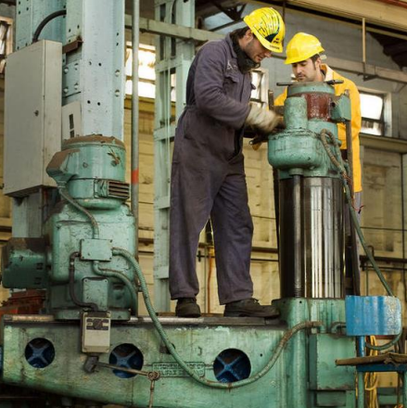
Chapter one
Introduction

Slide 4
1.1 Basics of Maintenance
MAINTENANCE FACTS AND FIGURES
Each year over $300 billion are spent on plant maintenance and operations by U.S. industry, and it is estimated that approximately 80% of this is spent to correct the chronic failure of machines, systems, and people.
In 1970, a British Ministry of Technology Working Party report estimated that maintenance cost in the United Kingdom (UK) was approximately £3000 million annually.
Annually, the cost of maintaining a military jet aircraft is around $1.6 million; approximately 11% of the total operating cost for an aircraft is spent on maintenance activities.

Slide 5
WHAT IS MAINTENANCE?
Maintenance: Keeping something in good condition by checking or repairing it regularly (Oxford Dictionary)
Maintenance consists of those activities required to keep a facility in original (i.e. as-built) condition so that its designed productive (or performance) capacity remains unchanged.
Maintenance can be defined as a combination of actions carried out to repair, replace or service the components with an aim to bring the servicing unit to original (or as original) condition so that it can operate designed capacity for a specified period of time.

Slide 6
In other words, maintenance can also be defined as follows
Maintenance is the totality of all measures directed towards control (preservation and restoration) of the performance of a plant.
It is an auxiliary process in a production process directed towards a high effectiveness of the main process.

Slide 7
1.2 Trends in the Evolution of Maintenance
According to John Moubray , author of Reliability Center Maintenance, the evolution of maintenance since the 1930’s can be traced through three generations.
The distinction between these generations depends up on basically three technical factors:
    Growing expectations of maintenance,
    Changing view on equipment failures, and
    Changing maintenance techniques

Slide 8
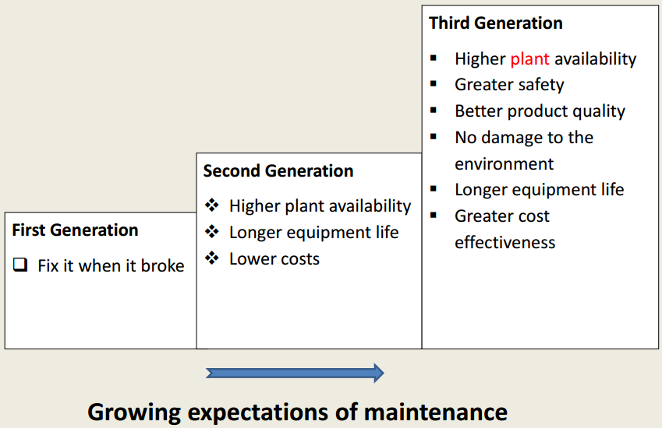

Slide 9
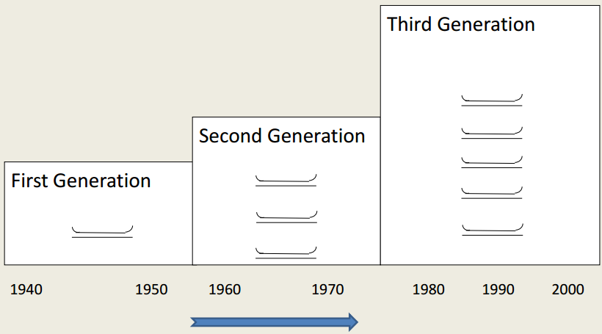
Changing view on equipment failures

Slide 10
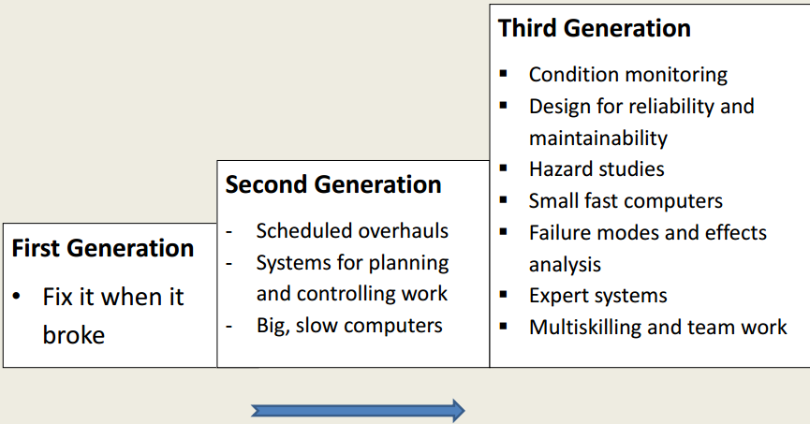
Changing maintenance techniques

Slide 11
First Generation
This covers the period up to the world war II. During this period:
– Industry was not highly mechanized
– Equipment Was not highly mechanized
– Downtime did not matter much
– Prevention of equipment failure did not have high priority
– Failures were corrected as they occur
As a result, there was not need for systematic maintenance beyond cleaning, servicing and lubrication.

Slide 12
Second Generation
During the war, demand for good increased and supply of industrial outputs was low.
This led to increase in mechanization. During this period:
  Machines became numerous and more complex,
  Industry started to depend heavily on these machines Downtime started to matter,
  The idea the equipment failures could and should be maintained came up
As a result, the concept of preventive maintenance and maintenance planning and control systems grew up.

Slide 13
Third Generation
Since the mid-seventies, new expectations, new research and new
techniques have revolutionized maintenance. During this period:
  Maximizing life of equipment has become important
  Higher plant availability and reliability have become very important
  Greater automation has been effected
  Quality standards, safety and environmental consequences matter quite a lot
  Cost of maintenance has become central
  Greater expectations have lead to new research which in turn are leading to new techniques

Slide 14
1.3 Maintenance Objectives
Maintenance objectives should be consistent with and subordinate to production goals.
The relation between maintenance objectives and production goals is reflected in the action of keeping production machines and facilities in the best possible condition.

Slide 15
The basic objectives of maintenance are:-
Maximizing production at the lowest cost and at the highest quality and safety standards.
Reducing breakdowns and emergency shutdowns.
Optimizing resources utilization.
Reducing downtime.
Improving spares stock control.
Improving equipment efficiency and reducing scrap rate.
Optimizing the useful life of equipment and
Identifying and implementing cost reductions.

Slide 16
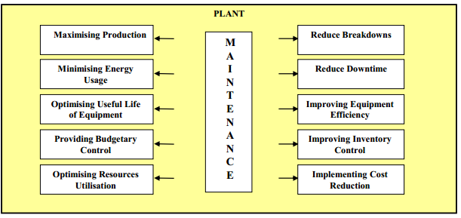
Figure Maintenance Objectives

Slide 17
1.4 Types of Maintenance
Different authors categorize maintenance in variety forms. The most acceptable ones is
  Planned maintenance
  Unplanned maintenance

Slide 18
TYPES OF MAINTENANCE
Maintenance
Planned Maintenance or Scheduled Maintenance or
Systematic Maintenance or Routine Maintenance
Unplanned Maintenance
Preventive Maintenance
Corrective Maintenance
Running Maint.
Predictive Maint.
Shutdown Maint.
Design Out Maint.
Shutdown Maint.
Breakdown Maint.
Emergency Maint.

Slide 19
PLANNED OR SCHEDULED MAINTENANCE
It is basically done for two purposes:
To prevent the occurrence of breakdown and
If breakdown has occurred then to restore it to original condition

Slide 20
A. PREVENTIVE MAINTENANCE
Principle – “Prevention is better than cure”
Procedure - Stitch-in-time
It is done to keep an equipment or machinery in a satisfactory operating condition through regular inspection, calibration, lubrication, overhauling, or replacement of certain components. It is action before breakdown occurs.

Slide 21
ADVANTAGES OF PREVENTIVE MAINTENANCE
  Reduction in downtime
  Reduction in loss of production
  Reduction in repair and replacement cost
  Fewer stand-by equipment required
  Less expenditure on maintenance personnel due to over time
  Fewer parts to be stored
  Higher safety level in the shop
  Planned output possible to maintain

Slide 22
Preventive Maintenance is divided into four categories
Running Maintenance is done even when the machine or equipment is in service.
Shut-down Maintenance is done when the machine is not in use.
Design-out Maintenance: Equipments are designed that no maintenance should be required or at worst least maintenance should be done.
Predictive Maintenance is done on the information received regarding the performance of an equipment or machinery.

Slide 23
B. CORRECTIVE MAINTENANCE
corrective maintenance:- is done to bring the machinery to original performance level, by minor adjustments of certain knobs, or key units or replacing some worn-out parts.
This could be
  Complete failure
  Minor failure

Slide 24
Quite justified in small factories where:
  Down times are non-critical and repair costs are less than other type of maintenance
  Financial justification for scheduling are not felt
  Corrective Maintenance Could be:
  Shutdown Maintenance
  Breakdown Maintenance

Slide 25
TYPICAL CAUSES OF EQUIPMENT BREAKDOWN
Lack of lubrication
Failure of cooling system
Failure to replace worn-out parts
Negligence to rectify minor faults
Too high or too low voltage supply
Wrong fuels used
Uneven working parameters
Unsound foundation, etc.

Slide 26
Disadvantages of Corrective Maintenance
Breakdown generally occurs inappropriate times leading to poor and hurried maintenance
Excessive delay in production & reduces output
Faster plant deterioration
Increases chances of accidents and less safety for both workers and machines
More spoilt materials
Direct loss of profit
Can not be employed for equipment regulated by statutory provisions e.g. cranes, lift and hoists etc.

Slide 27
Maintenance Costs
Cost
Total Maintenance Cost
PM Cost
Breakdown Cost
Optimal
Maintenance
Commitment

Slide 28
1.5 Introduction to Machine Installation
Machine:
It is a device that takes some energy as input and transforms it to another useful form of energy as output.
Machine Installation:
It is the process of fixing and erecting the machinery in an industry so that they can be put to use for productive purposes

Slide 29
Why Machine installation is necessary?
It is the first step in the productive process of any newly established plant.
Where to install machinery?
The installation of light machinery used for domestic use may not require any expertise, where as the installation of the machinery used in the industry need attention as the performance of the machinery largely depend upon proper installation.
How to install machinery?
The installation process may differ from machine to machine and it is largely depend upon the main specifications of the machines to be installed.

Slide 30
Factors to be considered before installing the machinery
It is important that as much information as possible be supplied regarding the machine to be installed, this will include:
    Machine size and weights
    Any dynamic features of its operation
    Location including ground type, condition where optimal performance is required
    Vibration analysis of the machine
    Site conditions

Slide 31
FOUNDATION REQUIREMENTS
A. Building Foundations
Footings and foundations as having two functions:
1. To transfer the live and dead loads of the building to the soil over a large enough area so that neither the soil nor the building will move
2. In areas where frost occurs, to prevent frost from moving the building
Dead loads are the weight of the building materials and the soil surrounding the foundations.
Live loads include the weight of people, furniture, snow, rain, and wind.

Slide 32
B. Machine Foundations
The main purpose of machine foundations is to stabilize the machine as well as to reduce the vibrations caused due to the operation of the machine.
The foundation thus positively influences machine vibration by reducing the amplitude of oscillation.
The first step in machine installation is to find out whether it is required to build a special foundation for installation or it is possible to use the existing floor.

Slide 33
Foundation Requirements for machine installation
If the existing floor, where the machinery is to be installed, does not meet the following minimum requirements, It is required to build a foundation.
The area of the floor where the machine frame is to be located must be a single, homogeneous slab in good condition.
The floor must be 4" to 6" thick (It is not a constant and may change depending upon the type and weight of machinery).
The floor must be capable of supporting 3.5 tons/ft² (This is also not a constant one and may subject to change depending upon the type of machine going to be installed and the floor must be level to 0.032"/ft).

Slide 34
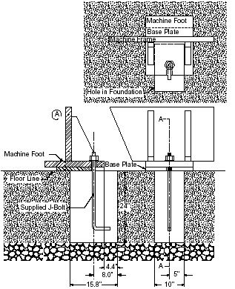
Methods of machine installation
There are two types of machine installations in practice, which include both foundation anchoring and floor installation procedures. The following sections will explain these methods.
1. Foundation Anchoring Procedure
Installing the machine
using foundation & J-bolt

Slide 35
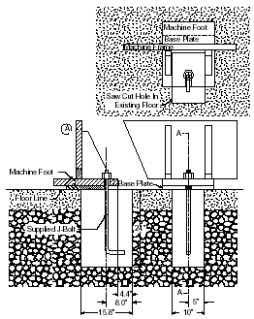
2. Floor anchoring method
Installing the machine using
existing floor & J-bolt

Slide 36

MACHINE LEVELING
Proper Machine leveling is critical in the machine installation for the desired machine performance.
The term leveling, with respect to machinery installation, means the operation of placing machinery or equipment on a true horizontal plane.
The flatness of the floor plays an important step in the levelling procedure of the machine.
ALIGNMENT OF SHAFTS
Proper shaft alignment is achieved when the two centerlines
of coupled machinery are the same or collinear.
There are two types of coupling or shaft misalignment:
angular misalignment and parallel misalignment

Slide 37

Angular misalignment is a condition where two shaft centerlines are at an angle to each other.
Parallel misalignment is a condition where no angular
misalignment exists and the shafts are parallel, but offset
from each other.

Slide 38
Four basic steps are required to correct misalignment:
1. Correct for angular misalignment in the side view plane

Slide 39
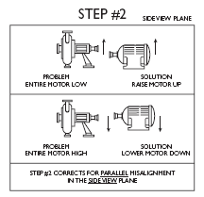
2. Correct for parallel misalignment in the side view plane

Slide 40
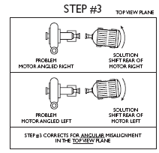
3. Correct for angular misalignment in the top view plane

Slide 41
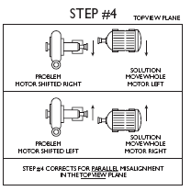
4. Correct for parallel misalignment in the top view plane

Slide 42
CHAPTER- 2
FUNDAMENTALS OF THE THEORY OF DAMAGES
Damages are causes for the loss of functionability or workability of a means of production, if proper action is not taken against them.
Even with optimum design and operation conditions damages are unavoidable.
Thus damages are the reasons for the existence of a maintenance organization.

Slide 43
2.1. Classification of Damages
The use-value of equipment or a means of production is affected by two processes. These are technological processes and technical and economical processes.
Processes reducing
Use - value
Technological process
(change of state)
Technical -economical
processes
Damage
Obstacles
Wear
Overload
Others
-fire, pests

Slide 44
2.2. Reasons of damage
Damage is influenced by environmental conditions and conditions of use of equipment.
For proper maintenance work, it is necessary to make systematic analysis of damages which includes discussions on reasons for damages and their consequences.
The conclusions obtained are feedback to designers, manufactures and operational maintenance personnel.

Slide 45
Cont.
Reasons for damages can basically be classified as follow:-
Objective: Those are damages caused by operational processes and environmental causes. These damages are unavoidable.
Subjective: These are caused by failure in design, manufacturing, and maintenance.
If an equipment or a means of production is handled appropriately, subjective damages can be avoided.

Slide 46
2.3. Typical Damages of Equipment
The changes of state or damages result from technological processes are basically classified into three. These are; corrosion, wear and fatigue.
2.3.1 Corrosion
Corrosion is the destruction of materials by chemical or electrochemical reaction with the environment.
This includes the destruction of metals in all types of atmospheres, liquids, and at any temperature.
Corrosion reduces the useful life of equipment.
About 5% of yearly production of steel is destroyed by corrosion.
Under most ordinary conditions of exposure, corrosion products consist mainly of oxides, carbonates and sulphids.

Slide 47
The processes of corrosion
The process of corrosion takes place due to direct chemical action when the metal enters into a chemical reaction with other elements to form nonmetallic compound or due to electrochemical action.
Metallic elements when placed in contact with water or a solution have definite inherent tendencies to go in to the solution in the form of electrically charged particles.

Slide 48
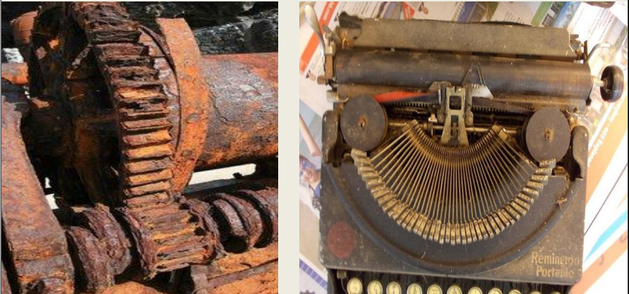
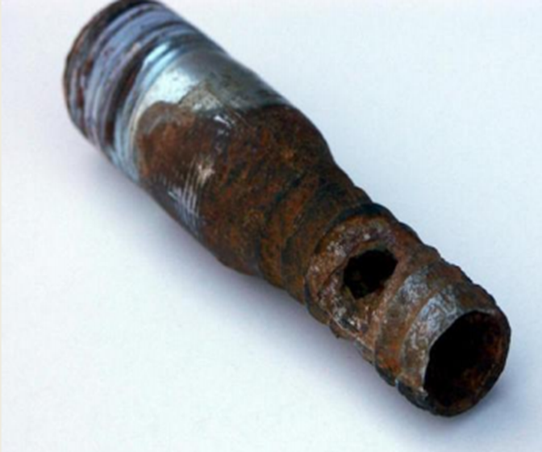
Cont.

Slide 49
Kinds of corrosion
Corrosion is classified by the forms in which it manifests itself,
The basis for this classification being the appearance of the corroded metal, which can be identified by visual observation
i. Surface corrosion
ii. Pitting corrosion
iii. Inter-crystalline corrosion (around the grain)
iv. Trans-crystalline corrosion (across the grain)
v. Galvanic corrosion (two metal corrosion)

Slide 50
Common locations of corrosion
Common locations where problems of corrosion can be found are the following:-
  Along the water-line in partially filled tanks
  In and around drops of water on steel surfaces
  Along crack lines
  Along joints, particularly in dissimilar metals
  Along cold-worked areas like bending, sharp ends, etc.

Slide 51
Methods of minimizing corrosion
From the point of view of maintenance, damages caused by corrosion have to be dealt with preventively.
Some of the methods of minimizing of corrosion are the following
  Use of protective metals such as zinc, tin, lead, etc.
  Application of protective paints
  Rendering the surface of the metal passive (immersing in nitric acid after it has been highly poised immersing in fuming sulfuric acid)

Slide 52
Corrosion problems
Corrosion problems are pronounced, to a varying degree, in:-
  Steam generating plants
  Equipment in chemical plants
  Pipes and piping and
  Structures

Slide 53
2.3.2. Wear
Wear is an undesired change of surface of machine components by the removal of little particles caused by mechanical reasons and/or tribo-chemical reasons.
(tribology is the science of interacting surfaces in relative motion)
Mostly wear is caused by friction of two mating parts Thus
There must be a pair of contacting wear partners ( a basic body and a mating body)
A normal force must act maintaining contact between the two bodies
There must exist a relative motion b/n the two surfaces

Slide 54
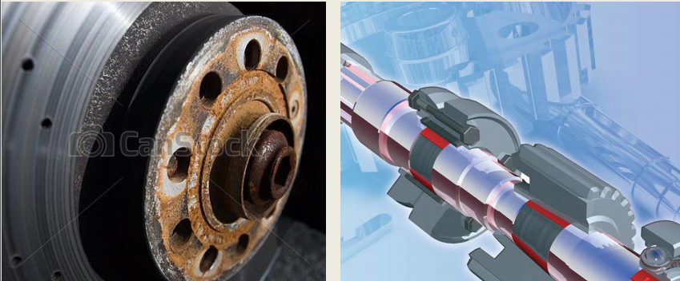
Cont.

Slide 55
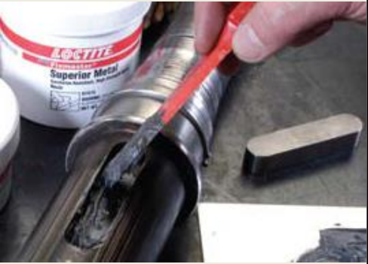
Kinds of wear
The whole field of wear which is diverse is divided in two limited area with similar condition
i. Depending of the relative motion of mating parts
a. Kinematic wear
    Sliding
    Rolling
    Drilling
    Mixed
b. static wear
c. Impact

Slide 56
ii. Depending on the time behavior of wear there are two kinds of wear:-
a. Stationary wear – in which the wear intensity remains constant
b. Non-stationary wear – in which the wear intensity depends on time
Wear processes
The wear process is a complex one being dependent on a number of factors:
      Load,
      Velocity,
      Intermediate materials,
      Ambient condition, etc.
Wear processes are accompanied by heating in the micro-range as well as changes in the physical and chemical material properties of the wear partners.

Slide 57
Wear processes can be differentiated as
i. Shearing process
Roughness points will be sheared off if the acting forces are greater than the shear strength. This leads to the reduction of roughness and increased percentage of contact area which reduces energy concentration and wear velocity .
ii. Elastic deformation
Big surface roughness results in low percentage of contact area and high energy concentration in contact point. This may result in high local stresses in the elastic range this causes small flattening or bending of roughness points. Repetition of this process will cause local fatigue of material.

Slide 58
Cont.
iii. Plastic deformation
If local stress produced exceeds the elastic limit, plastic deformation takes place in flattening and bending the material with no loss in mass.

Slide 59
Wear types
Depending on the presence of lubricants and/or lack of it, wear types are classified into the following.
i. Wear by solid friction
Solid friction occurs between the contacting surfaces of two bodies having relative motion where there is no intermediate material.
ii. Wear by liquid friction
In the case of liquid friction the two mating bodies are completely separated from each other by an intermediate material, mostly a lubricant.

Slide 60
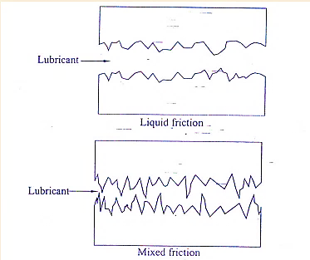
Cont.
iii. Wear by mixed friction
Simultaneous action of solid and liquid friction, caused by high roughness or high load for the lubricating film causes wear by mixed friction.
Schematically these wear types are shown.

Slide 61
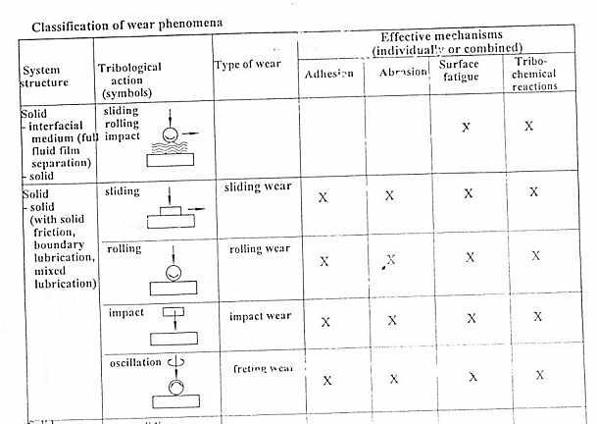

Slide 62
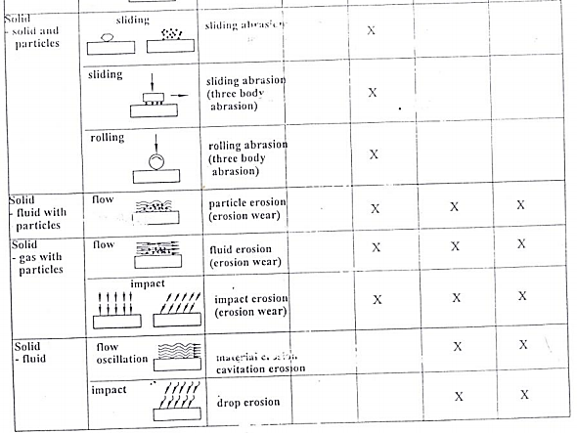
Cont.

Slide 63
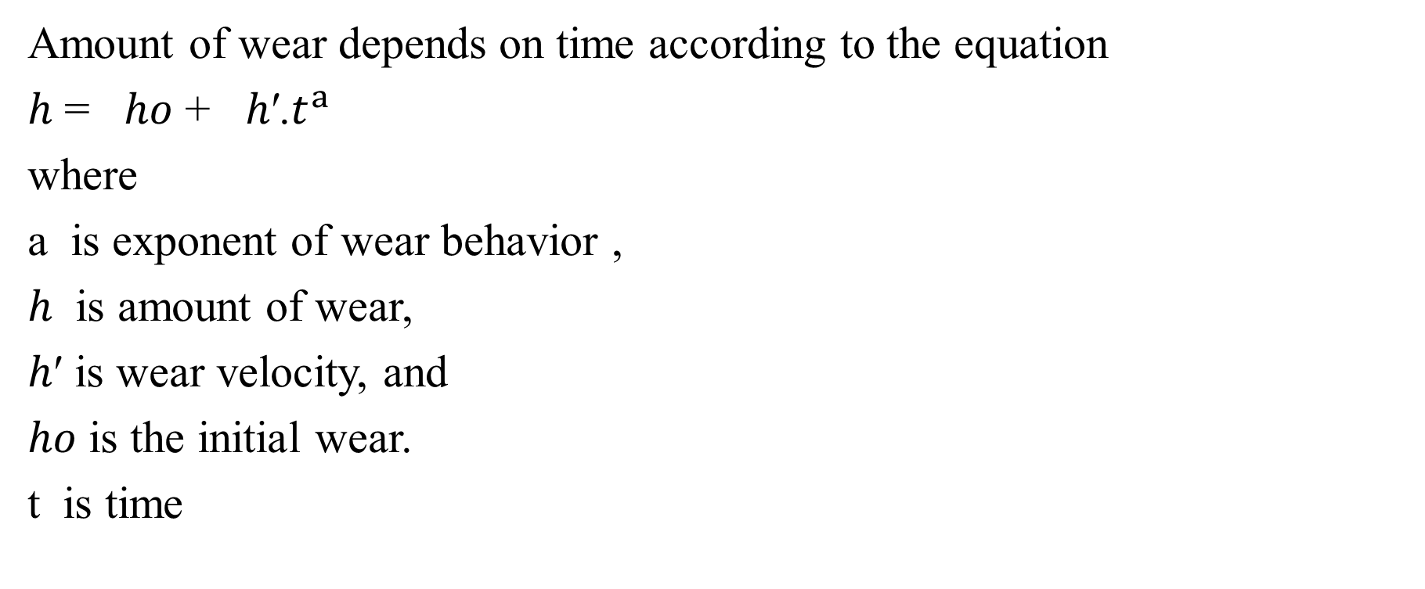
Time- behavior of wear
Amount of wear depends on time according to the equation
ℎ = ℎ𝑜 + ℎ′.$t^{a }$
where
a is exponent of wear behavior ,
ℎ is amount of wear,
ℎ′ is wear velocity, and
ℎ𝑜 is the initial wear.
t is time

Slide 64
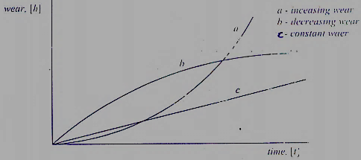
Cont.
Depending on a, assuming the initial wear ℎ𝑜 = 0, the wear behavior with time can be increasing, decreasing or constant. These three wear behaviors With time are shown in the figure below.

Slide 65
Protection against wear:
The main protection measure against wear is lubricating of the moving parts.
A lubricant is the intermediate material between two parts with relative motion for the purpose of reducing friction and/or wear between them.
Addition/replacement of lubricant plays a vital role in maintaining machine accuracy and increasing its working life.

Slide 66
Classification of lubricants
Lubricants are in the form of lubricating oils, grease and solid lubricants.
i. Lubricating oils
Lubricating oils are of two types: mineral and synthetic oils.
In addition to preventing or minimizing wear, lubricating oils perform the following duties:
Cooling by reducing friction and removing excess heat generated
Protection by inhibiting corrosive processes caused by air and water
Cleaning by flushing dirt particles away from lubricated surfaces

Slide 67
A, Mineral oil:
Mineral oil is basically hydrocarbons often with some additives to introduce specific characteristic features in the oil. Mineral oils are classified as:-
Paraffinic:- which contain significant amounts of waxy hydrocarbons with little or no asphaltic matter;
Naphthenic:- which contain asphaltic matter in fraction, with little or no wax;
Mixed base:- which contain asphaltic materials

Slide 68
Cont.
The most important physical property of mineral oils is viscosity which is a measure of resistance to flow .
Other important lubricant properties are the following
Anti-wear and EP (extreme pressure) properties
Oxidation resistance
Anti-corrosion properties
Anti-foaming property; and
Ability to separate from water

Slide 69
B, Synthetic oils
Synthetic oils are products produced under controlled conditions from chemical base and additives.
Synthetic oils are engineered to perform under rigorous conditions and extreme temperature.
The most important properties of synthetic oils are the following
Added lubricity
Higher film strength
Good engine start-up properties
Good resistance to thinning:
Improves energy efficiency
Less sludge or deposit formation
Good thermal properties:

Slide 70
Cont.
Because of their properties, synthetic oils are used for high speed
lubrication under extreme loading conditions.
However, synthetic oils have some disadvantages and these are:
Compatibility problem with paints, elastomers and certain metals;
Reactive in the presence corrosion;
High potential for toxicity;
Disposal problem due to un-degradable molecular structure;
More expensive;

Slide 71
ii. Greases
Grease may be defined as:-
solid to semi-fluid lubricant consisting of a dispersion of a thickening agent in a lubricating fluid.
Depending on the degree of consistency, greases are classified as:-
Semi-fluid, Soft and Stiff
In selecting grease for use, considerations must be given to conditions and nature of use including:-
The first thing to be decided is the consistency range.
Next comes the operating temperature.
Use of greases is limited to very low speeds up to 2m/s.

Slide 72
iii. Solid lubricants:
A solid lubricant is defined as any solid used as powder or a thin film on a surface to provide protection from damage during relative motion so as to reduce friction and wear .
Solid lubricants are used when fluid lubricants. i.e. oils and greases, are undesirable or ineffective.
Fluid lubricants are undesirable if they are liable to contaminate product as in food machinery, electrical contacts, etc.
Fluid lubricants are ineffective in hostile environments, high temperatures and extreme pressures.
A common type of solid lubricant is graphite.

Slide 73
Cont.
The following are some properties of solid lubricants:
Solid lubricants are incapable of carrying away heat.
Solid lubricants are immobile and they must somehow be bonded to the surface.
Solid lubricants are capable of retaining their lubricating effectiveness at high temperatures.

Slide 74
2.3.3. Fatigue
Fatigue is the failure (or reduction in strength) of a material under fluctuating stresses, which are repeated a very large number of times.
Fatigue failure begins with a hair-line crack which develops at a point of discontinuity in the material (notches, groves, fillets,…). Once a small crack develops, it propagates under load to cause failure.
Components subjected to fluctuating forces must be designed for fatigue conditions. Surface conditions, residual stresses due to metal working processes or metal – treating processes, stress concentration affect strength very much. Hence, they should be considered properly at design stage.
Fatigue strength (the endurance limit) of materials is greatly decreased by the presence of a corroding medium.

Slide 75
Chapter Three
Typical Damages of machine parts
3.1. Sliding Bearings
The damage in sliding bearings is wear plus fatigue
Static loads cause wear whereas dynamic loads cause wear plus fatigue.
In cases where lubricant contains corrosion stimulating substances like acids produced by aging lubricant, water leaking in lubricant, etc. , corrosion also becomes an important damage.

Slide 76
Cont.
But when dealing with damages of the system, the whole system has to be considered especially with respect to:-
Alignment and shape of bush hole or bore,
Lubricating, and
Deformation of shaft under applied loads.

Slide 77
Cont.
The process of wear depends on:-
wear velocity and operation conditions, particularly, temperature.
High temperature and high wear velocity produce overheating which change the properties of the material.
Presence of foreign substances in the lab. causes increased wear velocity.

Slide 78
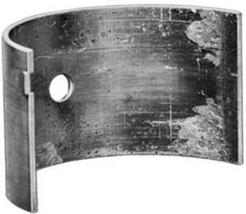
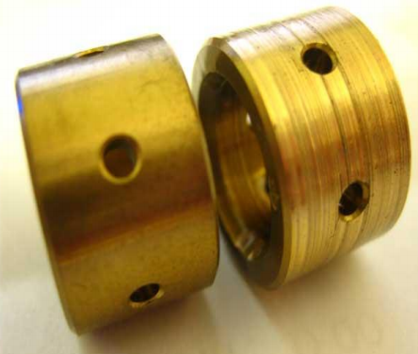
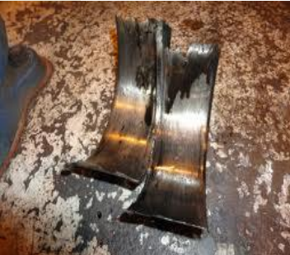
Example

Slide 79
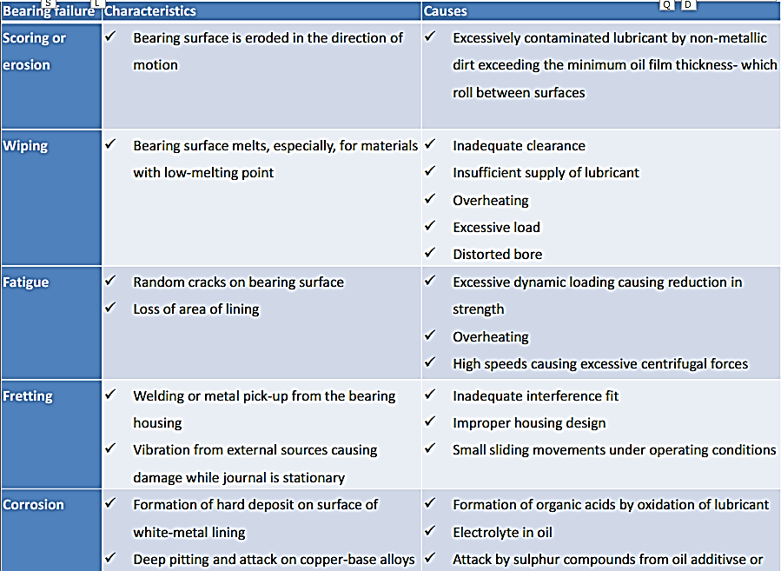

Slide 80
3.2. Anti - friction Bearings
Roller and ball bearings
Ball and roller bearings normally fail by fatigue.
In the case of tightening and lubrication problems, wear also can occur
Rarely failure can occur by random damages like overload
High contact pressure causes damage of inner and outer races.
In case of over load and assembly problems failure takes place in a short time.

Slide 81
Cont.
Wear of bearing elements increases axial and radial play, which can be a cause for vibration leading to increased fatigue.
Analysis of damage
Due to damages bearings will either get heated up or will run with abnormal noise and/or vibration.

Slide 82
Anti - friction bearing defects can be any one or combination of the following:-
Bearing inner race loose on shaft,
Housing bore loose on shaft,
Bearing running dry and
Miss-alignment.
Avoid it!!!
    Using sleeve,
    By undergoing knurling,
    Welding and
    Chromium plating.

Slide 83
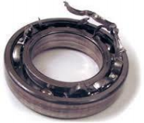
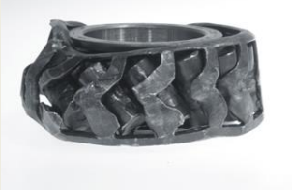
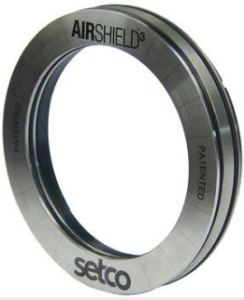
Examples
Caused due to miss alignment
Thrust bearing

Slide 84
Characteristics of damages in Anti Friction bearings
Damage characteristics | Reasons for damage
1. Running out of roundness | Damage at the rings (pitting, rippling) Contamination roundness Too much bearing clearance
2. Uncommon running noise 2.1. howling, whistling | Too small bearing clearance
2.2. Unequal noise: rattling, scrabbling | Too big bearing clearance Damage on racing tracks (pitting, toughening, impressions) Contamination Too viscous lubricant
2.3. gradual change of noise | Changing of effective bearing clearance (caused by change in temperature Fast fatigue process Fast arising of impressions
3. High temperature 3.1. Overheating | Too small bearing clearance Insufficient lubricant Excessive lubricant
3.2.Sudden increase in temperature | Lack of lubricant Fast arising of pitting

Slide 85
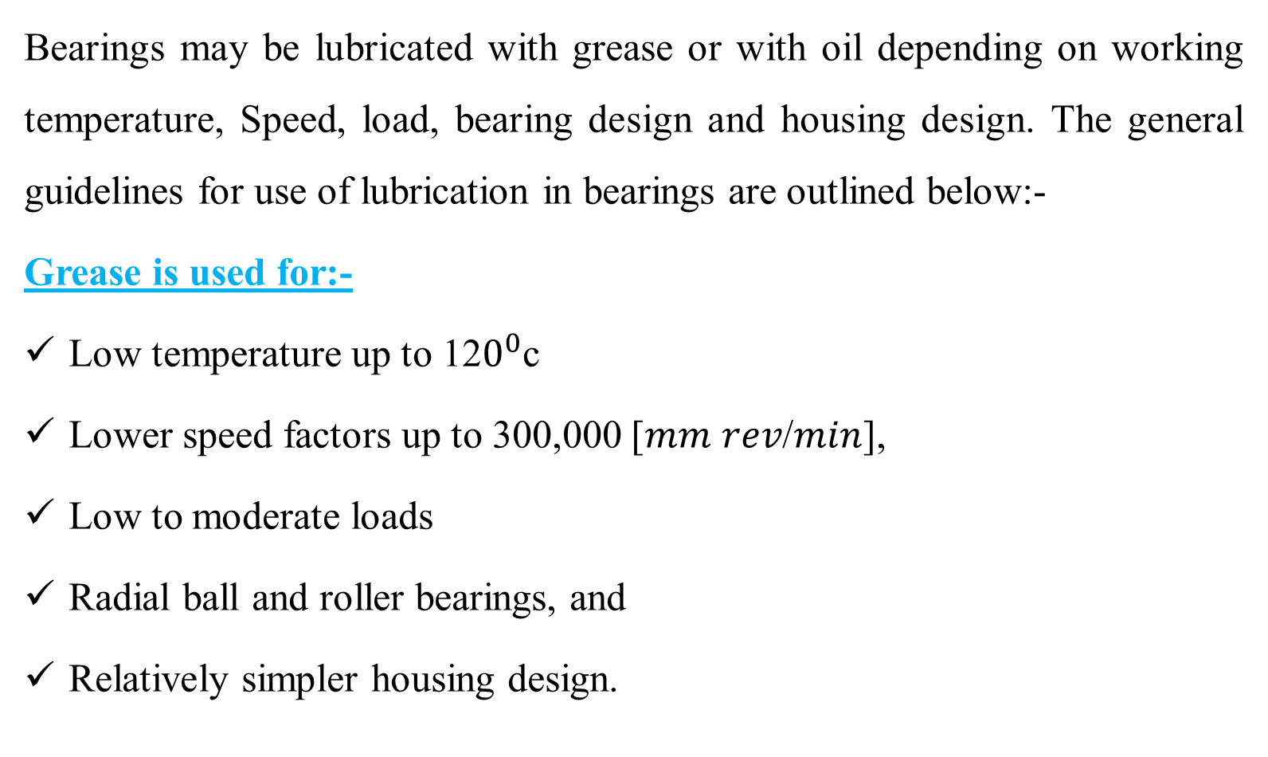
Preventing the damage using lubricant
Bearings may be lubricated with grease or with oil depending on working temperature, Speed, load, bearing design and housing design. The general guidelines for use of lubrication in bearings are outlined below:-
Grease is used for:-
Low temperature up to 12$0^{0}$c
Lower speed factors up to 300,000 [𝑚𝑚 𝑟𝑒𝑣/𝑚𝑖𝑛],
Low to moderate loads
Radial ball and roller bearings, and
Relatively simpler housing design.

Slide 86
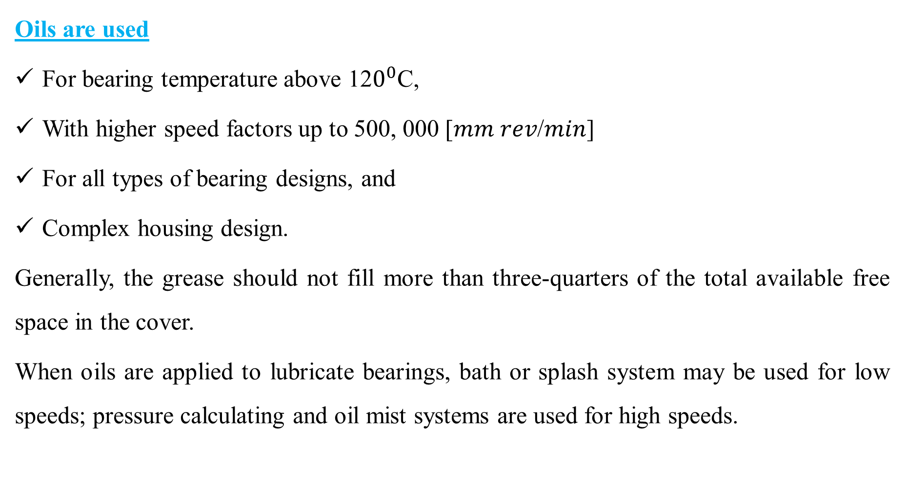
Cont.
Oils are used
For bearing temperature above 12$0^{0}$C,
With higher speed factors up to 500, 000 [𝑚𝑚 𝑟𝑒𝑣/𝑚𝑖𝑛]
For all types of bearing designs, and
Complex housing design.
Generally, the grease should not fill more than three-quarters of the total available free space in the cover.
When oils are applied to lubricate bearings, bath or splash system may be used for low speeds; pressure calculating and oil mist systems are used for high speeds.

Slide 87
3.3 Gear Damages
A gear pair has not failed until it can no longer be run.
This condition is reached when any one or both of the following has occurred:-
➢One or more teeth have broken away preventing transmission;
➢Teeth are so badly damaged or worn-out that unacceptable vibration and noise are set up when the gear runs

Slide 88
Typical failures of gear
Gear failure |  | Characteristics | Causes | Remedies
1. Surface fatigue (pitting)
a. Progressive Pitting | Pits continue to form with persistent running Rapid increase may large pieces of teeth breaking away Continuous line of pitting reduces bending resistance in the affected tooth |  | Over-stressing of gear Material | Remove cause of overload (e.g. correct alignment)
b. Deddendum attrition | Dedendum covered by a large number of small pits (with mat appearance) formation of a step at the pitch after a continued running |  | Possibly vibration in the gear unit | Use of more viscous lubricant

Slide 89
Cont.
2. Scuffing
a. Light scuffing | Tooth surfaces appear dull and slightly rough in comparison with un-affected areas Wear in the direction of sliding at the tip and root of the engaging teeth |  | Disruption of the lubricant film with the gear tooth surfaces temperature reaching critical temperature of lubricating oil |  | Use of high grade oils with higher temperature
b. Heavy scuffing | Tooth surfaces severely roughened as a result of unchecked adhesive wear |  | Use of low viscous oils Shortage of lubricant |  | Avoid repeated light scuffing
3. Abrasive wear
a. Foreign matter in oil | Grooves are cut in the tooth flanks in the direction of the sliding | Dirt falling in an open gear Inadequate initial gear cleaning Dislodged scale in oil supply pipes |  | Use clean lubricant Prevent dirt from entering system periodic flushing of gear unit

Slide 90
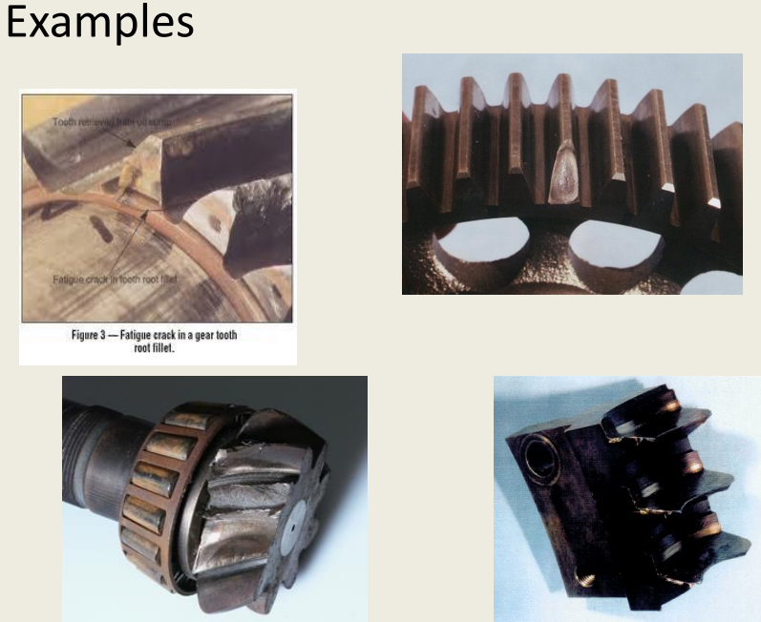

Slide 91
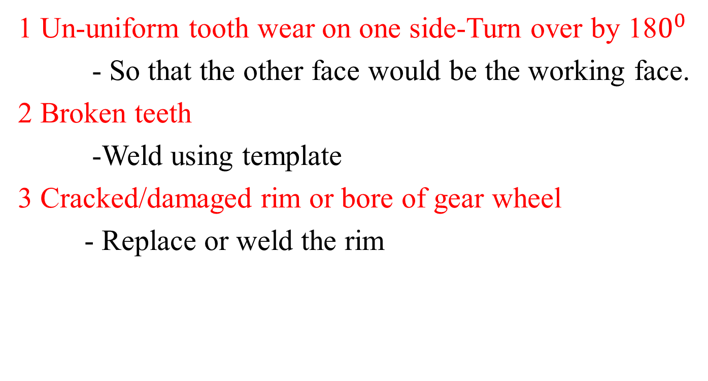
Repair of transmission gears
1 Un-uniform tooth wear on one side-Turn over by 18$0^{0}$
- So that the other face would be the working face.
2 Broken teeth
-Weld using template
3 Cracked/damaged rim or bore of gear wheel
- Replace or weld the rim

Slide 92
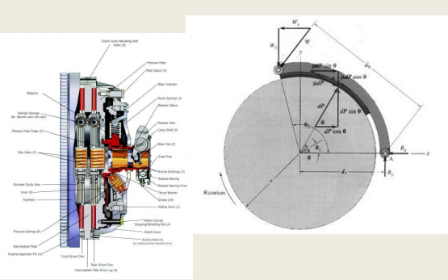
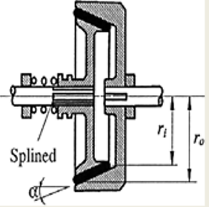
3.4 Damages of friction surfaces
Friction surfaces of clutches and brakes usually fail by wear and/or deformation.
Typical clutch typical brake

Slide 93
Brake damages
Brake metal surface failures, their characteristics and causes
Failure | Characteristics | Causes
1. Heat spotting | Heat spotted areas with reddish brown color | Distortion causing heavily loaded contact on a small area Uncomfortable mating
2. Crazing | Randomly oriented cracks on the rubbing surface of mating component | Overheating Repeated stress cycling from comp. to tension (heating and cooling)
3. Scoring | Scratches of the rubbing path in the line of movement | Too soft metal for the friction material Abrasive material embedded in the lining material

Slide 94
Cont.
Failure | Characteristics | Causes
1. Fade | Material degrades or flows at the friction surface resulting in decreased and loss in performance | Over heating caused by excessive braking or brake dragging
2. Metal pickup | Metal plucked from the mating member and embedded in the lining | Unsuitable combination of materials
3. Grab | Linings contact at ends only Noisy brake Erratic performance | Incorrect radiating of lining (fault in assembly)

Slide 95
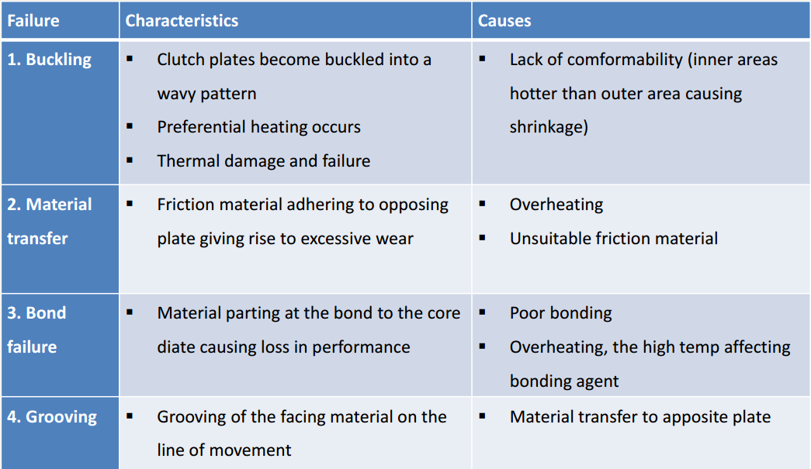
Clutch damages
Clutch failures, their characteristics and causes

Slide 96
3.5. Shaft failures
shafts are subjected to various loading condition and experience tension, compression, bending or any combination of these loading conditions
These loads can be stationary or may vary with time.
The basic causes of shaft failures are wear, fatigue and misalignment.

Slide 97
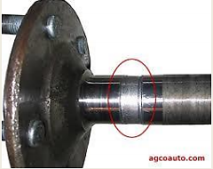
3.5.1 Shaft failures due to wear
Wear is a common cause of shaft failures. The wear process takes place by abrasive wear mechanism which is followed by removal of material from the surface of the shaft.
Abrasive wear reduces shaft size and destroys shape of the shaft and causes shaft failure.

Slide 98
3.5.2 Fatigue failure
One of the more common causes of shaft failure is fatigue.
Fatigue failures commonly initiate at stress raisers.
The mechanism of fatigue requires the simultaneous presence of three things:-
There must be cyclic stresses on the shaft;
These stress must be tensile in nature, and
There must be plastic strain.

Slide 99
Cont.
The process of fatigue is considered to consist of three stages:-
Initial fatigue damage involving plastic strains leading to crack initiation;
Crack propagation that continues to grow across the part until the remaining cross section of shaft becomes too weak to carry the imposed loads: and
Final and sudden fracture of the remaining cross section, due to overload

Slide 100
Cont.
Some typical shaft features that act as stress raises are
– Corners, fillets, notches, etc.
– Key-ways, grooves, splines, etc.
– Press or shrink fits
– Welding defects,
– Metallurgical defects introduced by metal working such as forging, machining, heat treating, etc.
Others service-related factors that are important factors in fatigue initiation are damages caused by corrosion and wear

Slide 101
3.5.3 Shaft failures due to misalignment
Another common cause of shaft failures is misalignment. Misalignment can be introduced due to following problems:-
Mismatching of mating parts,
Original assembly error of equipment,
Any maintenance activity resulting in maintenance induced alignment problems,
Deflection or deformation of supporting components,
Deflection or deformation of the shaft itself.

Slide 102
Remedies of shaft failures
Some of the remedies for preventing shaft failures are the following:-
by using proper lubrication.
Misalignment can be eliminated by proper assembly procedures.
Fatigue can be reduced by proper design of local areas known as stress raisers.
Avoiding sharp surfaces during machining as much as possible eliminates the formation of stress raisers.
Use of proper fits and tolerances reduces misalignment, wear and fatigue.

Slide 103
3.6. Seals
Basic seal types and their characteristics :-
Dynamic seals
Between surfaces in sliding contact or narrowly separated surfaces.
Static seals
Between surfaces which do not move relative to each other
Exclusive seals
Restrict access of dirt, etc., to a system, often used in conjunction with dynamic seals

Slide 104
Rubber seals
Symptoms | Cause | Remedy
- rubber brittle - possibly cracked - seal leaks | - rubber aging - exposure to the sunlight - overheat due to high fluid temperature or high speed | - renew seal - change rubber compound - improve seal environmental or operating conditions
- rubber softened, possibly swollen | - rubber incompatible with sealed fluid | - change rubber compound or change fluid
seal motion irregular - jerky - vibration | -stick-slip phenomena | - higher or lower speed may avoid problem - Change fluid temperature - change rubber
- seal friction very high on starting | - static friction (time dependent) | - probably inevitable - effect slowed by softer rubber or more viscous fluid
- seal permanently deformed | - permanent set (characteristic of rubbers) | -change rubber compound

Slide 105
O-rings, rectangular rubber rings, U-rings
Symptoms | Cause | Remedy
Fine circumferential cut set back slightly from sliding contact zone Ring completely ejected from its groove | - Extrusion damage | - Reduce back clearance - Check concentricity of parts - Fitting of back-up ring - Use reinforced seal - Use harder rubber
Wear (not restricted to sliding contact) Partial or total fracture | - Ring rolling or twisting in groove | - Replace O-ring by rectangular section ring or lobed type Ring

Slide 106
Lip seals
Symptoms | Cause | Remedy
Rotating lip seal Excessive leakage | - Damaged lip (during assembly) | - Remove cause of damage during assembly
Lip cracked in places | - Excessive speed - Poor lubrication - Hot environment | - Improve lubrication Reduce environmental temperature - Consider using alternative rubber compound
Reciprocating lip seal - Excessive wear/high Friction | - Poor lubrication - Seal overloaded | - Replace single seal - Use heavy duty seal - For aqueous fluids leather may be better than rubber

Slide 107
Chapter-4
Determination of state of damage
The state of damage of machinery is the undesired deviation from the required state fixed in the design procedures.
For the phase of testing of new components or equipment (means of production), knowledge of the state of damage can be used for setting meaningful maintenance routines.
The state of damage of equipment depends on:-
    Kind and condition of damage, and
    Duration of operation of equipment.

Slide 108
Cont.
Determination of the state of damage is part of technical diagnostics and maintenance.
Technical diagnostics is the determination of the technical state or state of damage of equipment, evaluation of the state and collection of information for deciding the state and kind of maintenance.
This is normally done without disassembling while the equipment is in operation.

Slide 109
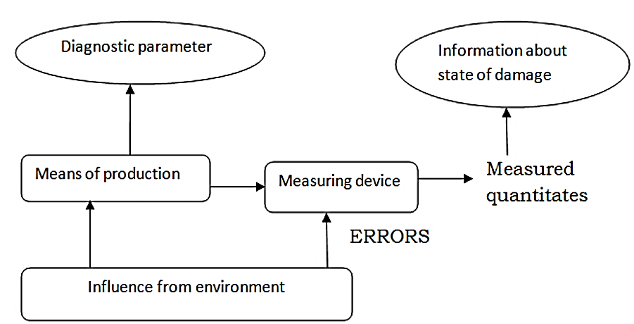
Cont.

Slide 110
Cont.
Conclusions arrived at about the state of damage of an equipment are probabilistic, and
The accuracy of results obtained depends on the accuracy of the method of investigation used, sampling techniques.
Hence, the usefulness of the results has to be weighed carefully and decisions made have to be supported by experienced and good judgment.

Slide 111
4.1 Measuring values for the state of damage
The measuring principles employed are two:
a. Direct measured quantities, and
b. Indirect measured quantities
Direct measured quantities
The direct measuring technique determines the difference between the initial state and the state after wear process.
The measurement taken can be direct linear, volumetric or mass quantities

Slide 112
Cont.
These measured quantities can be absolute or related to duration of operation.
Absolute measurement:- gives the amount wear as an average worn out thickness.
Related measurement:- gives amount of wear per unit time of operation
Direct measurement:- is usually done after disassembly But it can also be made without disassembling provided there is easy access to the measured quantities.

Slide 113
Indirect measuring quantities
During the operation of a machine or parts of it, certain signals are produced which are related to the state of operation of the machine.
These signal, which are known as the diagnostic parameters; if properly analyzed provide some information regarding the state of the machine.
It should be noted that influence from the environment introduces errors in the measured results.

Slide 114
4.2 Methods of condition monitoring
Most techniques of condition monitoring amount to the systematic application of commonly accepted methods of fault diagnosis.
These techniques are classified as on-load or off-load monitoring techniques.
4.2.1 On-load monitoring techniques
On-load monitoring techniques are mostly carried out without interruption of operation of the unit.

Slide 115
Cont.
These techniques include:
  Visual, aural and tactical inspection of accessible components;
  Temperature monitoring.
  Lubricant monitoring.
  Leak detection.
  Vibration monitoring/sound monitoring and
  Corrosion monitoring.

Slide 116
4.2.3 Off-load monitoring techniques
Off-load monitoring techniques require shutdown of one unit.
These techniques include:
  Crack detection;
  Visual, aural and tactical inspection of normally inaccessible or moving parts;
  Leak detection;
  Vibration testing;
  Corrosion monitoring

Slide 117
4.3. Condition monitoring techniques
Most failures give some warning before they occur. This warning is called potential failure.
Potential failure is defined as an identifiable physical condition which indicates that a functional failure is either about to occur or it is in the process of occurring;
A functional failure is defined as the inability of equipment in meeting a specified performance standard.

Slide 118
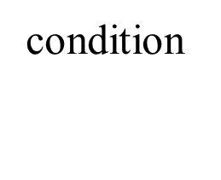
Potential failures and on-condition maintenance:-
If evidence can be found that some component/equipment is in the final stage of failure, it may be possible to take action to prevent complete failure and/or its consequences.
The P-F curve is employed to show what happens in the final stages of failures:-
point where failure start to occur
point where we can determine that
component is falling
(potential failure)
point where component has failure
(functional failure)
time

Slide 119
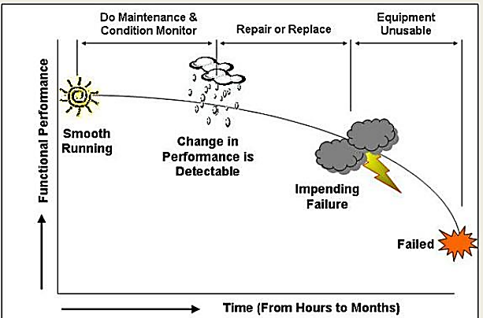
The P-F curve shows:-
Where failure in the equipment starts to occurs:
Where equipment condition going to the point at which the failure can be detected; and finally,
Where the equipment has failed indicating functional failure.
Fig. P-F curve

Slide 120
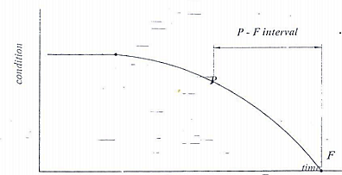
Cont.
The P-F interval:- is the interval between the occurrence of a potential failure and its deterioration in to functional failure. The P-F interval is the warning period, or the lead time to failure, or the failure development period.
Fig. P-F interval curve

Slide 121
Cont.
Between points P and F it may be possible to take action to prevent functional failure or to avoid consequences of functional failure.
Tasks designed to detect potential failures are known as on-condition tasks.
On - condition tasks entail checking for potential failures so that action can be taken to prevent functional failure or to avoid the consequences of the functional failure. This is known as predictive maintenance or condition-based maintenance.
The longer the P-F interval for inspection more time to take appropriate actions to avoid the consequence of failure.
Small deviation from the normal requires sensitive monitoring techniques and equipment.
It can be concluded that the P-F curve is an important tool-in determining the condition monitoring techniques and setting the equipment for conducting the monitoring task.

Slide 122
4.4. Categories of condition monitoring techniques
Condition monitoring techniques are designed to detect specific symptoms which are related to the state of damage of the equipment.
The monitoring techniques are classified according to the symptoms monitored.
1. Dynamic monitoring
Detects potential failures which cause emissions of abnormal energy in the form of waves such as vibration and noise.
Equipment which contain moving parts that vibrate are monitored dynamically.

Slide 123
Cont.
There are various techniques that belong to this category,
Broad band vibration analysis (changes in vibration characteristics are monitored by using transducer)
Constant bandwidth analysis (changes in vibration characteristics are monitored by using accelerometers)
Real time analysis (measurement of vibrational signals; shock analysis)
Ultrasonic analysis (changes in sound pattern are monitored)

Slide 124
2. Particle monitoring
Particle monitoring detects potential failures which cause particles of different sizes and shapes to be released in to the environment in which the component is operating. These include wear particles and corrosion particles;
Examples:-
    Real time ferromagnetic sensors
    Graded filtration
    Sedimentation

Slide 125
3. Chemical monitoring
Chemical monitoring detects potential failures which cause traceable quantities of chemical elements to be released in to the environment.
This technique is used to detect elements in the lubricating oil which indicate occurrence of potential failure elsewhere in the system. They are employed to detect wear, corrosion, leakage
  Electro-chemical corrosion monitoring
  Exhaust emission analyzers
  Color indicator titration

Slide 126
4. Physical effect monitoring
Changes in the physical appearance or structure of equipment which can be detected directly. like crack, wear by:-
  Strain gauge
  Viscosity monitoring
5. Electrical effects monitoring
look for changes in resistance, conductivity, etc.
  Electrical resistance monitoring
  Breaker timing testing
6. Temperature monitoring
look for potential failures which cause rise in temperature
      Infrared scanning
      Temperature indicating painting

Slide 127
Chapter 5
Elements of maintenance
Broadly speaking, the elements of maintenance technology can be classified as Attendance (operation), servicing and repair.
Attendance is the right way of avoiding mal - operation which influences the damages and indirectly the maintenance.
5.1. Attendance (Operation)

Slide 128
Cont.
The fundamentals for the use of any technical means of production are:
Proper use of operating instruction provided in operators manuals;
Proper use of service instructions given in service instructions; and
Following proper maintenance procedures and instructions as outlined in maintenance manuals.

Slide 129
Cont.
Knowledge of these instructions is essential in attending the machine.
In this respect qualification of operators, maintenance personnel and management is a requirement.
Proper attendance avoids subjective damages (due to mis-handling) and minimizes objective damages.

Slide 130
5.2. service
Servicing of a machine is important in decelerating wear or damage of machine parts. Important measures to be taken in servicing are:-
cleaning,
Lubricating and
Adjusting.
5.2.1. cleaning
Penetration of dust, dirt deposited, etc. accelerate the wear processes and corrosion of machine components.
Hence cleaning makes the preliminary maintenance element.
Cleaning should be done in short time intervals and
The means used for cleaning should not be corrosive and should not damage paints, working surfaces, etc.

Slide 131
Cont.
For cleaning purposes detergents can be used, but compatibility with the working environment should be given due attention.
Accessories like water jet, steam jet or compressed air can be used to assist cleaning of machinery.

Slide 132
5.2.2 lubricating
A lubricant has the task of:-
reducing friction between mating surfaces with relative motion,
transfer of heat generated and
prevention of dust and other materials from entering in to the working environment.
Rules for lubricating include:-
Use the right lubricant and the specified amount
Complete replacement of lubricant

Slide 133
Cont.
Avoiding contaminants at the point of lubrication
In applying lubricants, taking good care of filters is of great importance.
The task of filters is to separate wear products and contaminants from the lubricant to reduce wear process.
Different types of oil filters, air filters, restrainers can be used.

Slide 134
5.3. Repairs
Repair is the totality of measures of restoration with the aim of determined final state, or quality, or condition of equipment.
Classification of repair activities is based on various consideration.
These considerations are:-
Time related breakdown
Number of elements involved in the repair task
Nature of repair activity
Territorial, or
Labor involved

Slide 135
The classification of repair activities are outlined in the chart below:-
Kinds of repair
Time related to breakdown
Preventive
corrective
Number of elements of a system involved
Individual
One element
Complex
Several elements

Slide 136
Medium repair
(One or several elements)
General overhaul
(Nearly all elements)
Number of elements of a system involved
Single repair
Repair in series
Nature of repair activity
Decentralized
Centralized
Territorial
Manual
Industrial
Division and type of labor involved

Slide 137
Chapter 6
Maintenance strategies and decision making
Maintenance is the combination of all technical and management actions intended to retain an item in, or restore it to, a state in which it can perform as required.
Almost every business/industry has some sort of maintenance program for its physical assets. As such, over period of time, many maintenance strategies or methodologies have been developed mainly basing on:-
Time for doing maintenance,
Frequency of maintenance,
Quality of maintenance,
Complexity , and sophistication of equipment's and
Value of total assets etc.

Slide 138
Basis of selecting maintenance strategies
Maintenance strategies are methodologies and software programs which balance maintenance costs against the impact of plant failure.
  Too little of maintenance can cause costly system failures
  Too much of maintenance is not cost-effective
By optimizing equipment maintenance strategies against both targets, availability and the penalty of failure, you can optimize your asset life-cycle costs.

Slide 139
There are various reasons for selecting maintenance strategies such as: -
Which set of tasks that should be performed and their frequency,
With aging of the plant a different mix of tasks is needed to maintain reliability,
Perhaps with reduced staff it is not possible to perform all tasks that used to be done and, only the most effective tasks are selected, or
The plant operators may want to reduce maintenance expenditures without elevating risk or reducing reliability;
The resulting strategy must strike a balance between maintenance cost and plant reliability.

Slide 140
.....cont’d
This evaluation develops tools and techniques for determining the best mix of maintenance tasks.
An element of the maintenance strategy is to prioritizing maintenance tasks.
One approach is called risk-based evaluation and prioritizing (REAP).
REAP has been successfully used to prioritize routine and outage maintenance tasks, based on improved reliability and cost of the task.
Any good maintenance strategy must have an integrated information system for interacting with all concerned areas such as shown below

Slide 141
......cont’d
Work procedure
(maintenance & operation)
driving
Problems defects & fault reports
Purchasing
Work schedules, job orders
Maintenance strategy
Or program
Inventing
Work history
Finance
Assets
Contractors & other externals
Integrated information systems for maintenance strategy

Slide 142
Selection criteria and types of maintenance
Selection of maintenance systems/strategies has to be made depending on:-
The need,
Complexity,
Reliability needed and
Considering techno- economics
Most of the commonly used strategies can be grouped as shown:-

Slide 143
Breakdown or emergency maintenance
Reactive/ Corrective maintenance
Un planned
Routine maintenance
Opportunistic maintenance
Maintenance strategy
planned
Preventive
Predictive
Scheduled/fixed time maintenance
Proactive/ Condition based maintenance

Slide 144
1. Breakdown or emergency maintenance
In such maintenance, repair is done after failure has already occurred
Only when the equipment fails to perform designated functions or comes to a grinding halt, any maintenance or repair job is taken.
It may work well in a small factory/plant, where, Number of equipment are few,
Equipment are simple and repair does not call for specialists or special tools/tackles,
When sudden stoppage/ failure of the equipment will not cause severe finical loss in terms of delivery commitment or further damage to other equipment/components,
When sudden failure will not cause any severe safety or environmental hazards.

Slide 145
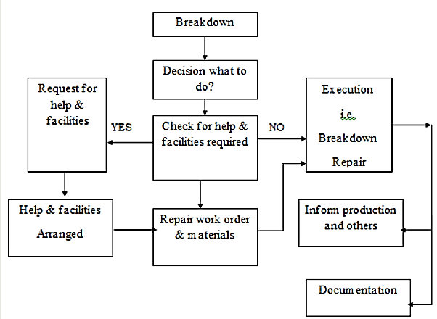
However, such maintenance system cannot work in big industries, having large number or equipment, some of which may be quite intricate.

Slide 146
2. Corrective maintenance
Corrective maintenance means action for correcting or restoring a failed unit (or unit going to fail). Its scope is very vast and may include different types of actions, from small actions like typical adjustments and minor repairs to minor redesign of equipment.
It is mostly unplanned action, but may include few planned/ scheduled actions.

Slide 147
Actions in corrective maintenance may be subdivided, according to priority, as follows:-
Emergency work, high priority, generally offline, i.e. after stopping the equipment. Giving normally less than 24 hours notice to take up the job,
Deferred works-jobs of lower order priority; generally off-line, to eliminate / reduce repetitive break downs, and
Specific reconditioning or redesign jobs, generally small or medium in volumes.

Slide 148
WHAT ABOUT
Opportunistic maintenance?
Routine maintenance?
Scheduled/fixed time maintenance?
Predictive Maintenance?
Proactive/ Condition based maintenance?
YOUR READING ASSIGNMENT

Slide 149
Maintenance Decision-making Process
The decision-making procedure allows the selection of an optimum set of maintenance procedures.
Maintenance decision making can be broadly explained in terms of maintenance actions, (basic elementary work), maintenance policies and maintenance concepts.
Three maintenance decisions according to the questions of when, which, and what is needed. The question of:-
‘when’ refers to the right time to perform a maintenance;
‘which’ refers to the selection of the right component in the multi-component structure that requires maintenance; and
‘what’ refers to the appropriate maintenance action (e.g., repair or replace) to be carried out.

Slide 150
Introduction
Chapter 7
Basic Probability Concepts
People use the term probability many times each day. For example, physician says that a patient has a 50-50 chance of surviving a certain operation. Another technicians may say that the machine is 95% certain that a machine has a particular failure.

Slide 151
Definition
If an event can occur in N mutually exclusive and equally likely ways, and if m of these possess a trait, probability of the occurrence of E is read as:-
P(E) = m/N

Slide 152
Definition
Experiment = any planned process of data collection. It consists of a number of trials (replications) under the same condition.
Sample space: collection of unique, non-overlapping possible outcomes of a random circumstance.
Simple event: one outcome in the sample space; a possible outcome of a random circumstance.
Event: a collection of one or more simple events in the sample space; often written as A, B, C, and so on.
A, B

Slide 153
Cont.
Complement = sometimes, we want to know the probability that an event will not happen; an event opposite to the event of interest is called a complementary event.
If A is an event, its complement is The probability of the complement is AC or ‾A
Example: The complement of male event is the female.
P(A) + P(AC) = 1

Slide 154
Views of Probability:
1-Subjective:
It is an estimate that reflects a person’s opinion, or best guess about whether an outcome will occur.
Important in garage ➔ form the basis of a technician opinion (based on information gained in the history and technicians examination) about whether a vehicle or machine has a specific problem.
Such estimate can be changed with the results of diagnostic procedures.

Slide 155
2- Objective
Classical
It is well known that the probability of flipping a fair coin and getting a “tail” is 0.50.
If a coin is flipped 10 times, is there a guarantee, that exactly 5 tails will be observed
As the number of flips becomes larger, the proportion of coin flips that result in tails approaches 0.50

Slide 156
Example: Probability of lathe versus milling imported
Long-run relative frequency of lathe is about 0.512 (512) lathes imported per 1000 total lathe and milling import)
Table provides results of simulation: the proportion is far from .512 over the first few weeks but in the long run settles down around .512.
Weeks of watching | Total imported machines | Total lathes | proportion
1 | 30 | 19 | .633
4 | 116 | 68 | .586
13 | 317 | 172 | .543
26 | 623 | 383 | .615
39 | 919 | 483 | .526
52 | 1237 | 639 | .517

Slide 157
Cont.
B) Relative frequency
Assuming that an experiment can be repeated many times and assuming that there are one or more outcomes that can result from each repetition. Then, the probability of a given outcome is the number of times that outcome occurs divided by the total number of repetitions.

Slide 158
Problem 1.
Vehicle Group | Problem of Engine | Problem of Clutch | Total
Truck Automobile Bus Roller | 20 17 8 5 | 20 18 7 5 | 40 35 15 10
Total | 50 | 50 | 100

Slide 159
Problem 2.
An outbreak of not functional occurs in a group of machines who attended in maintenance shop
 | Not functional | functional | Total
lubricated Did Not lubricated | 90 20 | 30 60 | 120 80
Total | 110 | 90 | 200

Slide 160
a. Marginal probabilities
Named so because they appear on the “margins” of a probability table. It is probability of single outcome.
Example: In problem 1, P(engine), P(vehicle group truck)
P(engine) = number of engine/total number of subjects/problem
= 50/100
= 0.5

Slide 161
b. Conditional probabilities
It is the probability of an event on condition that certain criteria is satisfied.
Example: If a subject was selected randomly and found to be clutch problem what is the probability existed on the Truck
Here the total possible outcomes constitute a subset (clutch) of the total number of subjects.
This probability is termed probability of Truck given C
P(problem on Truck\ caused by Clutch error) = 20/50
= 0.40

Slide 162
c. Joint probability
It is the probability of occurrence of two or more events together.
Example: Probability of problem of being Engine & belong to Roller
P(E and R) = P(E∩R)
= P(E)X P(R) = (50/100) X (10/100)
= 0.05
∩ = intersection

Slide 163
Properties
The probability ranges between 0 and 1
If an outcome cannot occur, its probability is 0
If an outcome is sure, it has a probability of 1
The sum of probabilities of mutually exclusive outcomes is equal to 1 P(E) + P(C) = 1

Slide 164
Rules of probability
1- Multiplication rule
Independence and multiplication rule
P(A and B) = P(A) P(B)
P(A)
P(B\A)
P(B)
A and B are independent
P(B\A) = P(B)

Slide 165
Example:
The joint probability problem of an Engine and having in truck
To know that two events are independent compute the marginal and conditional probabilities of one of them if they are equal the two events are independent. If not equal the two events are dependent
P(truck) = 40/100 = 0.40
P(T\E) = 20/50 = 0.40
Then the two events are independent
P(T∩E) = P(T)×P(E) = (40/100)×(50/100) = 0.20

Slide 166
Cont.
1- Multiplication rule
Dependence and the modified multiplication rule
P(A and B) = P(A) P(B\A)
P(A)
P(B\A)
P(B)
P(B\A)
A and B are not independent
P(B\A) ≠ P(B)

Slide 167
Example:
The joint probability of * not functional and applied lubricant*
P(not functional) = 110/200 = 0.55
P(not functional\applied lubricant) = 90/120 = 0.75
Then the two events are dependent
P(not functional ∩ applied lubricant)
= P(applied lubricant)×P(not functional \ P(applied lubricant)
= (120/200)×(90/120)
= 0.45

Slide 168
2- Addition rule
i) A and B are mutually exclusive, The occurrence of one event precludes the occurrence of the other
Addition
Rule
P(A)
P(B)
P(A OR B) = P(A U B) = P(A) + P(B)

Slide 169
Example:
The probability of being either Truck or Automobile
P(OUA) = P(T) + P(A)
= (40/100)+(35/100)
= 0.75

Slide 170
ii) A and B are non mutually exclusive (Can occur together) Example: Male and smoker
P(A)
P(B)
Modified
Addition
Rule
P(A ∩ B)
P(A OR B) = P(A U B) = P(A) + P(B) - P(A ∩ B)

Slide 171
Example:
Two events are not mutually exclusive (engine problem and truck type vehicle ).
P(E OR T) = P(Engine)+P(Truck) – P(Engine ∩ Truck)
= 0.50 + 0.40 – 0.20
= 0.70

Slide 172
Chapter 8
Reliability, Maintainability, Availability and capability
Availability, reliability, maintainability and capability are components of the effectiveness equation is a figure of merit which is helpful for deciding which component detract from performance measures. In many continuous process plants the reliability component is the largest detractor from better performance.
Each effectiveness element varies as a probability. Since components of the effectiveness equation and its forms, it varies from one writer to the next.
Where :- LCC – Life cycle cost
System effectiveness = effectiveness/LCC

Slide 173
effectiveness = availability*reliability*maintainability*capability
The effectiveness equation is the product of:-
The chance the equipment or system will be available to perform its duty
It will operate for a given time without failure,
It is required without excessive lost maintenance time and
It can perform its intended production activity according to the standard.
Each element of the effectiveness equation requires a firm datum which changes with name plate ratings for a true value that lies between 0 and 1.

Slide 174
Reliability Definition
Generally defined as the ability of a product to perform, as expected, over certain time.
Formally defined as the probability that an item, a product, piece of equipment, or system will perform its intended function for a stated period of time under specified operating conditions.
In the simplest sense, reliability means how long an item (such as a machine) will perform its intended function without a breakdown.
Reliability is performance over time, probability that something will work when you want it to.

Slide 175
The Reliability definition has four important elements:-
  Probability (A value between 0 and 1, number of times that an event occurs (success) divided by total number trials)
e.g. probability of 0.91 means that 91 of 100 items will still be working at stated time under stated conditions
  Performance (Some criteria to define when and how product fails, which also describes what is considered to be satisfactory system operation)
  e.g. amount of beam collisions, etc.
  Time (system working until time (t), used to predict probability of an item surviving without failure for a designated period of time)
  Operating conditions
  These describe the operating conditions (environmental factors, humidity, vibration, shock, temperature cycle, operational profile, etc.) that correspond to the stated product life.

Slide 176
Basic Reliability Terms
Failure - A failure is an event when an item is not available to perform its function at specified conditions when scheduled or is not capable of performing functions to specification.
Failure Rate - The number of failures per unit of gross operating period in terms of time, events, cycles.
MTBF - Mean Time Between Failures - The average time between failure occurrences. The number of items and their operating time divided by the total number of failures. For Repairable Items
MTTF - Mean Time To Failure - The average time to failure occurrence. The number of items and their operating time divided by the total number of failures. For Repairable Items and Non-repairable Items
Hazard - The potential to cause harm. Harm including ill health and injury, damage to property, plant, products or the environment, production losses or increased liabilities.
Risk - The likelihood that a specified undesired event will occur due to the realisation of a hazard by, or during work activities or by the products and services created by work activities.

Slide 177
Cont.
Maintainability - A characteristic of design, installation and operation, usually expressed as the probability that an item can be retained in, or restored to, specified operable condition within a specified interval of time when maintenance is performed in accordance with prescribed procedures.
MTTR - Mean Time To Repair - The average time to restore the item to specified conditions.
Maintenance Load - The repair time per operating time for an item.
Availability - A measure of the time that a system is actually operating versus the time that the system was planned to operate. It is the probability that the system is operational at any random time t.
Supportability - The ability of a service supplier to maintain the Plant inbuilt reliability and to perform scheduled and unscheduled maintenance according to the Plant inbuilt maintainability with minimum costs.

Slide 178
cont.
As Reliability Engineering is concerned with analyzing failures and providing feedback to design and production to prevent future failures, it is only natural that a rigorous classification of failure types must be agreed upon.
Reliability engineers usually speaks of:-
Failures Causes
Failure Modes
Failure Mechanisms
Reliability measurement is based on the failure rate
Some products (Non-repairable) are scrapped when they fail e.g. bulb
Other products (Repairable) are repaired e.g. washing machine.
A failure is an event at which the system stops to fulfill its specified function.

Slide 179
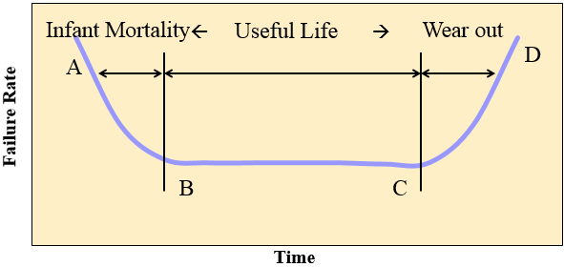
Failure rate over the life of a product
How Do Products Really Fail ?
Two common types of failures:
Sudden failure (no indicators): Stress exceeds strength ….
Degradation (gradual wear out): degradation indicator such as crack growth, change of resistance, corrosion, … This is ideal for Condition-Based Maintenance
Other failures may occur because of human errors.
The failure rate is expected to vary over the life of a product – ‘Bathtub Curve’

Slide 180
Bathtub Curve.
A-B Early Failure / Infant mortality / Debugging / Break-in
‘Teething’ problems. Caused by design/material flaws
Eg: Joints, Welds, Contamination, Misuse, Miss - assembly
B-C Constant Failure / Useful life.
Lower than initial failure rate and more or less constant until end of life
C-D End of life failure / Wear out phase.
Failure rate rises again due to components reaching end of life
E.g.:- Corrosion, Cracking, Wear, Friction, Fatigue, Erosion, Lack of PM

Slide 181
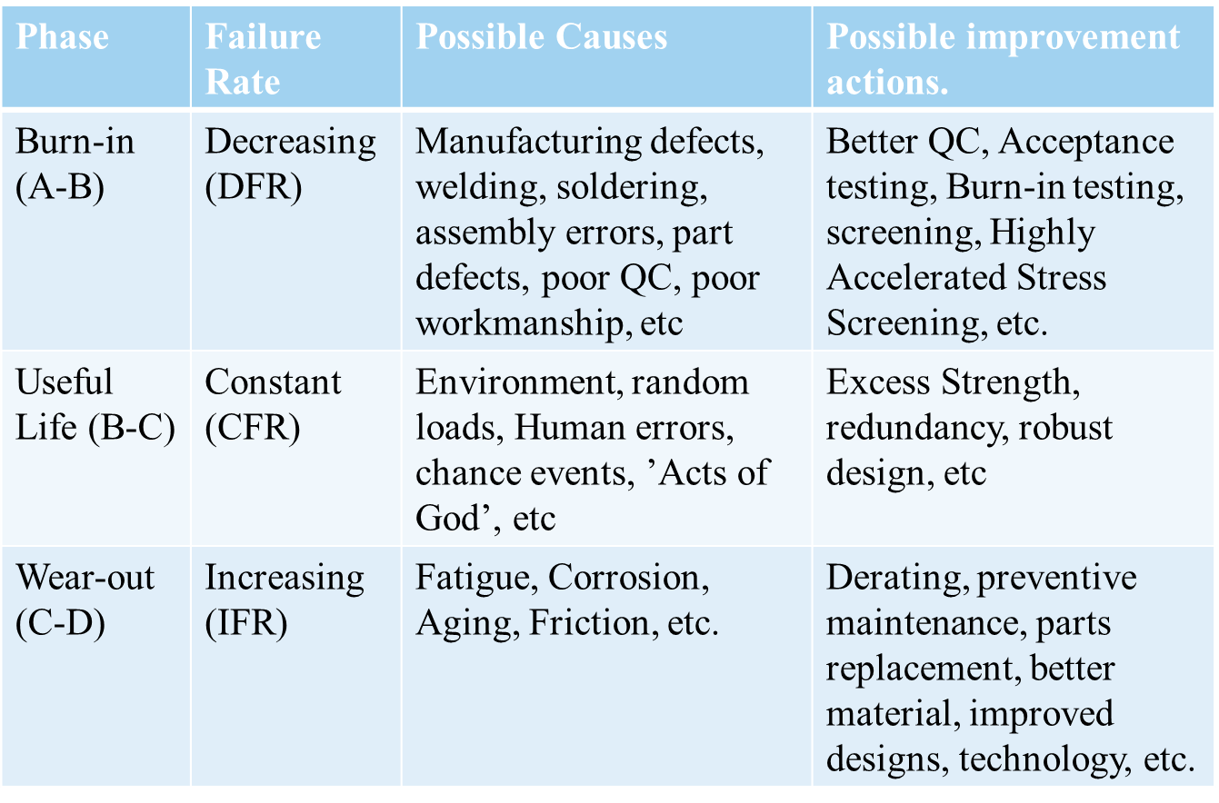
Bathtub Curve: Summary Table

Slide 182
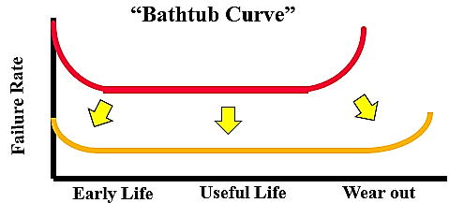
Managing Reliability
Reliability management is concerned with performance and conformance over the expected life of the product
A systems approach to planning for, designing in, verifying, and tracking the reliability of products throughout their life to achieve reliability goals.
Reliability of a system is often specified by the failure rate λ.
λ = failures per time unit (in a collection of systems)
For most technical products (incl. embedded systems), λ(t) is a “bath-tub curve“:

Slide 183
Reliability Characteristics
Non-Repairable Systems:
Reliability=Availability
Failure Rate
MTTF
Time to First Failure
MRL (Mean Residual or remaining Life)
Repairable Systems:
Availability …. (Function of Reliability and Maintainability)
Failure Rate and Repair Rate
MTBF
MRL (Economic Justification)

Slide 184
Failure Rate for Repairable and Non-repairable systems
MTBF θ = Total time / Total Number of failures
Average Failure Rate λ = 1 / θ → λ θ = 1
Example:
1) 300 cars have accumulated 45000 hours, 10 failures are observed. What is the MTBF? What is the failure rate?
Note: considering Car as repairable system, Use MTBF
MTBF = 45000/10 = 4500 hours.
Average Failure rate λ = 10/45000 = 0.00022 per hour.
2) Five oil pumps were tested with failure hours of 45, 33, 62, 94 and 105. What is the MTTF and failure rate?
Note:- considering pumps as non repairable systems, Use MTTF.
MTTF = (45+33+62+94+105) / 5 = 67.8 hours
Failure rate λ= 5 / (45+33+62+94+105) = 0.0147 per hour.
Note that MTTF is a reciprocal of failure rate.

Slide 185
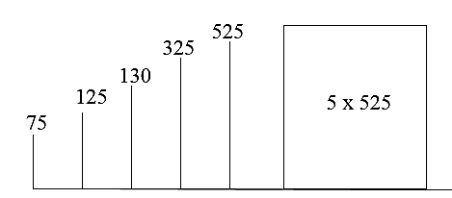
Example
10 components were tested. The components (not repairable) failed as follows:-
Component 1,2,3,4,5 failed after 75,125, 130, 325, 525 hours. Find the failure rate and mean time till failure.
Solution:-
No. of failures = 5
Total operating time = 75 + 125 + 130 + 325 + 525 + 5*525 = 3805
Failure rate λ = 5 / 3805 = 0.001314
Mean time till failure = 1/λ
=1/0.001314
= 761.04 hours.

Slide 186
Example:
50 components are tested for two weeks. 20 of them fail in this time, with an average failure time of 1.2 weeks. What is the mean time till failure assuming a constant failure rate?
Answer:
No. Of failures = 20
Total time = 20*1.2 + 30*2 = 84 weeks
Failure rate = 20/84 = 0.238/week
Mean time till failure is estimated to be = (1/failure rate)
= 1/0.238 = 4.2 weeks.

Slide 187
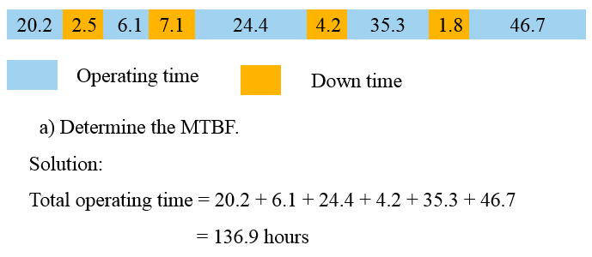
Example
The chart below shows operating time and breakdown time of a machine.

Slide 188
Cont.
λ = 4 / 136.9 = 0.02922
Therefore;
= MTBF = 1/ λ = 34.22 hours
b) What is the system reliability for a mission time of 20 hours?
R = e^{-λt} t = 20 hours
R= e^{-(0.02922)(20)}
^{R = 55.74%}

Slide 189
Maintainability
Maintainability is the measure of the ability of a system or item to be retained or restored to a specified condition when maintenance is performed by qualified personnel using specified procedure and resources.
Maintabnility can be measured with Mean Time To Repair (MTTR), MTTR is average repair time and is given by
MTBMA is Mean Time Between Maintenance Actions including preventive and corrective maintenance tasks.

Slide 190
OBJECTIVES OF MAINTAINABILITY
To influence design to achieve case of maintenance thus reducing maintenance time & cost.
To estimate the downtime for maintenance which, when compared with allowable downtime, determines whether redundancy is required.
To estimate system availability by combining maintainability data with reliability data.
To estimate the man-hours and other resources required for performing maintenance, which are useful for determining the costs of maintenance and for maintenance planning.
ADVANTAGES OF MAINTAINABILITY PREDICTION
It highlights areas of poor maintainability which require product improvement, modification or change of design.
It permits user to make an early assessment of whether the predicted downtime, the quality, quantity of personnel, tools and test equipment are adequate and consistent with the needs of system operational requirements.

Slide 191
Types of system maintenance actions:
corrective maintenance
Actions taken to restore a failed system to operational status,
Usually involves replacing or repairing the component that is responsible for the failure of the overall system,
Corrective maintenance is performed at unpredictable intervals because a component's failure time is not known a priori and
The objective of corrective maintenance is to restore the system to satisfactory operation within the shortest possible time.

Slide 192
Cont.
Diagnosis of the problem
  Maintenance technician takes time to locate the failed parts or otherwise satisfactorily assess the cause of the system failure
Repair and/or replacement of faulty component
  Action is taken to address the cause, usually by replacing or repairing the components that caused the system to fail
Verification of the repair action
  Once components have been repaired or replaced, the maintenance technician must verify that the system is again successfully operating

Slide 193
B) preventive maintenance
The practice of replacing components or subsystems before they fail to promote continuous system operation
The preventive maintenance schedule is based on:
  Observation of past system behavior
  Component wear-out mechanisms
  Knowledge of components vital to continued system operation
Cost is always a factor in the scheduling of preventive maintenance
  Reliability may be a factor, but cost is a more general term because reliability & risk can be expressed in terms of cost
  In many circumstances, it may be financially better to replace parts or components that have not failed at predetermined intervals rather than wait for a system failure that may result in a costly disruption in operations

Slide 194
C) Inspections
Used to uncover hidden failures (also called dormant failures)
In general, no maintenance action is performed on the component during an inspection unless the component is found failed causing a corrective maintenance action to be initiated
Sometimes there may be a partial restoration of the inspected item performed during an inspection
  For example, when checking the motor oil in a car between scheduled oil changes, one might occasionally add some oil in order to keep it at a constant level

Slide 195
Maintenance Downtime
There is time associated with each maintenance action, i.e. amount of time it takes to complete the action.
This time is referred to as downtime & defined as the length of time an item is not operational
There are a number of different factors that can affect the length of downtime
  Physical characteristics of the system,
  Repair crew availability,
  Spare part availability & other ILS factors and
  Human factors & Environmental factors
There are two Downtime categories for these factors: Waiting Downtime & Active Downtime.

Slide 196
Types of Maintenance Downtime
Waiting Downtime
  The time during which the equipment is inoperable, but not yet undergoing repair
  For example, the time it takes for replacement parts to be shipped, administrative processing time, etc.
Active Downtime
  The time during which the equipment is inoperable and actually undergoing repair
  The active downtime is the time it takes repair personnel to perform a repair or replacement
  The length of the active downtime is greatly dependent on human factors and the design of the equipment
  For example, the ease of accessibility of components in a system has a direct effect on the active downtime

Slide 197
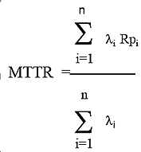
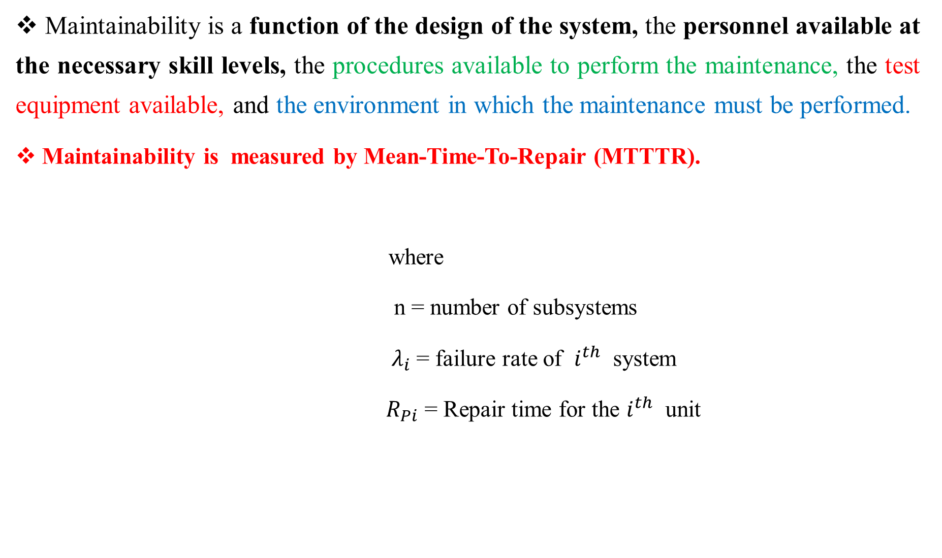
Cont.
Maintainability is a function of the design of the system, the personnel available at the necessary skill levels, the procedures available to perform the maintenance, the test equipment available, and the environment in which the maintenance must be performed.
Maintainability is measured by Mean-Time-To-Repair (MTTTR).
where
n = number of subsystems
$λ_{i}$ = failure rate of $i^{th}$ system
${ R}_{Pi}$ = Repair time for the $i^{th}$ unit

Slide 198
Probability of Repair Within the Allowable Downtime
To calculate the probability of performing a maintenance action within an allowable time interval use:
M(t) = 1 – e ^{- t / MTTR}
Where:
t = Allowable downtime
MTTR= Expected downtime (MTTR)
Mean-Time-To-Repair
The total corrective maintenance time divided by the total number of corrective maintenance actions during a given period of time.
Example: What is the probability of completing an action within 5 hours if the MTTR = 7 hours?
Solution: M(t) = 1 – e ^{- t/MTTR} = 1 – e^{5/7}
= 1 - .4895 = .5105
There is approximately a 51% probability of completion.

Slide 199
Availability
Availability is thus defined as the probability that an item will be available when required or as the proportion of total time that an item is available for use.
May be defined as the probability an item is operable & can be committed at the start of a mission when the mission is called for at any unknown (random) point in time. Example: For a lamp with a 99.9% availability, there will be one time out of a thousand that someone needs to use the lamp and finds it is not operating.
Availability issues deal with at least three main factors for:-
1 - increasing time to failure
2 - Decreasing downtime due to repairs or scheduled maintenance and
3 - Accomplishing items 1 and 2 in a cost be effective manner.
As availability grows, the capacity for making money increases because the equipment is in service a larger percent of time.

Slide 200
Availability analysis of the system requires a knowledge:
How the components are functionally connected.
The failure process of the component.
The method of operation and the definition of the failure.
The repair or maintenance policy
The three common measures of availability are:
1. Inherent Availability (A_{I})
2. Achieved Availability (A_{A})
3. Operational Availability (A_{o})

Slide 201


Inherent Availability (A_{I})
This is the ideal state for analyzing availability. The only considerations are the MTBF and the MTTR. This measure does not take into account the time for preventive maintenance and assumes repair begins immediately upon failure of the system. This can also be defined as steady – state availability.
The measure for inherent (potential) availability (A_{I}) is :
A_{I} =
Where: λ = Failure rate = 1/ MTBF
μ = Repair rate = 1/MTTR
Example: A system has an MTBF of 2080 hours and a MTTR of 10 Hours. What is the inherent availability of the system?
Solution:
A_{I} =

Slide 202

Achieved Availability (A_{A})
Achieved availability is somewhat more realistic in that it takes preventive maintenance into account as well as corrective maintenance. The assumption here is that, as in A_{I}, there is no loss of time waiting for the maintenance action to begin.
The measure for achieved (final) availability (A_{A}) is :
A _{A} =
Where :-
MTBMA is the mean time between maintenance actions both preventive and corrective.
MMT is the mean Maintenance Action Time, and MMT is further decomposed into the effects of preventive and corrective maintenance and is given as:

Slide 203
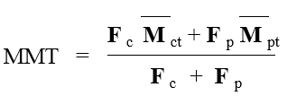
Where: F _{c} is the number of corrective maintenance actions per 1000 hours
F _{p} is the number of preventive maintenance actions per 1000 hours
M _{ct} is the mean active time for corrective maintenance (MTTR)
M _{pt} is the mean active time for preventive maintenance

Slide 204


Example : A system has a MTBMA of 110 hours, a F_{c} of ½, a F _{p} of 1, and M _{CT} of 2 hours, and M _{PT} of 1 hour. What is A _{A} ?
Solution :
First calculate MMT as :
Then determine A _{A} : A _{A} =

Slide 205


Operational Availability ( A ₀)
This is what generally occurs in practice. Operational availability takes into account that the maintenance response is not instantaneous, repair parts may not be in stock as well as other logistics issues.
The measure of operational (actual) availability A ₀ is :-
Where MDT is mean down time.
Example:- given MTBMA = 168 Hours and MDT = 4hours

Slide 206
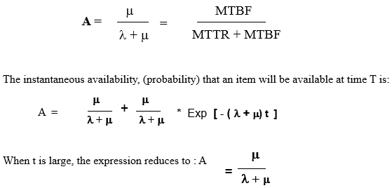
Availability for Constant Failures Rates and Mean Repair Rates
The steady – state availability was given earlier as:

Slide 207
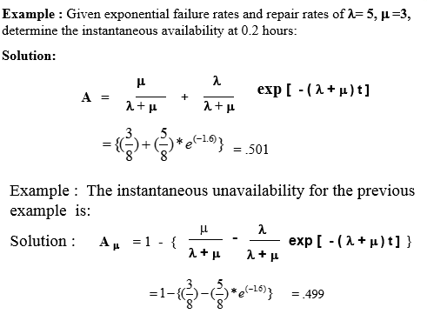

Slide 208
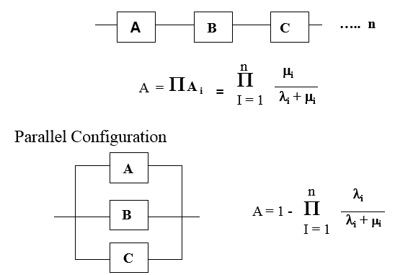
Other configurations to consider: The steady – state [A]
Series Configuration

Slide 209


Slide 210
Capability:- deals with productive output compared to inherent productive output which is a measure of how well the production activity is performed compared to datum. This index measure the systems capability to perform the intended function on a system basis.
In other word Productivity which is the product of efficiency multiplied by utilization. Efficiency measures the productive work output versus the work input. Utilization is the ratio of time spent on productive efforts to the total time consumed.
For example, suppose efficiency is 80% because of wasted labor/scrap generated, and utilization is 82.19% because the operation is operated 300dys per year out of 365 days. The capability is 0.8*0.8219 = 65.75%. These numbers are frequently generated by accounting departments for production departments as a key index of how they are doing.

Slide 211
chapter 9,10&12(Merged)
Maintenance Planning, organizing and network analysis for planning and controlling maintenance work
Maintenance Planning is the advance preparation of selected jobs so that they can be executed in an efficient and effective manner when the job is performed at some future date.
Maintenance Planning is a process of detailed analysis to first determine and then to describe the work to be performed, by task sequence and methodology.
Maintenance Planning provides for the identification of all required resources, including skills, crew size, labor-hours, spare parts and materials, special tools and equipment.
Maintenance Planning includes developing an estimate of total cost and encompasses essential preparatory, post maintenance and restart efforts of both operations and maintenance.

Slide 212
Why is Maintenance Planning Needed?
If the maintenance planning is professionally handled, the effective utilization of maintenance personnel can be increased by as much as 65% and job execution time can be reduced by as much as 40 to 50%.
The principal objectives of maintenance planning and scheduling include:-
Minimizing the idle time of maintenance forces;
Maximizing the efficient use of work time, material, and equipment; and
Maintaining the operating equipment at a level that is responsive to the need of production in terms of delivery schedule and quality.

Slide 213
PRINCIPLES OF PLANNING
Understand the department's mission in relation to the objectives of the company;
Always be aware of the magnitude and trend of backlog;
Quantify the magnitude of the resources effectively available to apply toward relief of the backlog;
Establish a plan for the allocation of available resources to a balanced workweek, considering both long-range importance and short-range necessity;
Categorize work consistent with planned resource allocation categories;

Slide 214
Cont.
Assign a planning priority (within job priority and category) to each job;
Break each job into logically sequenced tasks/activities;
Prepare a "Planning Week" schedule by phases of work planning and by task to determine progress toward completion of each week's work planning;
Work to meet this schedule. Protect it.
Measure progress and contribution.

Slide 215
Sequence of Planning
Scheduling (when to do the job): Scheduling is the process by which required resources are allocated to specific jobs at a time the internal customer can make the associated equipment or job site accessible.
It is the process by which jobs are matched with resources (crafts) and sequenced to be executed at certain points in time.

Slide 216
The maintenance schedule can be prepared in three levels depending on the horizon of the schedule.
The levels are:
medium range or master schedule to cover a period of 3 months to 1 year;
weekly schedule, it is the maintenance work that covers a week; and
the daily schedule covering the work to be completed each day.

Slide 217
Maintenance Job Priority System
The maintenance job priority system has a tremendous impact on maintenance scheduling.
Priorities are established to ensure that the most critical and needed work is scheduled first.
Priority systems typically include three to ten levels of priority.
Most organizations adopt four or three level priorities.
Table below provides classification of the priority level and candidate jobs to be in each class as identified by Duffuaa

Slide 218

Table :- Priorities of maintenance work

Slide 219
Scheduling Techniques
Techniques are developed to develop optimum or near optimal schedules with respect to different possible performance measures.
These are:
1. Gantt Charts and Scheduling Theory
2. Project Scheduling
3. Critical Path Method
4. Program Evaluation Review Techniques (PERT)

Slide 220
1. Gantt Charts and Scheduling Theory
developed by Henry L. Gantt during World War II.
The Gantt chart is a bar chart that specifies the start and finish time for each activity on a horizontal time scale.
It is very useful for showing planned work activities vs accomplishments on the same time scale.
It can also be used to show the interdependencies among jobs, and the critical jobs that need special attention and effective monitoring.

Slide 221

The following Figure shows the simplest form of the Gantt chart in which activities are scheduled at specified dates within the month.

Slide 222
Cont.
Gantt charts can also be used to show the schedule for multiple teams or equipment simultaneously. A case in which three heavy pieces of equipment are scheduled for different jobs throughout the day as shown below.
The chart indicates that jobs 25A and 15D are completed on schedule,
job 25C is behind schedule by about a full day while job 25B is ahead of schedule by about a day, and
job 41E is in progress exactly on schedule.
Jobs 33C and 44E scheduled but have not started yet.

Slide 223

Cont.

Slide 224
2 - Project Scheduling
Network Analysis for Planning and Control of Maintenance Work:-
Network analysis entails a group of techniques for presenting information relating to time and resources so as to assist in the planning, scheduling, and controlling of projects.
The information represented by network, includes the sequences, interdependencies, interrelationships, and critical activities of the project.
This is very useful for projects which are complex in nature or where activities are subject to considerable degree of uncertainty in performance time.

Slide 225
Applications of network techniques are very wide, but are very common in some of the following fields:
(i) Construction of buildings, bridges, highways, railways, stadiums, irrigation projects, factories, power projects etc.
(ii) Assembly line scheduling,
(iii) Development and launching of new products,
(iv) Strategic and tactical military planning,
(v) Research and development,
(vi) Market penetration programmed,
(vii) Planning of political campaigns,
(viii) Maintenance and overhauling of complicated or large machineries,
(ix) organizing big conferences etc.

Slide 226
Advantages of Network Technique:
1. Detailed planning provides better analysis and logical thinking.
2. Identifies the critical activities and focus them to provide greater managerial attention.
3. Network technique enables to forecast project duration more accurately.
4. It is a powerful tool for optimization of resources.
5. It provides a scientific basis for monitoring, review and control, to evaluate effect of slippages.
6. It helps in taking decision;
7. It helps in getting better co-ordination amongst related fields.
8. It is an effective management tool through a common and simple language, providing common understand.

Slide 227
Limitations of Network Techniques:
Network techniques have following limitations:-
Network technique is simply a tool to help the management; hence its effectiveness depends on how well it is used by the management.
Its accuracy depends on the estimation of the data used in the network.
It is useful only if it is updated regularly and decisions for corrective actions are taken timely.

Slide 228
Cont.
The two primary network programming techniques used in project scheduling are the critical path method (CPM) and program evaluation and review technique (PERT)
The main difference between the two is that CPM uses a single estimate of activity time duration while PERT uses three estimates of time for each activity.
Hence, CPM is considered to be a deterministic network method while PERT is a probabilistic method.

Slide 229
Cont.
Both networks consist of nodes representing activities and arrows indicating precedence between the activities.
The objective in both CPM and PERT is to schedule the sequence of work activities in the project and determine the total time needed to complete the project.
The total time duration is the longest sequence of activities in the network (the longest path through the network diagram) and is called the critical path.
Before we proceed by explaining the two methods it is worth noting that PERT and CPM are not well suited for day-to-day independent small jobs scheduling in a maintenance department.

Slide 230
Cont.
However, they are very useful in planning and scheduling large jobs (20 man hours or more) that consist of many activities such as machine overhauls, plant shut downs maintenance activities.
Furthermore, a prerequisite for the application of both methods is the representation of the project as a network diagram, which shows the interdependencies and precedence relationships among the activities of the project.
Formulating the maintenance project as a network diagram helps in viewing the whole project as an integrated system.
Interaction and precedence relationships can be seen easily and be evaluated in terms of their impact on other jobs.

Slide 231
Cont.
The project network representation will be demonstrated by an example from maintenance.
Next Table shows the data for overhauling a bearing in a train cargo carriage. The data shows the normal, crash duration, their corresponding costs, and precedence relationships for each activity.
The term crash time refers to the minimum time the job can be accomplished in (by committing more resources), beyond which no further reduction in the job duration can be achieved.
At this duration any increase in the resources for this job will increase the cost without reducing the duration.

Slide 232


Slide 233
Cont.
Next Figure shows the network corresponding to the data in the table.
It starts with node A with no predecessor activity and it is represented by a circle nearby a number indicating the time.
A itself is a predecessor for three activities B, C, and D drawn as three circles connected to A by arrows to indicate the precedence relation with A. Other activities (nodes) are traced back similarly. The resulting network is terminated by node I that has no successor.

Slide 234

Cont.

Slide 235
Cont.
There are many paths through the network in Figure starting from the first node to the last node. The longest one is called the critical path and the summation of the activity times along that path is the total project duration.
Jobs in the critical path are called critical in the sense that any delay in these jobs would cause a delay in the whole project.
All other paths include slack times (sometimes called floats), i.e. The amount of extra time that activities in the path can be delayed without delaying the completion time of the whole project.
Activities that are not in the critical path may have some slack times, i.e., delaying this activity for one reason or another will not delay the whole project. In this example there are three possible paths shown in the next Table.
Critical activities must be monitored carefully and adhere to their specified schedules; however, non-critical activities can be used for leveling the resources due to the available slacks.

Slide 236

Clearly the project duration is 467 min and the critical path is the first path (A-B-E-G-H-I). Paths 2 and 3 have slacks of 167 and 277 min respectively. In this example, it was easy to go through all possible paths to find the one with the longest time; however, it would be extremely difficult to do the same for larger projects having a large number of activities and more complicated relationships between them.
A systematic approach for identifying the critical path is known as the critical path method (CPM).

Slide 237
3) Critical Path Method
To identify the critical path using the CP method we need to follow the following steps:
1. Develop the project network diagram as shown in the previous section;
2. Perform the CPM calculation to identify the critical jobs (there are jobs on the critical paths and non-critical jobs (which are jobs with float);
3. Perform project crashing to (determine minimum times for each job) reduce project duration and investigate the cost tradeoffs; and
4. Level the resources in order to have uniform manpower requirements to minimize hiring, firing, or over time requirements.

Slide 238
Cont.
The critical path calculation includes two phases. The first phase is the forward pass (starting with the first node and proceeding to the last node). In this phase, the earliest start time, ES, and earliest finish time, EF, are determined for each activity. The earliest start time Esi for a given activity, i, is the earliest possible time in the schedule that activity i can be started.
Its value is determined by summing up the activity times of the activities lying on the longest path leading to it.
The earliest finish time Efi for a given activity i, is its earliest start time plus its activity time Tai.
The calculations for the bearing overhaul example are shown in next Table.

Slide 239

Activity i | Longest forward path
A B C D E F G H I | - A A A A – B A – C A – B – E A – B – E – G A – B – E – G – H | 0 50 50 50 117 140 152 362 427 | 50 67 90 35 35 55 210 65 40 | 50 117 140 85 152 195 362 427 467

Slide 240
Cont.
The second phase is the backward pass (starting with the last node and proceeding back to the first node).
We start this phase by assuming that the total project time Tcp, is the earliest finish time, EF, of the last activity found in the forward pass.
In this phase, the latest finish time, LF, and latest start time, LS, are determined for each activity.
The latest finish time Lfi for a given activity, i, is the latest possible time that activity i must be completed in order to finish the whole project on schedule. Its value is determined by - subtracting from Tcp the activity time along the longest path leading backward from the last node.

Slide 241

For the last activity of the schedule, LF is set to be the total time duration of the project, Tcp. The latest finish time, LFi, for a given activity, i, is its latest finish time minus its activity time Tai.
The calculations for the bearing overhaul example are shown in Table.
Activity i | longest forward path | Length of longest path
I H G F E D C B A | - I I – H I – H I – H – G I – H I – H – F I – H – G – E I – H – G – E – B | 0 40 105 105 315 105 160 350 417 | 467 427 362 362 152 362 362 117 50 | 40 65 210 55 35 35 90 67 50 | 427 362 152 307 117 327 372 50 0

Slide 242

The last step in the analysis of the network is to determine the slack time for each activity Si
It can be determined by the difference between the latest and the earliest start time of the activity. The calculations are shown in Table below.

Slide 243
Cont.
Note that the activities along the critical path (A-B-E-G-H-I) have zero slack times.
Activities not lying on the critical path have positive slacks, meaning that they could be delayed by an amount of time equal to their slack without delaying the project completion time.
The construction of the time chart should be made taking into consideration the available resources, and must take full advantage of the CPM calculation. In some circumstances it might not be possible to schedule many activities simultaneously because of personnel and equipment limitations. The total float for non-critical activities can be used to level the resources and minimize the maximum resource requirement.

Slide 244

4) Program Evaluation Review Techniques (PERT)

Slide 245





Where i is an activity in the critical path

Slide 246



Slide 247


Slide 248

CONT
The critical path calculations lead to the same critical path obtained in the previous CPM calculations. The total project time is expected to be 467 min.
The estimated variance is 213.37 min. The probability that the project will complete in 467 min can be calculated from the standard normal distribution to be 0.5, or the project has a 50% chance of completing in 467 min. The probability that the project may finish in 500 min can be calculated as:
meaning that, the chance of completing the project in 500 min is almost 99%.

Slide 249
Maintenance Organization
Organizing is the process of arranging people and physical resources to carry out plans and accomplish organizational objectives.
  Organization is the process of identifying, classifying, grouping and assigning various activities/responsibilities/ and delegating authority and establishing relationships for the purpose of enabling to work most effectively together in the accomplishments of objectives:

Slide 250
  Determine tasks necessary to attain objectives
  Create jobs and define their duties and responsibilities
  The Organizing Process
  Group jobs into departments
  Create authority/reporting relationship
  Delegate authority

Slide 251
Basic Management Organization Concepts
Establish reasonably clear division of authority with minimal overlap.
Authority can be divided functionally, geographically, or on the basis of expediency; or it can rest on some combination of all three
2. Keep vertical lines of authority and responsibility as short as possible.
Stacking layers of intermediate supervision, or the over application of specialized functional staff aides, must be minimized.

Slide 252
3. Maintain an optimum number of people reporting to one individual.
Good organizations limit the number of people reporting to a single supervisor to between three and six.
4. Fit the organization to the personalities involved.

Slide 253
Factors Affecting Maintenance Organization
Type of operation.
Maintenance may be predominant in a single area—buildings, machine tools, process equipment, piping, or electrical elements and this will affect the character of the organization and the supervision required.
2. Continuity of operations.
Whether an operation is a 5-day, single-shift or, say, a 7-day, three shifts makes a considerable difference in how the maintenance engineering department is to be structured and in the number of personnel to be included.

Slide 254
3. Geographical situation.
The maintenance that works in a compact plant will vary from that the one that is dispersed through several buildings and over a large area.
4. Size of plant.
As with the geographical considerations above, the actual plant size will dictate the number of maintenance employees needed and the amount of supervision for this number.

Slide 255
5. Scope of the plant maintenance department.
Inclusion of responsibility for a number of secondary functions means additional manpower and supervision.
6. Work-force level of training and reliability.
This highly variable characteristic has a strong impact on maintenance organization because it dictates how much work can be done and how well it can be performed.

Slide 256
Lines of Reporting for Maintenance
Many feel that a maintenance department functions best when it reports directly to top management.
If maintenance supervision considers itself part of production and its performance is evaluated in this light, it should report to the authority responsible for plant operations.
Maintenance engineering should report to a level that is responsible for the plant groups which it serves—plant manager, production superintendent, or manager of manufacturing — depending on the organization

Slide 257
Specialized Personnel in Maintenance Organization
Technically Trained Engineers
Combining engineering and supervisory skills assures:
Rapid maturity of newly graduated personnel
Increasingly expeditious work performance through shorter lines of communication.
An early introduction into the art of handling personnel, making them more adaptable to all levels of plant supervision.
Less resistance to new ideas.

Slide 258
Staff Specialists
The use and number of staff specialists—electrical engineers, industrial engineers, metallurgists — depends on availability, required need for specialization, and the economics of a consulting service’s cost compared to that of employing staff experts.
Clerical Personnel
Paperwork should be minimized consistent with good operations and adequate control; the clerical staff should be designed to relieve supervision of routine paperwork that it can handle. The number of clerks used varies from 1 per 100 employees to 1 per 20 to 25 employees.

Slide 259
Manpower Requirements
The number of employees— labor and supervision — to assure adequate plant maintenance coverage depends upon many factors.
Each plant must be treated as a separate problem with a consideration of all its unique aspects.
Hourly Personnel:
    Ratio of Maintenance Manpower to Total Operation Personnel
    Crafts That Should Be Included.

Slide 260
Selection and Training
a. Selection – Craft Personnel
Bases for selection could be:
  education,
  general intelligence,
  mechanical aptitude, and
  past experience
b. Training—Craft Personnel
  Formal Instruction
  Informal Instruction
  On-the-Job Training

Slide 261
c. Selection—Supervisory Personnel
Although there are advantages in selecting people entirely from among maintenance employees, others who display leadership potential should be considered.
d. Training—Supervisory Personnel
This training consists of initial orientation; a formalized, sustained program of leadership training; and on-the-job coaching and consultation.

Slide 262
Orientation gives the candidate basic data about the management team she/he is joining and about company and department policy.
Included also are facts about the scope of her/his personal responsibilities and the limits of the authority delegated to her/him.
Training ensuring continued effectiveness and improved performance should include such subjects as human relations, conducting of interviews, teaching methods, safety, and many more.
Goals of this part of the program should head toward increasing the candidate’s effectiveness as supervisor, instilling a feeling of unity with fellow managers, and enhancing personal development.

Slide 263
CONT
On-the-job coaching is especially important for the embryo supervisor.
There is no substitute for frequent, informal, personal contact with a superior concerning current technical, personnel, or personal problems.
This type of development is a force for high morale and job satisfaction.
It should include both praise and criticism, the former sincere, the latter constructive.

Slide 264
Area and Centralized Maintenance Control
Geography: The distribution of men, tools, material, etc., to positions within the plant site, geographically central meaning all men, tools, and material located at one point.
Organization: The direct organization control of craftsmen, including their supervision, scheduling, and guidance, organizationally central meaning the control of all maintenance in the facility by one person below the level of site manager.

Slide 265
Organizationally Central
Organizationally Area
Various Combination
Geographically Area
Geographically Central

Slide 266
CHAPTER 11&13(Merged)
Spares provisioning and reconditioning process
11. SPARES PROVISIONING
Industry with a high level of investment, such as the oil and gas industry, needs a high level of availability.
Product support and its related issues such as spare parts play an important role in maintaining a system at a desired level of availability.
Reliability performance is a critical factor for product support and spare parts planning which can be influenced by operational environment. Therefore, all influence factors (covariates) on reliability performances must be considered in order to predicate the required number of spare parts.

Slide 267

Cont’d
In general, provisioning means "providing" or making something available. The term is used in a variety of contexts.
11.1 Spares management

Slide 268
Criteria for Decision Making
Instant reliability
Interval reliability
Cost minimization
(Process) Availability

Slide 269
Cont’d
Due to the technology and economic issues, it is not possible to design a system without failure. Therefore, it is necessary to adopt appropriate and well-scheduled activities regarding support and spare parts to assure the desired level of availability throughout the system’s life.
However, spare parts provisioning is a complex problem and requires an accurate analysis of all factors that may affect the required number of spare parts.

Slide 270
Cont’d
Different reliability based statistical approaches have been developed for spare parts provision. The methods can be categorized in two main groups;
  Analytical methods, and
  Simulation methods.
The analytical methods are based on Renewal theory for non-repairable items. Birth and Death process have been frequently used for repairable items in the analytical methods.
The Monte Carlo method is one of the main simulation methods
In the reliability-based spare parts provision,
First step is to identify the reliability performance and failure rate of the item.
Second the number of the required spare parts and the probability of spare part availability can be estimated, However, to have an effective prediction, any factors which have an influence on the reliability performance of the item must be considered.

Slide 271
Cont’d
The reliability performance of an item can be influenced by different factors such as:
  The operational environment,
  Geographical location,
  Design material, maintenance history,
  Operator and
  Maintenance crew skill, etc.
The factors that may have an influence on the reliability performance of an item are referred to as covariates. Ignoring such covariates may lead to wrong result in reliability performance analysis and consequently on spare parts provisioning.

Slide 272
Cont’d
Spare parts are held to reduce the consequences of equipment downtime, playing an important role in achieving the desired equipment availability at a minimum economic cost.
The gap between theory and practice of spare parts management is investigated from the perspective of software integration, maintenance management information systems.

Slide 273

Cont’d

Slide 274
Objectives of spare parts management
The key questions in spare parts management are to decide which items are to be stocked as spare parts, when to (re)order them and how many items to (re)order. In this decision-making process, we should be clear about the objectives.
Maximizing spares’ availability,
Minimizing the economic costs. Is the sum of the inventory holding costs, stock-out penalty costs and ordering costs, and
Minimize enviromental costs

Slide 275
Main tasks of spare parts management through equipment lifecycle process
Equipment life cycle cost is closely connected to investment and management of spare parts inventories. In general, the equipment lifecycle process can be divided into three main phases, namely
    Initial procurement phase,
    Normal operation phase, and
    End-of-life phase.
The main tasks of spare parts management for each phase of the product lifecycle process are summarized below.
Initial procurement phase :
When a complicated piece of equipment is bought, spare parts are often bought simultaneously to satisfy the needs of equipment maintenance.
Then a decision must be made on the spare parts initial provisioning, and an inventory and forecasting system must be designed in advance.

Slide 276
Cont’d
Normal operation phase :
When equipment is used by the user, preventive maintenance may be carried out to prevent failure, while corrective maintenance is carried out as failures occur
In order to satisfy the needs of maintenance, a certain number and kinds of spare parts are supplied.
Successful equipment management depends on the proper execution of spare parts control is needed.
Therefore, the inventory system and forecasting parameters should be optimized (or at least improved) to provide sustainable supply support according to the operational requirements of the equipment.

Slide 277
Cont’d
End-of-life phase :
In Phase 3, a fundamental issue of supply chain design is whether products, or their components, should be reused, leading to refurbishment or remanufacturing, If not, then it may sometimes be necessary to set a ﬁnal order on spare parts according to the demand patterns at the end of the product life cycle (known as an ‘all-time buy’ or ‘last-time buy’).
This prompts a number of design issues to be resolved, including the methodologies for classifying and forecasting the demand, taking into account that no more orders may be made and simulating the consequences of alternative strategies for these parts in the end-of-life phase.

Slide 278
Forecasting
Forecasting spare parts demand is a basic requirement of spare parts management.
Because of the demand characteristics of spare parts, it is very diﬃcult to accurately forecast demand in this area.
the critical challenges of inventory management in service parts are inaccuracy of service parts forecasts ranks number two in the top ten challenges.
So it has been a hot topic in the industrial ﬁeld as well as in academic research.
There are many forecasting techniques and this section restricts attention to those forecasting methods which have been suggested for spare parts.
From a product lifecycle perspective, there are three kinds of forecasting tasks namely forecasting initial demand, ongoing demand and demand over the ﬁnal phase.

Slide 279
a. Time-series based forecasting
Forecasting approaches categorized in to three groups these are:
A time series is deﬁned as a time-ordered sequence of observations taken at regular intervals (e.g., hourly, daily, weekly, monthly, quarterly, annually).
Time-series forecasting is based on the assumption that future values of the series can be estimated from past values.
If there is sample historical data, time-series based forecasting is commonly used to forecast spare parts demand in practice.

Slide 280
b. Reliability based forecasting
The most appropriate time-series based forecasting approach depends on the availability of historical data.
In some cases, there is little time series data available to forecast the future demand. In such cases, practitioners can use reliability and maintenance variables to forecast spare parts demand, as long as these variables are known or may be estimated.
These models may also prove beneﬁcial when more extensive historical demand data are available, depending on their predictive strength.

Slide 281
c. Judgmentally based forecasting
There is some element of judgment in almost all forecasting processes.
In some cases, a forecast may be purely judgmental. For example, for new products, it may not be possible to generate a statistical forecast because of the lack of historical data on sales.
In other cases, a statistical forecast may be produced, but is then amended by a demand planner in the light of the planner’s judgment about changes in the internal or external environments.

Slide 282
11.2 Spare Parts Identification process
To stay in business, equipment manufacturers are expected not only to meet the needs identified by the client, but also to anticipate these needs and to demonstrate that the products and services offered are equivalent, if not superior to what is available on the market.

Slide 283


Slide 284
Decision tree with filters
Decisions are based on the manufacturers’ recommendations or on information from owners of similar equipment.
When complete information is available, then the decision-maker chooses the criteria according to which the components will be evaluated to determine if they should be on the list of spare parts.
A list of potential criteria is given in previous figure.
According to the criteria retained, evaluation and final decision-making methods are to be selected next.
Each component of the equipment is then evaluated according to the criteria and a total score is obtained.
A list of potential methods is also provided in previous figure.
A ranking of the components based on the final scores gives an ordered list of potential spare parts.

Slide 285

Desion tree
A ranking of the components based on the final scores gives an ordered list of potential spare parts. Once the preliminary list of spare parts is established, it is subjected to filters to select the parts to hold in stock and those to be supplied as needed.
This tree takes into account the cost of acquisition or production, repair costs, delays, whether there are early signs of failure or not, and if the component is a standard part or not. A standard part is a generic mass-produced part readily available at reasonable to low cost (e.g., seals, nuts and bolts, high replacement rate parts).
Selected components are then ranked in order of importance. This classification allows to pay more attention to the components considered as being more important, especially if the list of spare parts includes a large number of components and the resources available are limited or scarce.
Decision criteria most often used to justify that a spare part must be kept in stock to serve as a replacement are: criticality, reliability, availability, impacts of failure, failure rate and maintenance costs incurred in case of failure.
Any component i with RGi ratio greater than 1, is then kept in store as a spare.

Slide 286


Slide 287

Determination of the required quantity of non repairable spares
For each component requiring spare parts, it is important to estimate the required amount of spares needed throughout the economic life cycle of the equipment.
To achieve this, one must estimate the average number of replacements at failure and, where applicable, the average number of preventive replacements.

Slide 288
Determination of the required quantity of repairable spares
A failed component, according to its degradation state, is repaired and put back in a “as new condition” or put in a state where it can resume operation.
The acquisition cost of these repairable components is generally high. If the repair is found to be not feasible for technical, economical or other reasons, the failed component is sent to a recycling or disposal facility.

Slide 289
13. Reconditioning processes
To recondition a machine or piece of equipment means to repair or replace all the parts that are damaged or broken by repairing it, cleaning it, or replacing parts
Synonyms: restore, repair, renew, overhaul

Slide 290
Main elements which wants recondition before putting the vehicle on the lot
The reconditioning process ensures each vehicle is in good working order. Here are a few of the parts may need repair or replace before putting the vehicle on the lot:-
          A/C and heater
          Lights and radio
          Warning lights
          Engine and airbag warning lights
          Brakes
          Exhaust system
          Ignition system

Slide 291

Used Car Inspection Checklist

Slide 292

Cont’d

Slide 293

Cont’d

Slide 294
Example: Battery Reconditioning
The process of reconditioning a car battery is an operation that attempts to restore the ability of a dead battery to receive and store charge.
This process is a simple and straightforward operation that can be done in two ways. Almost the same method that uses different mediums.
The first option is restoring a dead car battery with the use of Battery Chem while the other method is carrying out the same process with the use of the Epsom Salt battery recipe solution.
During the process, both of the agents break down the sulfate buildups within the battery and its lead plates. This allows them to regain their ability to take in electricity and store it then convert it to power. Both of these processes are suitable for dead automotive batteries.

