Slide 1

Maintenance and Installation of Machinery
DEBRE MARKOS UNIVERSITY
INSTITUTE OF TECHNOLOGY
SCHOOL OF MECHANICAL & INDUSTRIAL ENGINEERING

Slide 2
Chapter one
Introduction to maintenance and Installation of machinery
History of maintenance
First generation
In the period of pre-World War II, people thought of maintenance as an added cost to the plant which did not increase the value of finished product.
Therefore, the maintenance at that era was restricted to fixing the unit when it breaks because it was the cheapest alternative

Slide 3
Second Generation
During and after World War II at the time when the advances of engineering and scientific technology
developed,
people developed other types of
maintenance, which were much cheaper such as
preventive maintenance.
In addition, people in this era classified
maintenance as a function of the production system.

Slide 4
Third Generation
Nowadays, increased awareness of such issues as environment safety, quality of product and services makes maintenance one of the most important functions that contribute to the success of the industry.
World-class companies are in continuous need of a very well organized maintenance programmed to compete world-wide.

Slide 5
1.1 Maintenance definition?
Maintenance: Keeping something in good condition by checking or repairing it regularly ,
Maintenance consists of those activities required to keep a facility in original (i.e. as-built) condition so that its designed productive (or performance) capacity remains unchanged.
Maintenance can be defined as a combination of actions carried out to repair, replace or service the components with an aim to bring the servicing unit to original (or as original) condition so that it can operate designed capacity for a specified period of time.

Slide 6
Con..
Maintenance is a set of organized activities that are carried out in order to keep an item in its best operational condition with minimum cost acquired.
Maintenance Activities
Activities of maintenance function could be either repair or replacement activities,
Maintenance activities are necessary for an item to reach its acceptable productivity condition and these activities,
It should be carried out with a minimum possible cost.

Slide 7
In other words, maintenance can also be defined as follows
Maintenance is the totality of all measures directed towards control (preservation and restoration) of the performance of a plant.
It is an auxiliary process in a production process directed towards a high effectiveness of the main process.

Slide 8
1.2 Trends in the Evolution of Maintenance
According to John Moubray , author of Reliability Center Maintenance, the evolution of maintenance since the 1930’s can be traced through three generations. The distinction between these generations depends up on basically three technical factors:
    Growing expectations of maintenance,
    Changing view on equipment failures, and
    Changing maintenance techniques

Slide 9
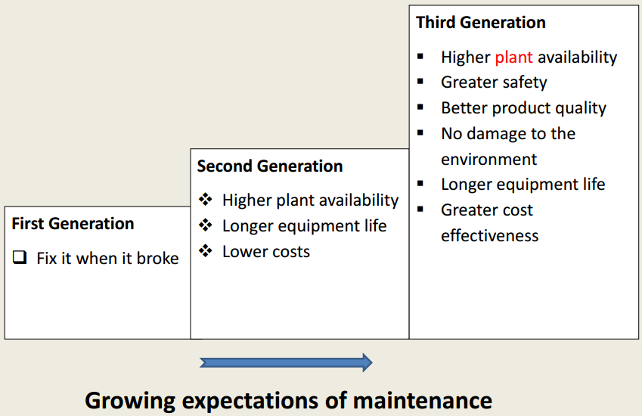

Slide 10
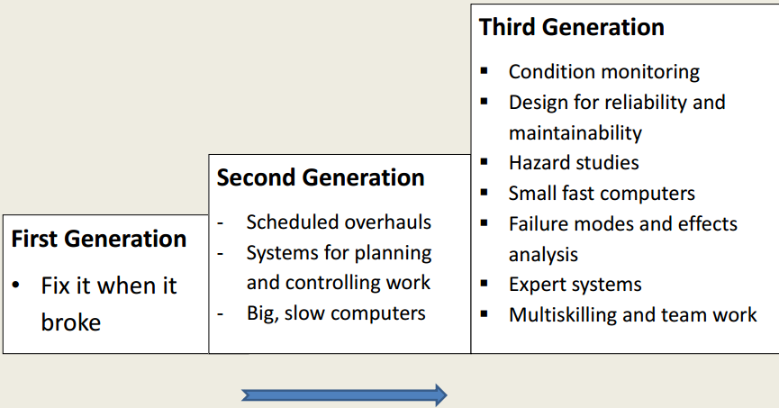
Changing maintenance techniques

Slide 11
1.3 Maintenance Objectives
Maintenance objectives should be consistent with and subordinate to production goals.
The relation between maintenance objectives and production goals is reflected in the action of keeping production machines and facilities in the best possible condition.

Slide 12
Basic Maintenance Objectives
Improving equipment efficiency and reducing scrap rate.
Minimizing energy usage.
Optimizing the useful life of equipment.
Reducing downtime.
Providing reliable cost and budgetary control.
Identifying and implementing cost reductions.

Slide 13
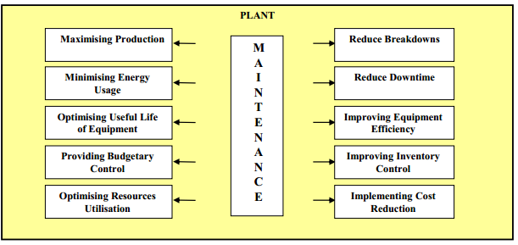
Figure 1.1 Maintenance Objectives

Slide 14
1.4 Types of Maintenance
Different authors categorize maintenance in variety forms. The most acceptable ones is
  Planned maintenance
  Unplanned maintenance

Slide 15
TYPES OF MAINTENANCE
Maintenance
Planned Maintenance or Scheduled Maintenance or
Systematic Maintenance or Routine Maintenance
Unplanned Maintenance
Preventive Maintenance
Corrective Maintenance
Running Maint.
Predictive Maint.
Shutdown Maint.
Design Out Maint.
Shutdown Maint.
Breakdown Maint.
Emergency Maint.

Slide 16
1. PLANNED OR SCHEDULED MAINTENANCE
It is basically done for two purposes:
To prevent the occurrence of breakdown and,
If breakdown has occurred then to restore it to original condition

Slide 17
A. Preventive Maintenance
Principle – “Prevention is better than cure”
Procedure - Stitch-in-time
It is done to keep an equipment or machinery in a satisfactory operating condition through regular inspection, calibration, lubrication, overhauling, or replacement of certain components. It is action before breakdown occurs.

Slide 18
Cont..
Preventive Maintenance
It is a set of activities that are performed on plant equipment, machinery, and systems before the occurrence of a failure in order to protect them and to prevent or eliminate any degradation in their operating conditions.
the maintenance carried out at predetermined intervals or according to prescribed criteria and intended to reduce the probability of failure or the degradation of the functioning and the effects limited.
Its activities include adjustments, major overhauls, inspections and lubrications.

Slide 19
Con…
The factors that affect the efficiency of PM of maintenance
1.The need for an adequate number of staff in the maintenance
department in order to perform this type of maintenance,
2. The right choice of production equipment and machinery that is
suitable for the working environment and that can tolerate the workload of this environment,
3. The required staff qualifications and skills, which can be gained through training,
4. The support and commitment from executive management to the PM program,
5. The proper planning and scheduling of PM program, and
6. The ability to properly apply the PM program.

Slide 20
Advantages Of Preventive Maintenance
  Reduction in downtime,
  Reduction in loss of production,
  Reduction in repair and replacement cost,
  Fewer stand-by equipment required,
  Less expenditure on maintenance personnel due to over time,
  Fewer parts to be stored,
  Higher safety level in the shop, and
  Planned output possible to maintain.

Slide 21
Preventive Maintenance is divided into four categories
Running Maintenance is done even when the machine or equipment is in service.
Shut-down Maintenance which is a set of preventive maintenance activities that are carried out. When the production line is in total stoppage situation
Design-out Maintenance Equipments are designed that no maintenance should be required or at worst least maintenance should be done.
Predictive Maintenance is done on the information received regarding the performance of an equipment or machinery.

Slide 22
Predictive Maintenance (PDM)
PDM is classified into two kinds according to the methods of
detecting the signs of failure:
1, Condition-based predictive maintenance, and
2, Statistical-based predictive maintenance.
Condition-based predictive maintenance depends on continuous or periodic condition monitoring equipment to detect the signs of failure.
Statistical-based predictive maintenance depends on statistical data from the meticulous recording of the stoppages of the in-plant items and components in order to develop models for predicting failures.

Slide 23
B. Corrective Maintenance
On this type, actions such as repair, replacement, or restore will be carried out after the occurrence of failure in order to eliminate the source of this failure or reduce the frequency of its occurrence
corrective maintenance:- is done to bring the machinery to original performance level, by minor adjustments of certain knobs, or key units or replacing some worn-out parts.
This could be
  Complete failure
  Minor failure

Slide 24
  Corrective Maintenance Could be:
  Deferred CM ,
  Shutdown CM.
Deferred maintenance: which is a set of corrective maintenance activities that are not immediately initiated after the occurrence of a failure but are delayed in such a way that will not affect the production process
Shutdown corrective maintenance, which is a set of corrective maintenance activities that are performed when the production line is total stoppage situation.

Slide 25
TYPICAL CAUSES OF EQUIPMENT BREAKDOWN
Lack of lubrication
Failure of cooling system
Failure to replace worn-out parts
Negligence to rectify minor faults
Too high or too low voltage supply
Wrong fuels used
Uneven working parameters
Unsound foundation, etc.

Slide 26
Disadvantages of Corrective Maintenance
Breakdown generally occurs inappropriate times leading to poor and hurried maintenance
Excessive delay in production & reduces output
Faster plant deterioration
Increases chances of accidents and less safety for both workers and machines
More spoilt or failed materials
Direct loss of profit
Can not be employed for equipment regulated by statutory provisions e.g. cranes, lift and hoists etc.

Slide 27
Maintenance Costs
Cost
Total Maintenance Cost
PM Cost
Breakdown Cost
Optimal
Maintenance
Commitment

Slide 28
1.5 Introduction to Machine Installation
Machine:
It is a device that takes some energy as input and transforms it to another useful form of energy as output.
Machine Installation:
It is the process of fixing and erecting the machinery in an industry so that they can be put to use for productive purposes

Slide 29
Why Machine installation is necessary?
It is the first step in the productive process of any newly established plant.
Where to install machinery?
The installation of light machinery used for domestic use may not require any expertise, where as the installation of the machinery used in the industry need attention as the performance of the machinery largely depend upon proper installation.
How to install machinery?
The installation process may differ from machine to machine and it is largely depend upon the main specifications of the machines to be installed.

Slide 30
Factors to be considered before installing the machinery
It is important that as much information as possible be supplied regarding the machine to be installed, this will include:
    Machine size and weights
    Any dynamic features of its operation
    Location including ground type, condition where optimal performance is required
    Vibration analysis of the machine
    Site conditions

Slide 31
FOUNDATION REQUIREMENTS
A. Building Foundations
Footings and foundations as having two functions:
1. To transfer the live and dead loads of the building to the soil over a large enough area so that neither the soil nor the building will move
2. In areas where frost occurs, to prevent frost from moving the building
Dead loads are the weight of the building materials and the soil surrounding the foundations.
Live loads include the weight of people, furniture, snow, rain, and wind.

Slide 32
B. Machine Foundations
The main purpose of machine foundations is to stabilize the machine as well as to reduce the vibrations caused due to the operation of the machine.
The foundation thus positively influences machine vibration by reducing the amplitude of oscillation.
The first step in machine installation is to find out whether it is required to build a special foundation for installation or it is possible to use the existing floor.

Slide 33
Foundation Requirements for machine installation
If the existing floor, where the machinery is to be installed, does not meet the following minimum requirements, It is required to build a foundation.
The area of the floor where the machine frame is to be located must be a single, homogeneous slab in good condition.
The floor must be 4" to 6" thick (It is not a constant and may change depending upon the type and weight of machinery).
The floor must be capable of supporting 3.5 tons/ft² (This is also not a constant one and may subject to change depending upon the type of machine going to be installed and the floor must be level to 0.032"/ft).

Slide 34
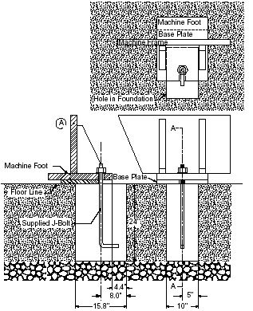
Methods of machine installation
There are two types of machine installations in practice, which include both foundation anchoring and floor installation procedures. The following sections will explain these methods.
1. Foundation Anchoring Procedure
Installing the machine
using foundation & J-bolt

Slide 35
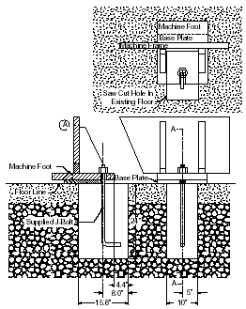
2. Floor anchoring method
Installing the machine using
existing floor & J-bolt

Slide 36

MACHINE LEVELING
Proper Machine leveling is critical in the machine installation for the desired machine performance.
The term leveling, with respect to machinery installation, means the operation of placing machinery or equipment on a true horizontal plane.
The flatness of the floor plays an important step in the levelling procedure of the machine.
ALIGNMENT OF SHAFTS
Proper shaft alignment is achieved when the two centerlines
of coupled machinery are the same or collinear.
There are two types of coupling or shaft misalignment: angular misalignment and parallel misalignment

Slide 37

Angular misalignment is a condition where two shaft centerlines are at an angle to each other.
Parallel misalignment is a condition where no angular
misalignment exists and the shafts are parallel, but offset
from each other.

Slide 38
Four basic steps are required to correct misalignment:
1. Correct for angular misalignment in the side view plane

Slide 39
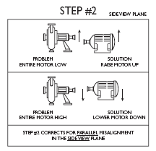
2. Correct for parallel misalignment in the side view plane

Slide 40
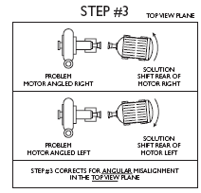
3. Correct for angular misalignment in the top view plane

Slide 41
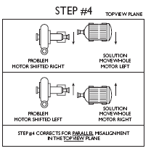
4. Correct for parallel misalignment in the top view plane

Slide 42
Reading assignment
Difference between Maintenance and Repair ???
Thank you !

