Slide 1
ECEG-4251,Power System Planning and Management
Lecture 3
Transmission and Distribution Planning and Design
Instructor: Yalew Gebru (MSc.)
School of Electrical & Computer Engineering
Institute of Technology
Debre Markos University
P.O.Box 269, Debre Markos, Ethiopia
E-mail: yalew1404@gmail.com
28 April 2020

Slide 2
ECEG-4251,Power System Planning and Management
  Lecture Outline:
  Classification and Characteristics of Transmission Lines
  HVAC and HVDC Transmission Systems
  Critical Considerations for Transmission system Planning
  Steady State Stability Analysis
  Transient Stability Analysis
  Reactive Power Compensating Equipments
  Transmission and Substation Design and Modelling
  Distribution system planning
  Power System Network in Ethiopia

Slide 3
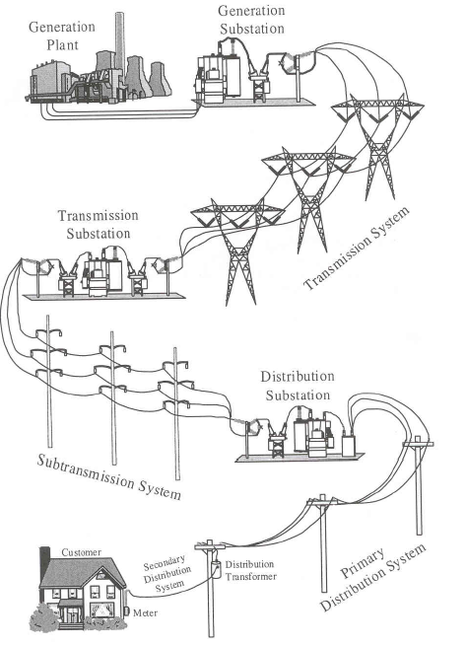
ECEG-4251,Power System Planning and Management
This transmission and distribution (T&D) system consists of thousands of transmission and distribution lines, substations, transformers, and other equipment scattered over a wide geographical area and interconnected so that all function in concert to deliver power as needed to the utility's customers.

Slide 4
ECEG-4251,Power System Planning and Management
Objectives:
The transmission planning determines the expansion or rehabilitation plan of transmission system based on the existing system, forecasted demand, generation schedule and generation location at a least cost, stable, reliable and efficient planning criteria.
In the transmission network planning some of the following issues, but not limited, shall be appraised:
The need for new substations and transmission lines as well as the need for reinforcement in the existing system
The voltage levels and right-of-way constraints
The investment cost, O&M cost
Line loadability, reliability, stability analysis
substation Capacity, reliability and switching stability
Compensating equipment requirements for voltage stability
System network stability (Voltage magnitude, generator angle or voltage angle and Frequency) and reliability during contingency and fault cases
Modelling each component of a power system and analysis the steady state and transient stabilities as well as the fault levels at each node of the network.

Slide 5
ECEG-4251,Power System Planning and Management
INTRODUCTION
Transmission of electric power has been along the years and will still continue one of the most important elements of today’s electric power systems. Power transmission from generating stations to industrial sites and to substations is the fundamental objective of the transmission systems.
This function is accomplished by overhead AC or DC transmission lines or underground cables that connect the power plants in to the transmission network, interconnect various areas of transmission networks, interconnect one electric utility with another, or deliver the electric power from various areas within the transmission network to the distribution substations, from which the distribution systems supply residential and commercial consumers.
The planning studies take a leading role in the definition of an electric system or in its expansion. Due to the several variables involved in the process, the planning activities have to start several years before a new installation or an expansion of an existing one is planned to be implemented.

Slide 6
ECEG-4251,Power System Planning and Management
A transmission line project may be considered as being initiated with some planning activities long before its execution can be started. Several stages are usually necessary inside a power utility before a new transmission system from its conception until its completion is energized.
The conception of a transmission line and of the associated substations starts in the long-term planning with initial system evaluations and continues with further steps of medium-term planning and finally with the detail design and installation of the line and then the granting of operation licence and approval.

Slide 7
ECEG-4251,Power System Planning and Management
For completing the preliminary studies of a new line, some complementary studies of performance assessment are carried out such as:
  Rout length alternatives,
  Line loadability,
  Voltage level and number of circuits,
  Reactive compensation needs,
  load-flows and stability,
  Transposition needs,
  Switching surge over voltages,
  Short-circuit levels,
  Reliability evaluation and Contingency evaluations.
Finally, the line owner proceeds to the line basic design and then detailed design with all associated activities. The last stages consist in establishing the rights-of-way, performing and approving environmental impact studies and providing indemnification or compensation to the land owners affected by the new line in order to obtain their agreement. Only then survey and construction can legally be started and carried out until completion. The commissioning of the line and start-up of operation ends the process.

Slide 8
ECEG-4251,Power System Planning and Management
  3.1 Classification and Characteristics of Transmission Lines
As pointed out in the introduction of the course, an Electrical power system can be considered to consist of a Generation system, a Transmission system, a Sub-transmission system and a Distribution system. Between a generating station and a customer we have transmission, sub-transmission and distribution levels of voltage. Since the long distance transmission at high voltage is cheap and, low voltages are required for utility purposes, the voltage level goes on decreasing from bulk transmission system to the distribution system.
In general, the generation & transmission systems are referred to as bulk power supply, and the sub-transmission and distribution systems are considered to be the final means to transfer the electric power to the ultimate customer.
Bulk power transmission is made of a high-voltage network, generally 132-765 kV alternating current, designed to interconnect power plants and electrical utility systems and to transmit power from the plants to major load centres.
The Sub-transmission refers to lower voltage network, normally 34.5 – 115 kV, interconnecting bulk power and distribution substations. While the Distribution system refers for all voltage levels below 34.5 kV

Slide 9
ECEG-4251,Power System Planning and Management
An electric transmission line has four parameters, namely resistance, inductance, capacitance and shunt conductance. The electrical design and performance of a line are dependent on these parameters. These parameters are uniformly distributed along the whole line. Each line has its own value, and it is not possible to concentrate or lump them at discrete points on the line. For this reason the line parameters are known as distributed parameters. Their values are given in per unit length of line and they are denoted as R, L, C and G respectively.
The line parameters are functions of the line-geometry, construction material and operational frequency. The line resistance and inductance form the series impedance of the line. While the capacitance and conductance form the shunt admittance of the line.
These parameters together with the load current and power factor determine the electrical performance of the line. The term performance includes the calculation-end voltage, sending-end current, sending-end power factor, Power loss in the line, efficiency of transmission, regulation and limits of power flow during steady-state and transient conditions.

Slide 10
ECEG-4251,Power System Planning and Management
Transmission lines are classified in to short, medium and long groups according to the length of the transmission lines. The performance of one or more of the parameters of a line is governed by its length and conductor configuration.
For overhead lines up to 80 km the capacitance C and shunt conductance G are negligibly small but for cable lines where the distance between the conductors is small, the effect of capacitance can not ignored. All low-voltage overhead lines having lengths up to 80 km are generally classified as Short lines.
The lines ranging in length from 80 to 240 km are termed as Medium or moderately long lines. For these lines, the capacitance of the line cannot be neglected and it’s considered to be lumped at one or more points of the line. The effect of capacitance is more at higher frequency. The leakage conductance or leakance is neglected.
The term Long line refers to a line having its length more than 240 km. The long line treatment takes all the four parameters in to account and allows for the fact that they are distributed uniformly over the entire length of the line.

Slide 11
ECEG-4251,T & D Planning – Transmission Line Voltage Selection
We also distinguish five types of power transmission lines according to their voltage class:
  Low-voltage (LV) lines provide power to buildings, factories, and houses to drive motors, electric stoves, lamps, heaters, and air conditioners. The lines are insulated conductors, usually made of aluminium, often extending from a local pole-mounted distribution transformer to the service entrance of the consumer.
  Medium-Voltage (MV) lines tie the load centres to one of the many substations of a utility company. The voltage is usually between 2.4 kV and 69 kV. Such medium voltage radial distribution systems are preferred in larger cities. The radial systems spread out like fingers from one or more substations to feed power to various load centres such as shopping centres and campuses.
  High-Voltage (HV) lines connect the main substations to the generation stations; connect two isolated sub-transmission systems or two separate generation stations. The lines are composed of aerial conductors or underground cables operating at voltage range from 69 kV to 230 kV levels.

Slide 12
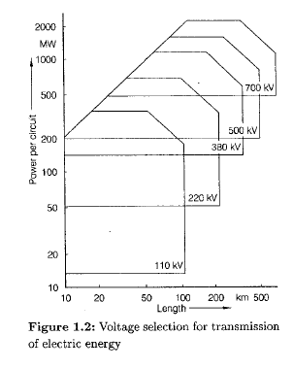
ECEG-4251,T & D Planning – Transmission Line Voltage Selection
  Extra-high-Voltage (EHV) lines are used when generating stations are very far from the load centres. These lines are put in separate class because of their special electrical properties. Such lines operate at voltage levels of 230 kV to 760 kV and may be used for long transmission lines.
  Ultra-high-Voltage (UHV) lines transfer bulk electrical energy from remote large scale power stations to the extra-high or high voltage substations. The voltage above 760 kV is called Ultra high voltages (UHV).

Slide 13
ECEG-4251,T & D Planning – Transmission Line Voltage Selection
The system voltage very much affects the capital cost of a transmission line. The weight of conductor material, the efficiency of the line, the voltage drop in the line and the system stability depend upon the system voltage. The choice of voltage, therefore, becomes a major factor in the line design.
Consider an n-phase system of transmission, let
P = power to be transmitted per phase in watts,
V = Voltage to neutral in volts,
I = current in each phase in amperes,
L = length of the line in meters,
A = cross-sectional area of each conductor in m2,
ρ = Specific resistance of the conductor material in ohm-m,
R = resistance of each conductor in ohms,
α = Current density in A/m2, and
= power factor of the load.

Slide 14
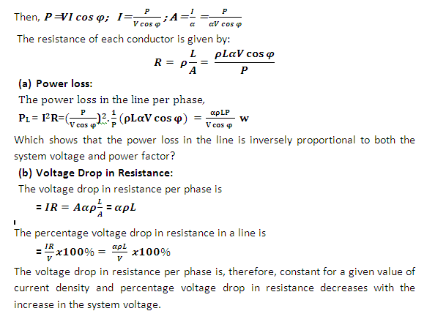
ECEG-4251,T & D Planning – Transmission Line Voltage Selection

Slide 15
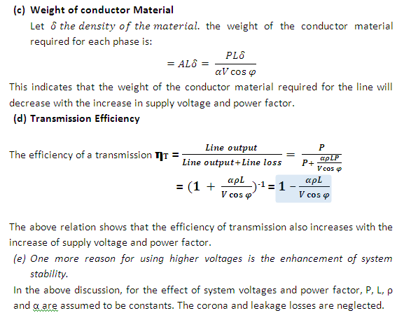
ECEG-4251,T & D Planning – Transmission Line Voltage Selection

Slide 16
ECEG-4251,T & D Planning
  3.2 EHVAC and HVDC Transmission Systems
With tremendous growth in power transmission, there is an essential need for installation, commissioning and operation of extra high voltage AC (EHV AC) and high voltage DC (HVDC) transmission.
It is advantageous to have high voltage transmission lines because of lower loss and facility to have bulk power transmitted over long distances. HVDC transmission system acts as a highly reliable asynchronous link between two grids and when operated in conjunction with EHV AC lines, the overall stability is improved.
The power transmission lines are usually operated in the EHV (extra high voltage) or UHV (ultra high voltage) due to the following reasons:

Slide 17
ECEG-4251,T & D Planning
        The transmission efficiency increases as the transmission voltage increases for a given amount of power to transmit over a given distance.
        The p.u. resistance drop and volume of conductor materials decreases in the EHV voltage lines.
        The power transmitting capacity of the transmission line, at the EHV/UHV range, increases tremendously as the transmission capacity is proportional to the square of the operating voltages. Though the costs of the tower, insulation and terminal equipments increase but in general these costs are proportional to the voltages rather than square of voltage. As a consequence, the capital cost of transmission decreases as the voltage increases. Transmission of large blocks of power is thus economically feasible at EHV/UHV voltage levels.
        Economic considerations have led to the construction of large capacity power stations and hence the corresponding transmission lines need to evacuate bulk power. As bulk power transmission is economically feasible at EHV/UHV range hence wit these higher voltage ranges of operation, it has become possible to achieve economies in generation also.
        The installation cost of transmission line per km decreases with an increase in voltage level.

Slide 18
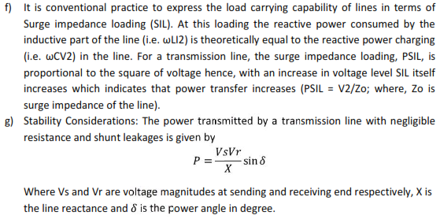

ECEG-4251,T & D Planning

Slide 19
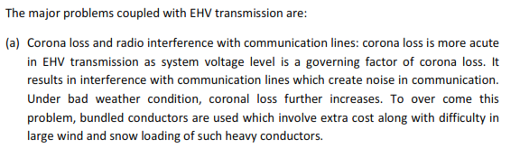
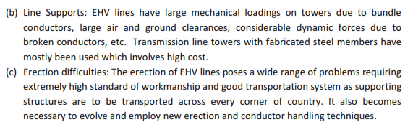
ECEG-4251,T & D Planning

Slide 20
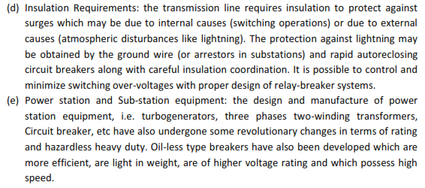
ECEG-4251,T & D Planning
The high voltage DC (HVDC) transmission has been developed to overcome the associated problems of EHV AC transmission of bulk power. The following figure shows some of the typical circuit arrangements (links) for high-voltage dc transmissions.

Slide 21
ECEG-4251,T & D Planning
a) monopolar arrangement, there is only one insulated transmission conductor (pole) installed and ground return is used. It is the least expensive arrangement but has certain disadvantages.
b) Monopolar arrangement with metallic return grounded at one end
c) Bipolar arrangement

Slide 22
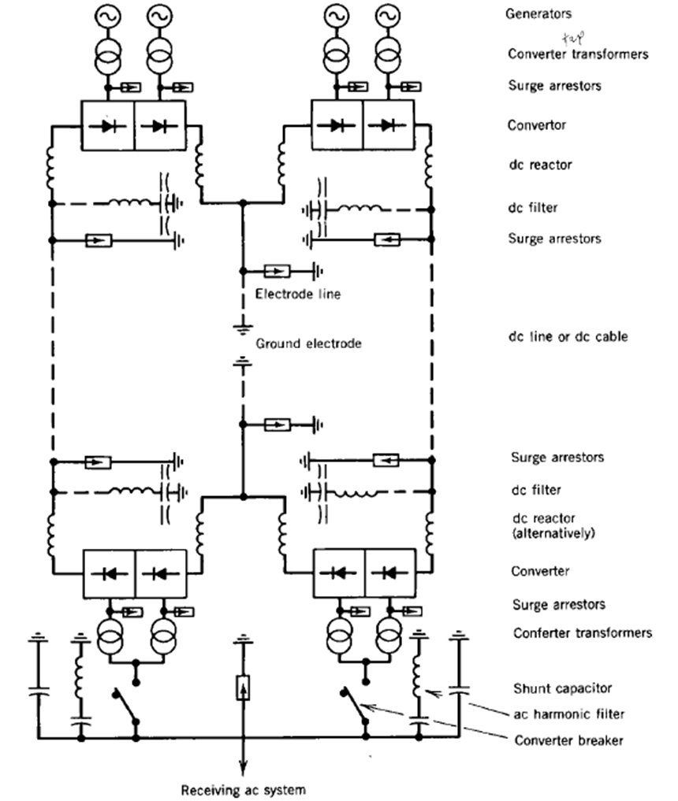
ECEG-4251,T & D Planning
A dc transmission system operating in bipolar mode

Slide 23
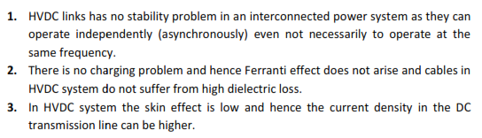
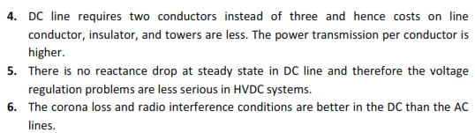
ECEG-4251,T & D Planning
HVDC Transmission- Advantages and Disadvantages
Advantages:

Slide 24
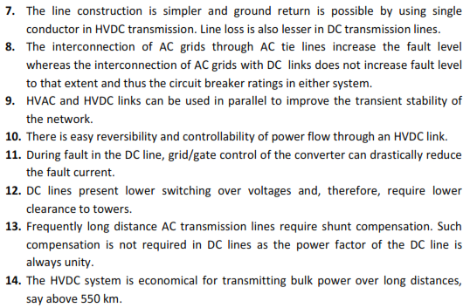
ECEG-4251,T & D Planning

Slide 25
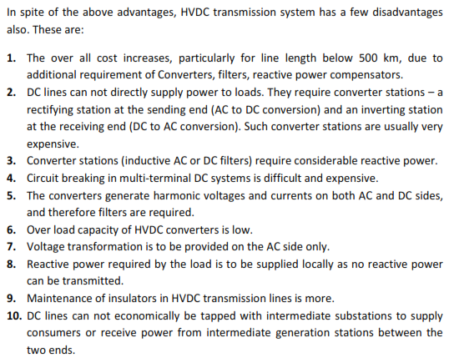
ECEG-4251,T & D Planning

Slide 26
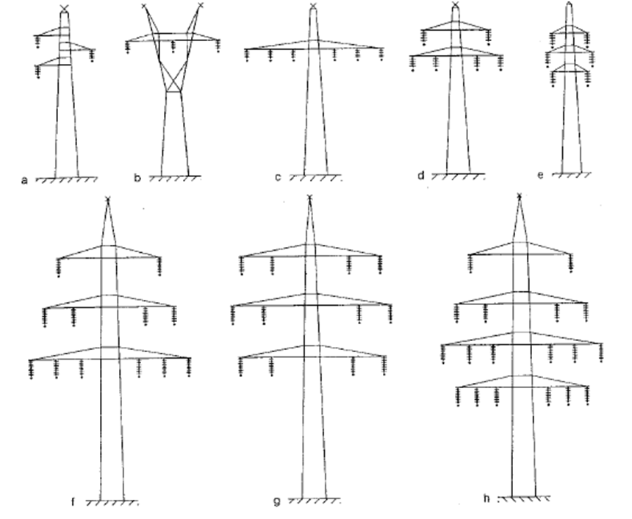
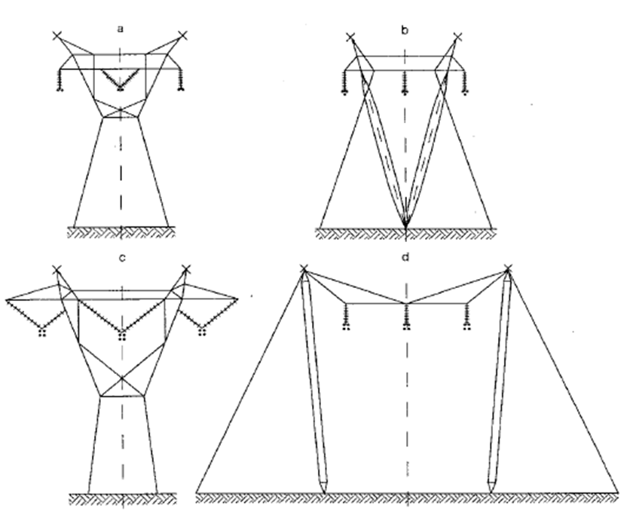
ECEG-4251,T & D Planning
The common tower configurations of HVAC and HVDC transmission systems are:
AHV AC Towers for High voltage and extra-high voltage line configurations
EHV AC Tower configurations for 500 kV (a & b) and 765 kV lines (c & d)

Slide 27
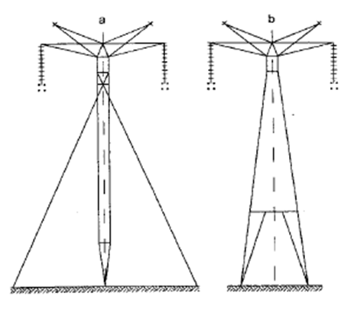
ECEG-4251,T & D Planning
Tower Configurations of DC for ±600kV line

Slide 28
ECEG-4251,T & D Planning
  Steady State Stability Analysis
The main tasks of steady-state analysis are:
Load flow Analysis
Reactive power Compensation requirement analysis
Steady-state stability analysis
Contingency analysis
Short-circuit current levels
Steady state fault analysis

Slide 29
ECEG-4251,T & D Planning
The power system is a highly nonlinear system . When subjected to a transient disturbance, the stability of the system depends on the nature of the disturbance as well as the initial operating condition. The disturbance may be small or large. Small disturbances in the form of load changes occur continually, and the system adjusts to the changing conditions. The system must be able to operate satisfactorily under these conditions and successfully meet the load demand.
The required input data for load flow Simulation software (E.G PSS/e) generally include:
Bus designations,
Line and transformer impedances,
Real and reactive (var) power flows for each load,
Generator power output,
Voltage schedules and reactive (var) power flow limits of generators synchronous condensers and switched capacitors,
Tie-line designations, and
Systems interchange information.

Slide 30
ECEG-4251,T & D Planning
The results of the software output includes:
Calculated voltage magnitude and phase angle at each bus,
Transformer, capacitor and reactor data,
Real and reactive (var) power flows for each line and transformer,
Net system interchange and tie-line power flows and
A record of system changes. Special output features are available or can be developed to aid the planner in the analysis of the system. Examples include lists of facilities loaded beyond pre-established limits, and lists of buses where the voltage is below desirable levels.

Slide 31
ECEG-4251,T & D Planning
Reactive Power Compensating Requirements
Reactive (var) compensation studies utilize information from load flow studies to establish optimum types and sizes of reactive (var) sources. There are two basic types of system compensation:
series compensation, in terms of impedance, is used to reduce a transmission line's effective reactance, and
shunt compensation, in terms of reactive power, is used to reduce the magnitude of reactive (var) power that flows in the network.

Slide 32
ECEG-4251,T & D Planning
The insertion of capacitive reactance in series with the line's inductive reactance decreases the line impedance. This helps to increase the transmission system capability requirements. Series compensation effectively increases the transmission line capacity. This reduces the need for higher transmission voltages or greater number of circuits.
As transmission voltages and line lengths increase, the capacitive charging currents from EHV lines also increase. These currents can cause undesirable over voltages on generators and transformers, as well as increase power losses. In order to reduce the capacitive charging currents, shunt reactors are utilized to minimize the over voltages during lightly loaded, switching or transient conditions.
Shunt reactors may be either switched or directly connected at the transmission line terminals or to the tertiary windings of autotransformers.

Slide 33
ECEG-4251,T & D Planning
  Transient Stability Analysis
Stability is a condition of equilibrium between opposing forces; instability results when a disturbance leads to a sustained imbalance between the opposing forces.
Transient power system stability denotes the ability of an electric power system, for a given initial operating condition, to regain a state of operating equilibrium after being subjected to a physical disturbance, with most system variables bounded so that system integrity is preserved. It must be able to survive numerous disturbances of a severe nature, such as a short-circuit on a transmission line or a sudden loss of large units or generating plants, or a large concentration of load.
Following such transient disturbances, if the power system is stable, it will reach a new equilibrium state with practically the entire system intact; the actions of automatic controls and possibly human operators will eventually restore the system to normal state.

Slide 34
ECEG-4251,T & D Planning
Dynamic studies generally simulate system performance during the period following sudden loss of generation or load.
The main tasks that are performed in Transient Stability analysis are:
    Voltage stability
    Power-frequency and
    Power angle behavior
Results from transient Studies can help determine:
    Need for faster protective relay system,
    To know the reliability of power system
    System operating and design weaknesses,
    Desirability of fast valving,
    Initial heavy loading of key transmission facilities
    etc

Slide 35
ECEG-4251,T & D Planning
  Critical Considerations for Transmission system Planning
As pointed out earlier, the purpose of transmission system planning is to determine the timing and type of new transmission facilities required in order to provide adequate transmission network capability to cope with the future generating capacity additions and load-flow requirements.
In general, planning a new transmission addition includes several important aspects of the overall power system, namely:
  Real and Reactive Power Flow Analysis
  Economics of the new transmission line
  Stability issues due to the new line
  Interchange capability
  Reliability issues
  Environmental impact
The planning process is usually iterative in nature in order not only to meet a near-term system need, but also to develop a viable plan for the evolution of the overall future transmission line.

Slide 36
ECEG-4251,T & D Planning
The logic diagram for transmission expansion study is shown in a functional block diagram in the following slid. After this analysis stage, the planner develops alternative plans or scenarios that not only will prevent the foreseen problems but also will best meet the long-term objectives of system reliability and economy.
The key objective is to minimize the long-range capital and operating costs involved in providing an adequate level of system reliability, with due consideration of environmental and other relevant issues.
Transmission planning may include not only existing but also new service areas. The starting point of the planning procedure is to develop load forecasts in terms of annual peak demand for the entire system, as well as for each region and each major present and future substation, and then finding specific alternatives that satisfy the new load conditions.
The transmission planner shall acquire and prepare the market load forecast, generation expansion and existing transmission systems prior to the transmission planning studies.

Slide 37
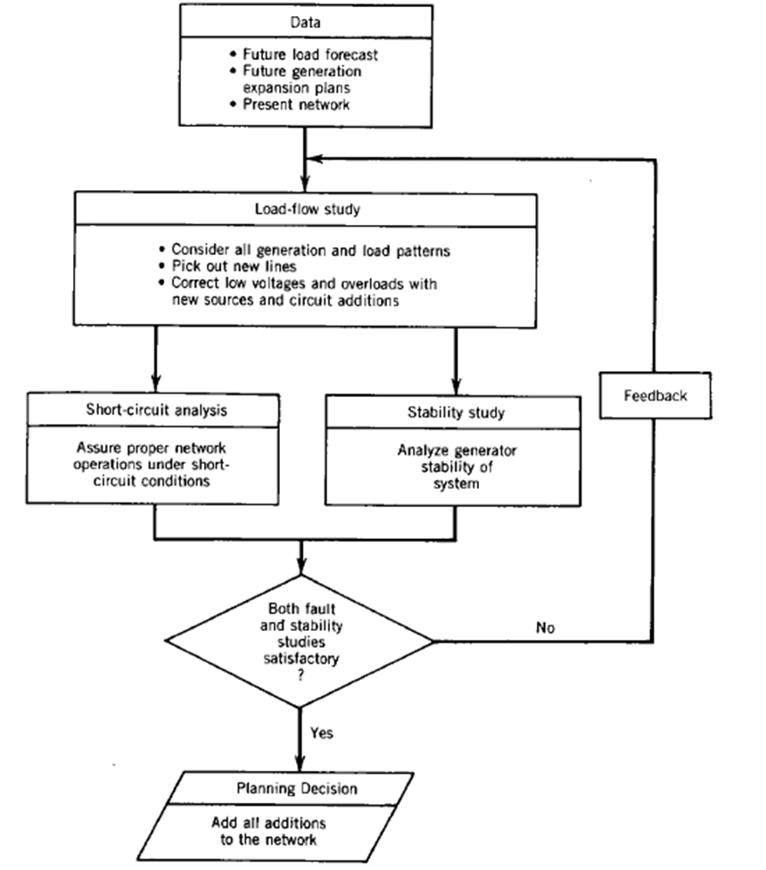

Slide 38
ECEG-4251,T & D Planning
  Transmission and Substation Design and Modelling
The decision to build a transmission system results from system planning studies to determine how best meet the system requirements.
The basic configuration selection depends on many interrelated factors, including esthetical considerations, economics, performance criteria, company policies and practices, line profile, right-of-way restrictions, preferred materials, and construction techniques.
  The set of substation service areas for a transmission & distribution (T&D) system must "tile" the utility service territory, covering all locations where there is any demand, and each substation must have sufficient capacity to serve the load in its service area.

Slide 39
ECEG-4251,T & D Planning - Transmission system Planning and Design
Once transmission planning has been completed, the broad objective in the designing of a specific transmission system addition is to achieve the desired power transfer between prescribed locations in a reliable and cost-effective manner. More specifically, the design of the transmission addition must take into account:
  Power to be transferred
  Length of line
  Nature of Compensation required
  Magnitude of over voltages anticipated
  Protection against disturbances such as fault and over-voltage
  Anticipated weather conditions
  Line conductor and insulation design
  Line tower and mechanical design
  Environmental constraints to be met
  Corona and losses
  Potential unfavourable interactions between the transmission system, generators, and loads due to such aspects as harmonics and resonances
  Equipment, installation, and maintenance costs
  Intermediate switching stations
  Transpositions
  Insulation and conductor hardware selection

Slide 40
ECEG-4251,T & D Planning
  Distribution system planning
Distribution planners must determine the peak load magnitude and its geographic location. Then distribution substations must be placed and sized in such a way as to serve a certain load at minimum cost by minimizing feeder losses and construction costs, while considering the constraints of service reliability, such as the voltage of substations and feeders, and capacity constraints.
Physically, the primary distribution system can be divided into two distinct subsystems: the substations and the primary feeder circuit. In each subsystem a number of variables must be considered in the planning stage, as follows:
(1) Substations: location, number, transformer rating and loading, and service areas;
(2) Primary feeder circuit: number of primary feeders, feeder routing, feeder branch loading, and conductor size.

