Slide 1
Unit Six:
Managing Resources for Health

Slide 2
Brain storming
What are the major resources in an organization?

Slide 3
1. Human Resource Management

Slide 4
Human Resource Management
Session objectives
Define human resource management
Identify components of HRM activities/functions
Describe different stages of disciplinary actions
Discuss on performance appraisal types

Slide 5

Human Resource Management

Slide 6
Human Resource Management
The process of attracting, developing and maintaining a talented and energetic workforce to support organisational mission, objectives and strategies.
HRM is supplying organizations with the right people in the right position, when they are needed.
HRM is the integrated use of procedures, policies and practices to recruit, maintain and develop employees to meet the desired goals of the organization.

Slide 7
HRM…
HRM includes seven basic activities
1. Human resource planning
2. Recruitment
3. Selection
4. Socialization (Orientation)
5. Training and Development
6. Performance Appraisal
7. Promotions, Transfers, Demotions, and Separations

Slide 8
1. Human Resource Planning
Planning for the future personnel needs of an organization taking into account analysis of both internal and external factors.
Human Resource Planning includes the estimation of numbers and categories of personnel required both in the immediate and long-term and the allocation of resources to train and pay these staff.

Slide 9
Approaches used in calculating health personnel requirements
Health needs approach
Human resource to population ratios
Service targets

Slide 10
2. Recruitment
Recruitment: Process of searching /attracting potential candidates to fill the vacant position in accordance with HRP
Recruitment includes:
Job description: is a written document that shows the nature and characteristics of the task to be performed.
Job specification: a written description of the education, experience, and skills needed to perform a job or fill a position effectively
  Note: Every employee should be provided with a job description.

Slide 11
HRM…
Methods of recruitment
Peer recruiter (advantage: well informed person is identified)
Within the organization (advantage: familiar, inspiring, less expensive)
Outside the organization (e.g. colleges, graduate schools, other organizations)
Formal announcement (mass media)

Slide 12
Legal considerations
Prohibiting discrimination by: Race, Sex, Age, Colour, National origin
Equal employment opportunity, which should apply to both public and private sectors.
3. Affirmative action for like job for women, disable persons
4. Comparable worth /equivalent/: Different jobs that require comparable skills and knowledge deserve comparable pay ( like pay for like job)

Slide 13
3. Selection
It is the process of choosing individuals who can successfully perform a job from available candidates
It is a crucial process in management and requires constant attention, interest and concern of management.
The three sources of information used in selection are application forms, pre-employment interviews and testing

Slide 14
4. Introduction (Socialization) and Orientation
When the candidate is selected and offered a job, it is necessary to introduce the new employee to the rules and polices, etc of the organization.
Thus, before the employee begins his/her work, he/she should be assimilated /full understand/ to job and organizational environment.
Introduce employee peers, superiors & subordinates.
Orienting him/her to the new working environment.

Slide 15
Socialization…
Employee’s concerns:
  • Anxious (new environment)
  • Perception of the tasks and performance
  • Experience in relation to job & organization
  • How to go along with other employee
  • Personal and family problems

Slide 16
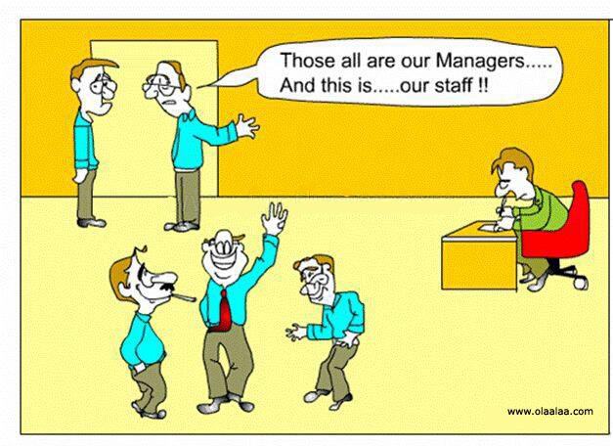
.

Slide 17
5. Training and development
  Training begins at the first day, which is designed to improve the person’s skills and knowledge to do the current job at high level.
  Designed to provide learners with the knowledge and skills needed for their present jobs – formal and informal.
  Development refers to the organizations efforts to help employee’s acquire knowledge, skills and behavior that improve their ability to meet changes in job requirements and customer needs. Involves learning that goes beyond today's job – more long-term focus.

Slide 18
Training and Development…
Approaches to training
On-the-job training
Job rotation: Employees move from one job to another to broaden experience.
Helps new employees understand variety of jobs
Internship: Combined classroom teaching, that offer students the opportunity to gain real-life experience while allowing them to find out how they will perform in work organizations.
Apprenticeship: training under guidance of skilled co-worker

Slide 19
Training and Development…
Off- the-job training
Vestibule training: training on realistic job setting or equipment.
Behaviorally experienced training: simulation exercises, cases, games, role-playing (done outside the organization).

Slide 20
Training and Development
Procedures to determine training needs of individuals:
1. Performance appraisal
2. Analysis of job requirements
3. Organizational analysis
4. Employee survey

Slide 21

6. Performance Appraisal

Slide 22
Performance Appraisal
The process by which an employee’s contribution to the organization during a specified period of time is assessed.
It is the process through which a manager measures employees’ activities and output against organizations objectives.
It involves measuring actual performance of an employee and providing information about his/her strengths and weakness.
It is systematic, periodic review and analysis of employees’ performance.

Slide 23
Performance Appraisal…
Purpose:
To give feedback,
To recognize outstanding performance,
To locate the need for additional training
To identify candidates for promotion

Slide 24
Performance appraisal …
Types: informal appraisal and formal systematic appraisal
Formal appraisals
  An appraisal conducted at a set time during the year and based on performance dimensions that were specified in advance(usually semi-annually or annually)
Informal appraisals
  An unscheduled appraisal of ongoing progress and areas for improvement

Slide 25
Who Appraises Performance?
Self
  Self appraisals can supplement manager view.
Peer appraisal
  Coworkers provide appraisal; common in team settings.
360 Degree
  A performance appraisal by peers, subordinates, superiors, and clients who are in a position to evaluate a manager’s performance

Slide 26
Why Performance Appraisal Fails?
Ineffective Application of Standards
Insufficient Rewards
Lack appraisal skills
Manager not prepared
Mgr not honest or
sincere
No on-going feedback
Fear of Hurt Feelings
Ineffective discussion
Mgr Lacks Information
Notes:
Ineffective Application of Standards-Over rating often results when supervisors do not have a good grasp of the standards being applied.
Fear of Hurt Feelings--Some supervisors would rather give everyone a high rating rather than risk “hurting someone’s feelings” by pointing out performance deficiencies.

Slide 27
Poorly Implemented PM Systems
False and misleading information
Increased turnover
Wasted time and money
Damaged relationships
Decreased motivation
Job dissatisfaction
Risk of litigation
Unfair standards

Slide 28
7. Promotion, Transfer, Demotion and Separation
Promotion
Moving to a higher position and responsibility
Recognize outstanding performance
Transfer
Shift to other positions without change in status or pay.
For experience
To fill gap
To keep promotion ladders open
To keep individuals interest in the job sometimes, for those with inadequate performance

Slide 29
Discipline, Demotion and Separation
When the organization’s policy is violated.
Steps:
Warning
Admonishment-Counseling/Advising
Probation Testing
Suspension
Disciplinary transfer
Demotion
Discharge/separation
“For poor performance, separation is better than letting the employee stay on the job”.

Slide 30
2. MANAGEMENT OF FINANCE

Slide 31
Objectives
Define Finance, Budget and Budgeting.
Describe the different types of budgeting
Mention the different models and codes of line item budgeting

Slide 32
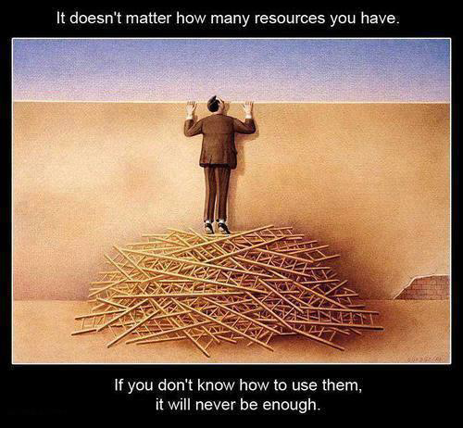

Slide 33
Financial Management
one of the useful resources for running Health Sector Organizations is finance.
It needs to be handled and managed properly.

Slide 34
Why FM is Important?
Could not implement our plans with out finance.
To be more accountable to donors
Gain the respect and confidence of funding agencies, partners, beneficiaries
Give the HSO a competitive advantage for increasingly scarce resources
For financial sustainability

Slide 35
Financial Management…
Who Is Responsible For Financial Management?
Managers are more responsible to use it more effectively and efficiently.
Given in the form of budget.

Slide 36
Budget
An estimate of income and expenditure for a specified period of time.
Budget is a plan for the allocation of resources and a control for ensuring that the results comply with the plans.
The results are expressed in quantitative terms.
Budgeting – is the process of planning and controlling future operations by comparing actual results with planned expectations.

Slide 37
Types of Budget
1. Revenue Budget: It is the organization’s statements of expected revenues for the coming year. e.g. taxes, surpluses, etc.
2. Expenditure Budget
  Recurrent expenditures: activities that are recurring and continuous in nature (like salaries of civil servants)
  Capital expenditures: Short-term activities that are project in nature are included in capital budget (e.g. construction of roads, buildings or other infrastructures)

Slide 38
BUDGET Cont…
Other types
1. Line-Item Budgeting:
Fixed amount of money is allocated to a given item & expenditure.
Has a number of advantages: First, it promotes control since the budget is detailed down to particulate expenditure items.
The use of the budget of one line item for another may require the verification of both the finance and health office.
2. Program Budgeting.
Budget is allocated for the program/project rather than for specific items.
used by large organizations
flexible decisions
usually obtained from aids and funds

Slide 39
Line-item budgeting in Ethiopia
The Ethiopian government prepares its revenue and expenditure budgets using Line item budgeting.
In line-item budgeting a fixed amount of money is allocated to a given item.
Expenditures above the allocation or transfer of allocation, whole or in part, from item to another is impossible without prior request and authorization from government.

Slide 40
Budgeting Techniques
1. Incremental budgeting
This approach bases any year’s budget on the previous year’s actual, or budgeted, figures with an allowance for inflation and known changes in activity levels
Most useful for organisations where activity and resource levels change little from year to year

Slide 41
Budgeting Techniques
2. Zero-based budgeting
Start with a clean sheet – a zero base.
Zero-base budgeting (ZBB) ignores previous experience and starts with next year’s targets and activities
May suit organizations going through a period of rapid change

Slide 42
BUDGET…
Budget Cycle
- Budget preparation
- Budget compiling and approval
- Budget execution
- Budget audit
Fiscal Year: A specified 12-month period during which operational and financial performance is measured.
Budget allocated has to be used within this time.

Slide 43
Budget Cycle:
1. Budget preparation
2. Budget compiling & approval
3. Budget execution
(implementing)
4. Budget audit
(evaluation)

Slide 44
AUDIT
WHAT IS AN AUDIT?
An independent examination of records, procedures and activities of an organization resulting in a report on the findings.
Why do we need audit?
Accountability
Credibility
Transparency
Legal requirement.

Slide 45
Coding the line item budget
There are three major line of item Coding
1000: Revenue items
6000: Items for recurrent budget:
e.g. 6101, 6102, 6201, 6202, 6301
8000: Item for capital budget

Slide 46
Line Item Budgeting
Once approved-money can not be transferred from one category of item to another
61: Item for salaries
6101: Salary for civil servants
62: Line item for diff, services (Budget)
6201: Item for postage, water, telephone and electric bill
6202: Transport and per diem
6203: Information advertisement and publication
6204: Equipment, building and fence repair and maintenance
6205: Repair and maintenance of vehicles
6206: For rent
63 : Line item for expendable items
6301: For food

Slide 47
Line Item Budgeting...
6302: Drugs and equipment
6304: For clothing
6305: Fuel for cars
6306: For stationers
6307: Contingency fund for which item not set for
64 : Item for supportive fund
6401: For individual support
6402: For organization support
6403: For international organization support
65: Line item for non-expendable items
6501:For parches of cars

Slide 48
Line Item Budgeting...
There are six major items or recurrent budget
6000: Recurrent Budget
6100: Expenditure for social service
6200: Non-social contract based service
6300: Expendable (consumable) goods and
equipment
6400: Support and contribution
6500: Purchase of vehicles and machines
6600: Military construction works and equipment

Slide 49
Line Item Budgeting...
8000: Capital Budget
8100: Surveying, surveillance, Design and Engineering works
8101: Preliminary studies and surveillance
8102: Engineering works and technical designs
8200: Building construction and related works:
8201: Residential Buildings
8205: Transport equipment (vehicles. etc)
8300: Labour and running expenses:
8301: Management and Control
8304: Financial expenses:
8400: Capital Transfer:

Slide 50
Models dealing with property and finance
Model 20:Model for requesting items/drugs
Model 21:Model for approving item delivery by person in authority
Model 22:Model for issuing items/drugs
Model 19: Model for confirming delivery of items
Model 33: (Pay roll) – payment of salary
Model 85: to deposit money
Model 86 : to release deposited money

Slide 51
3. Managing Time

Slide 52
Session objectives
Understand the concept of time management
Explain benefits of time management
Describe strategies of effective Time management
Understand time management matrix
Obstacles to effective time management

Slide 53

Time management

Slide 54
Time
It is a non-renewable resource
No event can take place unless there is time for it.
Using time efficiently requires managerial skills.
Time can not be stored
Time is equally shared to people
  NB- Our ability to manage our time is the ONE to make difference in life

Slide 55
What is time management?
It is the ability to decide what is important in life, both at work, in our home and personal life.
Simply, it is devoting most of time and energy for the bold goal.
It is not a way to make you work harder and longer, but a means to help you work smarter to accomplish your work more easily and rapidly.
Spending time on important, not just urgent matters

Slide 56
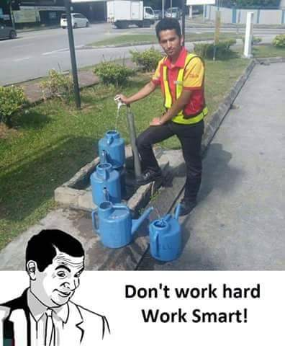

Slide 57
Time Management…
Efficient time use
  Plan the time daily
  Prioritize activities
  Time for important one
  Set recording system
  Resources before start
  Do one activity at a time
  Decide time limit for every activity
  Take rest whenever necessary
  Inefficient time use
    Disorganized desk and cluttered files
    Wrong appointments,
    Lack of delegation,
    Stress/ tiredness ,
    Counting saying no as guilty,
    Getting early or staying late at work,

Slide 58

The Benefits of Time Management
Yes!
Increases productivity,
Reduces stress,
Improve self-esteem,
Avoids meltdowns,
Develops confidence,
Reach goals.
Achieve Balance in your life.

Slide 59
Time Management…
Strategies to Effective Time Management
Set Goals
Set priorities
Plan your time
Avoid Procrastination
Delegation

Slide 60
Where to start?
Go for the goal!
1. Set Goals!
Start with big, then set smaller goals.
Make your goals specific and concrete.
Set both long and short-term goals support one other.
Integrate your goals: school, personal and career.
Set a deadline for your goals.

Slide 61
Time Management…
2. Set priorities
Select what’s important and what is not?
What order do things need to be done?
Based on your priorities, plan out a schedule for the time period
Planning may seem hard at first, but the more you do it, the easier and more natural it gets.
1
2
3

Slide 62

Time Management…
No! I have a study group tonight. Are you free on Thursday?
3. Plan your time
Begin with blocking/portion/ all activities.
Consider: office work, field work, social work, religious worships, meetings, so on.
Highlight all project due dates.
Identify routine work days.
Avoid temptation to socialize when you’ve scheduled work.

Slide 63
Time Management…
3. Plan your time…
common ways of time plan arrangement:
Time table:- used for daily/weekly recurring and regular events, e.g. staff meeting, classes, etc.
Schedule:- for intermittent, irregular or variable events, e.g. visit to peripheral health centers.
Program: - Long term arrangements of events e.g. TTP, apprentice, semester break, etc.

Slide 64
Time Management…
4. Avoid Procrastination
“Procrastination is the theft of time” – it is a time waster.
It is the act of postponing tasks that could have been done now.
Note: Deadlines are really important, doing things at the last minute is much more expensive than just before the last minute

Slide 65
Time Management…
4. Avoid Procrastination…
Forms of procrastination:
Ignoring the task, hoping it will go away.
Underestimating how long it will take.
Overestimating your abilities and resources.
Telling yourself: poor performance is okay.
Doing something else that isn’t very important
Believing that repeated delays not hurt you

Slide 66
Time Management…
4. Avoid Procrastination…
How to Overcome Procrastination:
Win mental battle to being on time.
Organize, schedule & plan
Set and keep deadlines.
Divide a big job into smaller ones.
Make game of your work or make it fun.
Reward yourself when you have done it.
Tell your friends to remind deadlines.
Use memo
Learn to say “no” to time wasters.

Slide 67
Time Management…
5. Delegation
“Delegation: is granting authority with responsibility”
No one is an island
Delegation is not dumping/discarding tasks.
Treat your people well by delegating for tasks
We can accomplish a lot more with help
Graduate students, subordinates, secretaries, families, colleagues etc. can be delegated.

Slide 68
Time management Matrix
 | Urgent | Not Urgent
I M P O R T A N T | I Crisis Pressing problems Deadline-driven projects, meetings, preparations vital programs/schedules | II Preparation . Prevention . Values clarification . Planning . Relationship building . True re-creation
Not I M P O R T A N T | III Interruptions, some phone calls Some mail, some reports .Some meetings . Many popular activities- breaking news | IV Irrelevant talks Some Time wasters Irrelevant e-mail, chat Excessive TV Long fictions/novels

Slide 69
Manage the best you can
Focus here
Managing Your Time Effectively
Quadrant of Necessity
Important, Urgent
Quadrant of Quality & Personal Leadership
Important, Not Urgent
Quadrant of Deception
Not Important, Urgent
Quadrant of Waste
Not Important, Not Urgent
Avoid as much as possible
Be careful here
Notes:
EXPLAIN the table on the slide with this information:
Here is another way of looking at the quadrants:
Quadrant 1 is also considered “Quadrant of Necessity” – you have to manage the best you can when you are focused on activities in this area.
Quadrant 2 is considered “Quadrant of Quality and Personal Leadership” – you will want to focus here. And if you do, you will achieve your goals faster.
Quadrant 3 is also considered “Quadrant of Deception” – you want to be careful here – these activities may appear urgent, however, when in relation to your goals, they are not important.
Quadrant 4 is the “Quadrant of Waste” – you will want to avoid these activities as much as possible. The more time you spend here, the fewer goals you achieve.
ASK participants to look at the black arrow at the top of the slide. The Quadrant of Quality & Personal Leadership directly impacts how easy or hard it is to manage the Quadrant of Necessity.
Your focus should be on Quadrant 2 to achieve goals faster and be a leader. This can apply to leaders at any level of an organization and in other aspects of life. By focusing your efforts in this quadrant, you can impact your ability to manage urgent activities that come as best you can.
Be careful in the third quadrant, the area of deception, these tasks appear urgent but have no relation to your goals!
Quadrant 3 is best to avoid as much as possible.

Slide 70
Obstacles to effective Time Management
Unclear objectives
Inability to say “no”

Slide 71
Obstacles to Effective Time Management…
Too many things at once
Stress and fatigue- always work, no play

Slide 72
Importance of Time Management
Keeps balance in our lives
A skill can be learnt, practiced and improved upon all the time.
enable to fix our undivided attention on what needs to be done.
A skill everyone needs unfortunately not everyone will acquire it.

Slide 73


Don’t let this be you!

Slide 74

manage your time Manage your self!

Slide 75
“Never do tomorrow what you can do today”
“Prioritize, and do the most
important things first”

Slide 76
Thank you!!

Slide 77
Quiz
Develop your activities based on the following time management Matrix and which quadrants are quadrant of quality and waste ?
 | Urgent | Not Urgent
I M P O R T A N T | I | II
Not I M P O R T A N T | III | IV

Slide 78
4: Logistics and Pharmaceutical Management

Slide 79
Pharmaceutical Logistics Mgt.
It is a system of:
  Selecting
  Quantifying
  Supply-planning
  Ordering/procuring
  Distributing products from one level to another

Slide 80
Types of Logistics Systems
Allocation or “Push” System: the higher-level decides what, when and how much of each pharmaceuticals move down through the system
Requisition or “Pull” system: the lower level orders what, when and how much of each pharmaceuticals, thus pulling or receiving through the system

Slide 81
Integrated Pharmaceutical Logistics System (IPLS)
In the integrated pharmaceutical logistics system, pharmaceuticals are handled and managed in an integrated manner.
There are three pipeline levels namely;
  Central PFSA,
  PFSA Hubs/branches and
  Health Facilities (health centers and hospitals).

Slide 82
I. Central Level (Central PFSA)
This level is the central medical store where pharmaceutical products are procured, received and stored.
Major activities done at this level are:
  Perform forecasting and quantification and procure pharmaceutical products necessary for the country
  Perform supply planning, follow shipment status of procured supplies
  Receive, store, manage and distribute them to PFSA Hubs (branches)

Slide 83
II. PFSA Branch or PFSA Hub Level
Major responsibilities of branch PFSAs are:
  Plan, quantify and request pharmaceutical requirement from central level for health facilities under their area, periodically.
  Receive, store, and manage supplies coming from central level
  Receive and check requests coming from facilities
  Distribute products to facilities appropriately

Slide 84
III. Facility Level
Prepare and submit their reports and requests on time
Receive, store and manage supplies at their facility
Receive periodic reports from different units (for health centers this includes from health posts) and issue supplies to them

Slide 85
Flow of pharmaceuticals and information in the IPLS

Slide 86
Inventory Management (Inventory Control) System
An inventory management is a system that informs the store manager:
  How much stock is available
  When to order more stock
  When to issue
  How much to order or issue and
  How to maintain an appropriate stock

Slide 87

Thank you very much!
  .
Notes:
87

