Slide 1
Unit Four:
Leading health care

Slide 2
Learning Objectives
At the end of this session you will be able to:
Define leadership
Describe the leadership practices.
Discuss different leadership theories, types & styles.
Explain the differences between leader and manager.
Describe on different types of power

Slide 3
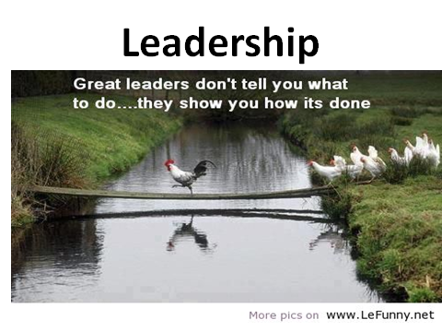

Slide 4
Leadership
“I am more afraid of an army of 100 sheep led by a lion than an army of 100 lions led by a sheep”
Talleyrand

Slide 5
What is Leadership?
Multidimensional concept that can be defined in different ways,
The ability to influence a group toward the achievement of goals.
leadership is Enabling Groups to Make Progress in Complex Conditions. Management sciences for health (2006)
Leadership is not domination, but the art of persuading people to work toward a common goal. Goleman and Daniel,1995.

Slide 6
Leadership…
Leadership is always exercised in relationship with others.
The true test of effective leadership is the visible progress towards the realization of vision,
inspire others to follow.
Leadership involves unequal distribution of power between the leader and group members.

Slide 7
Leadership…
The leader must win the willingness of the workers to accept directions.
Leaders are agents of change, persons whose acts affect other people more than other people’s acts affect them.
Leadership is an activity that takes place at all levels, not a position of authority

Slide 8
Leadership is about:
Influencing
Motivating
Inspiring
Taking people to greater heights
Working with participants on the how and helping them figure out the what and why
Encouraging them to push themselves to achieve the highest possible performance
Action
Enabling, not telling

Slide 9
Who is a leader?
A leader is an individual in a team influencing group activities towards goal formulation and achievement.
In other words, a leader is someone who has a vision, and the ability to make it a reality.

Slide 10
Who is a leader?
To achieve
objectives
Influence
followers
behavior

Slide 11
Dimensions of leadership
Leadership involves not just “doing” but “being”
Leadership is exercised with others.
Leadership is responsibility, not rank, title, privilege, or money.
Leadership and management are both necessary.
Leadership is about enabling people to face challenges.

Slide 12
Activity
From your experience, try to describe at least one leader you know personally, or who is well known on a national or global scale, that you consider a role model of a successful leader.
What in your opinion are the practices that made this person a successful leader?

Slide 13
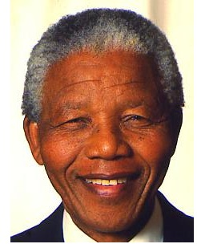
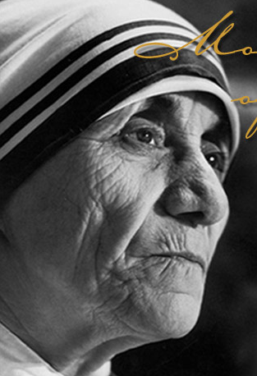
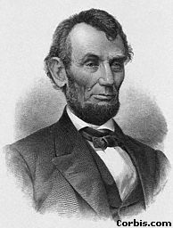
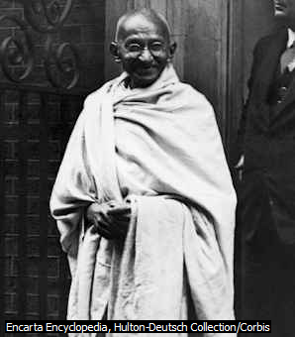
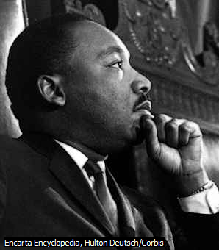
Some of the Great leaders

Slide 14
Leading Practices
Four Leadership Practices
Scanning
Focusing
Aligning/Mobilizing
Inspiring

Slide 15
Leadership Practice: Scanning
Leaders encourage their teams to scan their internal & external environments, organizations, teams, and themselves.
  Identify client & stakeholder need & priorities
  Recognize trends, opportunities, & risks that affect organizations.
  Identify staff capacities & constraints.
  Know yourself, your staff, & your organization values, strengths, & weakness.

Slide 16
Leadership Practice: Focusing
Using information from scanning, focus on a response.
Leaders focus their limited time, energy, and resources on the people and things that are most important.
  Articulate the organization’s mission & strategy
  Identify critical challenges
  Link goals with the overall organizational strategy
  Determine key priorities for action

Slide 17
Leadership Practice: Aligning/Mobilizing
A leader aligns and mobilizes others to achieve objectives.
This means seeking out other groups or people whose objectives are in line with yours and getting them to work alongside you.
You should align and mobilize stakeholders’ and staff time and energies as well as the material and financial resources to support organizational goals and priorities.
Facilitate teamwork.

Slide 18
Leadership Practice: Inspiring
Helps staff to face challenges creatively.
They are the people whose example moves us to follow in their footsteps.
Inspiring involves demonstrating:
Values through actions as role model & supporting staff
“Walking the talk” - matching deeds with words.
Trust & confidence in staff, acknowledging their contribution
Be a model of creativity, innovation ,learning& supporting staff.

Slide 19
Manager Vs Leader
Sometimes used interchangeably.
A person emerges as a leader.
A manager is put in to his position by appointment.
If a manager cannot influence others he is not a good leader; though he is a manager.
There are good leaders who are not managers.

Slide 20
Managers | Leaders
Cope with system complexity Plan and budget Control and solve problem | Seeks change Set direction and shared values Motivate people
Administers A copy Maintains Focuses on systems &structure Relies on control Short- range view Asks how and when Eye on the bottom line Imitates Does things right | Innovates An original Develops Focuses on people Inspires trust Long-range perspective Asks what and why Eye on the horizon Originates Does the right thing

Slide 21
Approaches to leadership
1. The trait approach(Theory):
It was assumed that some people are set apart from others by virtue of their possession of some quality or qualities of ‘greatness’ and that it is these people who become leaders.
This approach to leadership suggests that it is personal characteristics, or traits, that differentiate leaders from those they lead.
“Leaders are born but not made”

Slide 22
The trait approach…
These leadership traits include
  personality characteristics (adaptability, dominance, self-confidence),
  physical characteristics (above-average height, medium weight, attractive appearance), and
  ability (intelligence, task expertise, sensitivity in dealing with others).

Slide 23
2. The behavioral approach(Theory):
Assumptions:
- Leaders can be made, rather than are born.
- Successful leadership is based in definable, learnable behavior.
Description:
  Behavioral theories of leadership do not seek inborn traits or capabilities. Rather, they look at what leaders actually do.
  • Studied behavioral characteristics of leaders;
  • What they do and how they interact with the subordinates;

Slide 24
3. The contingency approach:
Leadership could vary with the situation or circumstances.
Focuses on task requirements.
No single trait has been shown to be common to all effective leaders and no single style has been found to be effective in improving staff performance in all situations.
The management technique that best contributes to the attainment of organizational goals might vary in different types of situations or circumstances.

Slide 25
  Types of leaders
1. Transactional leaders
Identify the expectations of their followers
Act managerially by establishing a close link between effort and reward.
They evaluate, correct and train staff whenever staff performance needs to be improved, and they reward appropriately when the required outcomes are achieved.
Power is given to the leader to evaluate and reward the followers.

Slide 26
2. Transformational leaders
Transformational leaders, as defined by Bass (1985) support their staff and encourage them to ‘do more than they originally expected to do’.
Transformational leaders motivate staff to do better.
Transformational leaders provide encouragement and support to followers.
show trust and respect for them as individuals.
They build self-confidence and heighten personal development.

Slide 27
Types of Leaders…
3. Charismatic leaders
Max Weber, a sociologist, defined charisma (from the Greek for “gift”) more than a century ago as “a certain quality of an individual personality, by virtue of which he or she is set apart from ordinary people.”
Charismatic leaders rely on their personality, their inspirational qualities and their aura/ characteristic.
Key Characteristics of a Charismatic Leader
  Vision and articulation
  Willing to take on high personal risk
  Sensitive to follower needs

Slide 28
Types of Leaders
4. Situational leaders
Is one who can adopt different leadership styles depending on the situation.
Effective leaders are versatile/Adapt in being able to move between the styles according to the situation, so there is no one right style.

Slide 29
Leadership styles
It is the typical pattern of behavior that a leader uses to influence their employees to achieve organizational goals.
1. Autocratic Leaders:
Make decisions and announce them.
There is also a clear division between the leader and the followers.
“ Do just what I say” or “ Don’t touch the hot iron”.
Subordinates carry out orders
Believe that money is the only reward that will motivate staffs.

Slide 30
Styles of Leadership
2. Democratic /participative Leaders:
Democratic leaders, also known as participative leaders, encourage group members to participate.
Democratic leaders keep staff informed about everything that affects their work and share decision-making and problem-solving responsibilities.
Group members feel engaged in the process and thus are more motivated and creative.
Permit subordinates to make decisions
Ideas are bilaterally proposed
What do you think? “Let’s do together”

Slide 31
Democratic /participative Leaders…
This style is most successful
  when used with highly skilled or experienced staff or
  when implementing operational changes or resolving individual or group problems.
This is a popular style because when it is done well it creates a harmonious, productive and developing work force.

Slide 32
Styles Leadership….
3. Laissez – faire Leaders:
Laissez-faire leadership is a style where the leader provides little or no direction and gives staff as much freedom as possible.
All authority or power is given to the staff and they determine goals, make decisions, and resolve problems on their own.
The laissez-faire leader promotes a strong sense of competence and expertise in team members and allows others to rise to their performance potential.
This style can lack accountability for team failures.
Type I
Leaders have little or no confidence in their ability
“Do as you like”
Have no concern for both staffs and the work output.

Slide 33
Laissez – faire Leaders ….
Type II:
Leaders are extremely confident about their staffs.
Subordinates may be high in their academic position.
Every staff knows the objectives of his / her organization
Able to plan and implement independently.

Slide 34
You are a leader if:
You create something of a value that did not exist before
You exhibit positive energy
You actualize
You welcome change

Slide 35
Leadership use of power and authority
Leaders influence people to do things through the use of power and authority.

Slide 36
Leadership use of power and authority…
‘Authority’ is the formal right to get people to do things or the formal right to control resources.
Factors within a person, such as talent or charm, help them achieve power.
Power is the ability to influence decisions and control resources.
Powerful people have the potential to exercise influence, and they exercise it frequently.
Only the organization can confer authority.

Slide 37
Types of Power
Leaders use various types of power to influence others.
However, power can also be exercised upwards by the behavior of group members or staff, and this acts as a constraint on how much power leaders can employ in practice.
The list that follows describes the types of power exercised by leaders and sometimes by group members (French and Raven, 1960).

Slide 38
Five types of power
1. Legitimate power
It is a result of the position a person holds in the organization hierarchy.
It is the easiest type of influence for most staff to accept.
For example, virtually all employees accept the manager’s authority to conduct a performance evaluation.

Slide 39
2. Reward power
Emanates/issue from the leaders ability to reward desirable behavior.
It stems partly from the legitimate power.
Reward includes pay increase, promotions, work schedule, recognitions of accomplishment, etc

Slide 40
3. Coercive power
is the opposite of reward power
based on the leader’s ability to punish or prevent them from obtaining desired rewards.
Organizational punishments include assignment to undesirable working hours, demotion, and firing.
Effective leaders generally avoid heavy reliance on coercive power.

Slide 41
4. Expert power
  It derives from a leader’s job-related knowledge as perceived by group members.
  This type of power stems from having specialized skills, knowledge, or talent.
  Expert power can be exercised even when a person does not occupy a formal leadership position.

Slide 42
5. Referent power
It refers to control based on loyalty to the leader and the group members’ desire to please that person.
Having referent power contributes to being perceived as charismatic, but expert power also enhances charisma.
Part of the loyalty to the leader is based on identification with the leader’s personal characteristics.

Slide 43
Activity
What types of power does Geteye exert?
Geteye is a highly qualified and experienced doctor who works as Chief of the anesthesia team in a small hospital.
Makes His team of ten staff work in shifts.
Geteye performs annual reviews with each member of the team and recommends bonus payments, promotion, secondments, demotion, additional training, etc. as necessary.
He has worked in this role for eight years and is liked and respected both generally and within his team.

Slide 44
Comment
Geteye is a highly qualified and experienced doctor [expert power] who works as Chief of the anesthesia team in a small hospital.
His team of ten staff work in shifts [legitimate power].
Geteye performs annual reviews with each member of the team and recommends bonus payments, promotion, secondments, demotion, additional training, etc. as necessary [reward power and coercive power].
He has worked in this role for eight years and is liked and respected both generally and within his team [referent power].

Slide 45
Thank you!!

Slide 46
Individual reading Assignment
The Challenge Model

Slide 47
Leading teams to face challenges
  Coming together is a beginning.
  Keeping together is progress.
  Working together is success.
  (Henry Ford)

Slide 48
Leading teams to face challenges
Team: two or more individuals who have specific roles, perform interdependent tasks, are adaptable, and share a common goal.
Leading means helping people to identify and better face challenges.
Use the Challenge Model as means of exercising leading and managing practices for achieving organizational objectives

Slide 49
Leading teams to face challenges
The model leads you through a process of forming commitment to a shared vision that contributes to
  realizing your organization's mission,
  defining and owning a challenge,
  prioritizing actions for implementation, and
  carrying out the work plan to achieve results.
The challenge is ‘How will we achieve our desired result in light of the obstacles we need to overcome?’

Slide 50
The challenge model
What is Challenge model?
The Challenge Model is a graphic analytical tool for systematically translating dreams into action.
The Challenge Model offers a systematic approach for working together as a team to identify and face one challenge at a time and achieve results
It helps you to move from vision to action.

Slide 51
Why challenge model?
It helps you to move from vision to action.
Creates a road map for your team and yourself.
It helps you make a careful diagnosis of where you want to go and where you currently are before you decide on a plan of action.
Your success in facing each challenge inspires your team to apply the process repeatedly with new challenges to keep moving toward the vision.

Slide 52
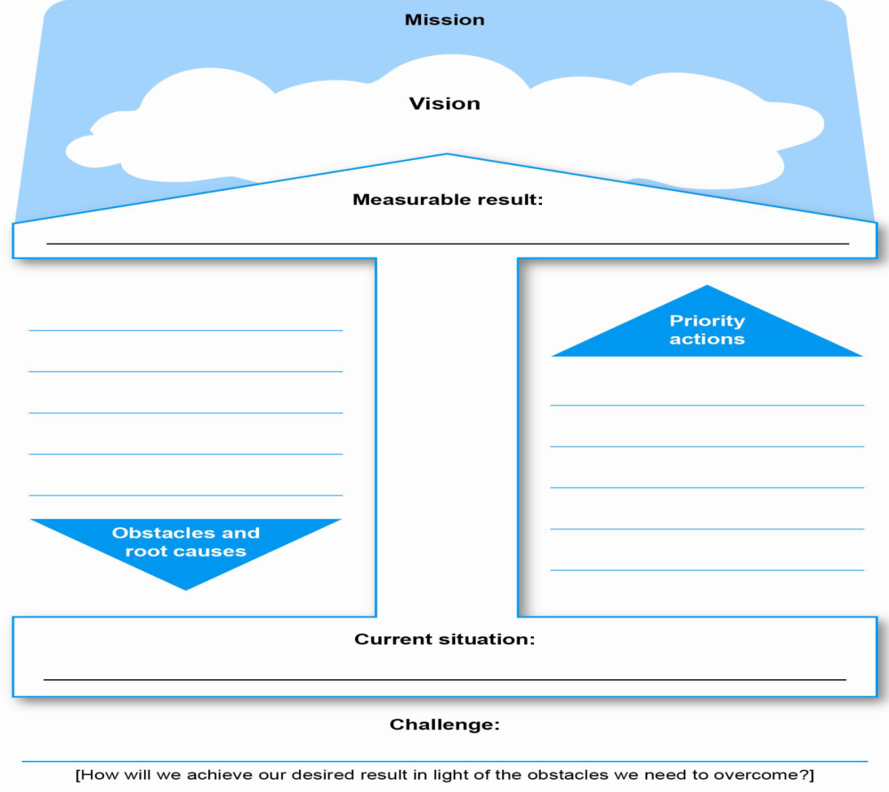
Leading teams to face challenges

Slide 53
How to use the challenge model
  Step 1: Review your organizational mission and strategic priorities
  Step 2: Create a shared vision
  Step 3: Assess the current situation
  Step 4: Agree on one measurable result
  Step 5: Identify the obstacles and their root causes
  Step 6: Define your key challenge and select priority actions
  Step 7: Develop an action plan
  Step 8: Implement your plan and monitor and evaluate your progress

Slide 54
Step 1: Review your organizational mission and strategic priorities
Mission is the purpose of the existence of an organization.
With your team, form a common understanding of your organization's mission and strategic priorities.
This will help you shape your vision.
When developing the mission, the following should be emphasized:
Purpose for which the organization exists;
Target population to which its services are aimed;
Services and/or products offered
Scope of the activities of the organization.

Slide 55
Step 2: Create a shared vision
A vision is a picture we create in our mind of a desirable future toward which we can begin to act.
Work with your team to create a shared vision of the future you want and that contributes to accomplishing the organization's mission and priorities.
This shared vision serves to inspire the team to face each new challenge.

Slide 56
Mission and vision
Example 1- City administration health office
Mission: To reduce morbidity and mortality through provision of quality and equitable, promotive, preventive and curative health services to the inhabitants in the city administration.
Vision: We aspire to see healthy and productive inhabitants in the city administration.

Slide 57
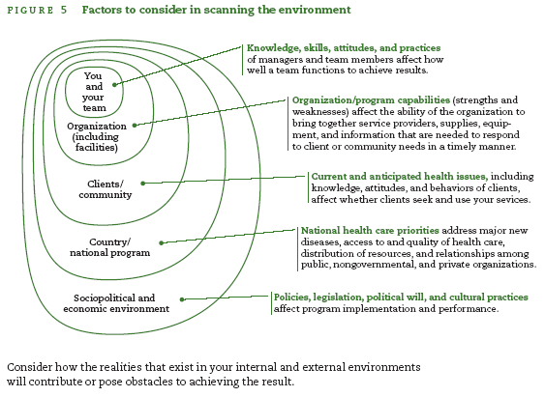
Step 3: Assess the current situation
Scan your internal and external environments to form an accurate baseline of the realities or conditions that describe the current situation in relation to your stated result.

Slide 58
Step 4: Agree on one measurable result
are statements of the results that the HSO/HS team seeks to accomplish.
To make sure your desired result is clearly defined, follow the SMART rule:
  Specific: Clearly written to avoid different interpretations;
  Measurable: To allow you to monitor and evaluate progress toward achieving the result;
  Appropriate: To the scope of your program or work activities, so that you can influence or make changes;
  Realistic: Achievable within the time allowed;
  Time bound: With a specific time period for completion.
Example: To reduce the number of new HIV infection by 25% in 2020.

Slide 59
Step 5: Identify the obstacles and their root causes
Make a list of obstacles that you and your team will have to overcome to reach your stated result.
Use root cause analysis tools to analyze the underlying causes of these obstacles to make sure you are addressing the causes and not just the symptoms.
Two root cause analysis technique
Fish bone diagram
Five why technique

Slide 60

Fish bone diagram

Slide 61
Fish bone diagram
The causes can be grouped under four categories:
People: Knowledge, skills, feedback, motivation, support
Policies: Rules and regulations that you can affect
Processes and procedures: Standards, equipment
Environment: Woreda Health Office, Regional Health Bureau, community, families , other stakeholders

Slide 62
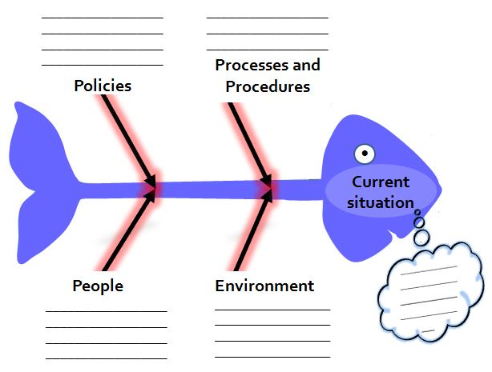
Example:
Lack of teaching/counselling materials
Equipments
Low utilization of long acting family planning methods (24.5 % of the total family planning users)
People
Shortage of service providers
Environment
Low involvement of male partners
Family pressure

Slide 63
Five whys techniques
Why?
  Low rate of FP service
  Low involvement of male partners
    Women did not inform their partners
      Women fear their partners to involve in a discussion
        Feel that their partners have Misconception
        their partners have low awareness
Why?
Why?
Why?
Why?
Why?

Slide 64
Step 6: Setting priority actions
Priority actions are activities or interventions that directly target the root causes of the obstacles identified.
Three to five actions are often enough to focus your efforts on a single challenge and on the underlying root causes of the obstacles.

Slide 65
Sample priority matrix
Criteria (Rate from 1 to 3) | Priority actions
 | Train counselors | Conduct community education/seminars | Renovate clinics
Time to implement (1=the most time) (3= the least time) | 2 | 2 | 1
Cost to implement (1=the most cost) (3=the least cost) | 2 | 3 | 1
Potential for improving Quality in the long term (1=the least potential) (3=the most potential) | 3 | 2 | 2
Capacity to implement (1=the least available) (3=the most available) | 1 | 3 | 1
TOTALS | 8 | 10 | 5

Slide 66
Step 7: Develop an action plan
At a minimum, an action plan should identify:
The actions or activities that will be implemented;
Who will be responsible for carrying out each action;
The human, financial, and material resources needed to implement the actions;
A timeline showing when the actions will be carried out.

Slide 67
Action plan format
Challenge: |  | Indicators:
Desired measurable result:
Priority actions
Activities | Person responsible | Start date | End date | Resources

Slide 68
Step 8: Implement your plan and monitor and evaluate your progress
Support your team in implementing the plan, and monitor and evaluate your progress toward achieving your result.

Slide 69
Indicator
An indicator is like a road sign which shows whether we are on the right track or not in relation to our measurable result/objectives.
Input: The resources needed to achieve the result
Process: The activities we conduct to achieve the results
Output: Immediate result of activities (for example, number of people trained).
Outcome: Short-term change (for example, changes in service use comparing one period to another.)
Impact: The long-term change among a population

Slide 70
MISSION
To reduce morbidity, mortality and disability through providing package of preventive, promotive, and rehabilitative via decentralization and democratization of heath system
Vision
To see diarrheal disease free children's of “X” Woreda /HF
.
To decrease diarrheal disease among under five children at ----------HF from 17% to 10% b/n April 1- May 31, 2018.
Weak supportive supervision
Lack of community awareness
Lack of refreshment training
Low client flow
Priority Actions
Improve community awareness
Strengthening supportive supervision
Provision of refreshment training
Increase client flow
Obstacles and root causes
Current Situation:
17 % of under five diarrheal disease
challenge Statement
How we will decrease diarrheal disease among under five children from 17% to 10% in the light of weak supportive supervision, lack of community awareness, lack of refreshment training, and low client flow

Slide 71
Thank you!!

Slide 72
Group Dynamics & team sprite
What is a group? And What is a team?
What is the advantage of team sprite?
list some of the different types of teams found in healthcare?

Slide 73
Session objectives
At the end of this session we are able to:
Understand the concept of formal and informal groups
Explain why groups and teams are key contributors to organizational effectiveness.
Explain how different elements of group dynamics influence the functioning and effectiveness of groups and teams.
Describe the advantage of team sprite in HSOs

Slide 74
Group Dynamics& team sprite
A Group is:
– Two or more freely interacting individuals who share a common identity & purpose.
Informal groups: a collection of people seeking formed by them selves for a
common interest: like specific sport club supporters, groups due to some similar behaviors and activities.
Formal groups: a collection of people created by the organization to do something productive that contributes to the success of the organization like task force or committee

Slide 75
Management Health Team
What is a Team?
A group with shared leadership and accountability.
Effectiveness is measured by the team’s collective outputs.
A team is a small number of consistent people committed to a relevant shared performance goal.
The heart of a true Team:
Respect each other
Flexibility
Communication
Trust

Slide 76
Team . . .
It is a special type of group
Preferably2-8 people,
Interacting and influencing each other
Members have willingness to work and active participation
The members stimulate each other, and show no domination of one member over another.
E.gs of Health care teams : Operating teams, ICU teams, emergency response teams, infection control teams. . .

Slide 77
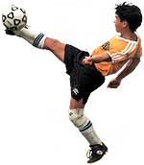
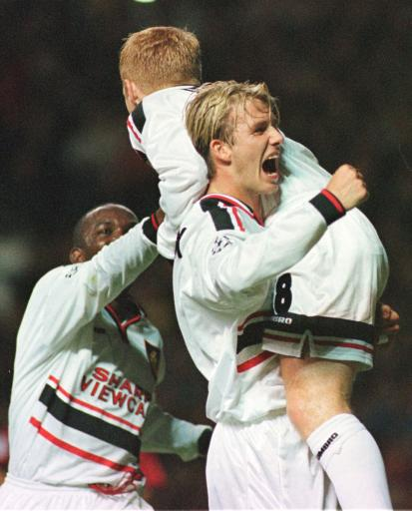
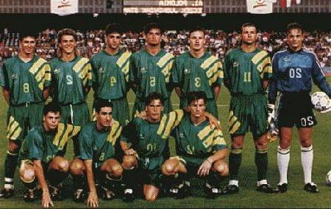
“Teamwork” Climate
    Together
    Everyone
    Achieves
    More
    Nobody wins until we all do!

Slide 78
Stages of team development
1. FORMING
Team members establish the ground rules for how the team is to operate
Development acceptable to the group.
Period of orientation or acclimation
2. STORMING
Members oppose the formation of the structure.
Become hostile and fight to the ground rules.
While the storming stage can be difficult, intense discussion during this phase of team development leads to more productive working later on in the project
3. NORMING
Conflicts are addressed and resolved.
Group unity emerges.

Slide 79
team development…
4. PERFORMING
Structural issues resolved.
Structure supports group dynamics and
performance.
The team will be working productively together
Structure used for task accomplishment
5. ADJOURNING
For temporary groups (task force): the group wraps up activities
The project comes to an end and the team disbands

Slide 80
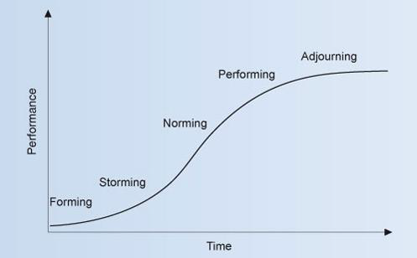
The S-shaped curve of team development

Slide 81
Team, Teamwork, and Trust
Six Ways to Build Trust
  Communication: keep people informed.
  Support: be an approachable person.
  Respect: delegate important duties and listen.
  Fairness: evaluate fairly and objectively.
  Predictability: be dependable and consistent.
  Competence: be a good role model.

Slide 82
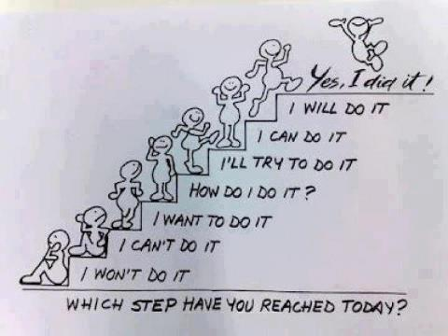
Motivation

Slide 83
WHAT IS MOTIVATION?
Motivation is an internal impulse or power that predisposes someone on a certain goal directed behavior.
It is the willingness to exert high level of effort towards organizational goal.

Slide 84
IMPORTANCE OF MOTIVATION
Health sector performance is critically dependent on worker motivation, thus, service quality, efficiency, and equity are all directly mediated by workers’ willingness to apply themselves to their tasks (Franco, et al 2002).
Motivating individuals improves
Maximum use of efforts for production
Willingness to work
Reduce absenteeism and slowness/tairdiness
Reduce labor turn over

Slide 85
Motivation Theories
Content theories – focus on factors within the person that energize, direct, sustain, and stop behavior. They attempt to determine the specific needs that motivate people
Process theories – describe and analyze how behavior is energized, directed, sustained and stopped by factors external to the person.

Slide 86
Theories of Motivation
Maslow’s needs hierarchy theory
Alderfer’s ERG theory Content Theories
Hertzberg's two-factor theory
McClelland’s Need Theory
Expectancy theory
Goal-setting theory Process Theories
Reinforcement theory
Equity theory

Slide 87
Motivation Theories…
Maslow’s Needs Hierarchy Theory
People have needs, and when one need is relatively fulfilled, the other emerges in predictable sequence to take its place.
He hypothesized that within every human being there exists a hierarchy of five needs

Slide 88
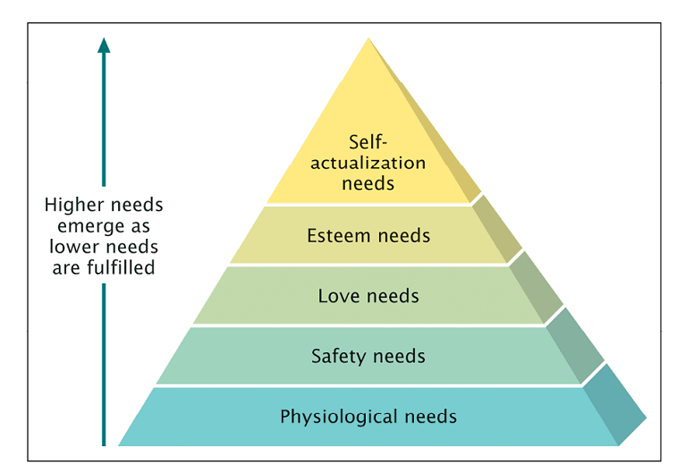
Maslow’s Hierarchy of Needs Theory

Slide 89
Relevance of Maslow’s Theory for managers
A fulfilled need does not fully motivate an individual.
Effective managers can anticipate emerging needs based on individual need profiles and provide opportunities for fulfillment.

Slide 90
Hertzberg's Two-Factor Theory
Dissatisfies - factors associated with the job
context or work environment context or work environment.
Satisfiers: factors associated with the nature of the task itself (job content)

Slide 91
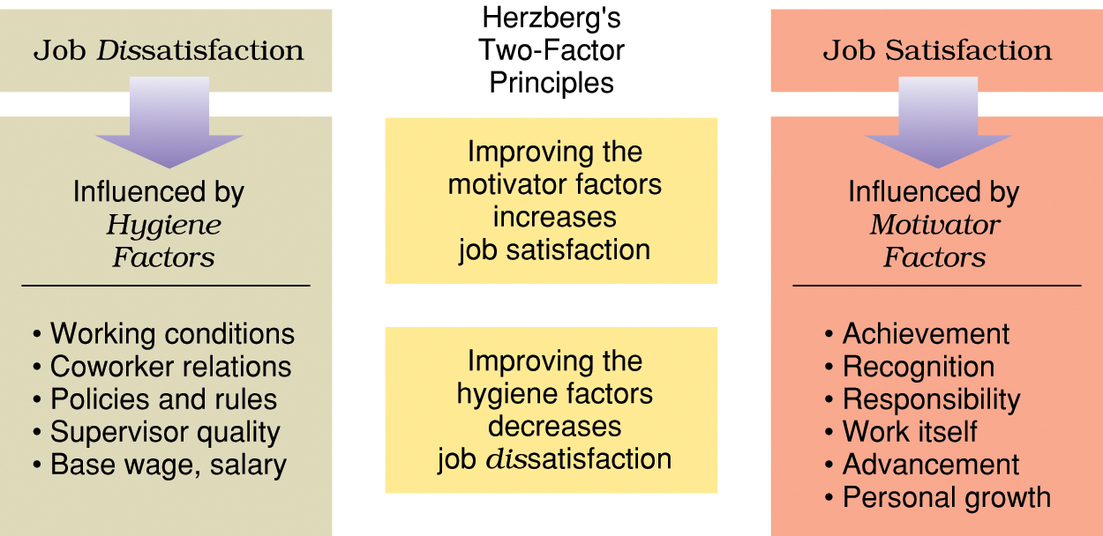
Herzberg’s two-factor theory.

Slide 92
Herzberg’s theory Influence;
Satisfaction can be increased by enabling people to take responsibility.
Dissatisfaction can be reduced by having effective organisational policies and procedures, paying workers well, improving the working environment,

Slide 93
Expectancy Theory
A model that assumes motivational strength is determined by perceived probabilities of success
One’s motivational strength increases as one’s perceived effort-performance and performance-reward probabilities increase the likelihood of obtaining a valued reward.

Slide 94
Expectancy Theory: An Overview
Effort
Skills and
abilities
Expectancy
Performance
X
Instru-
mentality
Job
Performance
Motivation
Rewards
X
Valence of
Rewards
Role perceptions
and opportunities
16

Slide 95
Expectancy Model: Components
Expectancy: The degree to which you expect that hard work (effort) will lead to good performance or high accomplishments
Instrumentality: The perception that if you perform well you will be rewarded
Valence: How much do you value the rewards you may receive

Slide 96
Goal-Setting Theory
Goal setting: the process of improving performance with objectives, deadlines, or quality standards.
Properly conceived goals trigger a motivational process that improves performance.
That is, goals tell an employee what needs to be done and how much effort will need to be expended.
specific goals increase performance

Slide 97
Goal Setting Theory
Goal-setting theory includes the following components:
Goal specificity: refers to the degree to which goals are real and unambiguous, which is necessary in order to direct behaviour and maintain motivation.
Goal difficulty : suggests that hard goals are more motivating than easy ones but that they should be achievable.

Slide 98
Adam’s Equity Theory
Individuals compare their job inputs and outcomes with those of others and then respond so as to eliminate any inequities.
Which proposes that individuals are motivated when they perceive they are treated equitably in comparison with others in the organization.

Slide 99
Reinforcement theory
Positive reinforcement – reward desired behavior to increase the probability that an
individual will repeat that behavior e.g. Praise, pay, promotion
Negative reinforcement - the attempt to
decrease or stop the recurrence of undesired
behavior as a result of negative consequences

Slide 100
Motivation Through Rewards
Extrinsic Rewards
Payoffs granted to the individual by other rewards.
E.g. Money, employee benefits, promotions, recognition, status and praise.
Intrinsic Rewards
Self-granted and internally experienced payoffs.
E.g. Sense of accomplishment, self-esteem, and self-actualization.

Slide 101
.
Improving Performance with Extrinsic Rewards
– Rewards must satisfy individual needs.
– Employees must believe effort will lead to reward.
– Rewards must be equitable.
– Rewards must be linked to performance.
Motivation through Employee Participation
– The process of empowering employees to assume greater control of the workplace.
Setting goals
Making decisions
Solving problems
Designing & implementing organizational changes

Slide 102
SPECIAL ISSUES IN MOTIVATION
Motivating Professionals
Professionals are typically different from nonprofessionals. They have a strong and long-term commitment to their field of expertise.
Their loyalty is more often to their profession than to their employer.

Slide 103
They need to regularly update their knowledge, and their commitment to their profession.
Provide them with ongoing challenging projects.
Give them autonomy to follow their interests and allow them to structure their work in ways that they find productive.
Reward them with educational opportunities – training, workshops, attending conferences
Also reward them with recognition, and ask questions and engage in other actions that demonstrate to them you're sincerely interested in what they're doing.

Slide 104
Motivating the Diversified Workforce
Not everyone is motivated by money.
Not everyone wants a challenging job.

Slide 105

Thank You!

