Slide 1
Unit Two:
Health Planning

Slide 2
Session objectives
Define planning and health planning
Describe the benefits of health planning
Differentiate and analyze different types of planning
Discuss the basic steps of health planning

Slide 3
What is planning
Planning
The process of determining what the organization will do to accomplish its objectives
The conscious, systematic process of making decisions about goals and activities to be pursued in the future
Deciding in advance on what, how, when and who will do activities.
Planning is the process that lays the base for future action

Slide 4
Planning…
Health planning
The process of defining community health problems, identifying needs and resources, establishing priority goals and setting out the administrative action needed to reach those goals.
Is a specific action proposed to help health organizations to achieve their objectives.
It’s concerned with both ends (what) and means (how).

Slide 5
Planning …
Important components of definitions of planning are;
Where are we going (objectives)
With what (resources)
How (efficient and appropriate implementation)
When (future)
A degree of formalization (explicitness and method) about the process

Slide 6
Why should managers plan?
Planning:
Provides direction to managers and non-managers.
Reduces uncertainty by forcing managers to look ahead, anticipate change, consider impact of change, and develop appropriate responses.
Helps foreseeing & identifying potential risks
Helps efficient utilization of resources while achieving objectives
Establishes the goals or standards used in controlling.

Slide 7
Decisions related to planning
There are 3 main planning decisions
Decision on objectives:
How much of the problem can be reduced
Decision on activities
Which type of activities?
Who will do those activities?
Decision on resources
identification, specification & quantification of resources to be utilized

Slide 8
Characteristics of good plan
Futurity Objectivity
Flexible (Continuous and dynamic)
Stability Comprehensiveness
Clarity

Slide 9
Classification of planning
Plans can be classified on different bases or dimensions.
Repetitiveness/frequency of use
Time dimension/ Duration, and
Scope/breadth dimension

Slide 10
PLANNING…
Classification of Plans Based on Repetitiveness
Standing Plans
Single-use Plans
Standing Plans
Plans that provide guidance for activities performed repeatedly.
That are followed each time a given situation encountered
Include mission or purpose, goal, strategy, policy, procedure, method, and rule

Slide 11
PLANNING…
2. Single-use Plans
A one-time plan developed for a single occasion or purpose.
Not used up once the objective is accomplished
The amount of time you spend on it depends on its nature and importance
Include Programs, projects and budgets

Slide 12
PLANNING…
Classification of Plans Based on Time
1. Long-range planning
The development of a plan for accomplishing a goal over a period of several years.
The time may range usually from 5-10 years

Slide 13
Planning…
2. Short-range planning
Complementary of long- range plans
Constitutes the steps towards the implementation of long-range plans
covers a period of one year or less.
3. Intermediate-range planning
Ranges between long and short- range plans
lasts from 2 -5 years.

Slide 14
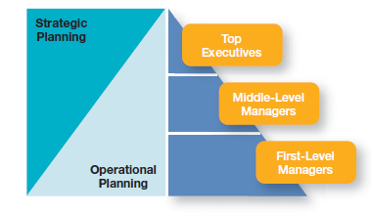
Planning…
Classification of Plans Based on Scope/Breadth
Strategic Planning
Tactical Planning
Operational Planning
1- Strategic Planning: is process of analyzing and deciding on the organization's mission, objectives, major strategies, major resource allocation
Strategic planning is:
performed by top level mangers, mostly long range in its time frame, expressed in relatively non-specific terms
type of planning that provide general direction
Tactical planning

Slide 15
Strategic planning…
Apply to the entire organization.
designed to meet an organization’s broad goals
focus on environmental assessment and
addresses objective and strategy.
That an organization must be responsive to a dynamic, changing environment.

Slide 16
Planning…
2- Tactical Planning
Translates broad strategic plans into specific plans that are relevant to a definite portion of the organization
developed for a functional area such as finance
focuses on the major actions that a unit must take to fulfill its part of the strategic plan
Departmental managers/ Midlevel managers often involved in tactical planning

Slide 17
Planning…
3- Operational Planning
Identifies the specific procedures and processes required at lower levels of the organization
Concerned with day-to-day activities
Short-range and more specific and more detailed.
First line managers: plan in relation to specific operations or activities e.g. scheduling work activity and allocating resource.

Slide 18
Planning…
Difference between strategic and operational plans
Areas of difference | Operational plans | Strategic plans
Experts involved | Developed by low-level management. | Developed by upper level management
Time horizon | Cover short periods (1 week to one year) | Cover long period (normally five years or more)
Scope | Narrow range of operations | Wide range of goal
Degree of detail | Detail and specific activities | Simplistic and general

Slide 19
The planning cycle
The planning cycle is a sequence of steps which must be followed in deciding what is to be included in the plan.
The cycle seeks to answer the following questions:
1. Where are we now?
This requires a situational analysis to identify current health and health-related needs and problems.

Slide 20
2. Where do we want to go?
Defining/establishing goals
Identification of objectives to be met in order to improve the health situation and/or service delivery.

Slide 21
3. How will we get there?
This details and organizes
the tasks or interventions to be carried out,
by whom, during what period, at what costs and using what resources in order to achieve set objectives and targets

Slide 22
4. How will we know when we get there?
This requires the development of measurable indicators for monitoring progress and evaluating results.

Slide 24
Planning out comes
Items that traditionally are considered to be outcomes of planning are Organizational Mission, Vision, Objectives, and Strategies, and Operational Policies, and Procedures.
Mission
A mission statement identifies/states the purposes and reasons for which the organization exists.
It specifies the unique aim of the organization.
The elements of mission are:
Who are you? What are we? Why do we exist? What is our constituency?

Slide 25
Planning out comes
Vision
It usually accompanies the statement of mission.
It is “a strategic view of the future direction and a guiding concept of what the organization is trying to do and to become”.

Slide 26
Mission and vision
E.g. 1- City administration health office
Mission: To reduce morbidity and mortality through provision of quality and equitable, promotive, preventive and curative health services to the inhabitants in the city administration.
Vision: We aspire to see healthy and productive inhabitants in the city administration.
E.g. 2- Apple Computer company:
Mission: To bring the best personal computing products and support to consumers around the world.
Vision: One person, one computer.

Slide 27
Planning out comes
OBJECTIVES
are statements of the results that the HSO/HS seeks to accomplish.
are HSO/HS outputs. They are the ends, targets and desired results toward which all organizational activities are directed.
Are specific, measurable, attainable, realistic, and have time bound, SMART.

Slide 28
Planning out comes…
E.g. of SMART Objectives
To reduce the number of new HIV infection by 25% in 2020.
To reduce mortality attributed to TB by 50% in 2020.
Increase Life Expectancy at birth from 64 yrs to 69 yrs by 2020.
Reduce MMR from 420 to 199 per 100,000 live births by 2020.
Reduce Under five-year, Infant and Neonatal mortality rates from 64, 44 and 28 to 30,20 and 10 per 1,000 live births by 2020.

Slide 29
Planning out comes…
Organizational STRATEGIES
the means/ways of accomplishing organizational objectives.
are broad, general programs that are selected and designed by the HSOs to accomplish their objectives.
Strategies:
Expansion and rehabilitation of H/facilities.
Adopt and develop standardized operational guidelines.
Establish strong public-private partnership.
Continuous improvement of the existing H/S, etc.

Slide 30
The steps of health planning
Situational analysis
Priority setting of the problem
Setting objectives and targets
Identifying potential obstacles and limitations
Designing the strategies
Preparing action plan and budget
Implementing
Monitoring and Evaluation

Slide 31
Some Steps in health planning
Step 1: Situational Analysis
Gives improved understanding of the current situation
Answers the question “Where are we now?”
The current situation is described with identification of health and health related needs and available resources
Outcomes:
A common reference point
Allows the selection of priority areas of concern for planning

Slide 32
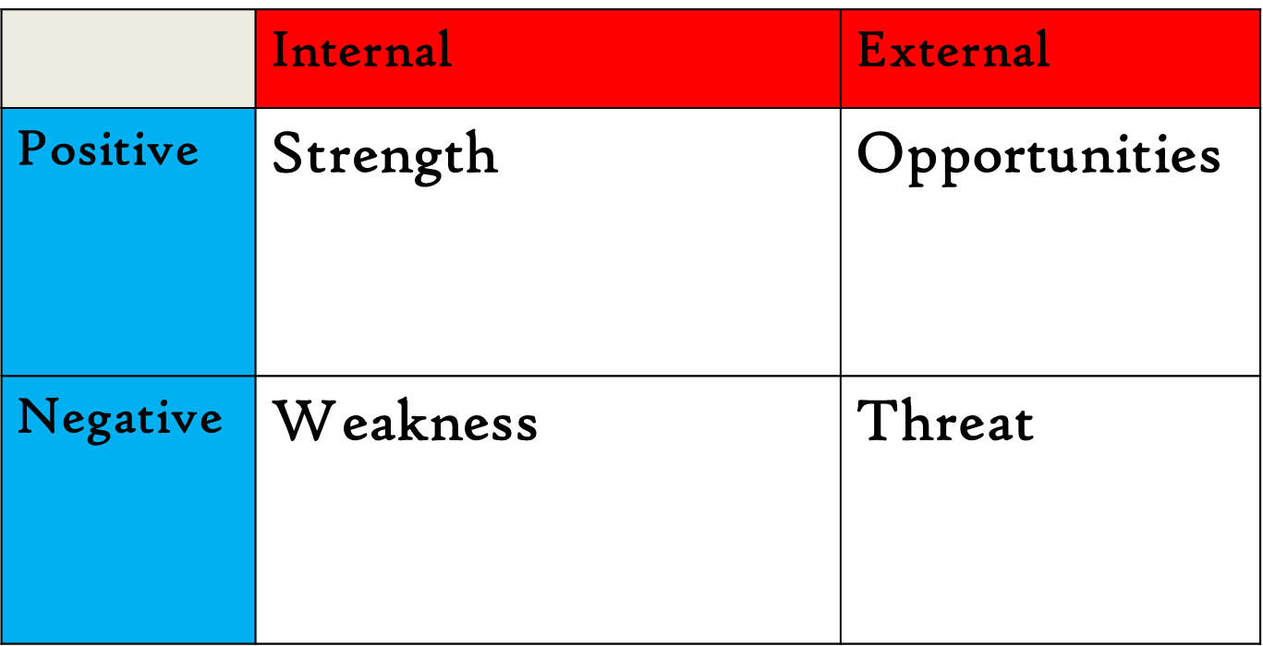
Situational analysis. . .
SWOT analysis

Slide 33
Situational analysis
Contents
1. Population characteristics
Study the size, composition and distribution of the population.
Identify the target groups
Determine population size by category
Estimate overall population growth
Determine religious, educational and cultural characteristics

Slide 34
Situational analysis. . .
2. Area characteristics and infrastructures
Assess:
Geographical and topographical situations
Infrastructures –transport modes and routes, means of communication, water supply and sanitary facilities, electric supplies etc
Socioeconomic situations-distribution of family income
Public and private sector structure

Slide 35
Situational analysis. . .
3. Policy and political environment
The national programs and programs should be used as a guide
relate actual situation in the area of concern with these guidelines

Slide 36
Situational analysis. . .
4. Health need analysis
analyzing the health needs and the magnitude of health problems is a basic prerequisite for planning
two broad approaches:
i. Medically perceived health needs
Information sources
community health survey
morbidity rates –incidence, prevalence
mortality rates-IMR, MMR
disability rates
record review of health service contacts
interview with health professionals

Slide 37
Situational analysis. . .
ii. Community perceived health needs
two sources of information
from survey of the attitudes and views of the community members
from existing community structures
E.g. village health/dev’t committees

Slide 38
step 2: Problem Prioritization
In analyzing problems:
Define clearly what the problem is
Find all possible causes of the problem
Don’t confuse ‘problems’ with ‘causes’
E.g. Diarrheal disease ………..problem
Inadequate and unsafe water supply
Poor sanitary conditions
Low level of awareness……..are all causes

Slide 39
Prioritization. . .
There are always discrepancies between problems and the available resources.
Planners are obliged to solve certain problems before others.
That is why problem prioritization has a paramount importance in the planning process
Priority problems are often selected by setting selection criteria and giving scores for each problem according to the criteria.

Slide 40
Criteria for problem prioritization
Magnitude of the problem: the public health burden imposed by the problem.
Degree of severity: consequent suffering, death and disability
Feasibility: in terms of cost effectiveness, social acceptability and local sustainability
Government concern: political acceptability
Community concern: how much does it relate to community perceived health needs?

Slide 41
Criteria for prioritization. . .
Ranking is then done by using criteria on 5 point scale
i.e.
very high (5),
high (4),
moderate (3),
low (2) and
very low (1)

Slide 42
E.g. Prioritization of health problems for Gondar Health Center, December, 2019
NO | Problems | Magnitude | Severity | Feasibility | Community concern | Government concern | Total | Rank
1 | EPI 50% | 4 | 3 | 5 | 5 | 4 | 21 | 2
2 | Delivery 3.4% | 5 | 5 | 5 | 5 | 5 | 25 | 1
3 | Latrine 84% | 2 | 2 | 3 | 4 | 4 | 15 | 4
4 | FP 76% | 3 | 3 | 5 | 5 | 4 | 20 | 3

Slide 43
Step 3: SETTING OBJECTIVES AND TARGETS
Describing the desired direction of a service definition in terms of measurable parameters
Answers the question “where do we want to go?”
Importance
Clear statement of objectives enables:
to decide how to achieve them
to evaluate how effective one is in achieving and leaching/identify/ objectives
Objectives of a program must be ‘SMART’

Slide 44
Setting objectives. . .
Specific- helps to solve the cause of the problem that it is meant to solve.
Measurable- allows monitoring / Evaluation
Appropriate- to the problems, goals & strategies
Realistic- achievable, & meaningful
Time-bound- has specified period of time
E.g. By the end of year 2019, 50% of eligible pregnant mothers will receive antiretroviral therapy in Gondar town.

Slide 45
step 4: Identifying Potential Obstacles & Limitations
situations that may prevent the achievement of each objectives & targets
The limitations may be :
Resources
Human –lack of interest/skill
Equipment –not available/Expensive
Money- lack of budget
Time- people may not have time
Information- needed for implementation not timely/well processed

Slide 46
Identifying potential obstacles & limitations…
(ii) Environmental obstacles
o Geographical features like lakes, rivers, mountains
o Climate– affect the nature of health problems
(iii) Social factors- traditions,…
Three groups of Obstacles
(1) Obstacles that can be removed
(2) Obstacles that can be reduced or modified
(3) Obstacles that can’t be changed

Slide 47
Step 5: Designing strategies
Strategies are the tactics or techniques that should be devised or adopted & utilized to facilitate the achievement of objectives & targets.
Strategies are ways of achieving objectives & targets
Potential strategies often include
Technology to be applied
Procedures to be used &
Defining the role of communities and other sectors

Slide 48
Strategies. . .
For each chosen strategy, the corresponding activities to be undertaken & the resources needed should be detailed.
What is to be done?
Who will do the activities?
Which resources are needed?
How?(procedures for technical, administrative, community workers, contribution of other sectors)
When to do it? (beginning , end)
Where the work will be done?
The methods of controlling

Slide 49
Step 6:Preparing action plan
Gantt chart
is a bar graph with time on horizontal axis and the resources /activities to be scheduled on the vertical axis
Columns of a Gantt chart
list of the project activities
a column that makes a filed time period showing when the activities will occur
Responsible bodies
Resource column

Slide 50
Writing up the plan
Purpose of writing a plan
(i) To request funds or resources from the government or funding agencies
(ii) For monitoring & evaluating the implementation process by all concerned bodies.
Several ways of writing a plan, a simple outline includes:
1. Summary of main points
2. Introduction (General background and Statement of the problem)
Statement of the problem explains the rationale for undertaking the project

Slide 51
Writing up the plan. . .
3. Objectives and targets should be clearly stated
4. Strategies & activities should be clearly stated using Gantt chart
5. Resources requirement
The type and number of resources needed should be documented
How each of the resources are going to be utilized has to be mentioned
6. Monitoring & evaluation
Mention how monitoring and evaluation is to be performed
By whom?
When?
Indicators of effectiveness should be decided beforehand

Slide 52
Limitations of planning
Lack of accurate information
Problems of change
Failure of people
Internal inflexibilities
External inflexibilities
Time and cost factors

Slide 53
Plan your work
Work your plan!
If you fail to plan
You plan to fail!

Slide 54
Thank you!!

