Slide 1
CHAPTER:3
PRINCIPLES AND METHODS OF PRESERVATION OF FRUITS AND VEGETABLES

Slide 2
Remember chapter one what is preservation???
What are the measure preservation method horticultural products???
What the importance of preservation???
How to preserve horticultural products???

Slide 3
Remember chapter one what is preservation???
3.1.Physical method of preservation
Application of heat - pasteurization, sterilization,
Removal of heat - Refrigeration, freezing etc.
Drying
irradiation
3.2. Chemical methods of preservation
Salt
Sugar
Acid
3.3.Preservation by fermentation
3.4. Preservation by combination of different methods,

Slide 4
3.1 Application of heat 3.1.1Preservation By Pasteurization using heat
What is Pasteurization????
General principle about Pasteurization
Mild heat treatment <100 oc.
Improve the products /keeping quality
Destroys all disease producing pathogens
Inactivate enzymes
Kills relatively heat sensitive Mos that cause spoilage. Eg. Non spore forming bacteria, yeast sand molds

Slide 5
Minimal changes in the food properties
Do not kill spore forming Mos.
Pasteurization can be achieved by a combination of time and temperature
1.Short time-high temperature
2.long time –low temperature
Shelf life of pasteurized foods is usually only extended by a few days and weeks.

Slide 6
Physical and chemical factors which influence pasteurization process are the following:
temperature and time;
acidity of the products.

Slide 7
Pasteurization processes
In pasteurizing certain acid juices for example, there are two categories of processes:
A) Slow pasteurization where pasteurization time is in the order of minutes and related to the temperature used; two typical temperature/time combinations are as following:
63° C to 65° C over 30 minutes or
75° C over 80 °c to 10 minutes.
Pasteurization temperature and time will vary according to:
nature of the product;
initial degree of contamination;
and shelf life required

Slide 8
In this first category of pasteurization processes it is possible to define three phases:
heating to a fixed temperature;
maintaining this temperature over the established time period (= pasteurization time);
cooling the pasteurized products: natural (slow) or forced cooling.

Slide 9
B) Rapid, high or flash pasteurization is characterized by a pasteurization time in the order of seconds and temperatures of about 85° to 90° C or more, depending on holding time.
Typical temperature/time combinations are as follows:
88° C for 1 minute;
100° C for 12 seconds;

Slide 10
the 100°C for 12 seconds treatment give the best quality products in respect of flavor and vitamin retention.
Advantages of flash/rapid pasteurization
Loss of flavor is minimum
Vitamins are not destroyed
Effects economy of time and space
Keeps the juice uniformly cloudy and
Juice is heated uniformly and thus its cooked

Slide 11
Advantage of Pasteurization And Sterilization:
Most Mos are destroyed so there is less chance of spoilage
The food can be kept longer and more safely
Disadvantage of Pasteurization
heating requires investment
Labor intensive

Slide 12
Disadvantage cont…
Over heating may be leads to
textural disintegration
Undesirable flavor
Nutritional deterioration
Requires access abundant clean water
Preserved fruit and veg. have lower quality.

Slide 13
The difference between pasteurization and sterilization???
S. No. | Pasteurization | Sterilization
1 | Partial destruction of microorganisms, | Complete destruction of microorganisms,
2 | don’t kill spore forming mos | Kill spore forming and non spore forming mos
3 | Temperature below 100 oC | Temperature 100 oC and above
4 | Commonly used for fruits | Commonly used for vegetables

Slide 14
3.1.2 Preservation by Low Temperature
1.Freezing(-18 to -40°C)
2.Refrigeration or chilling(0 to 5°C),

Slide 15
Microbial growth and enzyme reactions are retarded in foods stored at low temperatures.
The lower the temperature, the greater the retardation.

Slide 16
3. 2.1. Preservation by freezing
Freezing:
Process in which a liquid turns into a solid when cold enough
Best method for long storage of fruit and vegetables
Preserve the original color, flavor and nutritive value
Reduce the rate of degradation reaction and inhibit the Mos activity.

Slide 17
reduces the temperature of the food so that microorganisms cannot grow, yet some may still survive.
Enzyme activity is too slowed but not stopped during freezing.

Slide 18
It should be recognized that a number of physical, chemical and biochemical reactions can still occur.
Freezing and frozen storage is not a reliable biocide b/c few Mos can grow below -10 °c.
But significant extend the storage life.

Slide 19
Quality of frozen fruit is very dependent on:
Type of fruit
Varietal characteristics
Stage of maturity
Pre-treatments
Type of pack
Rate of freezing

Slide 20
Freezing process:
reduce the temperature -18 °c and below
Allows the preservation of the frozen product for 1 year or more.

Slide 21
Fruit and veg. are frozen in different shapes and styles:
Whole
Halves
Slices
With dry sugar, with no sugar added,
As juices

Slide 22
General Freezing principles
The use of low temperatures(-18 to-40 °c )
Freezing changes the physical state of a substance (water in to ice)
Energy is removed in the form of cooling below freezing temperature
Freezing process reduces food temperature until its thermal center

Slide 23
Crystallization of water during freezing reduces availability of water, this results:
Decline in chemical and biochemical rxns and reduce Mos.

Slide 24
As the temperature drops:
The molecules become less energetic
Moving more slowly
Followed by the transformation in to ice or solid water

Slide 25
Successful freezing:
Only retain the inherent quality present
Will not improve quality characteristics
Quality level prier to freezing is major consideration
Use a high quality initial materials
Freshness
Suitability of verity for freezing

Slide 26
Pre-treatments for freezing
A. Dipping
Dipping or soaking in different solutions
E.g. salt solution, ascorbic acid and sugar solutions to minimize browning
B. Blanching
most vegetables and some fruits can be used
Adv:
To remove inter cellular air.
Reduction of some undesired compounds present in some leafy vegetables

Slide 27
Blanching fruits may be detrimental in many cases:
Rapid discoloration
Loss of texture
Formation of cooked taste
Some loss of soluble solids
Hot water blanching is usually:
between 75°c and 90 °c for 1-10min
immediate cooling after blanching

Slide 28
Containers for freezing should be :
Moisture and vapor resistance
Durable and leak proof
Resistance to oil, grease and water
Not susceptible to becoming brittle and cracking at low temperature
Able to protect foods from absorbing other flavors or odors
Easy to seal
Easy to label

Slide 29
Suitable packaging materials :
Glass jars made for freezing and canning
Heavy duty aluminum foil
Moisture vapor resistance bags
Polyethylene plastic bags

Slide 30
storage
Store frozen fruits and vegetables at -32 °c or lower
Higher than -32 °c increases:
the rate of deterioration and
shorten the shelf life of foods
Avoid fluctuation of freezer temperature

Slide 31
Freezing methods
Freezing by contact with cooled solid-plate freezing
Freezing by contact with a cooled liquid: immersion freezing
Freezing by contact with a cooled gas

Slide 32
A. Freezing by contact with cooled solid :plate freezing
the product is sandwiched between metal plates and pressure is applied
Suitable for regular shaped materials
B .Freezing by contact with a cooled liquid: immersion freezing
Salt solution(sodium chloride)
Sugar solutions
Alcohol solutions
Solutes must be safe to the product in terms of health, test, color and flavor.

Slide 33
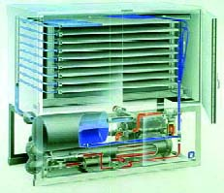
Figure 2. Plate freezer

Slide 34
C. Freezing by contact with a cooled gas
cold air is circulated in a cabinate where product is placed in a try
temperature of food is reduced with cold air

Slide 35
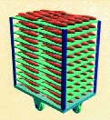
fig.4 Tunnel freezers

Slide 36
Procedure for proper freezing of fruits and vegetables:
A .Selecting and washing
Choose young, tender vegetables
Over mature vegetables may be hard, tough and flavorless
Wash vegetables thoroughly in cold water
Peel, trim and cut into pieces after washing

Slide 37
B. Blanching of vegetables
i)Boiling water blanch:
Place vegetables in wire basket or mesh bag; immerse in blanching water.
ii)Steam blanching:
Needs longer time than boiling water blanching
C. packaging vegetables
Air leads to flavor loss and off-flavors
To prevent air exposure and moisture loss

Slide 38
D. freezing
Freeze fruits and vegetable pieces to -32°c.
F. Storage
maintain freezer at -32°c or less

Slide 39
To summarize
Freeze products at -32 °c or lower
Freeze products when they are packed and seald
Do not overload frozen with unfrozen food
Leave a little space between packages.
Freezing does not completely destroyed bacteria, molds and yeasts but retard their growth
Freezing slows enzyme activity but does not stop it

Slide 40
3.2.3. Preservation by Refrigeration
Process of removing heat from a substance /product and maintaining that lower temperature.
Refrigeration preserves foods by slowing down the growth and reproduction of micro-organisms and the action of enzymes that cause food to rot.

Slide 41
Fruits, vegetables and their products can be preserved for a few days to many weeks when kept at this temperature.

Slide 42
the conventional refrigeration storage environment, three important factors must be controlled:
Temperature: The system should always be able to meet the demands placed upon it and controlled automatically by the use of thermocouples, pressure valves, etc.
Relative humidity (RH) should be kept high in a refrigerated storage room by controlling the refrigerant temperature.
High RH prevents water loss affects texture, freshness, color appearance and overall quality of food products.

Slide 43
Air movement in the refrigeration environment must be sufficient to remove respiration heat, gases, and the heat penetrating through the door, junctions, and structure of the refrigeration room
However, excessive air movement can cause food dehydration.
Air circulation must be uniform throughout the room.
Packages must be correctly stacked to achieve good air circulation.

Slide 44
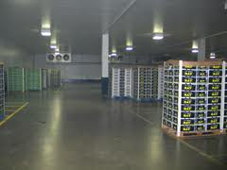
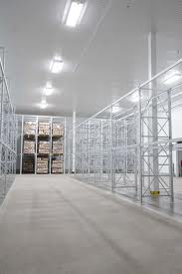
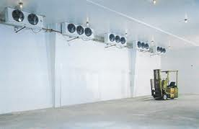

Slide 45
3.1.3 .Preservation by Drying

Slide 46
Drying is a method of food preservation in which food is dried (dehydrated ).
Drying inhibits the growth of bacteria, yeasts, and mold through the removal of water.
Water is traditionally removed through evaporation (air drying, sun drying), although today electric food dehydrators or freeze-drying can be used to speed the drying process and ensure more consistent results.

Slide 47
Drying removes most of the moisture from the foods
thus micro-organisms cannot grow and enzyme action is slowed down.
Dried foods should be stored in airtight containers
to prevent moisture from rehydrating the products and
allowing microbial growth
Drying is one of man’s oldest method of food preservation.

Slide 48
The drying rate depends on temperature, humidity and speed of air, type of drier and size of food pieces with fruits and vegetables
generally drying at 38-60 °c.

Slide 49
Dried products are easy to store and have long shelf life, reduced weight and bulk for transport and distribution costs, and provide raw materials for further processing.
However there are risks such as loss of quality in drying products and contamination is high may occur.
Properly drayed and packed veget. and fruits can be stored for about one year

Slide 50
The removal of moisture prevents the growth and reproduction of micro-organisms causing decay and minimizes many of the moisture mediated deterioration reactions
Drying which employs high temperatures for short times does less damage to food than drying processes employing lower temperatures for longer times.

Slide 51
Microorganisms need moisture to grow so when the concentration of water in the food is brought down below a certain level, they are unable to grow.
Moisture can be removed by the application of heat as in sun-drying or by mechanical drying (dehydration).
Sun drying is the most popular and oldest method of preservation.
In 'these days, mechanical drying has replaced sun-drying.

Slide 52
This is a more rapid process as artificial heat under controlled conditions of temperature, humidity and air flow is provided
In this method, juices are preserved in the form of powder.
The juice is sprayed as a very fine mist into an evaporating chamber through which hot air is passed.

Slide 53
Drying methods
1.Sun Drying
2.Artificial Drying
3.Drying using heated surfaces

Slide 54
A. Sun Drying
use of natural air
Drying in the open air is simple and inexpensive
Simply uses sunlight
The climate should be hot, relatively dry and free of rainfall
The product to be dried is placed in thin layers of trays or black plastics

Slide 55
Trays are usually made of wood, and lined plastic or galvanized nets
It should be placed 1m above the ground on stands

Slide 56
Disadvantages of Sun-Drying
Traditional sun-drying of the fruits is highly time consuming.
Open drying provides less hygienic conditions
Moreover sun drying is totally dependent on climate conditions and thus can not be processed every day.
Contamination from the environment, by insects, birds etc.
Floor space and labor requirements
Difficulty in controlling the process and bad odor

Slide 57
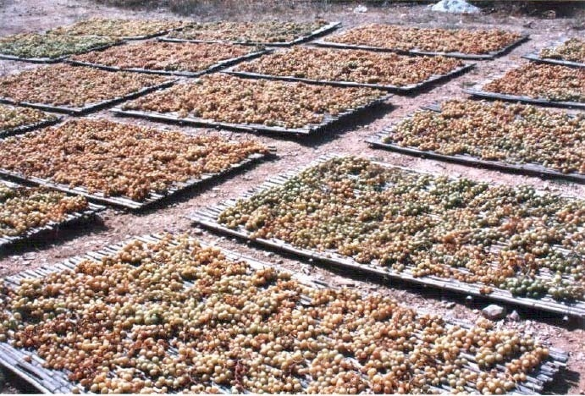
Figure 11. Open sun drying of grapes in Spain

Slide 58
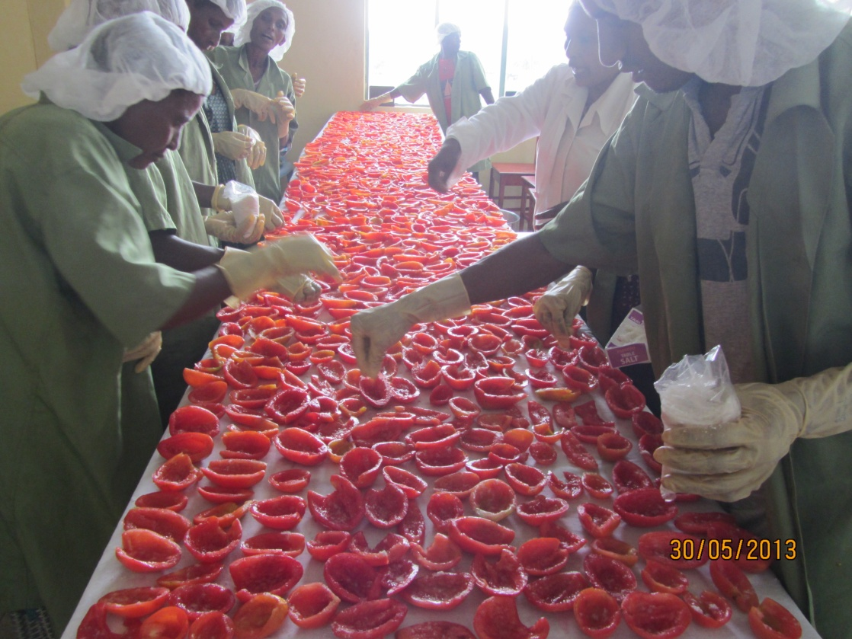
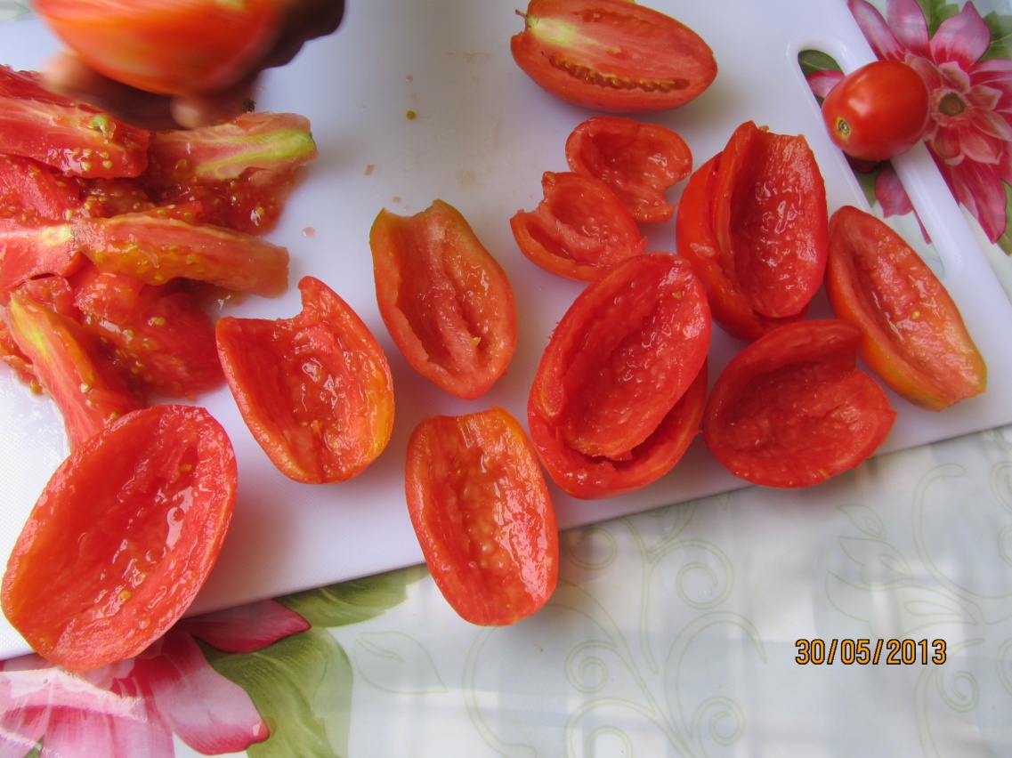

Slide 60
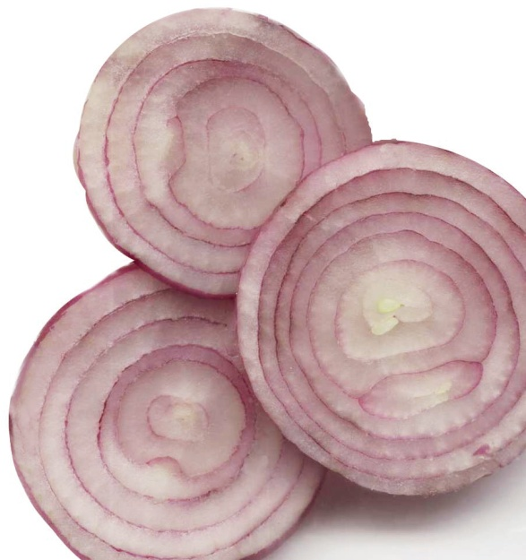
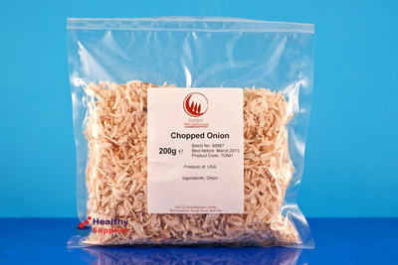

Slide 61
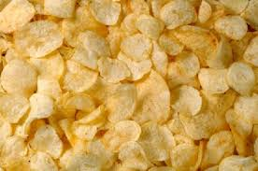
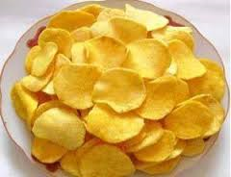

Slide 62
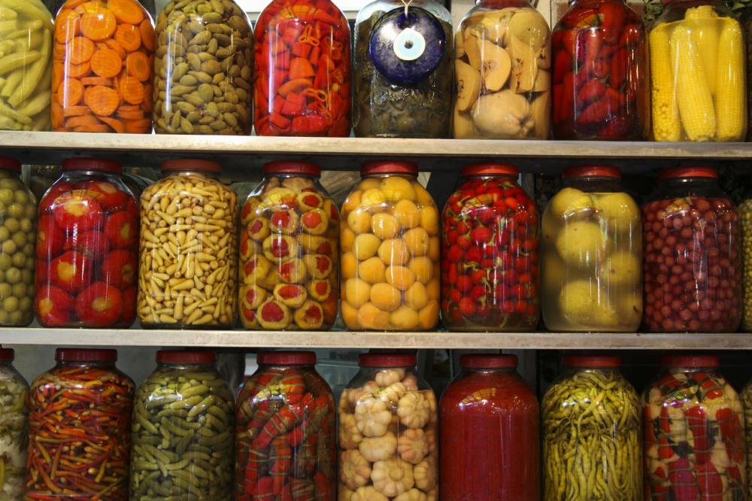
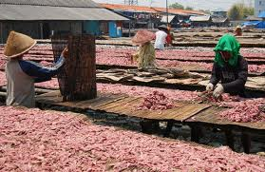

Slide 63
B Artificial Drying
In areas with high rain fall, it is advised to have artificial dryer.
Heating –increases the speed at which the product will be dried because ;
- the air can absorb more water from the product
- the product releases water faster at higher temperature

Slide 64
Solar draying :
Improved sun draying
Uses radiation energy from the sun
Allows the sun light to enter through a glass or transparent plastic cover
Trapping the warmth and raizes the temp.to 60-75oc.
Over heating can be avoided by regulating the ventilation
With out ventilation the temp. can reach 90-100 oc towards the end of the drying
Ventilation must be good enough to prevent condensation on the glass.

Slide 65
Fig .Solar dryer

Slide 66
Limitation of solar draying:
Limited to a large scale production
Need large area of space
Need high labor inputs
Insect infestation and microbial contamination

Slide 67
C .draying using heated surfaces:
Foods are deposited on a heated steel drum
Heat is conducted from the hot surface
Moisture is evaporated from the exposed surface
When is the drying process finished?
Fruit :12-14% water
Vegetables :4-8%water

Slide 68
Summery

Slide 69
3.1.4.Irradication
Irradiation of food is the exposure of food to ionizing radiation.
Application of different rays
– magnetic or ionized rays
killing bacteria, molds, and insect pests,
reducing the ripening and spoiling of fruits,
it is sometimes called "cold pasteurization", as the product is not heated.
common for Spices and herbs
foods are exposed to the intense fields of radiation
food remain safe for a longer duration.

Slide 70
Too high a dosage can produce undesirable changes in texture, color and taste of foods.

Slide 71
Irradiation can extend the shelf-life of foods in a number of ways.
By reducing the number of spoilage organisms (bacteria, mould, fungi etc.)
Since ionizing radiation interferes with cell division, it can be used as an alternative to chemicals to inhibit sprouting and thereby extend the shelf life of potatoes, onions and garlic.
Exposure of fruits and vegetables to ionizing radiation slows their rate of ripening.
Strawberries, for example, have been found to be suitable for irradiation.
Their shelf-life can be extended from 5 to 15 days.

Slide 72
The main advantages of irradiation are as follows:
There is little or no heating of the food and therefore negligible change to sensory characteristics
Fresh foods may be preserved in a single operation, and without the use of chemical preservatives
Energy requirements are very low
Changes in nutritional value of foods are comparable with other methods of food preservation
Processing is automatically controlled and has low operating costs.

Slide 73
The main advantages of irradiation are as follows:
There is little or no heating of the food and therefore negligible change to sensory characteristics
Fresh foods may be preserved in a single operation, and without the use of chemical preservatives
Energy requirements are very low
Changes in nutritional value of foods are comparable with other methods of food preservation
Processing is automatically controlled and has low operating costs.

Slide 74
3.2. Preservation by Fermentation
Fermentation is the microbial conversion of starch and sugars into alcohol.
Some foods, such as many cheeses, wines, and beers, use specific micro-organisms that combat spoilage from other less-benign organisms.
These micro-organisms keep pathogens in check by creating an environment toxic for themselves and other micro-organisms by producing acid or alcohol.
These methods are used to create the specific controlled conditions that will support the desirable organisms that produce food fit for human consumption.

Slide 75
Vegetables can also be preserved by a fermentation process.
During fermentation of raw vegetables, lactic acid bacteria develop, transforming the natural sugars present and the added sugar into acid.
In general, a low salt concentration of 3-5% is used to prevent the growth of spoilage bacteria, while lactic acid bacteria are under development.
The characteristic flavour and texture of fermented vegetables is produced by the action of lactic acid bacteria.

Slide 76
Vegetables must be kept submersed in the liquid to prevent contact with air, which can cause decomposition, due to action of yeasts and moulds.
During the fermentation process (2 to 3 weeks), the salt becomes diluted due to water drained from the vegetables, therefore salt must be frequently added to maintain the concentration at 3 to 5%.
The pickled vegetables are washed with water and packaged into glass jars containing a solution of 3% salt and 5% vinegar.

Slide 77
So fermentation is a valuable preservation technique.
Fermentation can also make foods more nutritious and palatable.
For example, drinking water in the Middle Ages was dangerous because it often contained pathogens that could spread disease.
When the water is made into beer, the resulting alcohol kills any bacteria in the water that could make people sick.
Additionally, the water now has the nutrients from the barley and other ingredients, and the microorganisms can also produce vitamins as they ferment.

Slide 78
Decomposition of carbohydrates by microorganisms or enzymes is called -'fermentation'.
This is one of the oldest methods of preservation.
By this method, foods are preserved by the alcohol or organic acid formed by microbial action.
The keeping quality of alcoholic beverages, vinegars and fermented pickles depends upon the presence of alcohol, acetic acid and lactic acid, respectively.

Slide 79
Care should be taken to seal the fermented products from air to avoid further unwanted or secondary fermentation.
Wines, beers, vinegar, fermented drinks, fermented pickles, etc., are prepared by these processes.
Fourteen percent alcohol acts as a preservative in wines because yeasts, etc., cannot grow at that concentration.
About 2 percent acetic acid prevents spoilage in many products.

Slide 80
Summery
Fermentation :
Fermentation of vegetables and fruits; technique used, whereby Starches and sugars in vegetables are converted into lactic acid
This is done by bacteria , present in the storage vessels and bacteria on the surfaces of vegetables.

Slide 81
3.3.2 Salt
3.3.1 Sugar
3.3. Chemical methods of food preservation
3.3.3 Acids

Slide 82
Criteria in selecting chemicals
Chemical to be used should be in controlled way
- There should not be indiscriminate use
The chemical should not be injurious to health
It should be easy to detect and estimate
Legally permitted and recommended.

Slide 83
3.3.1. preservation by Sugar
How does sugar prevent food spoilage and used for preservative?
Yes, in jams, jellies, etc. sugar is added to these foods not only for taste but also as a preservative.
The proportion of sugar has to be correct to protect such foods from spoiling.
Sugar dissolves in the water in the food item.
This results in less water being available for the growth of micro- Hence the food becomes safe.

Slide 84
The earliest cultures have used sugar as a preservative, and it was common place to store fruit in honey.
In northern climates without sufficient sun to dry foods, preserves are made by heating the fruit with sugar.
"Sugar tends to draw water from the microbes (plasmolysis).
This process leaves the microbial cells dehydrated, thus killing them.
In this way, the food will remain safe from microbial spoilage.

Slide 85
A concentration of 60% sugar preserves the food by drawing out water from the food and preventing micro-organisms from growing.
The fruit must be boiled, after which the sugar is added in variable amounts, depending on the kind of fruit and the product being prepared.
The mixture must then continue to boil until it reaches a high level of soluble solids, 65-70% which allows for its preservation.

Slide 86
Cont…
In general, Sugar preservation:
60% sucrose in solution will stop growth of all micro-organisms in foods.
Fruits can be preserved in sugar in form of jams, jellies, marmalades, juices, squash or whole fruits.
A concentration of 60% sugar can preserve fruits for as long as one year.
Sugar absorbs most of the available water with the result that there is very little water for the growth of microorganisms hence their multiplication is inhibited, and even those already present die out gradually.
Thus sugar acts as a preservative by osmosis and not as a true poison for microorganisms.

Slide 87
Summery
Principles
– Sugar acts by osmosis only.
– Sugar is added and concentration is raised,
– Water remains unavailable for the growth of
microorganisms.
– Spoilage M.Organisms die due to unavailability of water
Products preserved by sugar
– Jam, jellies, marmalades, juices etc.

Slide 88
3.3.2.Preservation by salt
How does salt act as a preservative?
Increasing the quantity of salt in the food changes its composition.
Due to the presence of salt in the food, osmosis takes place.
As a result, water comes out of the food.
When there is no or less water in the food, the micro organisms are not able to grow and the food becomes safe.
Salt also reduces the activity of enzymes, thus preventing the food from getting spoilt.

Slide 89
Cont…
Salt levels of about 15% to 25% in solution generally will prevent all growth of micro-organisms in foods.
– oldest method of preservation
- improves the taste – and keeping quality
– prevent non-enzymatic browning and discoloration of the food
–kill/inhibit the growth of microorganisms.

Slide 90
Cont…
methods of application of salt
a. Brining
food items are immersed into 15-25% salt solution
followed by sun drying.
b. Dry salting
dry salts are sprinkled over the food

Slide 91
3.3.3 .Preservation by Acid
Can you think of any sour food items used as preservatives?
Yes ,these are lemon juice, vinegar and citric acid.
Vinegar is used to preserve onions and tomato ketchup; lemon juice is used in pickles; citric acid is used in squashes.
Acids increase the acidic content of food items, thus preventing the growth and activity of micro-organisms.

Slide 92
Cont…
Fruits and vegetables can be preserved in vinegar , and then stored in glass containers.
Fruits and vegetables stored in vinegar can keep for as long as two years or more and also improves in flavor e.g. chutney, pickles and sauces.

Slide 93
3.4.Preservation by Artificial food additives
Preservative food additives can be antimicrobial, which inhibit the growth of bacteria or fungi, including mold, or antioxidant, such as oxygen absorbers, which inhibit the oxidation of food constituents.
Common antimicrobial preservatives include calcium propionate, sodium nitrate, sulfites (sulfur dioxide, sodium bisulfite, potassium hydrogen sulfite, etc.) and
Antioxidants.
Other preservatives include formaldehyde (usually in solution), glutaraldehyde (kills insects), ethanol.

Slide 94
chapter 4. Caning/Packaging/
for processed products

Slide 95
4.1 Requirements and functions of food containers
The following are among the more important general requirements and functions of food packaging materials/ containers:
they must be non-toxic and compatible with the specific foods;
sanitary protection;
moisture and fat protection;
gas and odor protection;
light protection;
resistance to impact;

Slide 96
Cont…
transparency;
Temperature proofness;
ease of opening;
reseal features;
ease of disposal;
appearance,
low cost;

Slide 97
4.2 packaging materials
1.Films and foils
For the most part such films are used in the construction of inner containers.
Since they are non-rigid, their main functions are to contain the product and protect it from contact with air or water vapor.
Their capacity to protect against mechanical damage is limited, particularly when thin films are considered.

Slide 98
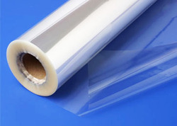
Cont…
2.Plastic sheets
Cellophane paper can be used for packing of dried products, mainly for dried fruit leathers.
They are flexible, transparent and have a perfect resistance to low temperatures and impermeability to water vapors.
An important advantage is that these sheets can be easily heat-sealed.

Slide 99
Utilization is in forms of sheets and bags.
It is a good packing material for primary protection of dehydrated products.

Slide 100
3.Glass containers
Glass containers have the following advantages:
they are impervious to moisture, gases, odors and micro-organisms
they are inert and do not react with or migrate into food products
they are suitable for heat processing when hermetically sealed
they are transparent to microwaves
they are re-useable
they are re-sealable
they are transparent to display the contents and can be decorated
they can be molded into a wide variety of shapes and colours

Slide 101
Cont…
The main disadvantages of glass include:
higher weight which incurs higher transport costs than other types of packaging
lower resistance than other materials to fracturing and thermal shock
potentially serious hazards from glass splinters or fragments in foods
the usual problem is corrosion
susceptibility to breakage
Costy
they do not protect food from the negative effects of light. This problem can be alleviated by storing the filled bottles and jars in a dark place.

Slide 102
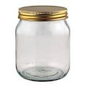
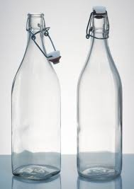
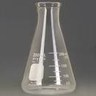
Cont…
Main classes of glass receptacles are:
1.jars which are resistant to heat treatments,
jars, for products like marmalades, acidified vegetables, etc.;
2.glass bottles for pasteurized products (tomato juice, fruit juices, etc.) and
3.receptacles with higher capacity (flasks, etc.)

Slide 103
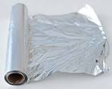
Cont…
4 Paper packaging
Like aluminum paper to improve water vapor and gas impermeability, flexibility, burst strength, wet strength, grease resistance, appearance, etc.

Slide 104
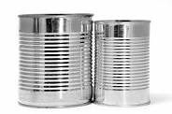
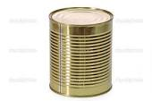
Cont…
4"Tin can"/tinplate
These are iron cans.
They are especially used for sterilizing, and are very suitable for sterilizing larger amounts.
Unfortunately, they can only be used once.

Slide 105
Cont…
The process of sealing foodstuffs hermetically in containers and sterilizing them by heat for long storage is known as canning.
The canned products are sold in the off-season and give better returns to the grower.

Slide 106
Figure

Slide 107
Cont…
Principle of Canning
Destruction of spoilage organisms within the sealed container by means of heat.
Canning involves sterilizing food, sealing it in sterile cans or jars, to kill or weaken any remaining bacteria.

Slide 108
4.3 Process of Canning
(1) Selection of fruits and vegetables
(i) Fruits and vegetables should be absolutely fresh.
(ii) Fruits should be ripe, but firm, and uniformly mature.
Over-ripe fruits should be rejected because they are infected with microorganisms and give a poor quality product.
Unripe fruits should be rejected because they generally shrivel and toughen on canning.

Slide 109
Cont…
(iv) All vegetables should be firm, fully ripe.
(v) Fruits and vegetables should be free from dirt.
(vi) They should be free from blemishes, insect damage or mechanical injury.

Slide 110
(2) Grading
The selected fruits and vegetables are graded according to size and color to obtain uniform quality.
This is done by hand or by machines such as screw grader and roller grader.

Slide 111
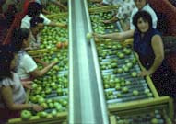

Slide 112
Cont…
(3) Washing
It is important to remove pesticide spray residue and dust from fruits and vegetables.
removal of microorganisms by washing with water is essential.
Root crops that loosen in soil are washed by soaking in water containing chlorine (as detergent).
Other methods of washing are spray washing, steam
washing, etc.

Slide 113
Cont…
(4) Peeling
The objective of peeling is to remove the outer layer.
Peeling may be done in various ways. i.e
Hand peeling
Steam peeling
Mechanical peeling
Flame peeling

Slide 114
Cont…
(5) Cutting/trimming
Removal of non-edible or non-digestible parts
Pieces of the size required for canning are cut.
Seed, stone and core are removed.
Some fruits like plum from which the seeds cannot be taken out easily are canned whole

Slide 115
Cont…
(6) Blanching
It is also known as scalding, parboiling or precooking.
The objective is to soften the texture and so enable a greater weight to be pressed into the container without damage to the individual fruit.
Blanching is Usually done in case of vegetables by
exposing them to boiling water or steam for 2 to 5 minutes, followed by cooling

Slide 116
Con…
Advantage of blanching :
(i) Inactivates most of the plant enzymes which cause toughness, discolouration and off-flavour
(ii) Reduces the area of leafy vegetables such as spinach by shrinkage or wilting, making their packing easier.
(iii) Removes tissue gases.
(iv) Reduces the number of microorganisms

Slide 117
Cont…
(vii) Removes undesirable acids thus improves flavor.
(viii) Removes the skin of vegetables such as beetroot and tomatoes which helps in their peeling.
Disadvantages
(i) Water-soluble materials like sugar and anthocyanin pigments are leached by boiling water.
(ii) Fruits lose their color, flavor and sugar

Slide 118
Cont…
(7) Cooling
After blanching, the vegetables are dipped in cold water for better handling and keeping them in good condition.

Slide 119
Cont…
(8) Filling
Before filling, cans are washed with hot water and sterilized
Automatic, large can-filling machines are used in advanced countries but choice grades of fruits are normally filled by hand to prevent bruising.
Hand filling is the common practice.
After filling, covering with syrup or brine (salt+water solution ) is done and this process is called syruping or brining.

Slide 120
Cont…
(9) Exhausting
The process of removal of air from cans is known as exhausting.
After filling, exhausting is essential.
The major advantages of exhausting are as under:
(i) Corrosion of the tinplate and pin holing during storage is avoided.
(ii) Minimizes discoloration by preventing oxidation.
(iii) Helps in better retention of vitamins particularly vitamin C.
(v) Reduces chemical reaction between the container and the contents.

Slide 121
Containers are exhausted by heating.
The cans are passed through a tank of hot water at 82 to 87°C or move on a belt through a covered steam box.
In the water exhaust box, the cans are placed in such a manner that the level of water is 4-5 cm below their tops.
The exhaust box is heated till the temperature of water reaches 82 to 100c and the centre of the can shows a temperature of about 79°C.
The time of exhausting varies from 6 to 10 minutes, depending on the nature of the product.

Slide 122
Cont…
(11) Processing
Heating of foods for preserving is known as processing, however, in canning technology processing means heating or cooling of canned foods to inactivate bacteria.
Processing time and temperature should be adequate to eliminate all bacterial growth.

Slide 123
Cont…
Moreover, over-cooking should be avoided as it spoils the flavor as well as the appearance of the product.
Almost all fruits and vegetables can be processed satisfactorily at a temperature of 100°C, i.e., in boiling water.

Slide 124
The temperature and time of processing vary with the size of the can and the nature of the food: the larger the can, the greater is the processing time
Fruits and acid vegetables are generally processed in open type cookers, while vegetables (non-acid) are processed under steam pressure in closed retorts known as automatic pressure cookers.

Slide 125
Cont…
(12) Cooling
After processing the cans are cooled rapidly to about 39°C to stop the cooking process and to prevent stack-burning.
Cooling is done by the following methods:
(i) dipping or immersing the hot cans in tanks containing cold water;
(iii) Spraying cans with jets of cold water; and
(iv) exposing the cans to air.

Slide 126
Cont…
Generally the first method, i.e., dipping the cans in cold water, is used.
If canned products are not cooled immediately after processing,
peaches and pears become dark in color,
tomatoes turn brownish and bitter in taste,
peas become pulpy with cooked taste and
many vegetables develop flat sour (become sour).

Slide 127
Cont…
(13) Storage
After labeling the cans, they should be packed in strong wooden cases or corrugated cardboard cartons and stored in a cool and dry place.
The outer surface of the cans should be dry as even small traces of moisture sometimes induce rusting.
Storage of cans at high temperature should be avoided, as it shortens the shelf-life of the product.

Slide 128
Cont…
Labeling by words or pictorial the following information shall appear on the label of packaged foods:
The name of the food/product
List of ingredients
Net contents and drained weight
Name and address of manufacturer
Country of origin
Lot identification

Slide 129
Cont…
storage instructions
Instructions for use
Date of manufacturing
Date of expired
Etc…

Slide 130
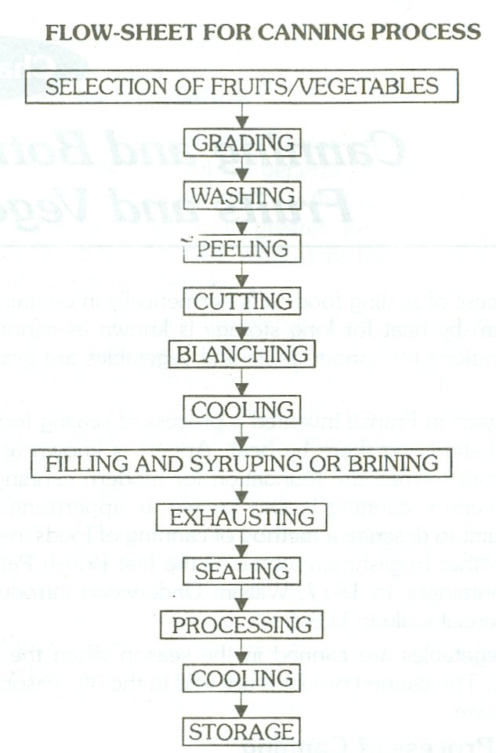

Slide 136
PLEACE READ IT THIS HANDOUT
I TRY TO SEND THE NEXT CHAPTER

