Slide 1

REDD+ Basics
Notes:
This presentation will provide an overview of REDD+ - what it is, why it is important, and the main elements of how it is implemented. We began this training with background on climate change, the drivers of deforestation, and the current strategies that are in place to combat deforestation. Now that we will start focusing on REDD+, it is important to keep that foundation in mind – REDD+ is fundamentally about addressing the drivers of deforestation in order to contribute to climate change mitigation. So think about the drivers that were identified in the earlier session while you begin to learn the specifics about REDD+ and think about what a REDD+ program in your country or area would need in order to address those drivers.

Slide 2


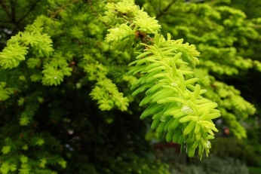

Contents
What is REDD+?
Building Blocks of REDD+
REDD+ Phases
Notes:
The presentation will begin by defining REDD+, then I will describe the main building blocks of REDD+ - which will serve as a guiding framework for the rest of this training, and finally I will finish by describing a phased approach to the implementation of REDD+ at the national level.

Slide 3
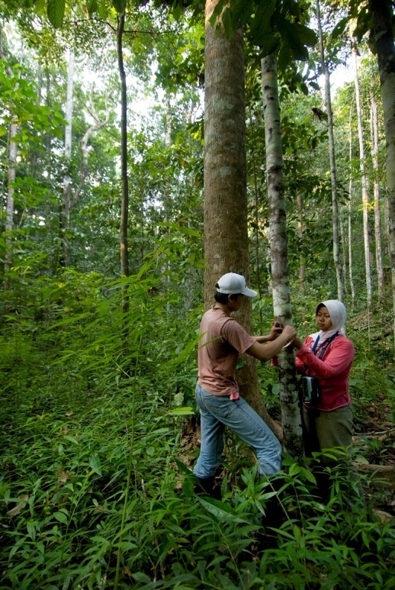

What is REDD+?
A policy framework with the goal of creating an economic value for the carbon in standing forests
An incentive system that motivates multiple actors across scales to address the drivers of deforestation and to undertake restoration/reforestation
Notes:
So we just described the activities that could be eligible under a REDD+ framework, but what is the objective of REDD+? Here are a couple of ways to describe it. REDD+ really is a policy framework that aims to create an economic value for the carbon in standing forests. Currently, many governments and land owners can only reap economic benefits from their forests through cutting them down and selling the timber and using the land for production. REDD+ aims to shift these economic incentives so that landowners and governments are motivated to conserve their forests.

Slide 4
REDD+ = Reducing emissions from deforestation + Reducing emissions from forest degradation + Conservation of forests + Sustainable forest management + Enhancing forest carbon stocks

Slide 5

What is REDD+?
Agriculture?
Other land-use types?
Conservation
Sustainable Management of Forests
Enhancement of Forest Carbon Stocks
AFOLU
Reducing Emissions from Forest Degradation
REDD+
REDD
Reducing Emissions from Deforestation in Developing Countries
Notes:
[click] When REDD was initially introduced in 2005, the focus was on reducing emissions from deforestation, as this was seen as the most urgent need. Under the initial concept, countries would need to reduce deforestation below historic rates to receive compensation from an international mechanism.[click] As negotiations and research continued on the topic, countries realized that forest degradation was also a signif icant source of emissions. Forest degradation is the gradual thinning of forests – which reduces the carbon stock of a forest, but does not result in the conversion of the land to another use. The causes of degradation are generally logging, fuelwood extraction, and/or fire. Forest degradation can be reduced through activities such as reduced impact logging, sustainable forest management, fuelwood management, and firewood management. [click] [click] Together, reducing emissions from deforestation and forest degradation are known as REDD. [click] As negotiations on REDD have evolved, other activities have been included. These activities include conservation, sustainable management of forests, and enhancement of forest carbon stocks. While these concepts have not been fully defined yet, conservation generally refers to the protection of standing forests that have not historically been under threat of deforestation. Sustainable management of forests refers to a activities which increase carbon stocks and/or reduce carbon emissions from forests by changing the way in which they are managed. Management changes may include implementing harvest methods that result in less damage to remaining trees, extending harvest rotations thereby leaving more carbon stored on the land, increasing the stocking of poorly stocked forests by encouraging growth of denser/healthier trees and converting previously harvested forests to no-cut protected areas. Enhancement of forest carbon stocks may include forest restoration, reforestation, and/or afforestation. [click][click] These activities, when added to REDD are referred to as REDD+. [click] Finally, some countries would like to include carbon emissions from all land-use types, including agricultural land, wetlands, and others. [click][click] When these activities are included, it is often referred to as AFOLU (agriculture, forestry, and other land uses).

Slide 6
What is REDD+?
A policy framework with the goal of creating an economic value for the carbon in standing forests
An incentive system that motivates multiple actors across scales to address the drivers of deforestation and to undertake restoration/reforestation
Notes:
So we just described the activities that could be eligible under a REDD+ framework, but what is the objective of REDD+? Here are a couple of ways to describe it. REDD+ really is a policy framework that aims to create an economic value for the carbon in standing forests. Currently, many governments and land owners can only reap economic benefits from their forests through cutting them down and selling the timber and using the land for production. REDD+ aims to shift these economic incentives so that landowners and governments are motivated to conserve their forests.

Slide 7
Why REDD+?
Notes:
Why has REDD+ captured the attention of the world? Three main reasons:
First, as we learned this morning, deforestation and forest degradation result in approximately 15% of annual greenhouse gas emissions globally. This is more than the entire global transportation sector. So we cannot solve the climate crisis without addressing deforestation.
Second, deforestation in the tropics affects million of people worldwide that depend on the forests directly for their livelihoods, in particular indigenous peoples and local communities. The on-going march of deforestation is a direct threat to these communities. REDD+ has the potential to protect the forests and the resources they provide for these people.
Third, deforestation threatens the world’s great storehouses of biodiversity and providers of important ecosystem services that the world depends on such as rainfall regulation, water quality and quantity, air quality, and others.

Slide 8

The Building Blocks of REDD+
Buyers/Funders
Policy
Actors
Incentives
Ministry of Forestry
United Nations
Local Governments
National Governments
Reporting and Verification
Researchers
Sub-national Governments
Reduce Emissions
Increase Sequestration
Local Communities
Reference Level
NGOs
Private Sector
Measurement and Monitoring
Investors
Notes:
Although REDD+ will likely be included in some manner in future international climate change agreements, the details of how a REDD+ mechanism might be incorporated have yet to be decided upon. Because of this, it is difficult to describe exactly what a REDD+ framework will look like and how it will work. Nevertheless, there are some basic components of REDD+ that will likely be incorporated in the final mechanism. This slide provides a brief overview of those key elements. This overview of the “building blocks” of REDD+ provides you with a general framework of a REDD+ mechanism in which you can fill in more details as you learn more about each component as the training proceeds. The building blocks of REDD+ include: measurement and monitoring, reference levels, strategies to reduce emissions and/or increase sequestration, reporting and verification, and the provision of credits or incentives. Also, we will look at the financial flows for REDD+ here and the main actors involved.
[Click]
Measurement and Monitoring
One of the main elements that make REDD+ projects unique from traditional forest protection strategies is carbon accounting – or the measurement and monitoring of carbon benefits over time as a result of forest carbon activities. While many efforts to reduce deforestation and enhance forest carbon stocks may result in a net benefit to the atmosphere in the form of reduced greenhouse gases, a REDD+ strategy must explicitly quantify that benefit using recognized methodologies in order to receive compensation or acknowledgement of that benefit. For this reason, carbon accounting forms the base of our REDD+ building blocks. Carbon accounting includes using remote sensing data from satellites to measure and monitor land cover change and performing field inventories to measure the carbon density of forests in order to measure the net gain or loss of carbon in the forest system. The remote sensing data allows you to calculate annual deforestation rates in terms of the amount of forest area converted to other uses. Field inventories allow you to calculate the how much carbon is in the existing forest as well as any land use which replaces forest, such as agriculture. Combining these two sources of data allows you to calculate the annual carbon emissions rate. This calculation is the basis for determining your baseline or reference level.
[Click]
Reference Levels
The fundamental challenge for REDD+ mechanisms is to demonstrate “additionality.” Additionality is simply defined for REDD+ as “greenhouse gas emission reductions or removals that are additional to what would have occurred without the REDD+ mechanism.” A reference level is the level of carbon emissions or removals that would have occurred in the absence of the financial mechanism and field interventions. The simplest method for calculating a reference level is using an average of historic annual emissions over the past 5, 10, or 15 years (known as a ‘reference period’), or just using a single recent annual emissions level. More complex methods involve projections of future emissions using models based on some combination of historic emissions, trends in emissions rates, and the expected behavior of the drivers of deforestation such as agricultural markets or infrastructure planning. The reference level is a key component of a REDD+ mechanism because incentives/credits are generated based on performance against the reference level. Therefore, a credible reference level is very important for determining how much financial compensation a country or project may receive.
[Click]
Strategies to Reduce Emissions or Increase Removals
In order to receive incentives from a REDD mechanism, a country or project must actually reduce emissions from deforestation or forest degradation and/or increase sequestration from enhancement of forest carbon stocks. In order to reduce emissions, strategies must be implemented that effectively address the drivers of deforestation or degradation in the project area. In order to enhance removals, strategies for restoring forests and planting trees would need to be put in place. Strategies used in a REDD+ mechanism may be the same or similar strategies that land managers and conservationists have used for decades to address deforestation and enhance forest carbon stocks. We discussed some of these strategies earlier in the training. The key is that the strategies must credibly and verifiably reduce emissions and/or increase removals, they must be additional to actions that would have occurred in the absence of REDD+ financing, and they must provide for permanent forest protection. Examples of strategies that can be used in a REDD+ project include: establishment of protected areas, reduced impact logging, stopping or reducing forest fires, undergoing forest certification, ensuring that land conversion occurs in degraded areas rather than in intact forest land, aiding the natural regeneration of forests, and planting trees.
[Click]
Reporting and Verification
Countries participating in a national level REDD+ approach would presumably need to report their reference level and emissions reductions/sequestrations to a body defined by the UN or defined in a bilateral agreement with a donor country.
Emissions reductions and increased sequestrations made through a REDD+ project need to be verified by an independent third party verifier. There are various companies that perform verification services. In the case of project activities, the verification process involves a review of the Project Design Document (PDD) and the methodologies used in the project. This includes an assessment of the project’s additionality, baseline, monitoring plan, and environmental and social impacts. Through the verification process, emissions reductions achieved by a project will be certified, at which point they can be sold, traded, or retired. It is still unclear whether independent verification would be required for national-level REDD+ programs.
[Click]
Incentives
Once the emissions reductions or removals from a project or program have been achieved, they can be offered for sale either through a carbon market to a buyer, or in exchange for donations made from a public fund. Transactions of incentives may be recorded in a registry in order to avoid credits being sold more than once. The sale price of the credits will depend on the demand and supply of credits, as well as on the quality of credits for sale and the needs of the buyer.
[Click]
Financial Flows
The financial flows involved in financing REDD+ projects or programs will be complex and will depend on the specific country and actors involved. For explanation purposes, we will simply illustrate some basic financial flows. First, the project or program will require some up-front financing from an investor. That financing will cover some of the costs associated with the design of the project, the calculation of the baseline, and the start-up costs for field activities. Once the project or program has moved through all of our building blocks, credits will be available for sale. The owner of the credits (the project developer, land owner, or the government depending on the scale of the mechanism) can sell those credits on the voluntary carbon markets (or potentially in compliance markets in the future) and receive payments. Alternatively, compensation may be granted to the credit owner from a designated fund, if the REDD+ mechanism is fund-based rather than market-based. The money received for the credits will need to be distributed back to the initial investors and to the actors on the ground involved in the implementation of emission reduction strategies.
[Click]
Actors Involved in REDD
REDD+ projects and programs will involve many stakeholders, and these stakeholders will vary depending on the design of the mechanism and the location. In general, stakeholders include: international policymakers, national governments, local governments, project developers, local communities, buyers, research institutions, local and international NGOs, and government agencies. Various actors will be involved in the financing of REDD+, the implementation of REDD+, or the design of REDD+ policies; some actors maybe involved in multiple aspects of a REDD+ mechanism.
[Click]
REDD+ Policy
Much is still to be decided in international and national policy related to REDD+.

Slide 9

A Phased Approach to REDD+
Phase 3: Quantified changes in GHG emissions and/or removals
Financial instrument: Transition from global facility to integration with compliance markets + stabilization fund
Eligibility: Compliance-grade MRV and emission / removals accounting relative to nested reference levels
Phase 2: Implementation of national REDD strategy PAMs; implementation of elements including reference level setting, improvement of MRV, participation
Financial instrument: Global facility (unitary fund or clearinghouse that records eligible bilateral and multilateral contributions relative to binding commitments)
Eligibility: Demonstrated cross-sectoral commitment to REDD strategy implementation within the national government. Continued access dependent on performance.
Phase 1: National REDD strategy development, capacity building, institutional strengthening. Demonstration activities.
Financial instrument: Voluntary contributions (FCPF, UNREDD, etc)
Eligibility: Demonstrated cross-sectoral commitment to REDD strategy development within the national government
2010
2012
2015
2020
Notes:
There is general consensus now that REDD+ can be implemented in three phases. The idea of these phases provides a good conceptual model for thinking about how a country can implement REDD+. [Describe the phases] It is important to remember that countries can begin in whichever phase they are eligible for and that they can move between phases at their own pace, as they fulfill the requirements for each phase.
Source: Adpated from Angelsen et al. 2009. REDD: An Options Assessment Report

Slide 10
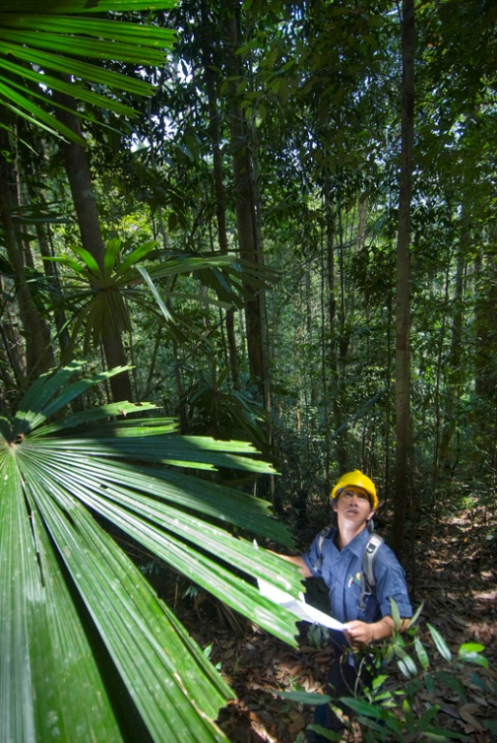
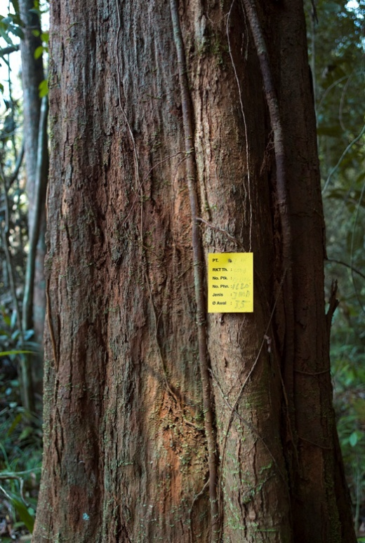
Important Considerations
Social considerations
Biodiversity and ecosystem services
Level at which incentives are granted
Sources of financing
Notes:
Some other important considerations for REDD+ are listed here. We will examine each of them in more detail as the training continues, but I will just give a quick overview here.
Social considerations – REDD+ will not be successful without the full and effective participation of all relevant stakeholders including indigenous peoples and local communities in the design and implementation of REDD+ programs and the equitable sharing of benefits from those programs. We will discuss this issue more later on in the training.
Biodiversity and ecosystem services – REDD+ has the potential to be highly beneficial for biodiversity and ecosystem services, but it is not guaranteed that it will be. Later in the training we will discuss what some of the benefits and risks are and how a mechanism could be designed to maximize the benefits and minimize the risks.
The level at which incentives are granted: it is important to remember that REDD+ will require action at multiple levels if it is going to be successful – action at the international level, the national level, at the level of state/local governments, and at the level of communities and individual landowners. However, one of the major outstanding questions in the negotiations on REDD+ is whether incentives can flow directly to sub-national actors, or whether it must be channeled only through national governments. The level at which the incentives are granted will have a big impact on how REDD+ is implemented. In this training, we will talk about national approaches to REDD+ as well as sub-national or project level approaches to REDD+ and how they are similar and different.
Sources of finance: The source of funding for REDD+ is another one of the main questions remaining in the negotiations on REDD+. Remember that REDD+ is essentially an incentive mechanism with the goal of creating an economic value for forests. The source of finance to provide those incentives can be either public funding (funds additional to traditional overseas development assistance that developed country governments allocate for REDD+) or market finance (access to sell carbon credits from REDD+ into developed country markets). We will explore each of these options more in depth tomorrow, but it is important to remember that the sources of finance will influence the level of MRV needed for REDD+.

Slide 11
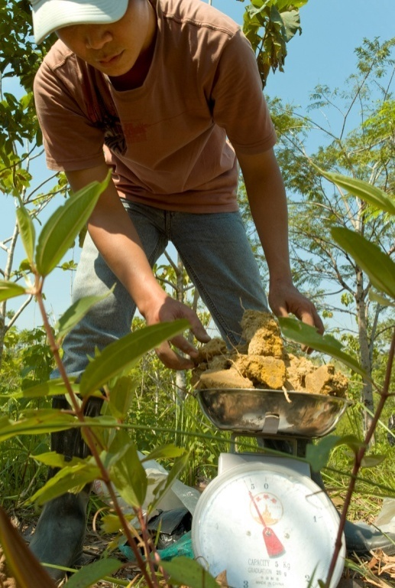
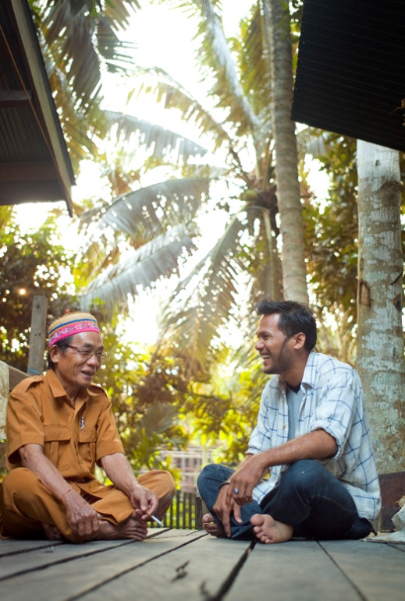
Great Resources
www.conservationtraining.org
www.theredddesk.org
www.forestcarbonportal.com
www.conserveonline.org/workspaces/redd
Notes:
Finally, I just wanted to end by providing some great resources for learning more about the basics of REDD+. The first is an online training that the partners involved in this training have created. The online course is a cool, interactive course with different lessons and quizzes that corresponds with the information that we are providing here. You can do it at your own pace and will recieve a certificate at the end. It’s a great resource – tell you colleagues who were unable to attend this training!
The other three links are clearinghouses of information which post many new documents and articles on REDD+ - you can read all day long for weeks with these websites!

