Slide 1
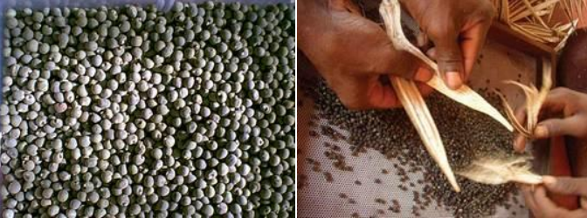
Chapter three
3. General Principles of Seed Production
Outline:
Introduction
Basic principles of seed production
  Genetic principles
  Agronomic principles
Seed classes

Slide 2
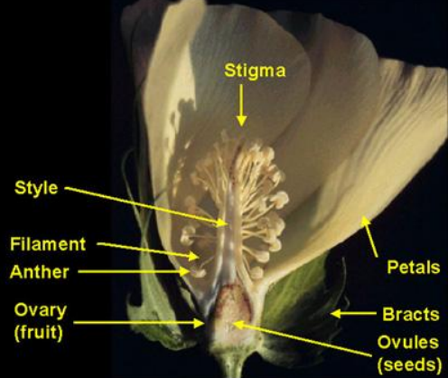
Introduction
Methods of Reproduction
The method of reproduction in crop plants broadly grouped into two:
  asexual/vegetative and sexual.
Modes of Pollination
Pollination refers to the transfer of pollen grains from anther to stigma.
  Pollen from an anther may fall on stigma of the same flower leading to self-pollination or autogamy.
  When pollen from flowers of one plant are transmitted to stigma of another plant, cross-pollination or allogamy.

Slide 3
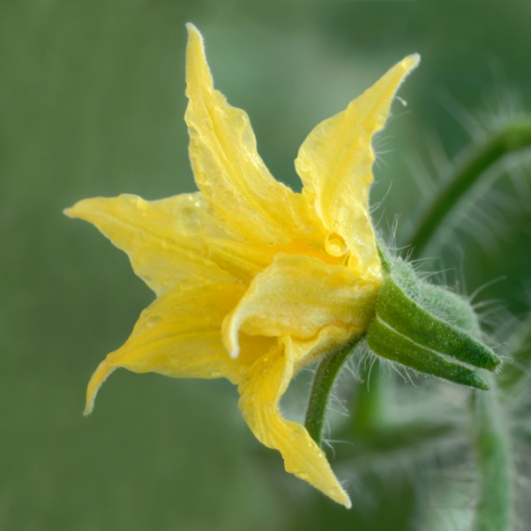
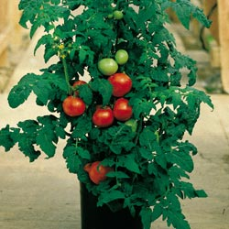
Self-Pollinated Crops
Have hermaphrodite flowers
But in most of these species, self-pollination is not exclusive and cross-pollination may occur up to 5%.
Partial list of self-pollinated vegetables
  Tomato (Lycopersicon esculentum)
  Lettuce (Lactuca sativa)
  Parsnip (Pastinaca sativa)
  Peas (Pisum sativum)
  Dwarf bean (Phaseolus vulgaris)

Slide 4
Cross-Pollinated Crops
The majority of the cultivated vegetable species are cross-pollinated crops.
Cross-pollination may occur both in bisexual and unisexual flowers but it is the rule in unisexual flowers.
Agents:
  Wind e.g. Amaranthus, spinach, beet
  Insects: e.g. All cucurbits, all brassica, onion, carrot.
Cabbage ( Brassica oleracea var. capitata)
Cauliflower (Brassica oleracea var. botrytis)
Broccoli (Brassica oleracea var. botrytis)
Brussel’s sprouts (Brassica oleracea var. gemmifera
Knol khol (Brassica oleracea var. caulorapa)
Carrot (Daucas carota)
Radish (Raphanus sativus)
Beet (Beta vulgaris)
Spinach (Spinacea oleracea)
Cucumber (Cucumis sativus)
Watermelon (Citrullus lanatus)
Pumpkin (Cucurbita moschata)
Squash (Cucurbita pepo)
Onion (Allium cepa)

Slide 5
  Basic principles of seed production
The seeds of different crops have different behavior both in their genetic makeup and their response to the environment
Those seeds from cross pollinated plants have higher potential for genetic mixing up than self-pollinated crops
Production of genetically pure seed requires high technical skill and specialization.

Slide 6
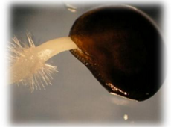
Cont..
Seed production must be carried out under standard and well-organized conditions.
Moreover, producer should be familiar with genetic and agronomic principles of seed production
Therefore, there is always a need to have guiding principles of producing seeds

Slide 7
Genetic Principles
  It involves all the factors which may lead deterioration of genetic purity (true-to-type) of a crop variety.
  All seeds used for sowing must have similar genetic constitution for uniform performance and quality produce.
  Permanent reduction either in the genetic or agronomic value of a released variety is known as varietal deterioration.
  During the course of seed production, it is necessary to ensure that the product is true-to-type.

Slide 8
Cont..
Genetic purity of a variety can be deteriorated due to several factors
Genetic impurity causes genetic deterioration
Not only impurity but also there is always other causes of genetic deterioration
Such genetic degradation occurs during the cycles of seed production and farmer to farmer diffusion

Slide 9
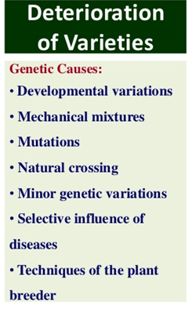

Slide 10
  Developmental Variations
Seeds of any given variety has the expected genetic makeup and acceptable quality when grown in its suitable environment
But a shift in the environment can degrade both genetic behavior and quality
Factors affecting plant growth and development include
  Edaphic (soil related )
  Climatic (temperature, precipitation, humidity and evapotranspiration),
  Elevations
  Biotic (diseases, insect pests, weeds, beneficial microorganisms and animals like human, livestock and others)

Slide 11
Cont..
When any variety is exposed to an unsuitable environment:
  The beneficial traits (behavior of the variety for which breeding is done) may not be well expressed due to environmental suppression
    It cannot give the expected yield and quality seed

Slide 12
Mechanical mix-up (Varietal mixture)
Mixing up of seeds of different varieties usually of a crop species
Such mixing up of seeds of different varieties occurs during:
  Sowing, harvesting or storage
  Volunteer plants of the same crop
  Seed distribution, cleaning and transportation
  Seed dispersal by wind, rodents and other carriers

Slide 13
Cont..
This happens when the seeds of the different varieties are difficult to separate because of their color and/or size
Rouging the fields critically and using utmost care during seed production and processing are necessary to avoid such mechanical contaminations.

Slide 14


Natural crossing
Important source of varietal deterioration in sexually propagating crops.
  major source of deterioration in cross fertilized crops.
Such crossing is not intentional and occurs naturally by wind and insects
The extent of such crossing depends on the magnitude of pollination system of the species, isolation distance, varietal mass, and pollinating agent.

Slide 15
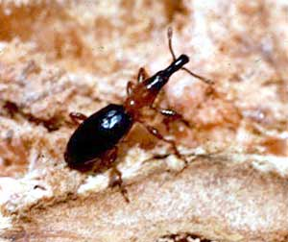
Use of non-refreshed seeds of variety staying on production for long time
When a variety stays at production for long time, it faces different environmental condition from season to season
Such variation on environmental condition causes genetic deterioration
Exposition to different environmental condition may also result in mutation of the varieties
Seeds produced long time before may not have the necessary behaviors due to reduction in viability and attack by weevils

Slide 16
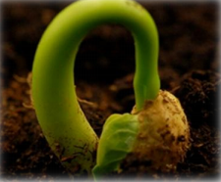
Minor genetic variations
Can occur even in varieties appearing phenotypically uniform and homogeneous when released.
Due care during the maintenance of breeder seed of cross fertilized varieties is necessary

Slide 17
Selective influence of diseases
Infected by disease to which it was considered resistant at the time of its release.
This can result either because of;
  absence of such disease in the area where the variety was tested or
  Formation of new races of a disease
  Seed production under strict disease free conditions is, therefore, essential.

Slide 18
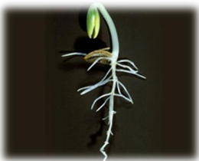
Technique of the plant breeder
Premature release of varieties (still segregating for resistance and susceptibility to disease or other factors)
Break down in male sterility and other heritable variations

Slide 19
Maintaining the genetic purity
The important safeguards for maintaining genetic purity during seed production are :
Control of seed source
  Use approved seed during seed multiplication
  It is critical to utilize a seed of an appropriate class and from an approved source

Slide 20
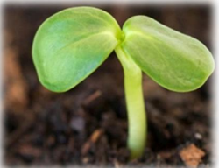
Inspection and approval of fields prior to planting
  To check for the presence of volunteer crops, weeds and disease history
  To test adaptability, nutritional status, soil born disease and pest

Slide 21
Crop Rotation
Satisfactory intervals between related or similar crops is required to minimize the risk of plant material or dormant seeds remaining from the previous crops
They are likely to cross-pollinate or make admixture with the planned seed crop.
Also helps to enhance plant nutrition, maintenance of soil physical condition and minimizing the risk of soil-borne pests and diseases.

Slide 22
Isolation
Helps to ensure that the possibility of cross-pollination between different cross-compatible plots or fields is minimized.
Adequate isolation avoids admixture during harvesting and the transmission of pests and pathogens from alternative host crops.
Horticulture seed crops can be isolated by time and by distance

Slide 23
Temporal /Time isolation
One crop is grown and timed to flower before other crops reach the reproductive stage
Two crops can be grown/planted side by side and, therefore, facilitates seed production by small farms (no big requirement for distance isolation)
Requires irrigation facilities
There is no pressure for labor among different crop fields

Slide 24
Distance Isolation
The minimum isolation distance required depends on whether the crop is
  cross-or self-pollinated
  wind or insect pollinated
Self-pollinated crops/cultivars do not normally require isolation but seed fields must be separated by a few meters from the fields growing crops of the same spp.
Cross-pollinated crops (isolation is more critical)

Slide 25
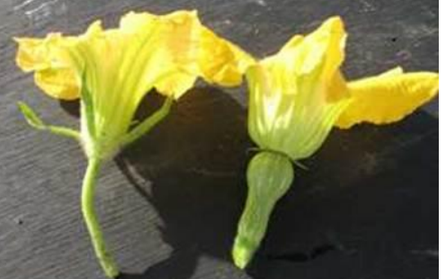
Cont..
Insect cross-pollinated vegetable crops like onion, radish, cabbage, cauliflower and cucurbits require isolation distance of 800-1000 meter
While wind pollinated vegetables like spinach, beet require isolation distance of about 2000 meters.
Isolation distance also varies according to category of seeds like foundation and certified seeds ( Table 1).

Slide 26
Table 1. Minimum isolation distance requirements for vegetable seed crop

Slide 27
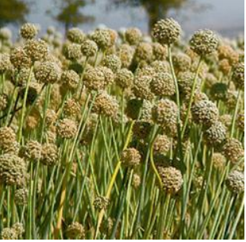
  Rouging off Seed Crop
    The existence of off-type plants in the seed crop is a potential source of genetic contamination.
    Not only the off-types but the diseased and abnormal plants are also to be removed.
    Rouging may be done at any stages as soon as the off-types are recognizable:
      Vegetative stage
      Flowering stage
      Maturity stage

Slide 28
  Cont..
Periodic testing of varieties for genetic purity
  Varieties being grown for seed production should periodically be tested for genetic purity by grow-out tests to make sure that they are being maintained in their true form.
Growing crops in areas of their adaptation
  It is important to cultivate each crops in their suitable environmental conditions

Slide 29
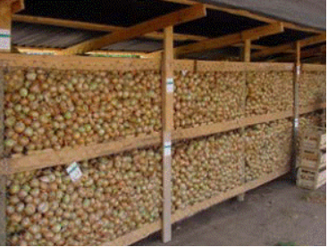
Seed Certification:
The genetic purity in the commercial seed production is maintained through a system of seed certification.
The crop and seed lot have been duly inspected and that they meet requirement of good quality pedigree seeds.

