Slide 1
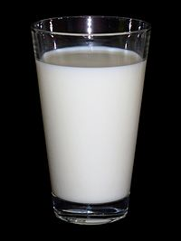

Milk hygiene

Slide 2
Milk is secreted by the mammary gland of mammals to feed their offspring
Well balanced diet
“nature's single most complete food” or "the most nearly perfect food”.
Milk hygiene: All conditions and measures necessary to ensure the safety and suitability of milk at all stages of milk production chain.
Objectives of milk hygiene: -
To provide consumers with wholesome milk and thus, safeguard the public from milk borne zoonotic diseases and residues.
To advise dairymen, creameries and consumers on the proper handling of milk and milk products.
To reduce economic losses resulting from milk spoilage and other problems associated to milk with poor hygiene.

Slide 3
Composition of Milk
Milk
Total solids (TS) in milk
Solids-Non-Fat (TNF)
Fat
Water
The principal constituents of milk
protein + lactose + ash or minerals + vitamins

Slide 4
The total solids (TS) in milk (i.e. fat + protein + lactose + ash or minerals + vitamins) minus the fat content are generally referred to as Total Solids-Non-Fat (TNF) or milk Solids Not Fat (TS- fat = SNF).
On average, normal milk must contain
SNF amount 9% and TS 12.5%.
SNF = protein 3.5%
= Lactose 4.8%
= Ash (mineral) 0.7%
Total = 8.54 %
TS = Fat + SNF
3.5% + 9% = 12.5%

Slide 5
Summary of the average composition of milk from different species of animals and human is given in Table 1
Mammals | Water (%) | Fat (%) | Lactose (%) | Protein (%) | Ash (%)
Cow | 87.25 | 3.8 | 4.8 | 3.5 | 0.65
Water Buffalo | 76.89 | 12.46 | 3.74 | 6.03 | 0.89
Goat | 87.88 | 3.82 | 4.54 | 3.21 | 0.55
Camel | 87.61 | 5.38 | 3.26 | 2.98 | 0.7
Sheep | 80.82 | 6.86 | 4.91 | 6.52 | 0.89
Bitch | 78.88 | 8.56 | 4.09 | 6.82 | 1.08
Cat | 81.63 | 3.33 | 4.91 | 9.08 | 0.51
Human | 88.3 | 3.11 | 7.18 | 1.19 | 0.21

Slide 6
Table 2. Composition of milk from the main breeds of dairy cattle
Breed | Fat % | Protein % | Lactose %
Ayrshire Brown Swiss Guernsey Holstein Jersey | 4.1 4.0 5.0 3.5 5.5 | 3.6 3.6 3.8 3.1 3.9 | 4.7 5.0 4.9 4.9 4.9

Slide 7
There are two types of milk depending on the lactation stage, namely:
          Colostrum and
          Non-colostral milk
Colostrum is the milk, which is secreted during first week of lactation and such milks are usually slightly varying in their color, consistency, flavor and composition from Non-colostral milk.
Milk fat (Butter): - is the second largest component of milk and is of major commercial value.
It plays important role in human nutrition being a good source of energy and essential fatty acids.
It supplies an energy value of 9.3 calories / gram of fat. This is higher when compared with energy value derived from protein and lactose.
Moreover, milk fat plays an important role in the flavor and physical properties of milk.

Slide 8
Fat is composed of fatty acids and glycerol, which can be saturated or unsaturated fatty acid, soluble or non soluble.
Fats present in the milk in the form of fat globulins and these fat globulins play important role in some operations such as milk separation, churning of cream and cheese production.
Milk fat is responsible for yellow coloration of normal colostrum and this is made by the carotene of the milk fat.
Milk fat is soluble in ether and ethyl alcohol and it absorbs odor from surrounding and its specific gravity may vary from 0.936-0.946 at 15ºC and melting points at 20-29º C.

Slide 9
Hydrolysis (Fat lipase fatty acid + glycerol) and oxidation of fat that gives rancidity are some the possibly mentioned chemical changes in milk fat. These changes are usually characterized by offensive smell and unpleasant odor.
Hydrolysis is influenced by lactation stage, type of feed, degree of homogenization of milk and microbial contamination.

Slide 10
Proteins: - Milk protein is valuable to human since it contains all essential amino acids which are important for normal functioning of human body. (about 20 amino acids among which 8 of them are essential) and a wide variety of these acids are found in each of the proteins of milk. leucine, isoleucine, lysine, methionine, phenylalanine, threonine, tryptophan, valine, and histidine
Milk proteins are further subdivided into casein, comprising approximately 76–80% of the total milk proteins, and the whey proteins such as albumin (e.g. lacto albumin), globulin (e.g. Lacto globulin, immunoglobulin and other globulins) and enzymes, comprising roughly 20–24%.
Casein is considered as the specific predominant protein of milk and it is white in color and thus, enables milk to have its normal whitish color. Addition of acids (e.g. citric acid, lactic acid), enzymes (e.g. rennin, pepsin) and alcohols and application of heat coagulates casein and hence casein is used in cheese production.

Slide 11
Milk sugar (Lactose): - Is the principal carbohydrate of milk.
It is almost found only in milk in nature and the amount present in milk depends up on the health of the udder, nutritional status and breed of the milk-producing animal.
The lactose content of the milk is increased by over feeding of carbohydrates, especially soluble carbohydrate and decreased by mastitis infection of udder.

Slide 12
When bacterial enzymes act on milk sugar, it leads to lactic acids production (Glucose bacterial enzymes lactic acid).
Decomposition of lactose that could result from the action of microorganisms acts as a precursor of lactic acid that is used for fermentation in yoghurt preparation.
Lactic acid affects milk constituent such as casein and when lactic acid acts on casein milk is coagulated (precipitated).
Even though, lactose doesn’t taste as sweet as an equal amount of sucrose, it imparts or gives fresh milk its normal sweet flavor and taste and constitutes as one of the major solid constituents of milk.

Slide 13
Enzymes: - enzymes are proteins or combination of protein and other materials called coenzymes.
Enzymes are usually very specific in their action and in most cases their power to act is destroyed by heat and as a result, each enzyme has a different critical temperature. The pH also may limit their activity.
Milk contains different types of enzymes such as peroxidase, phosphatase, lipase and amylase.
Peroxidase: - is most abundant enzyme found in milk. The test of milk for the presence of peroxidase are sometimes made to ascertain whether hydrogen peroxide has been added (used usually as preservative) or whether the milk has been subjected to sever heat treatment.

Slide 14
Heat treatment of milk such as at a temperature of
          80ºC for 3 ½ minutes
          73.5 ºC for 28 minutes or
          70 ºC for 150 minutes will destroy this enzyme. The test for peroxidase is not useful for proving pasteurization.
Phosphatase: - two functions of this enzyme are found in milk,
Alkaline phosphatase which is most active at ph >9.6 and
Acid phosphatase (is largely found in non-fat fraction of the milk) which shows its greatest activities around pH 4.0.
Alkaline phosphatase is destroyed in milk by pasteurization and thus a test for the absence of alkaline phosphatase is widely used to ascertain whether milk has been properly pasteurized.
The test can detect 0.2% raw milk in pasteurized milk.

Slide 15
Lipase: - the enzyme lipase seems to be present in all normal milk, but its quantity varies greatly.
Late lactation milk has higher lipase content than normal fresh milk and thus hydrolytic rancidity is common in it.
The major lipase in milk is lipoprotein lipase
Agitation during processing may bring the lipase into contact with the milk fat resulting in fat degradation and off-flavors. Pasteurization will inactivate the lipase in milk and increase shelf life
If not pasteurized before or immediately after homogenization, raw homogenized milk will rapidly become rancid because of activity of lipase on the greater fat surface.

Slide 16
Ash: - Incineration of milk leaves the ash, a residue which equals about 0.7-0.8% of the weight of the milk.
The ash includes all of the mineral elements of the milk, and these include the ff
Large amounts (relatively): Potassium, Sodium, Calcium, Magnesium, Chlorine, Phosphorus and Sulfur
Small amounts: Iron, Copper, Zinc, Aluminum, Manganese, Cobalt and Iodine
Traces amount: Silicon, Boron, Titanium, Vanadium, Rubidium, Lithium and Strontium have been reported to be present.

Slide 17
Vitamins: - Milk is good source of vitamin A, B₁ (thiamine) B₂ (riboflavin), small amount of vitamin C (ascorbic acid), vitamin D and B₃ (niacin) etc.
Vitamin A, D, E and K (ADEK) are fat-soluble, so they tend to be present in milk products in proportion to the fat content.
Vitamin C and several vitamins of the B-complex are water-soluble. Heat is detrimental to vitamin B and C.
Pasteurization destroys > 10% of the B and up to 50% of the C.

Slide 18
Trace components of milk
Somatic or body cells:- Body cells or leucocytes, originating from the udder, are always found in fresh milk, even if milk is drawn from healthy quarters.
California Milk Test: is used to estimate number of leucocytes and thus, evaluate the quality of milk. The number of somatic cells may vary considerably, but it is generally lower than 100,000 per ml [10⁵ cells/ ml of milk].
Counts of 500,000 and more are an evidence of abnormalities, usually being an indication of mastitis.
Milk from seriously diseased udder (e.g. sever mastitis) may contain millions of cells (>10⁶).

Slide 19
If milk from large number of animals is mixed, the infected milk of one or more animals will be diluted with milk of healthy animals and it becomes more difficult to detect the abnormality.
Micro-organism: - Even aseptically drawn milk may contain some bacteria.
They may be originated from the teat cannel of the udder (theses are usually the slowly multiplying and almost none pathogenic MOs).
Generally, the microorganisms could be of two types: -
Unfavorable microbes (pathogenic micro organisms or microbes that cause food spoilage and such MOs should be controlled or destroyed to make food/milk and milk products safe for human consumption) and

Slide 20
Favorable micro organisms (microbes which bring favorable changes in flavor and appearance of milk and such microbes are beneficiary and thus, are usually carefully handled and propagated).
Starter cultures (micro-organisms which develop acidity and desired aromatic milk) are an example of beneficiary MOs.
The 3 main functions of starter culture are to:
Produce acid
Produce desired characteristics of flavor or aroma and
Prevent the growth of unwanted microorganisms.

Slide 21
Such Micro-organisms are genus streptococcus and include;
Str. lactis, Str. cremoris and Str. lactis sub spps diacetylactis.
Generally, these are those bacteria, which naturally invade or which are intentionally added to milk to produce different types of products such as yoghurt, cheese and butter.
used at home and dairy industry to improve keeping quality and flavor of milk.
Such micro-organisms usually referred to as true milk bacteria because they produce lactic acid from lactose then reduce pH of milk and this induce milk coagulation to produce yoghurt.

Slide 22
Str. lactis: - commonest bacteria found in milk and it causes sourness and coagulation of casein and it is used as starter culture in cheese production. Optimum temperature 6-41ºC but it can grow also under 0ºC. At 25ºC it sinks pH of milk at 4.5 and at this it will produce 1% lactic acid.
Str. cremoris: - optimum temperature is 20-30ºC and at 25ºC it sinks pH of milk to 5.
Str. lactis sub spps diacetylactis:- This micro-organism has similar characteristics to Str. lactis however it differs from it in that it produces an aromatic substance known as diacetyl which produced from citric acid and for this reason it is used as starter culture in butter production.
Str. thermophilus withstand high temperature of 65 ºC for 30 minutes. Commonly found in milking cans and other utensils.

Slide 23
Table 1: Summary of starter culture and their use in milk production
Starter culture species | Role in milk production
Str. lactis | Souring, casein precipitation
Str. cremoris | Souring and yoghurt production
Str. lactis ssp diacetylactis | Souring, aroma production from citric acid
Str. thermophilus | Cheese production, souring and yoghurt production
Leuconostoc dextranicum L. citrovolurum | Production of butter aroma –diacetyl
Lactobacillus bulgaricus L. acidophilus | Souring and aroma production

Slide 24
Factors affecting milk composition
Milk composition is affected by genetic and environmental factors.
The potential fat content of milk from an individual cow is determined genetically, as are protein and lactose levels. Thus, selective breeding can be used to upgrade milk quality. Heredity also determines the potential milk production of the animal.
However, environment and various physiological factors greatly influence the amount and composition of milk that is actually produced. Herd recording of total milk yields and fat and SNF percentages will indicate the most productive cows, and replacement stock should be bred from these.

Slide 25
In general factors affecting milk composition include the ff: -
Breed
Milk composition varies considerably among breeds of dairy cattle: Jersey and Guernsey breeds give milk of higher fat and protein content than Shorthorns and Friesians. Zebu cows can give milk containing up to 7% fat.
Shorthorns: Breed of beef or dairy cattle: a reddish brown or white cow with short curved horns
Age
As cows grow older, the fat content of their milk decreases by about 0.02 percentage units per lactation. The fall in SNF content is much greater.

Slide 26
Stage of lactation
The fat, lactose and protein contents of milk vary according to stage of lactation. Solids-not-fat content is usually highest during the first 2 to 3 weeks, after which it decreases slightly.
Fat content is high immediately after calving but soon begins to fall, and continues to do so for 10 to 12 weeks, after which it tends to rise again until the end of the lactation.
Feeding regime (type and amount of feed):
Underfeeding reduces both the fat and the SNF content of milk produced, although SNF content is more sensitive to feeding level than fat content. Fat content and fat composition are influenced more by roughage (fibre) intake.
The SNF content can fall if the cow is fed a low-energy diet.

Slide 27
Disease: Both fat and SNF contents can be reduced by disease, particularly mastitis.
Interval between milking
The fat content of milk varies considerably between the morning and evening milking because there is usually a much shorter interval between the morning and evening milking than between the evening and morning milking.
If cows were milked at exactly 12-hour intervals the variation in fat content between milking would be negligible, but this is not practicable on most farms. Normally, SNF content varies little even if the intervals between milking vary.

Slide 28
Completeness of milking:
The first milk drawn from the udder is low in fat while the last milk (or strippings) is always quite high in fat.
Thus it is essential to mix thoroughly all the milk removed, before taking a sample for analysis. The fat left in the udder at the end of a milking is usually picked up during subsequent milking, so there is no net loss of fat.
Season: Season influences vegetation (pasture) and consequently influences milk constituent and color of the fat.

Slide 29
Physicochemical properties of milk
Knowledge of physicochemical properties of the milk is very important for the following reasons: -
Enables milk technology to determine sound and unsound milk and thus, to safeguard the public.
To determine the quality and price of milk.
Physical properties of milk:
The major and possibly dependable physical properties of milk include the following:
Color: - Ranges from bluish-white to golden yellow. Yellow color is influenced by breed, feed and fat percentage.
Taste: - sweet due to presence of lactose.

Slide 30
Flavor (perceived with the combined senses of taste and smell) Aroma (Smell): - Pleasant due to unsaturated fatty acid in the milk, but after few minutes it disappears.
Milk may absorb odors from utensils, equipment and atmosphere. The odors are foreign to good milk and their presence considered as a defect.
Specific gravity of milk: - Specific gravity is the ratio of the weight of a volume of a material compared to the weight of the same volume of pure water.
Specific gravity of milk is ranges between 1.0295- 1.0350 which usually determined at 20 ^{O}C.

Slide 31
This is important to determine adulteration of milk or removal of fat butter from milk.
Milk with a lower fat content has higher specific gravity than milk with higher fat content.
Freezing points: - freezing point of milk is almost a constant value and freezes at -0.55 to -0.53 ºC and is a suitable indicator for detection of dilution of milk with water.
Boiling point: - freshly drawn milk boils at about 100.17 ºC.
An increase in osmotic pressure raises the boiling point of the liquid.
Decrease of osmotic pressure lower the boiling point. Osmotic pressure affects both the freezing point and the boiling point of a solution.
As the strength or concentration of a solution increase, its freezing points diminish and its boiling point increases.

Slide 32
Chemical properties of milk (PH and titratable acidity)
There are two basically different methods of expressing acidity:
Titratable acidity: expressed as percent of lactic acid
Hydrogen ion concentration or PH. The former measures the total acidity but does not measure the strength of the acids.
PH: - indicates the strength of the acid condition.
The true neutral point is at pH 7.0; pH values below 7.0 indicate an acid reaction; pH values above 7.O indicate an alkaline reaction.
One pH unit means a tenfold difference in strength; for example, a pH 5.5 indicates an acidity that is ten times as great as pH 6.5.
When milk is freshly drawn from cow it shows an amphoteric reaction. Normal fresh milk has a pH of 6.5-6.8, which indicates that the milk is slightly acidic.

Slide 33
Titratable acidity: - it measures the total acidity, but not the strength. Titratable acidity of milk is demonstrated by titrating a given amount of milk with an alkaline such as NaOH.
The acidity in milk is measured, for example by titration with with a 0.1mol/L sodium hydroxide solution, and indicates the consumption of NaOH necessary to shift the pH-value from the average normal PH value (6.6 ± 0.1 which is corresponding to fresh milk) to a pH-value of 8.2 - 8.4 (phenolphthalein).

Slide 34
sodium hydroxide will be added till the solution is turned to pink using phenolphthalein as indicator.
The titratable acidity is calculated according to the volume of 0.1mol/L sodium hydroxide solution that has been used to bring the color change.
Titratable acidity of normal fresh milk ranges from 0.13-0.14%
Presence of low lactic acid indicate good/high hygienic standard of milk.

Slide 35
Criteria of normal (fresh) milk
Good quality milk is essential for production of dairy products that are of good quality, free from pathogens and have long keeping quality. Therefore, milk intended for human consumption and further processing shall meet the following criteria: -
Free from debris and sediment.
The Organoleptic qualities (appearance, flavor…) should not be affected.
Its constituents should be natural.
  ⇒ Shall not be highly deviated from normal and shall not be foreign.
Free of pathogenic microorganisms, antibiotics and other residues.

Slide 36
The temperature shall not be greater than 10ºC.
 This is to hinder bacterial multiplication. If the temperature is greater than 10 ºC, there will be bacterial multiplication and lactic acid production which leads to milk coagulation.
The specific gravity shall range from 1.0295 to 1.0350.
The pH shall range from 6.5 to 6.8.
Bacterial load shall not exceed the acceptable load.
The bacterial load in fresh raw milk should be less than 50,000 per ml when it reaches the collection point or processing plant.
Somatic cell count shall not exceed the acceptable load (less than 200,000 cells per ml of milk)

Slide 37
Contamination of raw milk
As long as the milk is still in the udder of a healthy animal the bacterial count will be low. After the milk leaves the udder, contamination will take place during milking, milk handling, transport and storage and
The micro-organisms will begin to grow rapidly particularly at high ambient temperature and cause marked deterioration/spoilage and thus badly affect the keeping quality of the raw milk/ spoil milk for liquid consumption/ and the quality of the products manufactured from such milk.
Milk contaminated with pathogenic bacteria is harmful to human health.
Dirt such as dung/ so does bacteria in the intestinal tract, soil, bedding, feed, dust, hair and etc from the skin of the body of the animal in general and udder and flank in particular may fall in to the milk during milking.

Slide 38
Milking in the rain may badly affect the quality of the milk if the rain water is allowed to flow from the animals’ body into the milk.
Milk may be contaminated by the hands of the milkers as dirt could fall from his/her hand in to container/pail.
The milker may be a source of pathogenic bacteria of human origin. Moreover, a disease can easily be carried from one animal to another on the milker’s hands.
Generally, the source of bacterial contamination of milk may be within the udder, or on the surface of the cows, milkers, and other personnel, or the environments.

Slide 39
The following diagram illustrates major sources of bacterial contamination of milk.
Udder infection
Milker’s hands
Other sources (dung, soil, hair, bedding, feed…)
Dirty udder and teats
milking equipments
Contamination of raw milk

Slide 40
Hygienic milk production (essential steps in hygienic milk production)
Animals must be clean and healthy.
Milking should be done away from the herd.
The milk handler should also be clean and healthy. She/he should wear clean outer garments during milking or processing the milk.
The milking room should be clean, ventilated and dustless.
Utensils and equipment for milking and milk handling must be cleaned well.
Immediately before milking the udder and teats of the cow must be washed with clean lukewarm water and dried with clean cloths – a separate one for each cow.
Immediately after milking the milk must be removed from the shed, placed in a clean and covered receptacle and kept in a cool place.

Slide 41
Recommended cooling temperatures:
Table 3: recommended milk cooling temperatures to prevent deterioration.
Delivery time in hours | Cooling temperature
Within 4 hrs | 15ºC
Within 4-24hrs | 6-10ºC
After 24hrs | 4ºC

Slide 42
Defects encountered in raw milk
The following Organoleptic changes may be detected in milk:-
Changes in color
Exaggerated yellow color: contamination with yeast or Flavobacteria.
It may also be due to lipolytic and proteolytic enzymes.
Blue milk: Pseudomonas eynacase.
Brown milk: Pseudomonas puterfaciens.
Red milk: Serratia marcens, inflammation of the udder.
Change in consistency
Roppiness or stickiness contamination with B. lactis
Frothiness: fungal contamination.

Slide 43
Flavor changes
Rancid taste: increased lipase activity.
Cooked taste: excessive heating
Bitter taste: increased catalase activity
Fishy taste: fish meal
Soapy taste: contamination with B. lactosaponasi
Sour/acid: acid production due to bacterial contamination
Barny taste poor ventilation

Slide 44
Heat treatment of milk:
Objectives: -
To safeguard the public i.e. to prevent milk borne diseases (e.g. bovine tuberculosis, brucellosis, salmonellosis etc) and render milk safe for human consumption.
To improve the keeping quality of milk and milk products and prolong shelf life.
To minimize economic losses resulting from milk spoilage.

Slide 45
Heat treatment to temperatures below 100ºC is designated as pasteurization, and that to temperatures above 100ºC is sterilization.
Pasteurization: The process of pasteurization was named after Louis Pasteur
Pasteurization of milk can also be defined as heating milk in order to reduce the number of any pathogenic microorganisms to a level at which they do not constitute a significant health hazard.
Pasteurization is used to kill harmful microorganisms by heating the milk for a short time and then cooling it for storage and transportation.

Slide 46
Pasteurization of milk has successfully eliminated the spread of diseases such as tuberculosis and brucellosis through contaminated milk.
In raw milk, the naturally-occurring lactic acid bacteria, under suitable conditions, ferment the lactose present to lactic acid.
The increasing acidity in turn prevents the growth of other organisms, or slows their growth significantly. During pasteurization however, these lactic acid bacteria are mostly destroyed.
Pasteurized milk is still perishable and must be stored cold by both suppliers and consumers. (Cold chain should be there after pasteurization)

Slide 47
Methods of pasteurization:
Pasteurization can be carried out in 2 major methods: -
As a batch operation (“batch pasteurization” or “Low Temperature, Long Time pasteurization” (LTLT)), with the product heated and held in an enclosed tank. This is a process of heating milk and milk products at a temperature of about 63ºC and holding at this temperature for 30 minutes and immediately cooled to 5ºC.
As a continuous operation (“High Temperature, Short Time pasteurization” (HTST)) with the product heated in a heat exchanger and then held in a holding tube for the required time. This is heating milk and milk products at 72ºC for 15 seconds and cooling it immediately to 5ºC.
Currently, the most common method of pasteurization

Slide 48
Generally, several Time-Temperature combinations have been approved as equivalent: -
These precise heat treatments are based on the destruction of the Coxiella burnetii, which is considered the most heat-resistant non-spore forming pathogen found in milk.
Absolute control of the thermal treatment is essential for the safety of milk.
63°C (145°F) for 30 min
72°C (161°F) for 15 s
89°C (191°F) for 1 s
90°C (194°F) for 0.5 s
94°C (201°F) for 0.1 s
96°C (204°F) for 0.05 s
100°C (212°F) for 0.01 s.

Slide 49
Sterilization of the milk
Sterilization is a microbiocidal control measure that can be obtained by various heat treatments, the most common and validated methods being UHT (Ultra High Temperature) processing in combination with aseptic packaging or container Sterilization.
Thermal processes necessary to obtain commercially sterile products are designed to result in the absence of viable microorganisms and their spores capable of growing in the treated product when kept in a closed container at normal non-refrigerated conditions at which the food is likely to be held during manufacture, distribution and storage.

Slide 50
UHT treatment is normally in the range of 135 to 150°C in combination with appropriate holding times necessary to achieve commercial sterility.
UHT allows the milk to be stored unrefrigerated or an even longer lasting sterilization process until opened but also loses more nutrients and assume a different taste (e.g. Condensed milk which can be stored in cans for many years, unrefrigerated).
Commercial sterilized products must be microbiologically stable at room temperature.
Either measured after storage until end of shelf life or incubated at 30 °C for 15 days in accordance with appropriate standards.

Slide 51
Milk preservation
Milk is perishable product particularly in tropical countries due to high humidity, high temperature and poor hygiene.
Therefore, spoilage occurs during transportation, collection and storage. Solution for these problems is refrigeration however; it is not realistic in developing countries.
The Lactoperoxidase System
The Lactoperoxidase System of Raw Milk Preservation is currently the only approved method of raw milk preservation, apart from refrigeration (as an alternative solution) by Codex Alimentarius commission.

Slide 52
The Lactoperoxidase System (LP-system) operates by the reactivation of the enzyme lactoperoxidase, which is naturally present in raw milk.
Hydrogen peroxide (H₂O₂) and Thiocyanate (SCN⁻) are also present in milk but in negligible quantity.
The lactoperoxidase - thiocynate - hydrogen peroxide system (LPS) inhibits bacterial respiration, reduces the enzymatic activity (Eg. Hexokinase) of glycolysis of the bacteria and induces the leakage of potassium through the cell wall.

Slide 53
LP itself has no antibacterial effect but in combination with certain co-factors, thiocyanate (SCN-) and hydrogen peroxide (H₂O₂), forms a potent antimicrobial system
The antibacterial mechanism is caused by oxidation of vital SH-groups by OSCN⁻/ O₂SCN⁻ in vital metabolic enzymes, e.g. hexokinase.
A wide variety of bacteria are influenced by the LP-system.
Many Gram-positive bacteria such as lactococci and lactobacilli are inhibited (Bacteriostatic) while many gram-negative bacteria such as Escherichia coli, Pseudomonas spp, Salmonella spp are killed.

Slide 54
Activation of the LP-s by addition of hydrogen peroxide and SCN⁻, both at concentration of 0.25 mM, extended the shelf life of raw milk at 10ºC for at least three days
Other dairy uses have included control of post-culturing acidification of yogurt
milk processing
Milk has been processed specially in countries where milk is not scarce.
Basically, milk is processed to increase palatability of milk products and shelf life.
Milk is processed in different ways; traditional or industrially

Slide 55
Traditional milk possessing in Ethiopia
(e.g. butter production)
Milk is collected in the morning and evening in a container, which may differ according to different area and communities (clay pot, chicho, sorora, gorfa etc).
This is set a side until it get fermented. In some area they set a side fire to facilitate the fermentation process.
After few days milk coagulate is formed (Ergoi/ yoghurt)

Slide 56
Usually they cover clay pot with pieces of leather in the area where the clay pot is used as container.
Churning is done by rocking a pot/calabash forth and back until granules of fat is formed.
A pieces of straw is inserted through a small hole at the neck of the container and formation of fat granules is noticed.
When the granules coalesce the churning will be stopped and the butter will be taken out from the top.
The buttermilk will be heated to a temperature of 40 to 70ºc

Slide 57
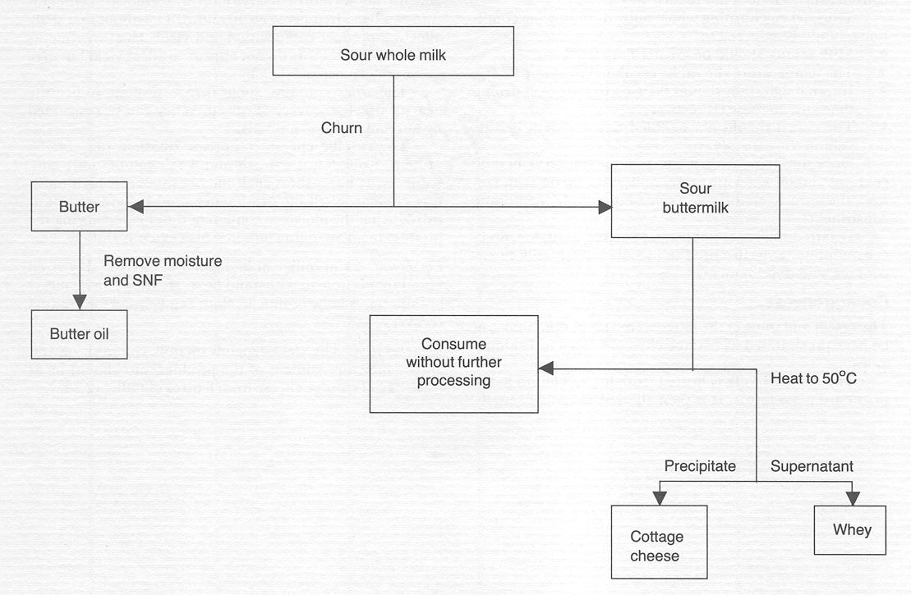

Slide 58
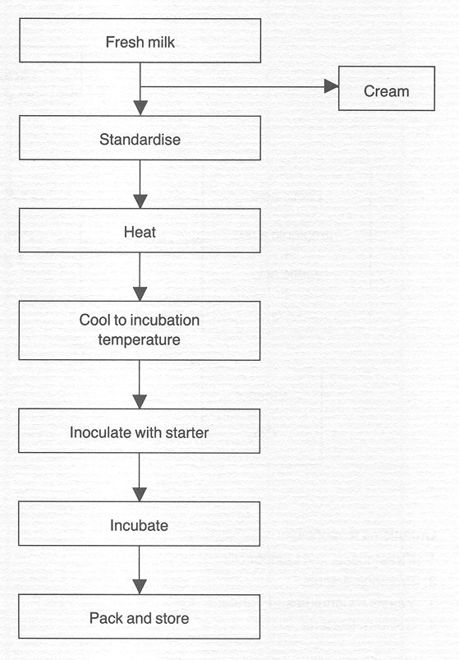
Industrially (yogurt)
a number of steps are common to each manufacturing process, and these are outlined. Flow diagram of fermented milk manufacturing.
Cream

Slide 59
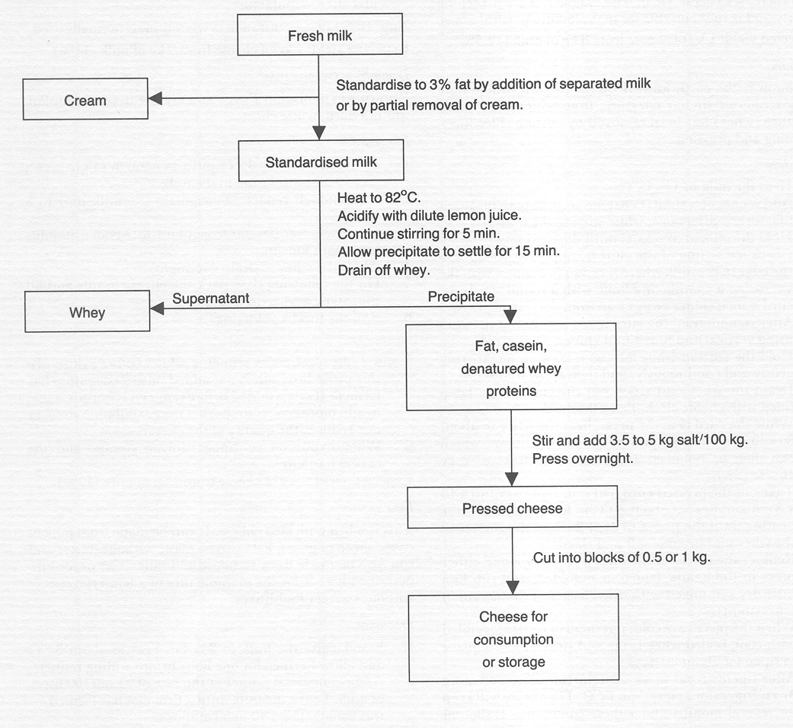
Cheese

Slide 60
Standardization:
If fine adjustment of the fat content of cream is required, or if the fat content of whole milk must be reduced to a given level, skim milk must be added. This process is known as standardization.
To make this calculation, draw a square and write the desired fat percentage of the standardized product at its centre and write the fat percentage of the materials to be mixed on the upper and lower left-hand corners.
Subtract diagonally across the square the smaller from the larger figure and place the remainders on the diagonally opposite corners.
The figures on the right-hand corners indicate the ratio in which the materials should be mixed to obtain the desired fat percentage. This is depicted in the coming diagram.

Slide 61
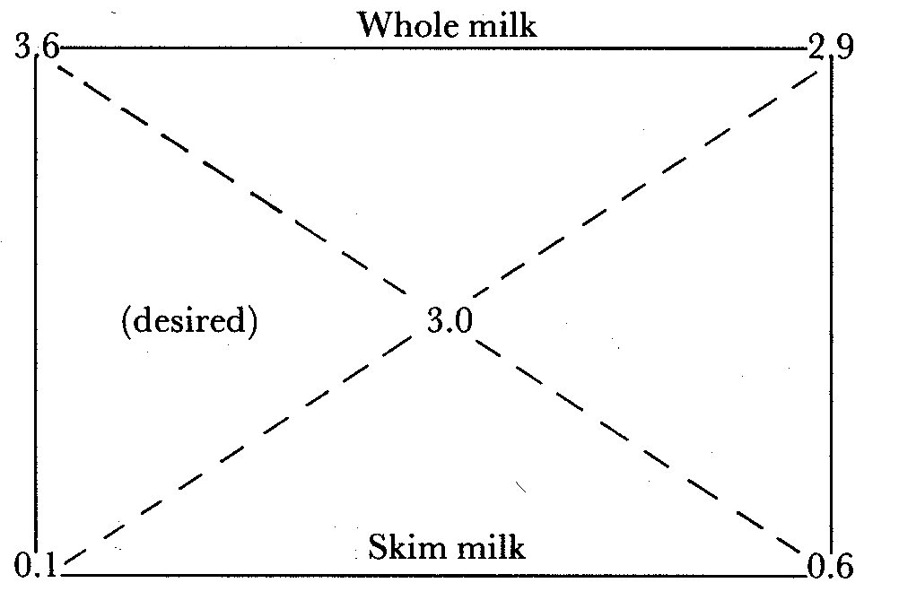

Slide 62
Determining milk quality
(organoleptic and laboratory tests including test on heated milk)
Milk testing and quality control is an essential component of any milk processing industry.
Milk being made up of 87% water is prone to adulteration by unscrupulous middlemen and unfaithful farm workers.
Moreover, its high nutritive value makes it an ideal medium for the rapid multiplication of bacteria, particularly under unhygienic production and storage at ambient temperatures.
For any processor to make good dairy products, good quality raw materials are essential.

Slide 63
Milk quality control: is the use of approved tests to ensure the application of approved practices, standards and regulations concerning the milk and milk products.
The tests are designed to ensure that milk products meet accepted standards for chemical composition and purity as well as levels of different micro-organisms.
  Techniques used in milk testing and quality control
  Accurate sampling is the first pre-requisite for fair quality control system
  Liquid milk in cans and bulk tanks should be thoroughly mixed to disperse the milk fat before a milk sample is taken for any chemical control tests.
  Representative samples of packed products must be taken for any investigation on quality.

Slide 64
  Organoleptic tests
The organoleptic test permits rapid segregation of poor quality milk at the milk receiving platform.
No equipment is required, but the milk grader must have good sense of sight, smell and taste. The result of the test is obtained instantly and the cost of the test is low.
Milk which cannot be adequately judged organoleptically must be subjected to other more sensitive and objective tests.

Slide 65
Procedure:
Open a can of milk
Immediately smell the milk
Observe the appearance of the milk
If still unable to make a clear judgment, taste the milk, but do not swallow it. Spit the milk sample into a bucket provided for that purpose or into a drain basin, flush with water.
Look at the can lid and the milk can to check cleanliness.

Slide 66
  Clot on Boiling Test
The test is quick and simple. It is one of the old tests for too acidic milk (pH<5.8) or abnormal milk (e.g. colostral or mastitis milk).
If a milk sample fails in the test, the milk must contain much acid or rennet producing microorganisms or the milk has an abnormal high percentage of proteins like colostral milk.
Such milk cannot withstand the heat treatment in milk processing and must therefore be rejected.
Procedure: Boil a small amount of milk in a spoon, test tube or other suitable container. If there is clotting, coagulation or precipitation, the milk has failed the test.

Slide 67
  The Alcohol Test
The test is quick and simple. It is based on instability of the proteins when the levels of acid and/or rennet are increased and acted upon by the alcohol. Also increased levels of albumen (colostrum milk) and salt concentrates (mastitis) results in a positive test.
Procedure:
The test is done by mixing equal amounts of milk and 68% of ethanol solution in a small bottle or test tube.
If the tested milk is of good quality, there will be no coagulation, clotting or precipitation, but it is necessary to look for small lumps.

Slide 68
Milk cleanliness test: -
In milk there can be dirt substances especially if the cows are milked in a cow shade which is not clean enough. The dirt substances include hair, thread, bedding and pieces of fodder. The presence(s) of these foreign materials indicate that the milk in question is not clean. There are two methods to check milk cleanliness:
Sedimentation test:
Materials: Milk sample and transparent glass or cylinder
Test procedure:
Milk is put in a glass and kept for about 15-30 minutes
The foreign materials sedimented is observed in the bottom
Filtration test: milk sample and special gauze which has very small (fine) holes allowing only milk molecules and not foreign particles.

Slide 69
Catalase test: -
The catalase content of milk primarily depends up on the number of cells in milk.
Hence, the increased activity of this enzyme could indicate mastitis. It is necessary to take in to account the lactation period and If milk is kept for a longer period, catalase test is not employed because there could be micro organisms in the milk which also produce catalase enzyme.
Test procedures: -
2 ml of 9% H₂O₂ is put in a test tube containing 20 ml milk sample
The content is mixed (3 times upside down)

Slide 70
Results: - Positive result i.e. in milk containing large no of cells, a strong bubbles of foam are formed giving spanking sound, while there is no foam formation in negative result.
N.B if there is 5ml or more foam layer, after exclusion of milk at the beginning of lactation period and milk around end of lactation period or bloody milk, it could be suspected of mastitis.
Apparently the final result could be given after microbiological examination is performed in order to confirm the test.

Slide 71
  Acidity test
Bacteria that normally develop in raw milk produce more or less of lactic acid.
In the acidity test the acid is neutralized with 0.1 N sodium hydroxide and the amount of alkaline need for complete neutralization is measured.
From this, the percentage of lactic acid can be calculated. Fresh milk contains in this test also "natural acidity" which is due to the natural ability to resist pH changes. The natural acidity of milk is 0.13 - 0.14%. Figures higher than this signify developed acidity due to the action of bacteria on milk sugar.

Slide 72
Procedure:
9 ml of the milk measured into the porcelain dish/conical flask, 1 ml Phenolphthalein is added and then slowly from the burette, 0.1 N Sodium hydroxide under continuous mixing, until a faint pink color appears.
The number of ml of Sodium hydroxide solution divided by 10 expresses the percentage of lactic acid.

Slide 73
  The Lactometer test
Addition of water to milk can be a big problem where we have unfaithful farm workers, milk transporters and greedy milk hawkers. A few farmers may also fall victim of this illegal practice.
Any buyer of milk should therefore assure himself/herself that the milk he/she purchases is wholesome and has not been adulterated. Milk has a specific gravity.
When its adulterated with water or other materials are added or both misdeeds are committed, the density of milk changes from its normal value to abnormal.
The lactometer test is designed to detect the change in density of such adulterated milk.

Slide 74
Procedure:
Mix the milk sample gently and pour it gently into a measuring cylinder (300-500ml).
Let the Lactometer sink slowly into the milk.
Read and record the last Lactometer degree (reading) (ºL) just above the surface of the milk.
If the temperature of the milk is different from the calibration temperature (Calibration temperature may be 20⁰C) of the lactometer, calculate the temperature correction.
For each ºC above the calibration temperature add 0.2ºL; for each ºC below calibration temperature subtract 0.2 ºL from the recorded lactometer reading.

Slide 75
  Freezing Point Determination
The freezing point of milk (-0.55₋-0.53ºC) is regarded to be the most constant of all measurable properties of milk.
A small adulteration of milk with water will cause a detectable elevation of the freezing point of milk from its normal value of -0.54ºC.
Since the test is accurate and sensitive to added water in milk, it is used to detect whether milk is of normal composition and adulterated.

Slide 76
  Inhibitor test
Milk collected from producers may contain drugs and/or pesticides residues.
These when present in significant amounts in milk may inhibit the growth of lactic acid bacteria used in the manufacture of fermented milk such as cheese and Yoghurt, besides being a health hazard to the consumers.
Principle of the method: The suspected milk sample is subjected to a fermentation test with starter culture and the acidity checked after 3 hours.
The value of the titratable acidity obtained is compared with titratable acidity of a similarly treated sample which is free from any inhibitory substances.

Slide 77
Procedure:
Three test tubes are filled with l0 ml of sample to be tested and three test tubes filled with normal milk.
All tubes are heated to 90⁰C by putting them in boiling water for 3 - 5 minutes.
After cooling to optimum temperature of the starter culture (30, 37, or 42ºC), 1 ml of starter culture is added to each test tube, mixed and incubated for 3 hours.
After each hour, one test tube from the test sample and the control sample is checked for development of acid.

Slide 78
Assessment of results:
If acid production in suspected sample is the same as the normal sample, then the suspect sample does not contain any inhibitory substances;
If acid production in suspect sample is less than in the normal milk sample, then, the suspect sample contains antibiotics or other inhibitory substances.

Slide 79
Public health significance of milk consumption
As it is well balance food type, Consuming of milk has may advantages. but
Consumption of milk by some individuals results in allergy to cow milk protein and lactose intolerance. Allergy is denoted by GIT syndrome and asthma. The difficulty in digesting milk could be due to one of the following reasons:
An individual may be allergic to milk proteins
Milk having a hard curd forms a comparatively hard, small and compact curd mass in the acid environment of the stomach and this reduces the area of contact between the curd and digestive fluids.

Slide 80
In areas of the world where animal milk is not a common human food, the digestive system of indigenous people inherently produces very little lactase. As a result, many people find their digestive systems reject milk.
By taking only small quantities of milk over a period of time an individual’s digestive system may develop the capacity to produce the necessary lactase so that milk can then be ingested in larger quantities with out adverse effects.
People of the more developed dairy areas of the world have little or no difficulty with this problem, since milk has been a regular part of their diet for generations.

Slide 81
Reaction due to the condition is mainly characterized by
GIT disturbances such as vomiting, diarrhoea, stomach ach, constipation, inappetance and stomatitis
Respiratory syndrome includes rhinitis, bronchitis, asthma and pneumonia
Skin allergic reactions are urticaria, edema, exanthema and vesicle formation.
As a solution:
Sensitive person should refrain from consuming cow milk.
Lactose intolerant individual advised to drink milk only up to 250ml of milk per day.

Slide 82
Effects of cleansing and disinfecting agents
cleansing and disinfecting agents may cause problem if the container are not well rinsed.
Ingestion of antibiotic residues along with milk results in allergic reactions, hypersensitivity and development of antibiotic resistance in humans.
Milk can also serve as a vehicle for transmission of zoonotic diseases such as tuberculosis, E. coli, salmonellosis, cholera, mycotoxicosis, S. aureus etc if not kept hygienically. Diseases transmitted to human through milk (due to milk consumption) are summarized and presented in Table bellow

Slide 83
Disease | Main sources of infection
 | Human | Lactating cow | Environment
FMD | X | X
Infectious hepatitis | X
Q fever |  | X
Anthrax |  |  | X
Botulism |  | X
Brucellosis |  | X
Cholera | X
E. Colli | X | X
Cl. Perfringens |  |  | X
Diphtheria | X

Slide 84
Disease | Main sources of infection
 | Human | Lactating cow | Environment
Leptospirosis |  | X
Salmonellosis | X | X
Shigellosis | X
Staph | X | X
Tuberculosis | X | X
Ameabiasis | X
Giardiasis | X
Toxoplasmosis |  | X

Slide 85
ZOONOSES
The word “zoonoses” was first coined by Dr. Rndolf Virchow, a German physician in 1880 to describe the animal diseases transmissible to man. He made an important observation that “Between human and animal diseases, there is no dividing line nor should there be”.
WHO in 1959 defined zoonoses as those diseases and infections which are naturally transmitted between vertebrate animals and man. The health of human being is tied to the health of animals.
Today, man is exposed directly or indirectly to the dreaded (feared) risks of more than 300 zoonotic diseases of multiple etiologies, the reservoirs of which occur in domesticated, pet, farm, captive and wild animals.

Slide 86
Any disease or infection that is naturally transmissible from vertebrate animals to humans and vice-versa is classified as a zoonosis
They are caused by all types of agents
Percentage of Zoonoses from human infectious diseases:
61% of human infectious diseases are zoonotic
75% of human emerging infectious diseases are zoonotic (pathogens originating from an animal or from products of animal origin)
33% of Zoonoses are transmissible between humans.

Slide 87
Classification of Zoonoses
Zoonoses are important public health problems in many developing countries of the world.
As a result of
Improved laboratory facilities,
Well trained staffs,
Adequate manpower and
Increased awareness among scientists,
large number of zoonotic diseases of diverse etiologies have been recognized. This therefore, demands for a classification of zoonoses. zoonoses are classified as follows:

Slide 88
  According to the type of causative/etiological agents:
  Viral zoonosis: It is caused by a virus, e.g. RVF, rabies, avian influenza, orf, etc
  Bacterial zoonosis: This zoonosis is caused by a bacterium, e.g. anthrax, brucellosis, tuberculosis, colibacillosis, leptospirosis,, salmonellosis, tetanus, yersiniosis, listeriosis, staphylococcus, etc
  Rickettsial zoonosis: The etiologic agent of this zoonosis is a rickettsia, e.g. coxiellosis (Q fever), rickettsial pox, scrub typhus (Rickettsia tsutsugamushi) and Rocky Mountain spotted fever.
  Chlamydial zoonosis: Chlamydia is the cause of this zoonosis, e.g. chlamydiosis.

Slide 89
  Myotic zoonosis: Fungus is involved in the etiology of this zoonosis, e.g. Aspergillosis, Cryptococcosis, Dermatophytosis (ring worm) and blastomycosis.
  Protozoan zoonosis: The causative organism of this zoonosis is a protozoa which is a unicellular, motile, eukaryotic organism, e.g. amoebiasis, giardiasis, leishmaniosis and toxoplasmosis.
  Helminthic zoonosis: This is further divided into three categories:
    Cestodiasis: e.g. Taeniasis, diphyllobothriosis and echinococcosis.
    Nematodiasis: e.g. ascariosis, filariosis, larva migrans, trichinosis and trichostrongyliosis.
    Trematodiasis: e.g. Fascioliosis and Schistosomiosis.

Slide 90
  Ectoparasitic zoonosis: Arthropod is incriminated in the etiology of the disease, e.g. scabies
  Unconditional agents: Creutzfeldt-Jakob disease

Slide 91
  According to the reservoir host:
Anthropozoonosis: Infection is transmitted from lower vertebrate animals to man, e.g. anthrax, brucellosis, cat scratch fever, contagious ecthyma, dermatophytosis and rabies.
Zooanthroponosis: Disease is transmitted from man to lower vertebrate animals, e.g. infectious hepatitis, measles, poliomyelitis, Trichophyton rubrum infection and tuberculosis (M. TB).
Amphixenosis: Infection is maintained in both man and lower vertebrate animals and may be transmitted in either direction, e.g. Salmonellosis and staphylococcosis.

Slide 92
According to the mode of transmission
(its maintenance cycle in nature):
  Direct zoonosis: It is transmitted from an infected vertebrate host by contact, vehicle or mechanical vector, e.g. chlamydiosis, glanders, leptospirosis, pasteurellosis, ringworm and scabies.
  Cyclozoonosis: It requires more than one vertebrate host but, no invertebrate host for the completion of the life cycle of the agent, e.g. echinococcosis and taeniasis.
  Metazoonosis: It is transmitted biologically by invertebrate vector in which the agent develops, multiplies or both in the vector, e.g., babesiosis, leishmaniosis, trypanosomiosis and yellow fever.
  Saprozoonosis: It requires a vertebrate host as well as non-animal sites like soil, pigeon dropping and plant material for the development of an infectious agent, e.g., aspergillosis, histoplasmosis coccidioidomycosis and cryptococcosis.

Slide 93
Modes of transmission of zoonotic pathogen
Direct contact: contagious ecthyma, cow pox, monkey pox, goat pox, dermatophytosis (ring worm), Marburg disease, and scabies.
Ingestion:
Milk: Brucellosis, campylobacteriosis, coxiellosis (Q fever), tuberculosis.
Meat: Taenia saginata, Taenia solium, Trichinella spiralis.
Fish: Diphyllobothrium latum, vibrio parahaemolyticus.
Poultry: Salmonella infection, campylobacteriosis.
Water: Amoebiosis, giardiosis, infectious hepatitis, shigellosis.

Slide 94
Inhalation: Anthrax, aspergillosis, bird flu, chlamydiosis, coxiellosis, cryptococcosis and tuberculosis.
Bite of animals: rabies, cat scratch disease, herpes simia e, pasteurellosis and rat bite fever
Bite of arthropods: Japanese encephalitis, leishmaniosis, plague (Yersinia pesti), scrub typhus, trypanosomiosis, yellow fever.
Intrauterine/transplacental: Listeriosis, toxoplasmosis.
Abraded skin/wound infection: Erysipelothricosis, melioidosis, necrobacillosis, tetanus.

Slide 95
Emerging and re-emerging zoonoses
WHO estimates more than 75 emerging or re-emerging zoonotic diseases that can be transmitted to humans either directly with or without the involvement of a vector or indirectly via food, water or other environmental sources.
Emerging zoonoses: are new zoonotic diseases, not observed before, not diagnosed before; e.g. RVF, Ebola, hemorrhagic fever, EHEC O₁₅₇:H₇
Re-emerging zoonoses: appearance after 10-20 years of complete absence or manifestation in large numbers than usual e.g. Tuberculosis, leptospirosis, plague (Yersinia pestis), yellow fever, etc.

Slide 96
Important bacterial zoonoses
Anthrax
Synonymes: Malignant carbuncle, malignant pustule, splenic fever, wool-sorter’s disease
Local Names: “Aba Sanga“, ” Afrit”
Aetiology: Bacillus anthracis. Gram-positive aerobic bacillus.
This organism is found in vegetative state in man and animals.
When exposed to oxygen in the air, it forms spores that are highly resistant to physical and environmental agents.
Bioterrorism agent
Geographic distribution:
Worldwide, with some areas of enzootic and sporadic occurrence.

Slide 97
Occurrence in man:
Anthrax in humans is correlated with the incidence of the disease in domestic animals.
Human Anthrax is most common in endemic areas in developing countries among those who:
  Work with livestock
  Eat insufficiently cooked meat from infected animals or
  Work in establishments where wool, hides and skin are stored and processed.
In developed countries, it occurs only occasionally among humans. Some cases stem from the importation of contaminated animal products

Slide 98
Sources of infection and modes of transmission
For man: infected animals, contaminated animal products, or environmental contamination by spores from these sources.
Cutaneous anthrax is contracted by inoculation during the process of skinning or butchering an animal or by contact with an infected leather, wool or fur.
Products made from contaminated hair (shaving brushes), skins (drums) or bone meal (fertilizers) may serve as sources of infection.
Pulmonary anthrax comes from inhaling spores from contaminated wool or animal hair.
Gastrointestinal form is contracted by the ingestion of meat from domestic and wild animals that died from anthrax.

Slide 99
Anthrax transmission cycles b/n animal human
Animals infected with B. anthracis
Sheep
Goat
Cattle
Ground contaminated with
spores
During grazing
Contact with dead animals/ products or ingestion of raw meat
sheep
goat
cattle

Slide 100
The disease in man occurs in three clinical forms:
Cutaneous form (malignant carbuncle/malignant pustule): This is the most common form & is contracted by contact with infected animals usually carcasses or contaminated wool, hides or skin.
Pulmonary form (wool sorter's disease): This form of anthrax is contracted by inhalation of B. anthacis spores.
Intestinal form: It is contracted by ingestion of meat from infected animals. It is manifested by violent gastroenteritis with vomiting and bloody stools.
In animals anthrax occurs in three forms as per acute, acute/sub acute and chronic.

Slide 101
The apoplectic form is seen mostly in cattle, sheep and goats. It occurs most frequently at the beginning of an outbreak.
The acute and sub acute forms are common in cattle, horses and sheep. Chronic anthrax occurs mainly in less susceptible species such as pigs, but is also seen in cattle, horses and dogs.

Slide 102
Diagnosis
Microscopic examination of stained smears of vesicular fluid (in man), edema (in swine), or blood ( in other animals),
Culturing the micro-organism from blood/ pus,
Inoculation of laboratory animals (guinea pig)
Ascoli's test
Molecular techniques
Treatment:
- Antibiotics especially penicillin and tetracycline are effective in curing skin form anthrax, but less effective for the GIT and pulmonary form.

Slide 103
Control
In man, the prevention of anthrax is based mainly on:
  Control of the disease in animals,
  Prevention of contact with infected animals and contaminated animal products,
  Environmental and personal hygiene in places where products of animal origin are handled,
  Prompt medical care for suspected human cases.
In animals, anthrax control is based on:
systemic vaccination in enzootic areas.
Do not open carcasses of animal that have died due to anthrax.
Preventing animals from grazing on contaminated pasture or land

Slide 104
BRUCELLOSIS
Synonyms:
In animal: bang’s disease, contagious abortion, infectious abortion.
In man: malta fever, mediterranean fever, undulant fever.
Etiology:
Disease is caused by Brucella abortus, B. canis, B. melitensis and B. suis which are small, non spore-forming, non motile, gram negative, rod-shaped organisms.
Facultative intracellular organism.
Multiplication and growth in uterus is favored by erythritol
B. melitensis was identified by David Bruce English doctor in Malta in 1887, B. abortus by Bang in 1897 and B. suis by Traum in 1914.

Slide 105
Host: - Man, buffalo, cattle, camel, goat, sheep, bear, dog, bison, deer, elk, horse, pig, poultry, reindeer, yalk.
Transmission:
Direct contact with infected uterine discharge, aborted foetus, placenta, urine and other body fluids and tissues.
Ingestion of unpasteurized, untreated, raw milk and other dairy products from infected animals.
Inhalation of infectious aerosol
    Pens, Stables, Slaughter houses
    Laboratory transmission
Accidental inoculation with animal vaccines

Slide 106
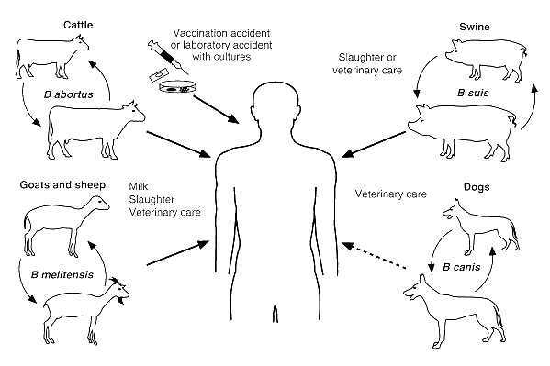

Slide 107
Symptoms:
Man:
Undulant fever characteristic
intermittent or irregular fever with variable duration.
Non specific and variable symptoms
headache, weakness, arthralgia, depression, fatigue.
In animals
Female: Abortion, loss of milk yield, retention of placenta, anoestrus, repeat breeder, sterility and mastitis.
Male: Orchitis, periorchitis, vesiculitis, ampullitis, arthritis and hygroma;
poll evil, fistulous wither, bursitis and tarsitis (in horse.)

Slide 108
Diagnosis
Microscopic examination
Gram stain and modified Ziehl Nelsen stains
⇒ small red-colored coccobacilli in clumps.
Cultural methods
Animal inoculation
guinea pigs are inoculated 0.5-1 ml of suspected tissue homogenate IM and are sacrificed at three and six weeks post inoculation and serum is taken along with spleen and other abnormal tissues for serology and bacteriological examination, respectively.

Slide 109
Serological diagnosis
- Body fluids (serum, uterine discharge, vaginal mucus, milk, or semen plasma) from suspected cattle may contain different quantities of antibodies.
The commonly used tests are:
Milk ring test (MRT)
Rose Bengal (RB) plate test
Complement fixation test (CFT)
ELISA

Slide 110
Control:
Surveillance/close observation
Control in animals
Pregnant animals (advanced) should be kept in isolation until parturition.
hygienic disposal of aborted fetuses, fetal membrane and discharges with subsequent disinfections of contaminated area.
Test and slaughter of positive reactors:
Eradication by test and slaughter principle is based on the magnitude of disease prevalence and economic status of the countries. When the sero prevalence of brucellosis is reduced to less than 2%, slaughter of positive reactors is possible.

Slide 111
Quarantine of imported stock
Immunization: using vaccines
Chemotherapy:
mostly not successful because of the intracellular sequestration of the organisms in the lymph nodes, the mammary glands and reproductive organs.
⇒ If deemed necessary the treatments often given are sulphadiazine, streptomycin and chlortetracycline

Slide 112
Tuberculosis
Etiology:
The genus Mycobacterium comprises more than 70 species.
⇒ Many of the species occur in the env. and are rarely associated with disease in humans/animals.
Human TB ⇒ Mycobacterium tuberculosis, M. africanum.
TB in bovines & many other animal spp ⇒ M. bovis.
M. tuberculosis, M. bovis , M. africanum, M. microti (rodents) M. caprae, M. canetti and M. pinnipedii form a very closely related phylogenetic group and referred to collectively as the M. tuberculosis complex (MTBC)

Slide 113
Human infection with members of the MTBC produces an indistinguishable clinical picture and
the individual species cannot be distinguished from each other based on microscopic examination of stained tissues or other clinical specimens.
⇒ Determination of which species is responsible for infection in a particular case normally requires culture of the microorganism in the laboratory, however, the process may take weeks, as the MOs grow slowly.
- The principal agent of zoonotic TB is M. bovis.

Slide 114
Host: - Man, cat, cattle, chimpanzee, deer, dog, elephant, goat, horse, leopard, monkey, parrot, pig sheep, wild animal.
Transmission:
    Inhalation of infectious droplets or droplet nuclei from active pulmonary lesion of a tuberculous infected person/animal.
    Ingestion of unpasteurized or raw milk from cows infected with M. bovis. Or consumption of raw or undercooked meat of infected animal
    Transmission may also occur from infected dams to offspring by milk.
    Nosocomial infection/disease originating from hospital/

Slide 115
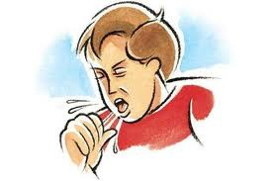
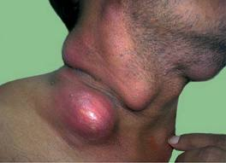
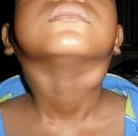
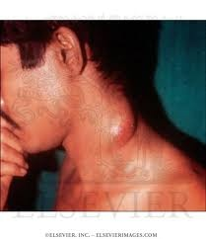
Symptoms:
Man: Productive cough, fever, fatigue, weight loss, chest pain, haemoptysis, night sweat are the signs of pulmonary tuberculosis.
In extra pulmonary form, cervical lymphadenitis (scrofula), osteomyelitis, meningitis, pericarditis, genito-urinary disorder are observed.
Notes:
115

Slide 116
Animals: organism can infect any organ/tissue of body; chronic cough, dyspnoea, depression, emaciation, fever, lymphadenopathy, dysphagia, intestinal ulceration, diarrhoea, weight loss, weakness, polyuria, osteomyelitis, chronic and unapparent infection.

Slide 117
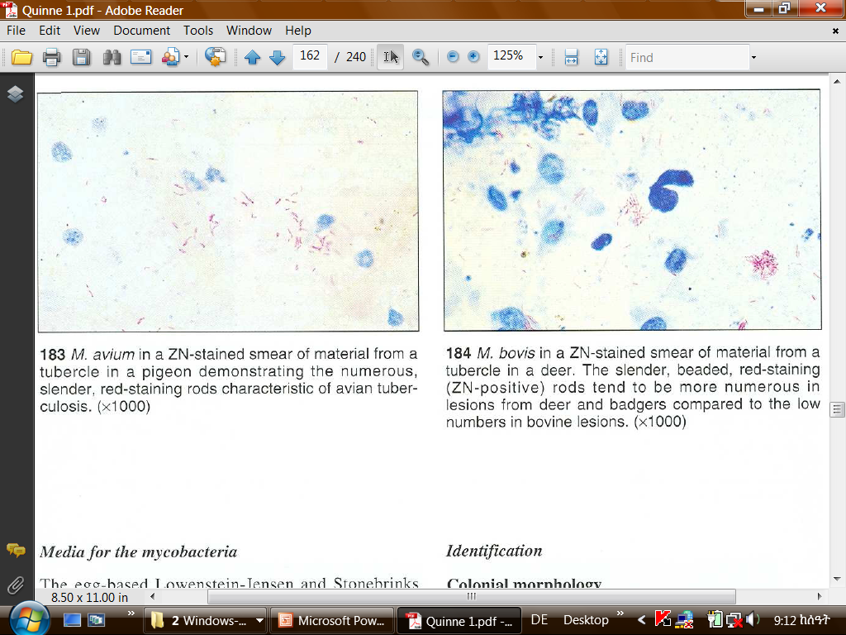
Diagnosis:
  Direct microscopic examination of sputum, pus, pleural fluid, exudates, lung biopsy etc for the presence of acid fast bacilli with Ziehl Nelson staining technique.
M. bovis in a ZN-stained smear of material from a tubercle in a dear. The slender, beaded, red-staining (ZN-positive) rods tend to be more numerous in lesions from deer and badgers compared to the low numbers in bovine lesions
Notes:
117

Slide 118
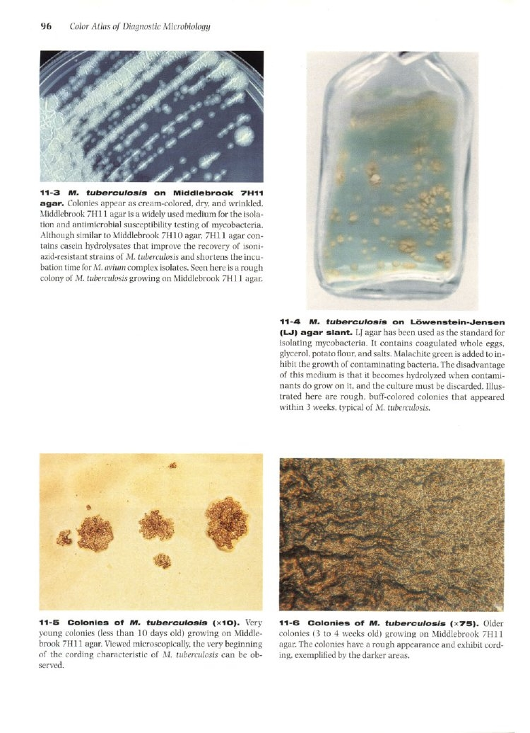
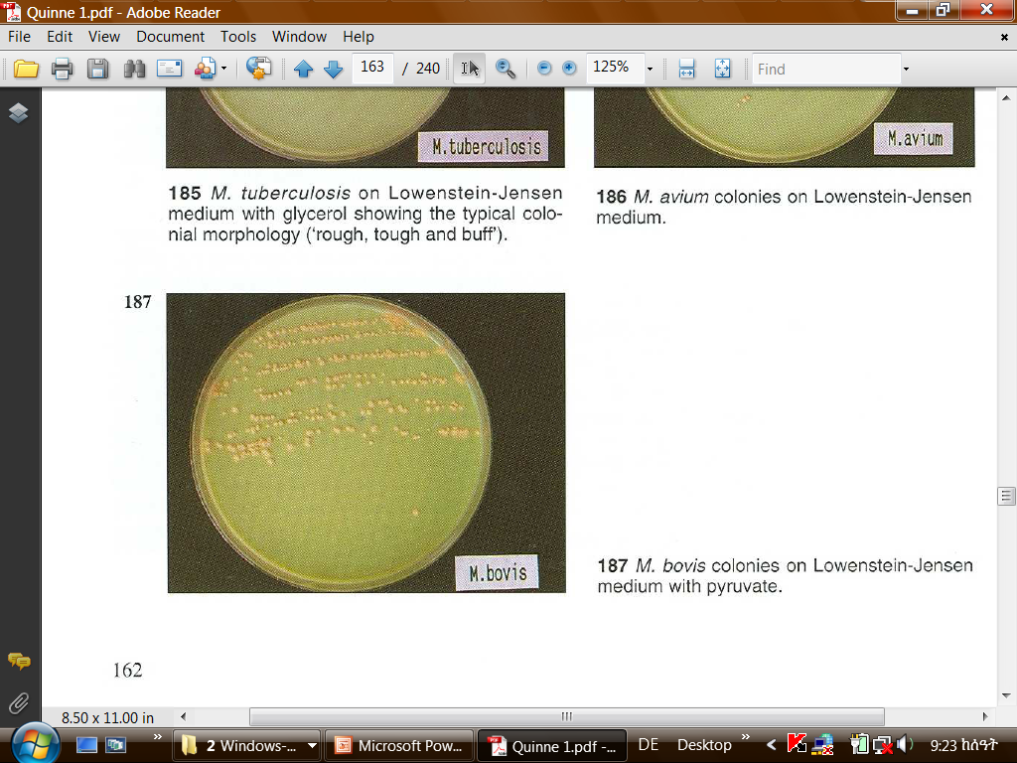
  Isolation of organism from sputum, pleural fluid, CSF, urine etc on Lowenstein Jensen (LJ) medium.
M. tuberculosis on Löwenstein-Jensen (LJ) agar slant.
M. bovis colonies on Lowenstein-Jensen medium with pyruvate.

Slide 119
  Guinea pig is also inoculated to recover the tubercle bacilli from samples.
  Radiography is helpful to detect pulmonary lesion.
  Intradermal tuberculin test in man and animal
For routine diagnosis of TB in cattle, the only available method is the tuberculin test using PPD.
      ⇒ it is specific and not very costly to produce.
      ⇒ may also be applied to goats, sheep and swine.
In animals pre-clinical infection may be recognized by use of the tuberculin test.
This test is based on detection of the specific immunological response to the infection.

Slide 120
The test involves intradermal injection of protein antigens derived from M. bovis (PPD) and inspection three days later for evidence of a local inflammatory reaction at the site of injection.
Interpretation of the test is based on measurement of any alteration in skin fold thickness at the site of administration of M. bovis PPD.
A positive reaction is indicative of infection with M. bovis. Animals with a positive tuberculin test are referred to as “reactors”.
Very recent infection (during the weeks immediately preceding the test) may not have resulted in the development of the specific immune response to a detectable level at the time of testing (false negatives).
In practice, a number of cattle presented for slaughter that were negative at their most recent previous tuberculin test, show evidence of tuberculosis on post-mortem inspection.

Slide 121
Conversely, not all reactor animals have tuberculous lesions detected on routine post-mortem examination. These animals may represent false positive tuberculin tests.
But, the routine post-mortem examination is not a perfect instrument and that discrete tuberculous lesions may go undetected in up to 60% of reactors.
It is also recognized that M. bovis may be isolated on culture from lymph nodes that appear normal on gross pathological inspection.
Since human infections caused by M. tuberculosis and M. bovis are clinically and radiologically indistinguishable, diagnosis can only be achieved by isolating and typing the etiological agent.
Treatment: Isoniazid, Ethambutol, Rifampin and Streptomycin

Slide 122
Epidemiology:
The most prevalent form caused by M. bovis is extra-pulmonary TB.
Cervical lymphadenitis, genitourinary infection, TB of bones and joints
The reason for extra pulmonary localization of the bovine bacillus is that it is most commonly transmitted by consumption of raw milk or raw milk products.
Children are among those most affected.
The incidence of pulmonary TB caused by M. bovis is significant in occupational groups in contact with infected cattle or their carcasses.
People suffering from pulmonary TB of bovine origin, can in turn, transmit the infection to cattle.
Inter human transmission of M. bovis is possible, but few cases have been confirmed.

Slide 123
Risk factors for Zoonotic tuberculosis:
The close physical contact between humans and potentially infected animals (very common in many rural areas in developing countries)
Infection by HIV
Poor food hygiene practices (Contaminated milk)
Control:
Prevention of human infection by M. bovis consists of:
Control and eradication of bovine TB
Pasteurization of milk
Vaccination (BCG)

Slide 124
The only rational approach to reduce and eliminate losses produced by infection of cattle and preventing human cases caused by M. bovis consists of establishment of a control and eventual eradication program for bovine TB.
Eradication campaigns are usually carried out by administering tuberculin tests repeatedly until all infected animals are discovered, and eliminating reactors from the herd.
In developing countries, campaigns should begin in regions of low prevalence where replacing reactor animal is easier, and later extended to areas of higher prevalence.

Slide 125
Prevention of Transmission of Zoonotic TB to Humans
Effective and well-controlled pasteurization of milk and dairy products.
  ⇒ effectiveness of the pasteurization process in individual plants should be closely monitored.
Educate farmers and farm families about the particular risks associated with the consumption of milk from tuberculosis-positive herds.
When private domestic consumption of milk, produced on the farm is practiced by farm families, proper boiling is recommended.
Educate dairy farmers, cheese makers and their families about the risks of consuming unpasteurized milk.

Slide 126
Prohibition of the sale of unpasteurized milk intended for human consumption.
Auditing of the ante-and post-mortem inspection of carcasses at abattoirs so as to verify the control and removal, from the food chain, of carcasses or parts thereof, considered unfit for human consumption because of the presence of tuberculosis is recommended.

Slide 127
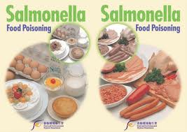

Slide 128
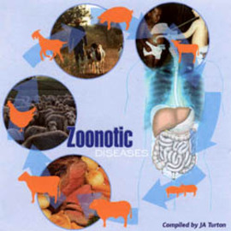

4. Salmonellosis
Etiology:
In 1885, the bacteriologist Theobald Smith (1859-1934) isolated S. Choleraesuis from porcine intestine, and the genus Salmonella was named after D.E. Salmon, his laboratory chief.
The genus Salmonella consists of three spp:
S. enterica,
S. bongori,
S. subterranea.

Slide 129
Salmonella enterica in turn is further divided in to six subspecies:
S. enterica subsp. enterica
S. enterica subsp. salamae
S. enterica subsp. arizonae
S. enterica subsp. Diarizonae
S. enterica subsp. houtenae
S. enterica subsp. indica.
Salmonella species are further classified into serotypes (serovars).
There are more than 2,500 serovars.
⇒ based on the O (somatic), H (flagellar) and Vi (capsular) antigens
The most common serotypes that cause infections in humans and food animals belong to S. enterica subspecies enterica.
The serotypes of the other subspecies are common in poikilothermic animals and in the environment, although some serotypes of S. arizonae and S. diarizonae have been associated with disease in turkeys and sheep.

Slide 130
Salmonellae is a:
Gram-negative, facultative anaerobic, non-spore forming rods.
motile by flagellation except S. Pullorum and S. Gallinarum.
From the epidemiological point of view, salmonellae can be classified in to three main groups: -
Human-adapted: Comprises S. Typhi, S. Paratyphi A and S. Paratyphi C, which infect humans only.
Serotypes that are host-adapted for particular species of vertebrates: Included are S. Gallinarum, S. Dublin, S. Abortus-equi, S. Abortus-ovis and S. Cholerae suis. Some of these are also pathogenic for human (especially S. Dublin and S. Cholerae suis).
Non host-adapted: Contains the majority of the other Salmonella serotypes with no particular host preference that infect both humans and other animals.

Slide 131
Salmonella causing infection in humans are classified into two groups
Salmonella causing human infection e.g., S. Typhi, S. Paratyphi
(Human adapted salmonella).
2. Enteric salmonelosis (Food borne salmonelosis).
The primary habitat of Salmonella is the intestinal tract of farm animals, humans, birds, reptiles and occasionally insects.
They have also been found in spleen, liver, bile, mesenteric and portal lymph nodes.
The organisms are excreted in feces from which they may be transmitted by insects and other living creatures to a large number of places.
They may also be found in polluted water.

Slide 132
Host: Man, cat, cattle, deer, dog, elk, fowl, goat, horse, opposum, rabbit, raccoon, rodent, sheep, tortoise, turtle.
Source of infection for humans: Poultry (eggs, meat), pork, beef, milk and milk products, vegetables, dirty utensils and water.
Transmission:
  Ingestion of Salmonella contaminated water, milk, meat, poultry, egg products, vegetable and other foods.
  Infection can also be acquired by direct contact in hospital (infected patients, their discharges, contaminated fomites like bedding, towel, lines etc…
  In endemic areas, arthropods may carry the organisms mechanically.

Slide 133
Man
Food of animal origin
sewage
Food animals
environment

Slide 134
Predisposing factors: The following facilitates humans infection
Inadequate cooking
Cross contamination
Inadequate refrigeration/reheating
Infected food handler
Animal carriers perpetuate the animal to animal cycle.
Contaminated feed such as bone meal, meat meal, blood meal, fish meal play an important role in the transmission of salmonellosis in animals.

Slide 135
Sick or carrier animals/birds
Feces
Contaminated feed and environment
Susceptible animals/birds
Ingestion
Ingestion of food
Vegetables and water
Man
Man
Man
Feco-oral route (hospital)

Slide 136
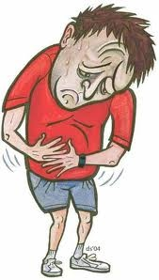

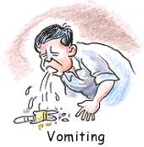
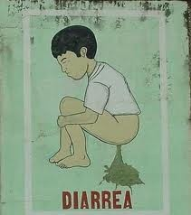
Symptoms:
Man:- Fever, headache, nausea, vomiting,
Abdominal pain and diarrhea.
Squeal: reactive arthritis, rheumatic syndrome.
Death in very young, very old or
in debilitated persons.
Animals: Four types:
Peracute septicemia
Acute enteritis
Chronic enteritis
Subclinical carrier

Slide 137
Diagnosis:
  Clinical signs and history of patient.
  Isolation of organism from blood, urine, stool, vomit, CSF, sputum, nasopharyngeal swab, biopsies from liver, gall bladder, lymph nodes by culturing on SSA agar, Mac Conkey agar (colorless colony), Brilliant green agar (pink colony), Bismuth salt agar (black colony).
  Agglutination test by using patient sera.
  FAT to demonstrate organism in smears.
Treatment:
  Ampicillin, Ciprofloxacin, Gentamicin, Ofloxacin.
  Antidiarrhoeal drugs like Bismuth salt and Magnesium trisilicate.
  In dehydration, give fluid therapy and electrolyte.
  In case of carrier, Amoxicillin and Ampicillin.

Slide 138
Epidemiology:
Source of infection for humans: Poultry (eggs, meat), pork, beef, milk and milk products, vegetables, dirty utensils and water.
Meat can become contaminated in abattoirs by equipment and utensils during skinning and butchering.
Contamination of meat occurs during slaughtering operation, especially during evisceration.
Rupture of the GIT may lead to contamination of the carcass.
Cross contamination could also occur during evisceration, cutting meat with a knife that has been used to remove the GIT.
Food of vegetable origin contaminated by animal products, human excreta, or dirty utensils.
Insects, particularly flies, can serve as mechanical vectors in highly contaminated environments.

Slide 139
Control:
Surveillance
Control in animals
Hygienic management of livestock and poultry farms
Bacteriological control and decontamination of animal feed
Vaccination where applicable
Control of vehicles: Adhere to codes of hygienic practices of production, processing, storage, transportation and distribution of food
Prevention in man:
Avoid eating food from unknown sources, especially raw or inadequately cooked food of animal origin and salads
Avoid cross-contamination of cooked food with raw products
Maintain sanitary kitchens and protection of foods against rodent and insect contamination
Avoid contact with animals suffering from salmonellosis or suspected of infection.

Slide 140
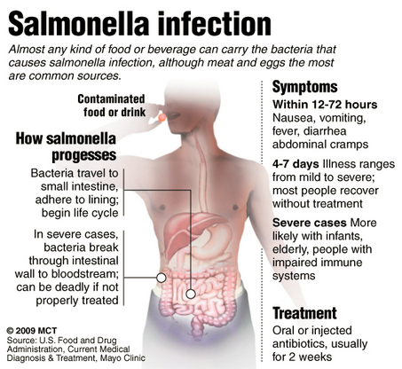

Slide 141
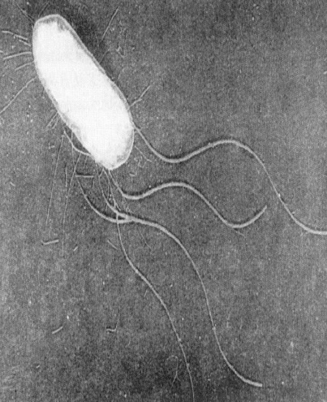
5. COLIBACILLOSIS
Synonyms:
Colibacteriosis, enteropathogenic diarrhea, White scours
Etiology:
Escherichia coli
is a normal component of the flora in the large intestine of warm-blooded animals, including man.
Gram negative rods
Somatic (O) antigen (LPS)
Flagellar (H) antigen
Serotype O:H
So far, 170 types of O (somatic), 100 K (capsular) antigen and 70 H antigens (Flagellar) have been recognized.

Slide 142
Types of pathogenic E. coli:
E. coli strains regarded as non-pathogenic can cause opportunistic infections in sites of the body such as mammary glands and uterus.
E. coli strains that cause enteritis are classified as:
Enterohaemorrhagic E. coli (EHEC): The principal strain of EHEC is E. coli O₁₅₇:H₇.
Enterotoxigenic E. coli (ETEC): Produce Enterotoxin causing neonatal colibacillosis.
It affects children often under 2-3 years of age and
cause “traveler’s diarrhea” in adults.
It is characterized by an incubation period of 12 to 72 hrs and profuse watery diarrhea, abdominal colic, vomiting and dehydration.

Slide 143
Enteroinvasive E. coli (EIEC): adhere to the cells of the small intestine and invade the enterocytes and deeper layers of the intestinal mucosa.
They are responsible for coli septicemia or colitis
Enteropathogenic E. coli (EPEC):
They can cause enteritis and diarrhea by other mechanisms.
The disease occurs primarily in babies under 1 year of age causing high mortality.
The disease is characterized by watery diarrhea, fever and dehydration.
5. Enteroaggregative E. coli (EAggEC): This includes a group of E. coli strains that have a property of aggregative adherence pattern.
They cause persistent diarrhea in nursing babies.

Slide 144
- E. coli is responsible for several important diseases in various food animals in addition to causing sporadic cases of mastitis, urogenital infections, abortions etc.
E.g.: - In cattle it causes calf diarrhea (white scours), neonatal enteritis in pigs, edema in suckling pigs, collibacillosis in poultry.
Man is the reservoir for all categories of pathogenic E. coli except EHEC for which the reservoir is most likely cattle.
The source of infection is the stool of infected persons (mainly sick persons, carriers) and contaminated objects.
The most common mode of transmission is the oral-fecal route.
Contaminated foods including those from animals (meat, milk etc) are a common vehicle in various categories of human colibacillosis.

Slide 145
In EHEC, beef is considered as the principal source of human infection.
Animals with diarrhea constitute the main source of infection.
In terms of the zoonoses, the most important category is the enterohemorrhagic, which is also the most severe.

Slide 146
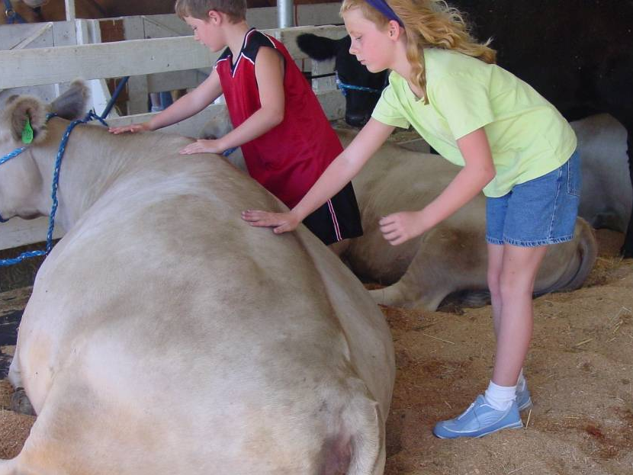
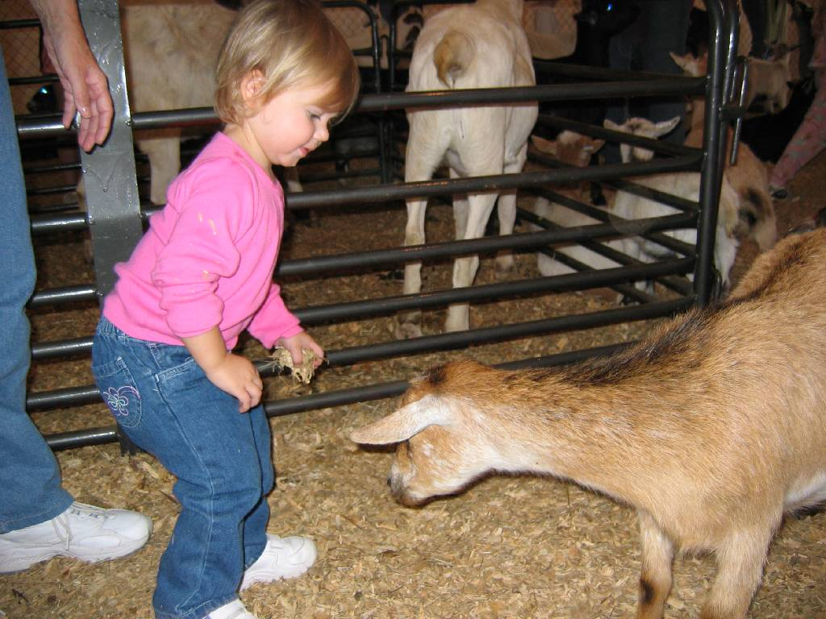
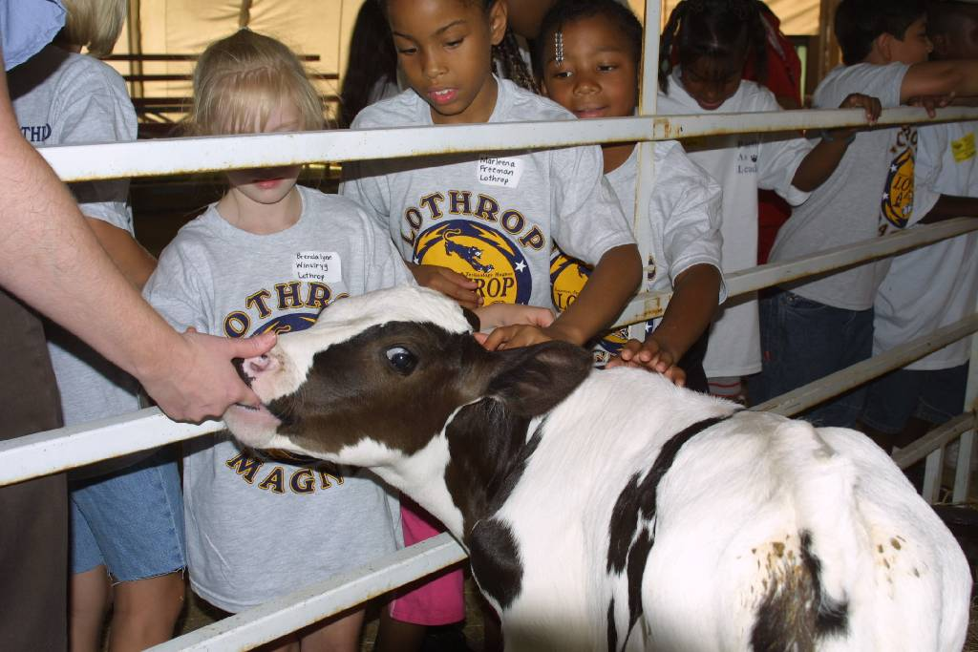
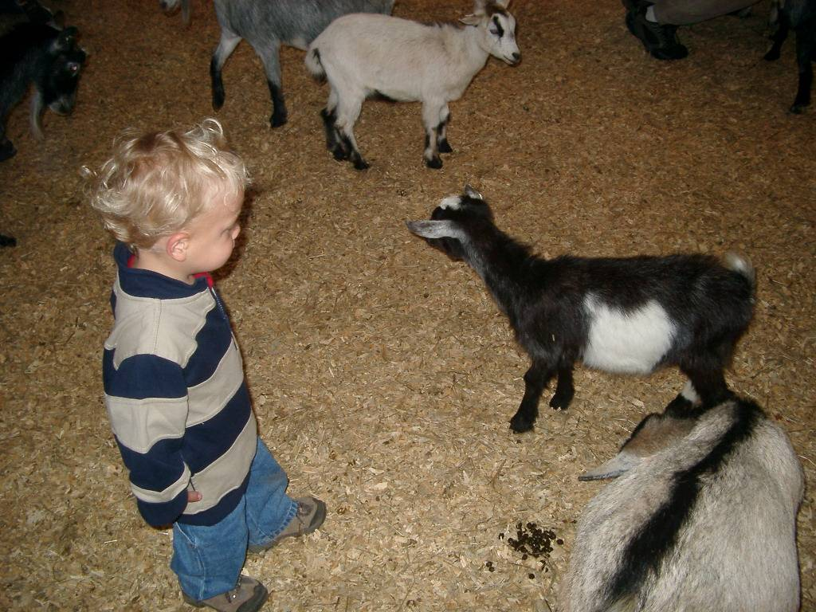
Indirect contact
(environmental) transmission
EHEC E. coli O157:H7
Direct contact transmission

Slide 147
Symptoms:
Hemorrhagic colitis: can be quite severe with painful abdominal cramps, vomiting, diarrhea and grossly visible blood in the stool, lasting for 6-8 days with no fever. This leads to anemia and shortage of platelets (thrombocytopenia) that causes abnormal bleeding.
Thrombotic thrombocytopenic purpura (TTP)
Hemolytic Uremic Syndrome (HUS): is the most common cause of acute kidney failure in infants and young children. It usually follows hemorrhagic colitis and produces kidney dysfunction, CNS problems like seizures and coma and finally death.

Slide 148
Diagnosis:
Sorbitol-MacConkey (SMAC) agar is recommended for isolation of E. coli O157:H7 from fecal samples.
Treatment:
Antimicrobial agent have no proven activities in the treatment of E. coli O₁₅₇:H₇ infections.
The use of antibiotics in the infection is controversial:
Since antimicrobial therapy may increase the risk of development of HUS.
Antibiotic may induced the expression of the shiga toxins, and /or
Bacterial injury caused by antibiotic may result in increases release of preformed toxins.
Therefore, management of patients with E. coli O157:H7 infection is supportive.

Slide 149


Control and Prevention:
Ground beef should be cooked.
Meat can be contaminated by feces during slaughter and processing.
Thus, all precautions should be taken to minimize this risk, and foods of animal origin should be well cooked before they are eaten.
Personal hygiene, particularly hand washing after relieving oneself, is also important
Health education to food handler, housewife and person engaged in food establishment about the source of infection, severity of disease and importance of personal hygiene.

Slide 150

6. Campylobacteriosis
Synonyms: Avian vibrionic hepatitis, Vibrionic abortion, Vibrionic enteritis.
Etiology: The disease is mostly caused by C. jejuni and by C. coli to lesser extent.
C. upsalienses is associated with campylobacteriosis in children and is frequently associated with a milder illness.
Gram -ve, slender, motile, curved, microaerophilic and thermophilic bacteria.

Slide 151
Mammals and poultry are the principal reservoir of Campylobacter species.
Campylobacter species are widespread in the intestinal tract of warm blooded animals used for food production and may therefore readily contaminate raw meat, raw milk and raw milk products.
Campylobacter species are also commonly found in the alimentary tract of healthy birds including domestic poultry.
⇒This relates to the high optimum growth temperature (42 º C) of the microorganism, which approximates the normal body temperature of poultry.

Slide 152
Transmission:
Infection is acquired by consumption of contaminated water, milk, chicken, beef, pork and lamb.
Close contact with diseased animals or their discharges.
Clinically healthy animals may also be a source of infection.
Source of infection for humans
Mainly chicken
Animal: both large and small ruminants (cattle, sheep, swine)
Pets (dogs and cats)
Contaminated food
Contaminated water
Food of animal origin: raw poultry, raw meat, raw milk, offal.

Slide 153
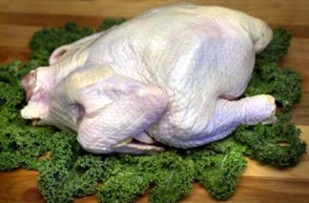
Risk factors associated with illness due to Campylobacter spp
Eating undercooked poultry
Frequent contact with diarrheic animals, particularly young pets such as kittens and puppies
Drinking non-potable water
Drinking unpasteurized milk or dairy products made from non heat-treated milk.

Slide 154
Symptoms:
Man: Fever, diarrhea, abdominal pain, nausea and diarrhea, sometimes containing blood
Animals:
Chicken: Drop in egg production, weight loss, enteritis, hepatitis, splenomegaly, enlarged kidney.
Dog: Watery, mucoid or bloody diarrhoea, vomiting, fever, reduced appetite.
Other animals: Enteritis; abortion, still birth (sheep), mastitis (cow).

Slide 155
Diagnosis:
Isolating the agent from fecal samples using campy-cefex selective media that are incubated under micro aerobic conditions at a temperature of 42ºC for about 48 hours.
This has to be followed by specific biochemical confirmation of presumptive Campylobacter isolates.
Latex agglutination test and
Molecular techniques such as PCR can also be used for confirmation.
Treatment:
Clindomycin, Doxycycline, Enroflaxacin, Erythromycin, Gentamicin, Kanamycin, Nalidixic acid.

Slide 156
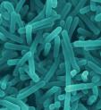
7. listeriosis
Synonyms: - Circling disease, meningoencephalitis, Silage disease,
Etiology:
Listeria: is gram positive, motile, non spore forming bacilli.
The genus includes six spp.
L. monocytogenes (of more public health importance)
L. ivanovii
L. innocua
Listeria grow between 1 ⁰ c and 45 ⁰ c, under aerobic and facultative anaerobic conditions.

Slide 157
Listeria spp have the unusual ability to grow at refrigeration temperature.
The minimum low temperature for growth of listeria is 1.7 ⁰ c.
L. monocytogenes is a food borne pathogen. The infective dose for humans is about 1,000 microorganisms.
Transmission:
  Consumption of infected raw or unpasteurized milk, cheese and poultry meat.
  Direct contact with sick animals, healthy carriers, aborted fetuses, placenta.
  Inhalation of infectious organism by susceptible person.
  Transmission by sexual contact
  Neonatal infection in new born children.

Slide 158
Symptoms:
Man: Incubation period 4 to 21 days, disease occurs in various forms viz. meningitis, septicemia, abortion, conjunctivitis, pneumonia, and endocarditis, neonatal meningitis leads to hydrocephalus. New-born infants and >50 years of persons are most susceptible.
Animals: Listlessness, meningoencephalitis, septicemia, anorexia, fever, pneumonia, marked salivation, dropping of ear, paralysis of facial and throat muscles, dysphagia, incoordination, circling movement (circling disease), abortion and still birth.

Slide 159
Diagnosis:
Isolation of the causal agent using Listeria selective agar media which require different successive stages:
primary selective enrichment in Half Fraser broth, secondary selective enrichment in Fraser broth, selective plating onto PALCAM (Polymixin Acriflavin Lithium chloride Ceftazidime Aesculin Mannitol) and Oxford agar plates followed by confirmatory tests including catalase test, motility, hemolysis test, carbohydrate utilization test (Rhamnose, xylose and mannitol) and CAMP test.

Slide 160
An enhanced zone of beta hemolysis between the test strain and either of the culture of Staphylococcus aureus and Rhodococcus equi is considered as a positive reaction
⇒Positive CAMP reactions of L. monocytogenes with Staphylococcus aureus
L. ivanovii with Rhodococcus equi.
No reaction can be detected with L. innocua.
Treatment:
- Ampicillin, Enrofloxacin, Kanamycin, Perfloxacin, Tetracycline; do not give Tetracycline < 7 years of age; Ampicillin is preferred for maternal foetal listeriosis.

Slide 161
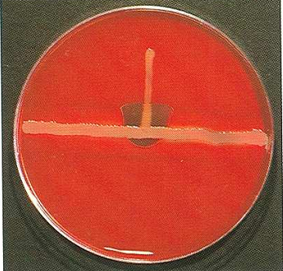

Slide 162
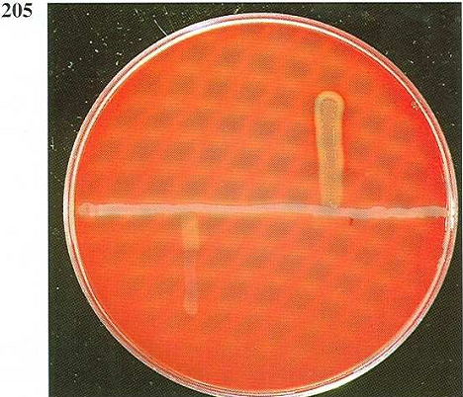
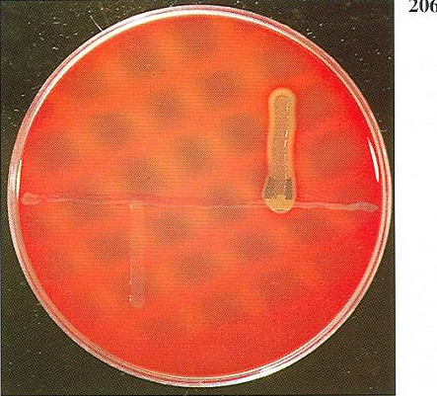
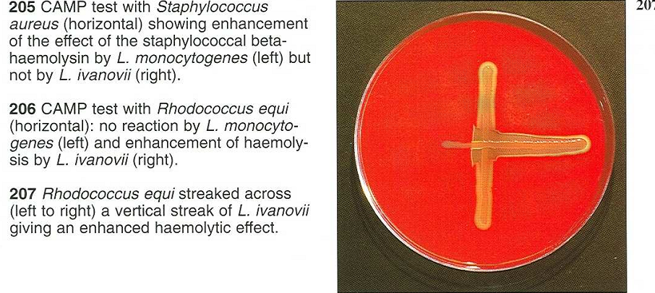

Slide 163
Epidemiology:
Listeria are widely distributed in nature and have been isolated from soil, vegetable, sewage, water, animal feed, fresh and frozen meat, slaughter house wastes and the feaces of healthy animals.
Thus, farm animals and their environment may present an important source of contamination and infection to humans.
Source of human infection
Raw milk
Cheese produced from non-pasteurized milk.
Ice cream
Raw vegetable.
Raw and cooked poultry, all type of raw meat, raw smoked fish.
Risk groups
Pregnant women, immunocompromized persons, AIDS patient, elderly.

Slide 164
Control:
Industrial: pasteurization of milk, reduction of cross contamination
Food service establishments/households: boiling of milk, through cooking of food of animal origin, thorough reheating of food, through washing of vegetables, avoid high risk food such as soft cheese,
Consumers: Teach pregnant women not to eat raw food of animal origin
Use protective clothing including gloves while removing retained placenta.
Proper disposal of infected material from aborted animal.
Disinfection of premises where an animal had aborted.
Spoiled silage should not be fed to animal.

Slide 165

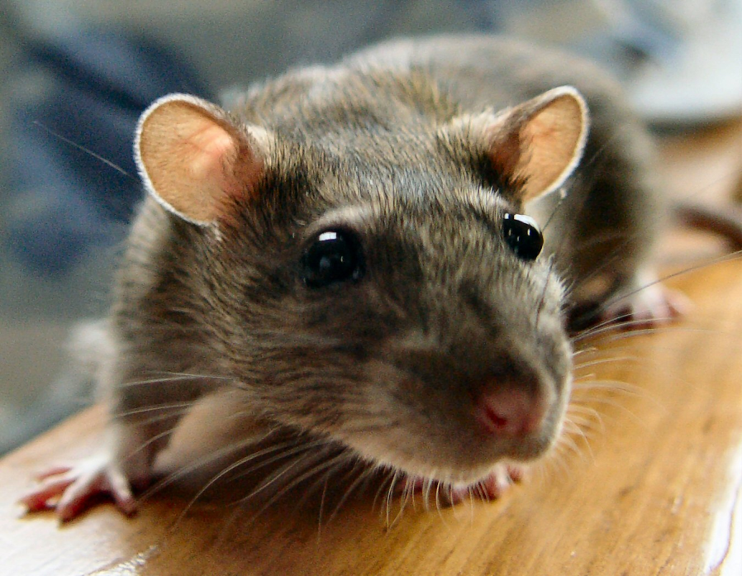

Leptospirosis

Slide 166
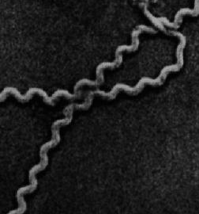
Synonyms:
Canicola fever
Hemorrhagic jaundice
Weil’s disease
Swampy fever
Rice field fever
1. INRTODUCTION
The disease in man was first time described by Adolfo Weil in 1886 in Germany.
ETIOLOGY:
Leptospira
17 Genomic species of Leptospira
Organized into many serogroups and serovars.
Pathogenic - Leptospira interrogans

Slide 167
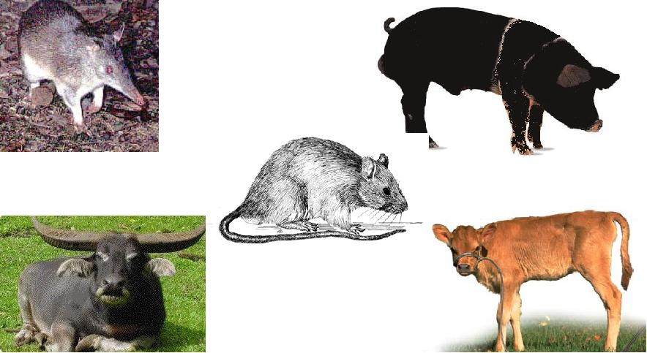
Reservoirs of infection:
Rodents
Dogs
Domesticated animals
Wild animals
  Leptospira are excreted in the urine
Common serovars
Icterohaemorrhagiae
Pomona
Harjdo
Major reservoir(s)
Rat
Canicola
Pig
Cattle, sheep
Dogs
Source:- www. google.com

Slide 168
Transmission:
Man acquires the infection by:-
1. Direct contact with urine or tissue of
infected animal.
2. Indirect contact with infected soil, water
or vegetation.
Leptospires penetrate through - Injured skin or
                Mucus membrane
Leptospira spp. can be ingested in contaminated food or water.

Slide 169
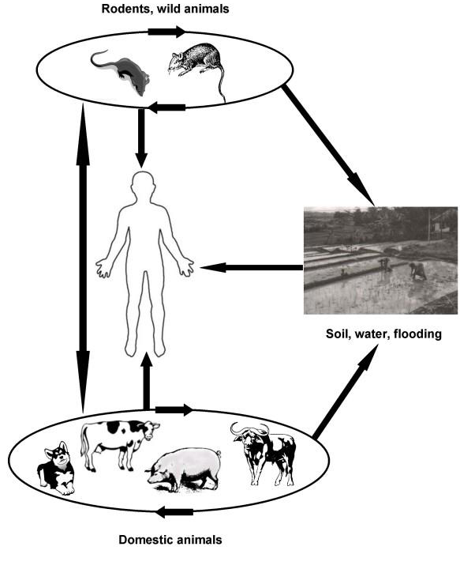
Source:- Victoriano, A. B. (2009)

Slide 171
Epidemiology:
Leptospirosis is more prevalent in tropical countries.
It is an occupational hazard of slaughter house worker, agricultural farmer, butcher, dairyman, livestock handler, veterinarian, laboratory worker, sugarcane grower, sewer worker, rice field worker and swimmer.
As the organisms multiply in the kidney of animals, they are excreted through urine and thus contaminate the environment including water and soil.
Most animals remain asymptomatic carrier and shedder.
The contaminated water, becomes an important source of infection to man.

Slide 172
Clinical spectrum:
In Man
Clinically, human leptospirosis is characterized by an acute influenza-like illness.
High fever, arthritis, meningitis, headache conjunctivitis, epistaxis, bronchitis, pneumonia, nausea, vomition, abdominal cramp, hepatitis, anemia, jaundice, nephritis and albuminuria.
85-90% of Cases
Anicteric
Common, mild
< 2% Mortality
- Any serovars
10% of Cases
Icteric
(Weil’s Syndrome)
Rare, Severe
15% Mortality
- Icterohaemorragiae

Slide 173
Icteric Leptospirosis (Weil’s Syndrome
A man with Weil’s disease Source: - Jansen and Schneider (2011).

Slide 174
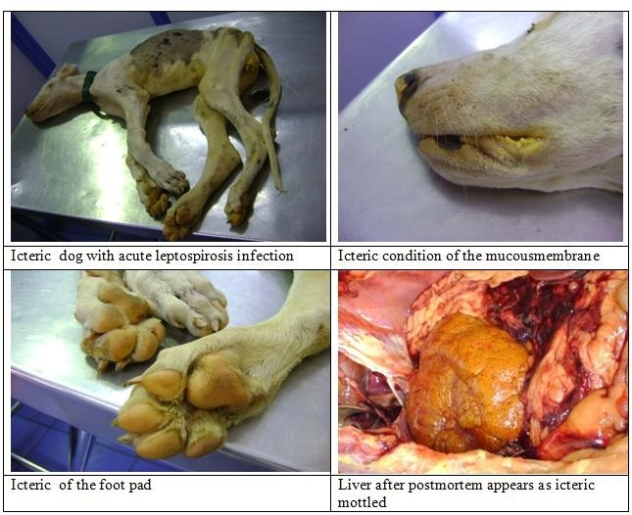
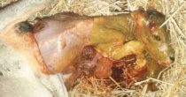
In Animals
Anorexia, fever, meningitis, conjunctivitis, dyspnoea, anaemia, icterus, nephritis, hemoglobinuria, still birth, abortion, mastitis and death.
Source:- https://secure.merck-animal-health.com

Slide 175
Risk factors
Abundant of rodents, cattle & stray dogs.
Contaminated environment.
Bare foot walking through water logged area.
Handling of infected organs like kidney and liver.
Agricultural activity: a person during agricultural operation may receive minor cut or injury in his hand or leg and thereby gives an opportunity to leptospires to enter through abraded skin.

Slide 176
DIAGNOSIS:
Examination of freshly voided urine by dark field microscopy for organisms.
Recovery of organism from blood, CSF during acute phase and urine after 7 days on EMJH medium with bovine serum albumin, Fletcher’s medium, Korthop’s medium and Stuart’s medium.
Direct detection of leptospires in clinical specimens with immunofluorescencet technique.
Serological tests like ELISA.
Molecular biological techniques

Slide 177
TREATMENT
The chemotherapy should be started as early as possible.
Human leptospirosis
Streptomycin
Erythromycin
Tetracycline
Animal leptospirosis
Chlortetracycline
Penicillin
Dihydrostreptomycn

Slide 178
Prevention and control
ANIMALS
All the preventive measures should be aimed towards proper sanitation and elimination of reservoirs.
Proper hygienic measures on the farm.
      Prompt disposal of dung and urine
      Disinfection of tools, floors and soil.
      Disinfection of water source if it is suspected.
Safe disposal of acute leptospirosis carcass and aborted materials by burial away from water sources
Elimination of swampy area in the farm.
Pig should not be allowed to be mingled with other animals
Control of rodents in the premises
Isolation of seropositive animals

